Slide 1
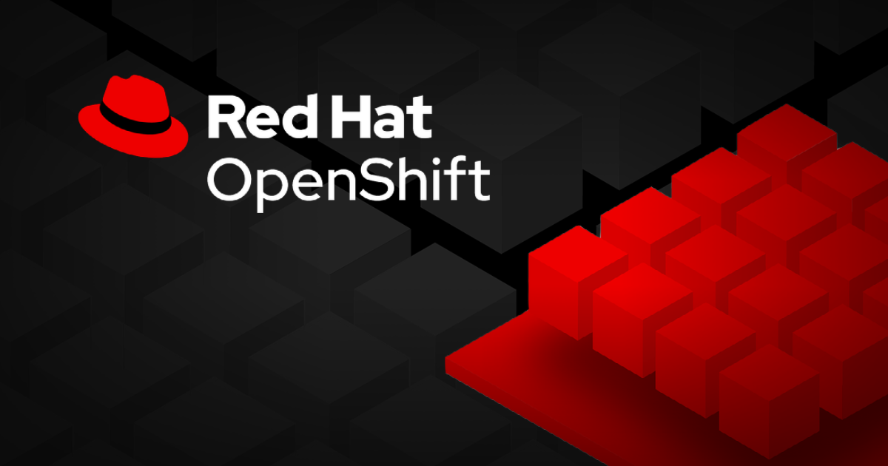
1. Introduction to Kubernetes & OpenShift

Slide 2
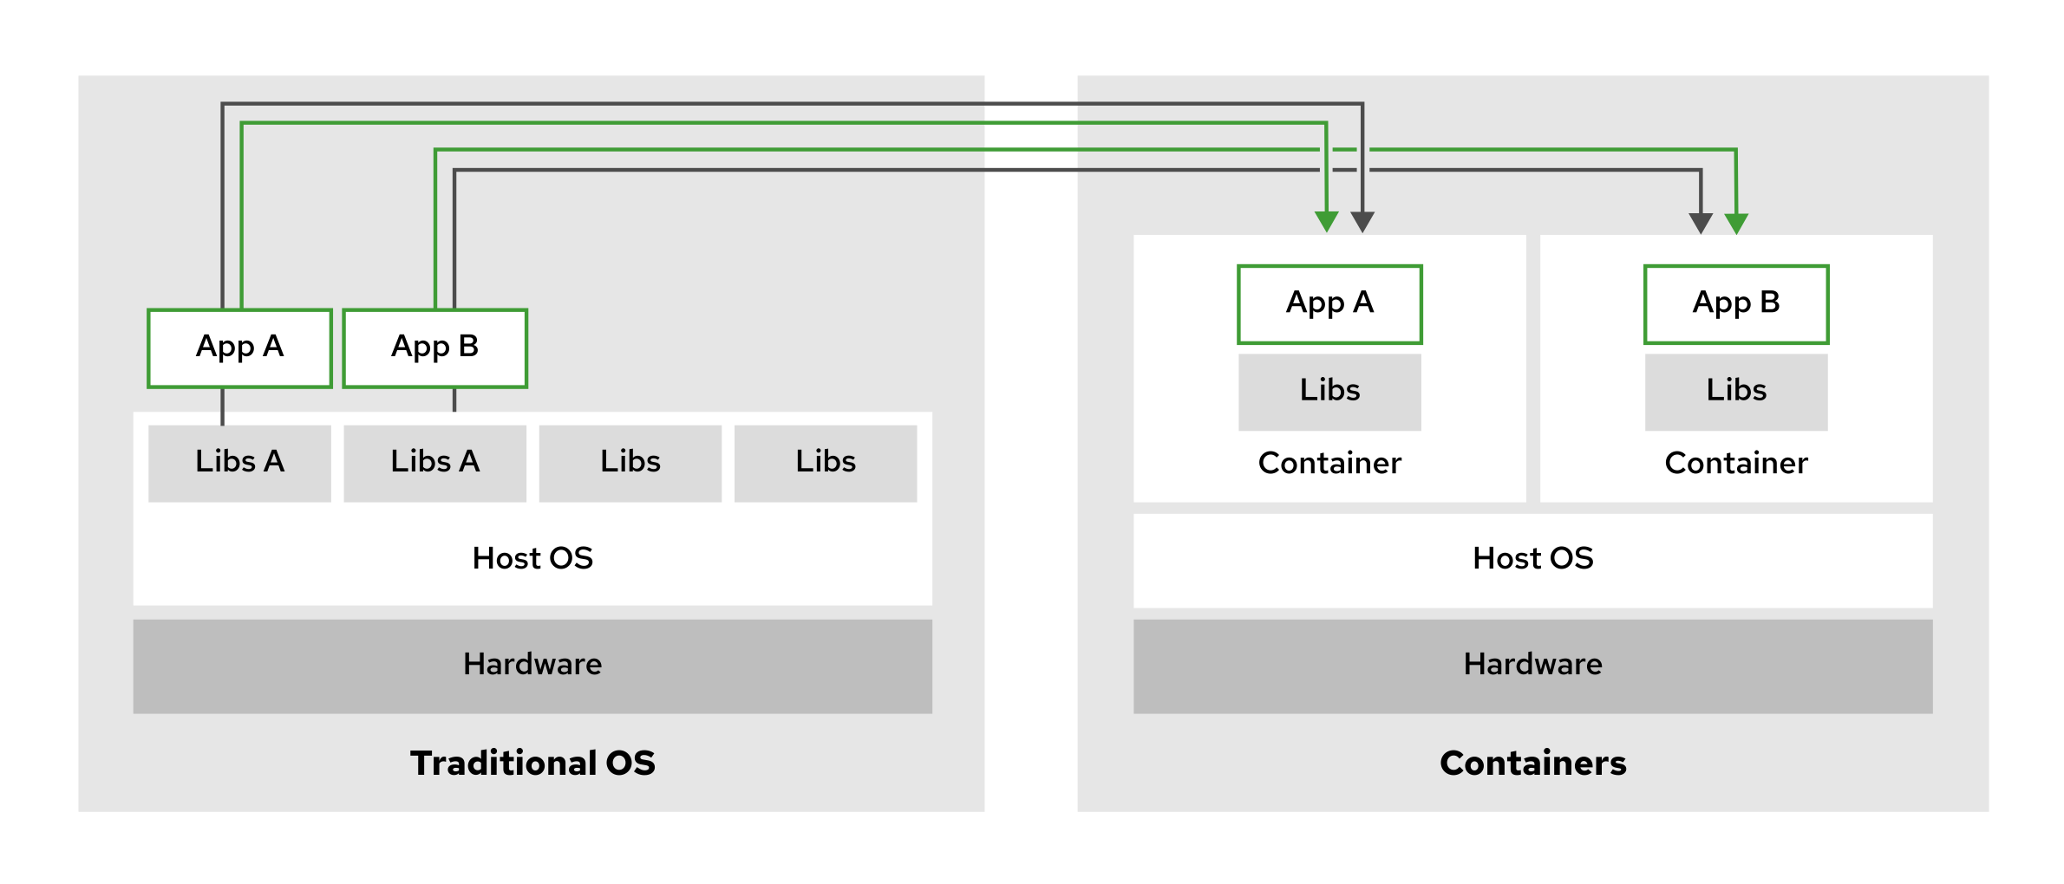
Container
A container is a running instance of a container image.
A container image is a single file (tar archive) that has all the files needed to support the application, including the application itself. Container images have a metadata which describes the image.
The ENTRYPOINT is container image metadata that describes the command to be executed whenever a container is started from the container image.
Containers rely on Linux kernel features like namespaces and control groups (cgroups) to function effectively. Cgroups manage resources, ensuring that each container gets the right amount of CPU time and memory, while namespaces create a separate space for each container’s processes and resources, keeping them isolated from one another and the host system.
Fig 1.1 Applications in containers versus on the host operating system

Slide 3
OpenShift: OCI Standards and the Role of CRI-O
The Open Container Initiative (OCI) maintains standards about containers, container images, and container runtimes. Because most container engine implementations are designed to conform to the OCI specifications, applications that are packaged according to the specification can run on any conforming platform.
CRI-O is a lightweight, secure container runtime built by Red Hat for Kubernetes environments, including OpenShift. It focuses on efficiency by offering only what Kubernetes needs, following OCI standards for broad compatibility. As the default runtime in OpenShift, CRI-O replaces Docker, delivering better performance and security.

Slide 4
Kubernetes
A platform that simplifies the deployment, management, and scaling of containerized applications.
Creates a cluster that runs applications across multiple nodes. If a node fails, then can restart an application in a different node.
Uses a declarative configuration model. The administrators write a definition of the workloads to execute in the cluster, and it ensures that the running workloads match the definition. For example, an administrator defines several workloads. Each workload defines the amount of required memory. It then creates the necessary containers in different nodes, to meet the memory requirements.
Defines workloads in terms of pods. A pod is one or multiple containers that run in the same cluster node. Pods with multiple containers are useful in certain situations, when two containers must run in the same cluster node to share some resource. For example, a job is a workload that runs a task in a pod until completion.

Slide 5
Kubernetes Features
Service Discovery & Load Balancing: Makes easy for applications to communicate across nodes by automatically configuring networking and providing DNS services. Pods can use hostnames instead of IPs, and it can balance incoming requests across multiple pods for better performance and reliability.
Horizontal Scaling: Monitors the load on services and can automatically create or remove pods to match demand. It can even add or remove nodes to handle changes in cluster load.
Self-Healing: It can monitor application health and automatically restart or reschedule them if they fail. This self-healing ability protects against both internal and external failures.
Automated Rollouts: It can roll out updates to your applications gradually, with the ability to roll back to a previous version if something goes wrong during the update.
Secrets & Configuration Management: Allows you to manage application secrets and configurations without modifying containers, keeping sensitive information like usernames and passwords secure.

Slide 6
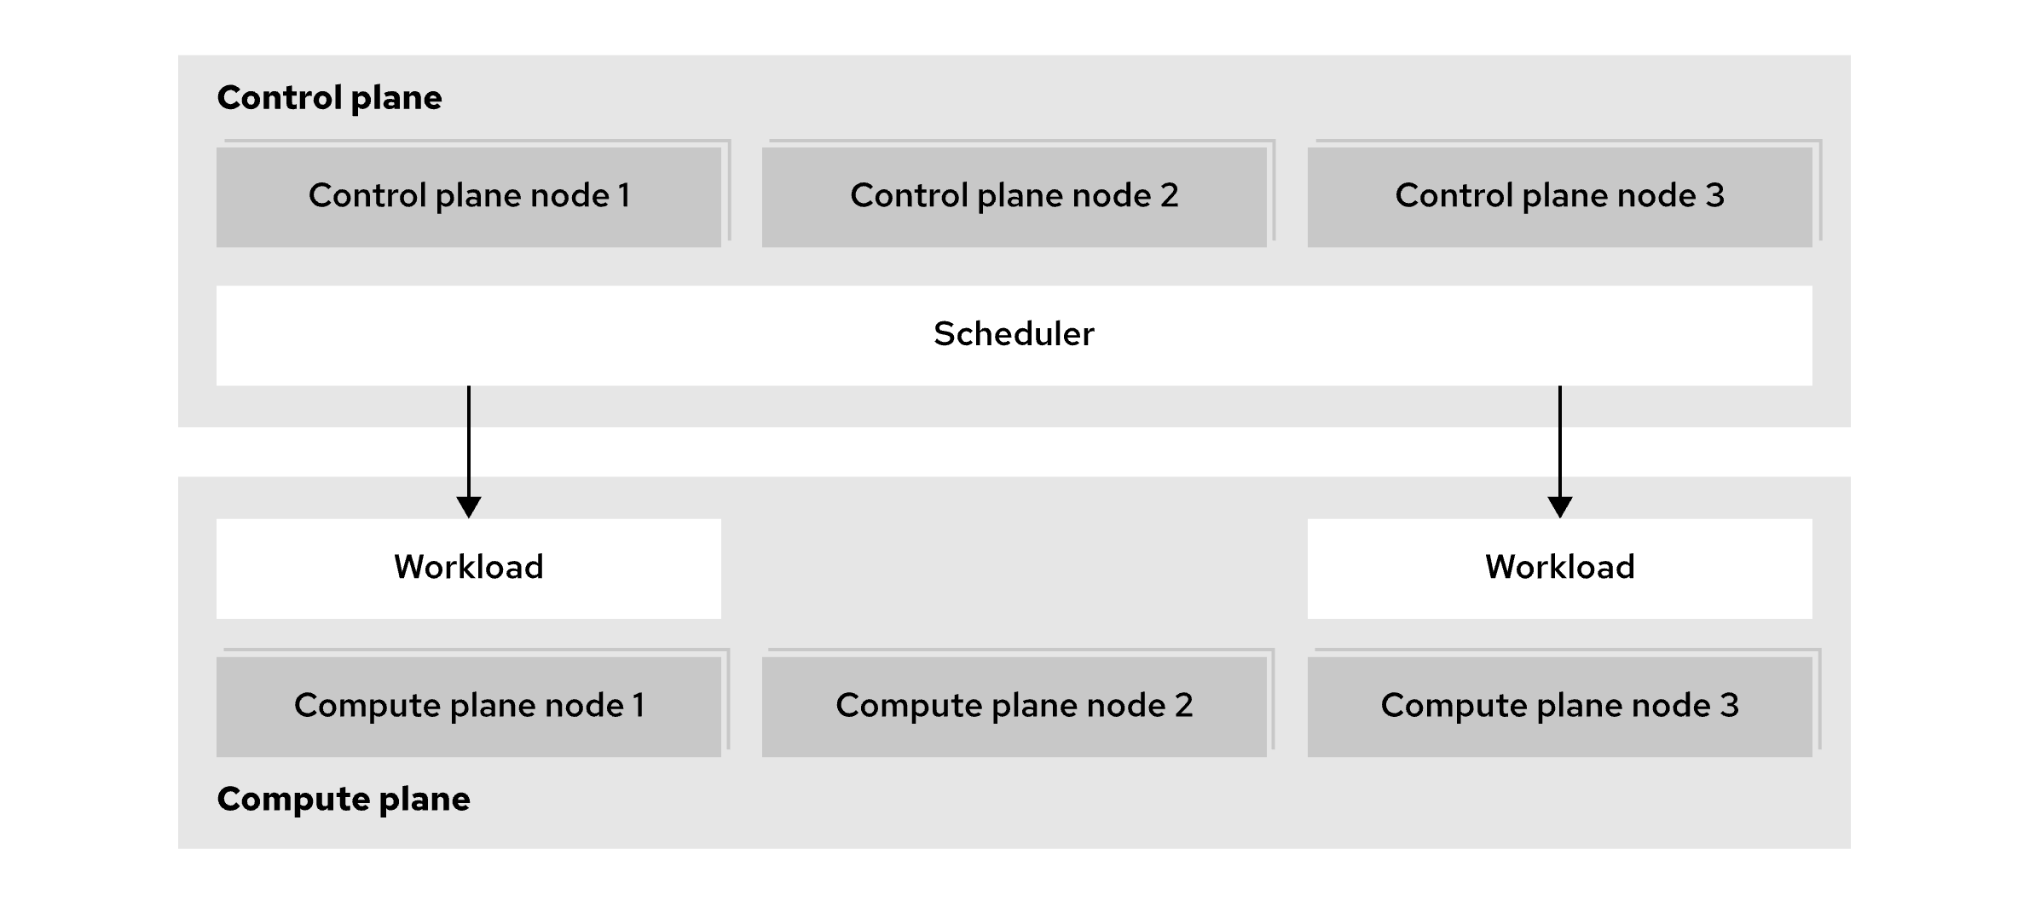
Kubernetes Architectural Concepts
Kubernetes uses multiple servers, called nodes, to ensure applications are resilient and scalable. These nodes can be physical or virtual machines and are typically divided into control plane nodes and compute nodes.
Control plane nodes handle cluster management, like scheduling workloads and maintaining cluster configuration.
Compute nodes run the actual user workloads. While a server can perform both roles, they are usually separated for better stability, security, and manageability.
Kubernetes clusters can vary in size, from a single node to large clusters with up to 5,000 nodes.
Fig 1.2 Kubernetes Components

Slide 7
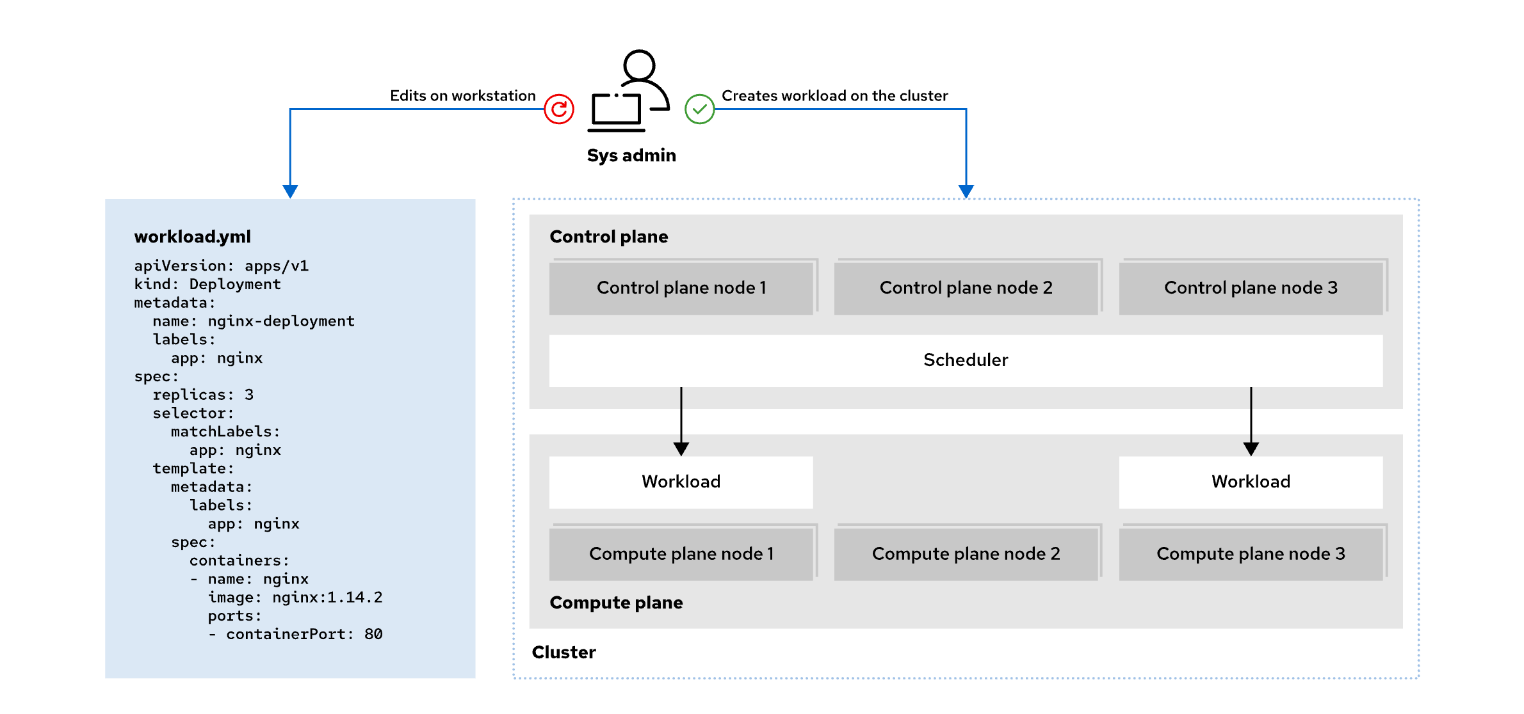
The Kubernetes API and Configuration Model
Administrators define workloads in Kubernetes using resources, which all operate through a uniform API. Tools like `kubectl` can manage any resource type, even custom ones. Kubernetes supports declarative resource management, where workloads are described in text files rather than manually configured. This improves maintainability and allows for change tracking using tools like version control.
To maintain the desired state of the cluster, Kubernetes uses controllers that continuously monitor and adjust resources as needed. For example, if an application requires more RAM than available, Kubernetes can automatically move it to a suitable node and redirect traffic once the move is complete.
Namespaces help organize and secure resources, allowing administrators to manage large sets and control access through specific permissions.
Fig 1.3 Declarative resource Management

Slide 8
OpenShift: Enhancing Kubernetes with Integrated Tools and Management
OpenShift extends Kubernetes to create a complete solution by adding key features:
Integrated Developer Workflow: OpenShift simplifies app development by integrating a built-in container registry, CI/CD pipelines, and S2I, which converts source code into container images.
Observability: OpenShift includes monitoring and logging services to help administrators maintain the reliability, performance, and availability of applications and the cluster.
Server Management: OpenShift streamlines installation and updates, using RHEL CoreOS as the underlying OS. This immutable, container-optimized OS is managed through Kubernetes tools, ensuring stability and security.
Unified Tools: OpenShift offers a graphical web console and unified tools for managing the platform’s features, along with enhanced security measures.

Slide 9
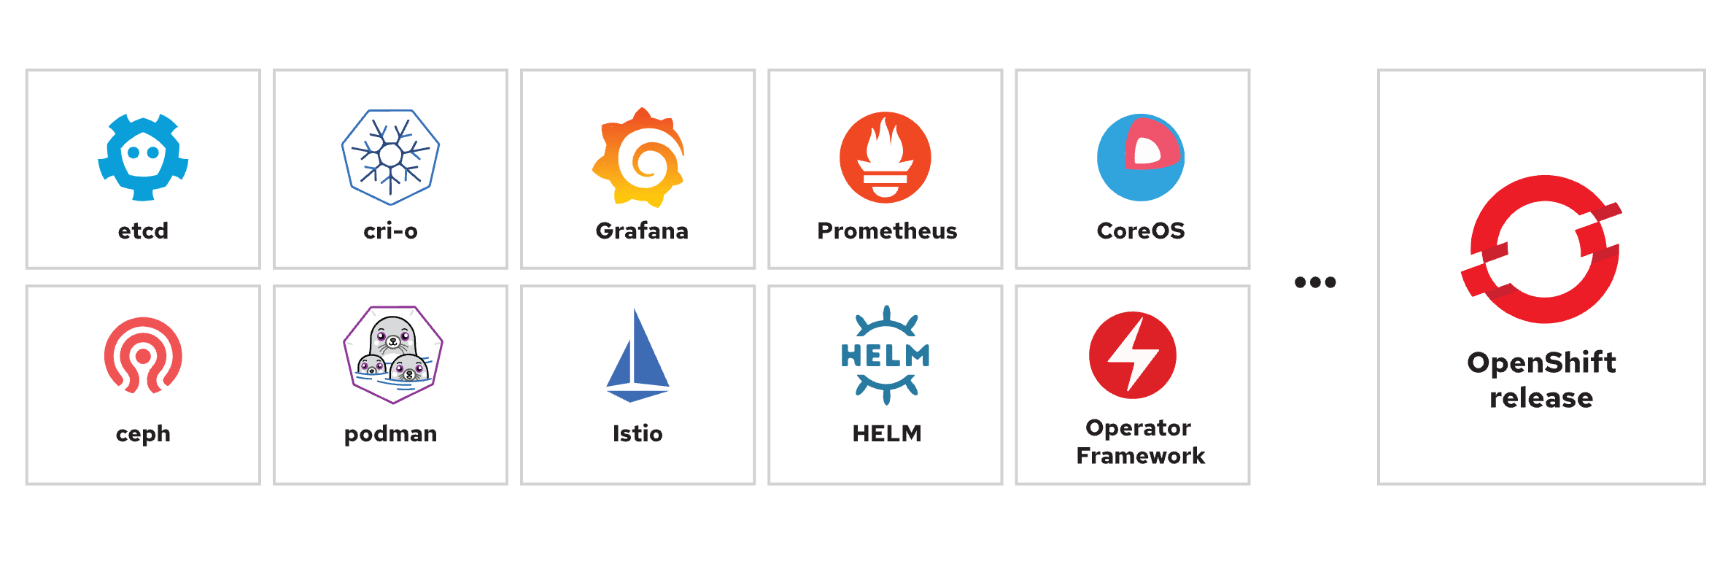
Functions in an OpenShift Cluster
Fig 1.4 Open-source projects in an OpenShift release
Each OpenShift release typically includes updates and enhancements to these key components to ensure that the platform remains robust, secure, and compatible with the latest advancements in containerization and cloud-native technologies. These components collectively enable OpenShift to deliver a comprehensive, enterprise-grade Kubernetes platform, ensuring that users can leverage the latest features and improvements in their containerized environments.

Slide 10
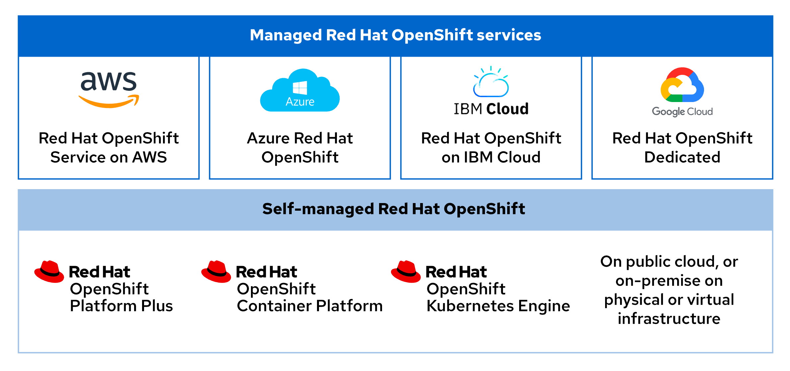
Red Hat OpenShift on Clouds
Fig 1.5 Product editions
Public cloud partners, such as Amazon Web Services, Microsoft Azure, IBM Cloud, and Google Cloud each provide quick access to an on-demand Red Hat OpenShift deployment. These managed deployments offer quick access to a cluster on infrastructure that you can rely on from a Red Hat trusted cloud provider.

Slide 11
Red Hat OpenShift Deployment Options
Red Hat OpenShift can be deployed on physical or virtual infrastructure, either on-premise or in the cloud, through self-managed installers or managed services.
Managed Services: Red Hat and the cloud provider handle most responsibilities, including cloud resource management and cluster updates, though you still have a say in scheduling.
Self-Managed: You manage more aspects, offering greater control and flexibility, such as over authentication, but also taking on more responsibilities, like cluster updates.

Slide 12
Red Hat OpenShift Editions
• Kubernetes Engine: Includes Kubernetes with added security and stability on Red Hat Enterprise Linux CoreOS, plus virtualization and an admin console.
• Container Platform: Builds on the Kubernetes Engine, adding tools like a developer console, log management, and features like Serverless, Service Mesh, Pipelines, and GitOps.
• Platform Plus: Offers the most comprehensive features, including advanced cluster management, security, and the Quay private registry.

Slide 13
Red Hat OpenShift Web Console
First step is to authenticate to the cluster
oc login -u <USERNAME> -p <PASSWORD> <API_ENDPOINT>:<PORT>
• oc login: This is the command to log into an OpenShift cluster. oc is the OpenShift command-line tool.
• -u <USERNAME>: Specifies the username you want to use to log into the OpenShift cluster.
• -p <PASSWORD>: Specifies the password associated with the username for authentication.
• <API_ENDPOINT>:<PORT>: Specifies address of the OpenShift cluster’s API server, including the port number.
Retrieve the web console URL
oc whoami --show-console
Web Console Perspectives: The OpenShift web console offers Administrator and Developer perspectives, each with a different sidebar layout and features. The first item on the sidebar is the perspective switcher, allowing you to toggle between these two views. Administrator focuses on cluster management and operations, while Developer emphasizes creating and running applications.

Slide 14
Red Hat OpenShift Key Concepts
Pods: The smallest unit in Kubernetes, consisting of one or more containers.
Deployments: Manage running applications with fine-grained control.
Projects: Kubernetes namespaces with added features for application multitenancy.
Routes: Network configurations to expose applications outside the cluster.
Operators: Packaged Kubernetes applications that extend cluster functionality.
Node: It is any system (bare metal, virtual, or cloud) where pods run. Nodes handle communication within the cluster and execute control plane requests. In OpenShift, the term machine specifically refers to a cluster node, particularly useful when provisioning infrastructure on public clouds.
MachineConfig resource: It defines the initial state and updates for files, services, and key OpenShift components like `kubelet` and `cri-o`. The Machine Config Operator (MCO) manages the configuration and maintenance of cluster machines, ensuring they remain in the intended state by continuously validating and applying updates across all nodes.

Slide 15
Thank You!

