Slide 1

3. Run Applications as Containers and Pods

Slide 2
Creating Linux Containers and Pods
1. Creating Containers and Pods
• Use commands like kubectl run or oc run to create and deploy applications in Kubernetes or OpenShift pods using container images. Example: kubectl run web-server --image registry.access.redhat.com/ubi8/httpd-24.
• Options include --command for custom commands, -it for interactive sessions, and --restart to define pod restart policies (Always, OnFailure, Never).
2. User and Group IDs Assignment
• OpenShift automatically assigns UID and GID ranges to containers, preventing regular users from running containers as root. Cluster administrators can run containers with the specified UID from the container image.
3. Pod Security
• Kubernetes provides warnings for pods without security contexts. OpenShift uses Security Context Constraints (SCC) to define security policies.
4. Execute Commands in Running Containers
• Use kubectl exec or oc exec to execute commands in running containers or open interactive sessions. Example: oc exec my-app -- date.

Slide 3
Creating Linux Containers and Pods
5. Container Logs
• Use kubectl logs or oc logs to retrieve logs from running containers. Options include --tail to display recent log lines and -f to follow logs in real-time.
6. Deleting Resources
• Delete pods using the delete command with resource names, labels, or configuration files. Example: oc delete pod php-app. Additional options like --grace-period or --force modify the deletion process.
7. CRI-O Container Engine
• CRI-O is the container engine used by OpenShift, optimized for Kubernetes clusters. The crictl command manages containers, and tools like nsenter allow access to container namespaces for troubleshooting

Slide 4
Find and Inspect Container Images
1. Container Image Overview
• A container image is a packaged version of an application, containing all dependencies for running it in an isolated environment. Containers rely on images to create instances, and multiple instances can be run from a single image.
2. Container Image Registries
• Registries like Quay.io, Docker Hub, and Red Hat Registry store and distribute container images. Public registries provide access to a wide range of images, while private registries offer more control and security.
3. Red Hat Registry and UBI
• Red Hat offers trusted, secure container images through registry.access.redhat.com and registry.redhat.io. Universal Base Images (UBI) from Red Hat provide a flexible, secure foundation for building containers and are available without requiring a subscription.
4. Quay.io and Private Registries
• Quay.io allows users to store their container images, and private registries give organizations control over their image distribution, keeping images secure and limiting public exposure.
5. Container Image Identifiers
• Container images are identified by a registry, name, tag, and a unique ID (hash). Tags help version control, while the hash ensures a unique, immutable reference to the image.

Slide 5
Find and Inspect Container Images
6. Container Image Components
• Images consist of layers that stack on top of each other, and metadata defines the environment and commands to run the container, such as ENV, CMD, and USER instructions.
7. Base Images
• Base images provide the foundational operating system and necessary dependencies for a container. Red Hat’s Universal Base Images (UBI) are compliant and supported across Red Hat platforms and beyond.
8. Inspecting and Managing Images
• Tools like Skopeo and oc image allow users to inspect, manage, and move container images between registries. Skopeo provides commands like copy, inspect, list-tags, and delete for remote image management without needing elevated privileges.
9. Registry Credentials and Security
• Access to certain registries, like Red Hat’s, requires authentication, and Skopeo stores credentials securely. Running containers as root is a security risk, and Red Hat provides non-root container options for safer deployments.

Slide 6
Troubleshoot Containers and Pods
1. Container Troubleshooting Overview
• Containers are immutable and ephemeral, so changes made to running containers are temporary and intended for troubleshooting. Redeployment is recommended after resolving the issue.
2. CLI Troubleshooting Tools
• Tools like kubectl and oc provide commands to inspect and interact with running containers and pods. Key commands include:
• kubectl describe for details about resources.
• kubectl exec to run commands in containers.
• kubectl logs to view logs.
• oc status, oc rsh, and oc rsync for OpenShift-specific operations.
3. Editing Resources
• One can edit a running container’s configuration using kubectl edit or oc edit, and update specific fields using kubectl patch or oc patch.
4. Copying Files to and from Containers
• Use kubectl cp or oc cp to transfer files between your local machine and a container. For syncing directories, use oc rsync.

Slide 7
Troubleshoot Containers and Pods
5. Remote Container Access (Port Forwarding)
• The kubectl port-forward command allows temporary network tunneling to expose a pod’s ports for local access during troubleshooting.
6. Connecting to Running Containers
• One can connect to a container’s shell using oc rsh or run specific commands with oc exec to troubleshoot directly inside the container.
7. Container Events and Logs
• Review logs with kubectl logs or oc logs, and inspect events with kubectl get events to track actions and errors related to a container or pod.

Slide 8
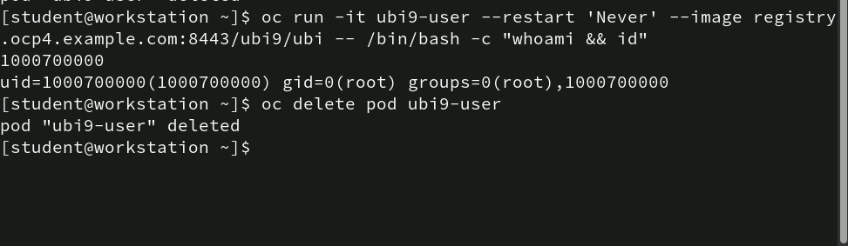
Command to run a pod: oc run
The first command is running a new pod interactively (-it) with the name ubi9-user in OpenShift. The --restart 'Never' option ensures that the pod does not restart once the command is completed.
The command executed inside the container is /bin/bash -c "whoami && id", which runs a bash shell that checks the current user (whoami) and displays user details (id), which are displayed as output in the screenshot. The output shows 1000700000 as the user ID and root group details.
The second command deletes the pod named ubi9-user. The output confirms that the pod ubi9-user has been deleted.

Slide 9
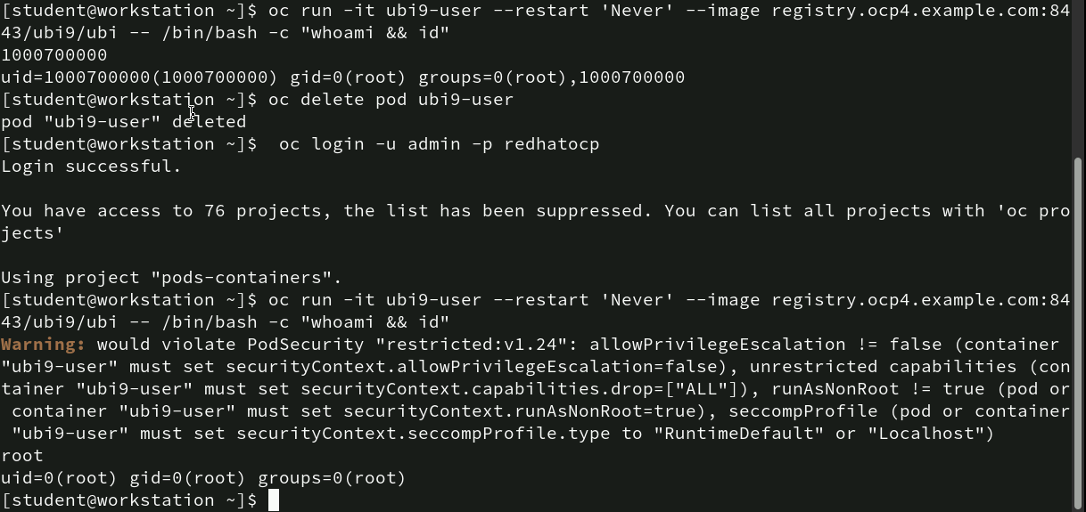
Commands for running a Pod with different Users: oc run
The first command runs an interactive pod named ubi9-user using an image from a specified registry. Inside the pod, the commands whoami and id are executed to print the current user and the associated user/group ID information.
The output shows uid=1000700000, meaning the process inside the pod is running with that user ID, and the root group ID.
The second command deletes the pod named ubi9-user.
The third command defines the login for admin user.
Then the first command is run again (ignoring the warnings) here we can see the output received contains uid=0(root) as this is a root user.

Slide 10
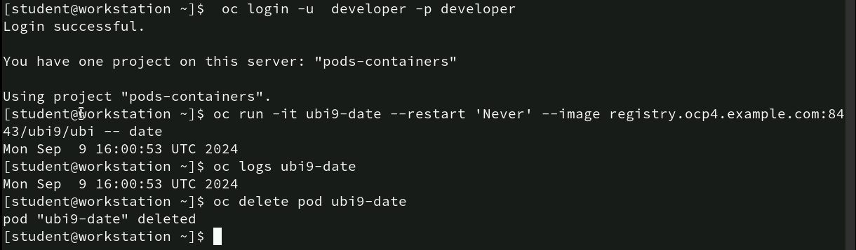
Commands to execute commands in a Pod and managing logs: oc run, oc logs
The first command describes the developer login. The second command runs a pod named ubi9-date using the UBI (Universal Base Image). The pod runs the date command inside the pod. The output displays the date and time.
The third command fetches the logs from the pod ubi9-date. Since the date command was executed, the logs show the same output, which is the current date and time Mon Sep 9 16:00:53 UTC 2024. At last, command to delete the pod ubi9-date.

Slide 11
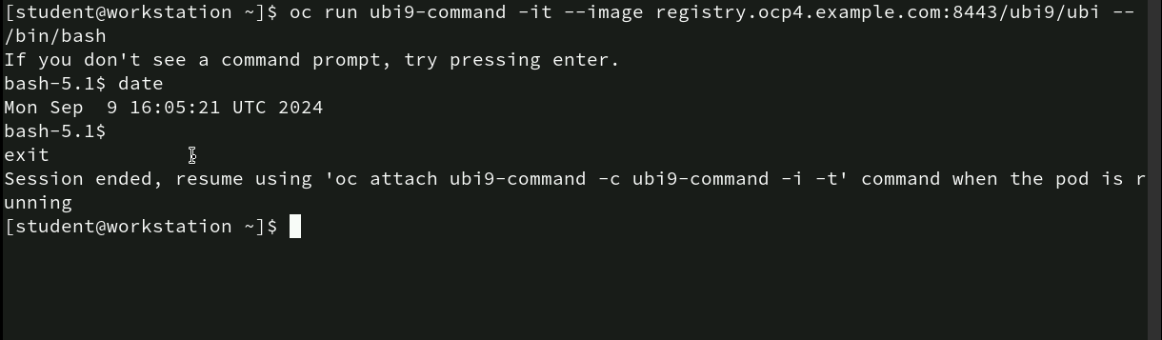
Command to run an interactive Pod with Bash shell: oc run
This command runs a new pod named ubi9-command in an interactive terminal (-it) using an image from the specified registry. The pod starts with a bash shell (/bin/bash), allowing the user to execute commands inside the running pod.
Inside the pod, the user runs the date command, which outputs the current date and time: Mon Sep 9 16:05:21 UTC 2024.
After running the date command, the user types exit to leave the interactive session and terminate the bash shell. This ends the session inside the pod.

Slide 12
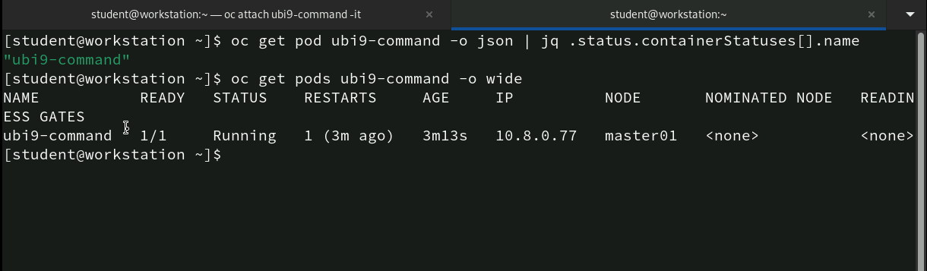
Command to query pod details and container status using jq: oc get
The first command retrieves detailed information about the pod ubi9-command in JSON format (-o json). It pipes the JSON output to jq, a command-line JSON processor, to extract and display the container name from the pod’s containerStatuses. The result is "ubi9-command", which is the name of the container running inside the pod.
oc get pods ubi9-command -o wide: This command retrieves information about the pod in a wide format, which includes additional details like the pod’s IP address, the node where it is running, and more.

Slide 13
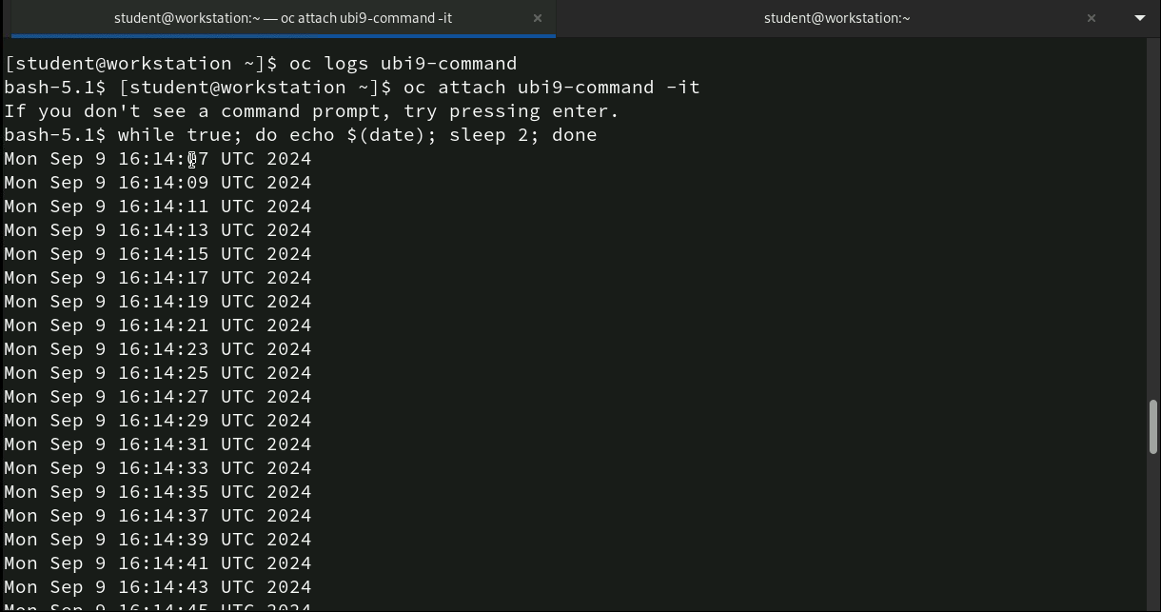
Command to run a continuous date output loop: oc logs, oc attach
The first command fetches and displays the logs from the ubi9-command pod. However, in this case, no logs are shown as the pod may not have generated any logs yet, or logs are minimal.
This command attaches to the running ubi9-command pod interactively (-it), allowing the user to interact with the bash shell inside the container.
The second command is a loop executed inside the bash shell of the pod. It continuously prints the current date and time ($(date)), waits for 2 seconds (sleep 2), and repeats (while true).

Slide 14
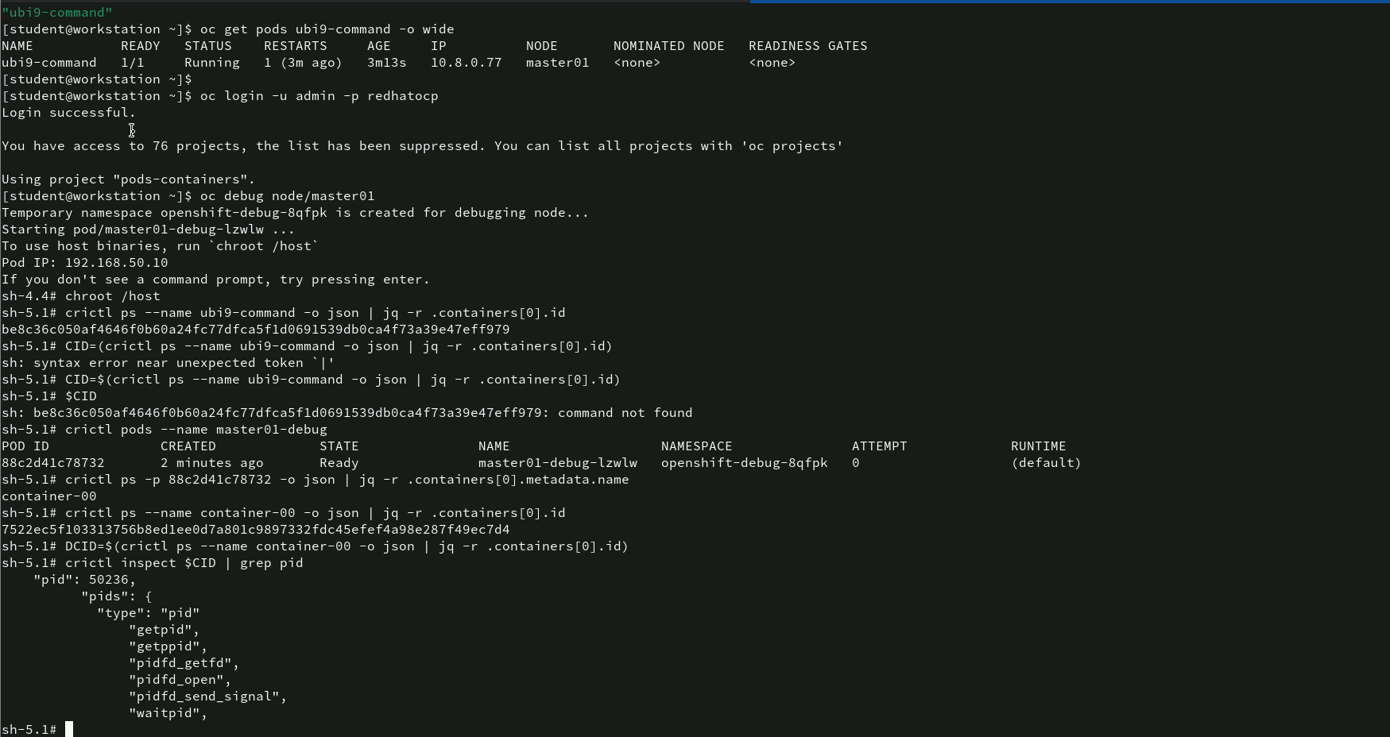
Command for debugging node and using crictl to inspect running containers:
The first command retrieves detailed information about the ubi9-command pod. The second command is for logging as admin user.
This command initiates a debug session on the master01 node. A temporary namespace (openshift-debug) is created, and a debug pod (master01-debug-lzvlw) is started. The pod is using the host’s binaries and allows root-level access.

Slide 15
Command for debugging node and using crictl to inspect running containers:
The next command is chroot /host used to change the root directory to the host file system. This command allows the user to interact with the node’s file system and execute commands in the context of the host.
crictl ps --name ubi9-command -o json | jq -r .containers[0].id: The crictl command is used to query the container runtime interface. It lists all running containers, filtering by the name ubi9-command. The output is in JSON format and is processed using jq to extract the container ID of the first container in the list. The command successfully retrieves the container ID:
crictl ps --name master01-debug: This command lists the running debug containers. It retrieves the pod name (master01-debug-lzvlw) and details such as the creation time (2 minutes ago), state (Ready), and namespace (openshift-debug-8qfpk).
The user attempts to retrieve more container IDs, particularly for container-00, and inspects the container to query its PID (process ID). The output successfully shows the PID structure, confirming the process information inside the container.

Slide 16
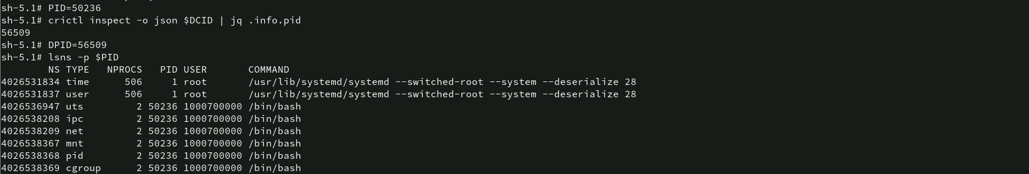
Command for inspecting container process NS using crictl and lsns
To a variable PID 50236 value has been assigned which is basically the process id.
crictl inspect -o json $CID | jq .info.pid: This command inspects the container using crictl, and the output is formatted as JSON. The jq tool is used to extract the process ID (pid) from the inspection data. The resulting PID value is 56509, which is assigned to the variable DPID.
DPID=56509: The value 56509 is now stored in the variable DPID, which represents the process ID of a different process running inside the container.
lsns -p $PID: This command uses the lsns (list namespaces) command to display the namespaces associated with the process ID stored in the $PID variable (50236). The output shows various namespaces for the process 50236, such as the type of namespace (e.g., time, user, ipc, net, etc.), number of processes in the namespace, the process ID, the user that owns the process, including root and 1000700000 (a non-root user).
COMMAND: The command running in the process, which in this case includes /usr/lib/systemd --switched-root and /bin/bash.

Slide 17
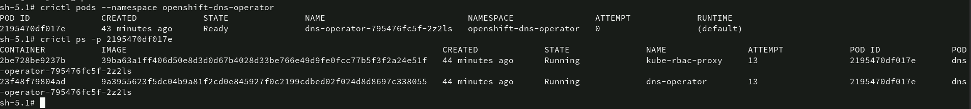
Command for inspecting containers inside Pod using crictl
crictl pods --namespace openshift-dns-operator: This command lists the pods running in the openshift-dns-operator namespace. The output shows POD ID, pod creation time, pod’s current state, name of the pod, namespace, how many attempts it took.
crictl ps -p 2195470df017e: This command lists the containers running inside the pod with ID 2195470df017e. The output shows two containers, image, name and attempts.

Slide 18
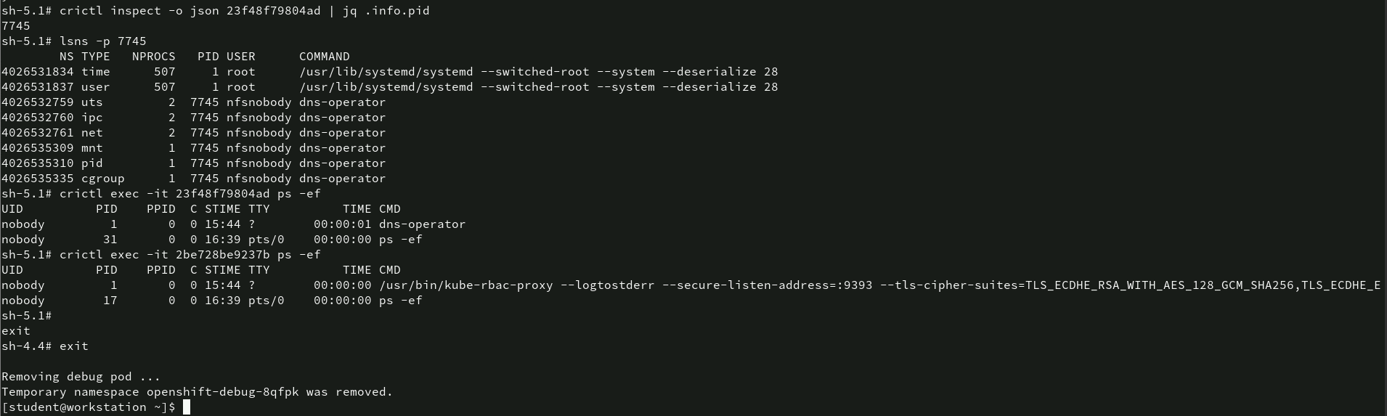
Command for debugging containers and inspecting process using crictl
crictl inspect -o json 23f48f79804ad | jq .info.pid: This command inspects the container with ID 23f48f79804ad, formats the output in JSON, and extracts the process ID (PID) using jq.
lsns -p 7745: This command lists the namespaces associated with the process ID 7745. The output includes namespace type, number of processes , the process ID, the user and the command running with that PID, which includes /usr/lib/systemd and dns-operator.

Slide 19
Command for debugging containers and inspecting process using crictl
crictl exec -it 23f48f79804ad ps -ef: This command runs the ps -ef command inside the container with ID 23f48f79804ad to display the list of processes running in that container. The output shows user IDs, Process ID and Parent Process ID and the command being executed.
crictl exec -it 2be728be9237b ps -ef: This command runs the ps -ef command inside another container (2be728be9237b). The output shows a process running with the command kube-rbac-proxy, which is responsible for managing Role-Based Access Control (RBAC) with a secure listen address. Exit command is used to close the interactive shell.

Slide 20
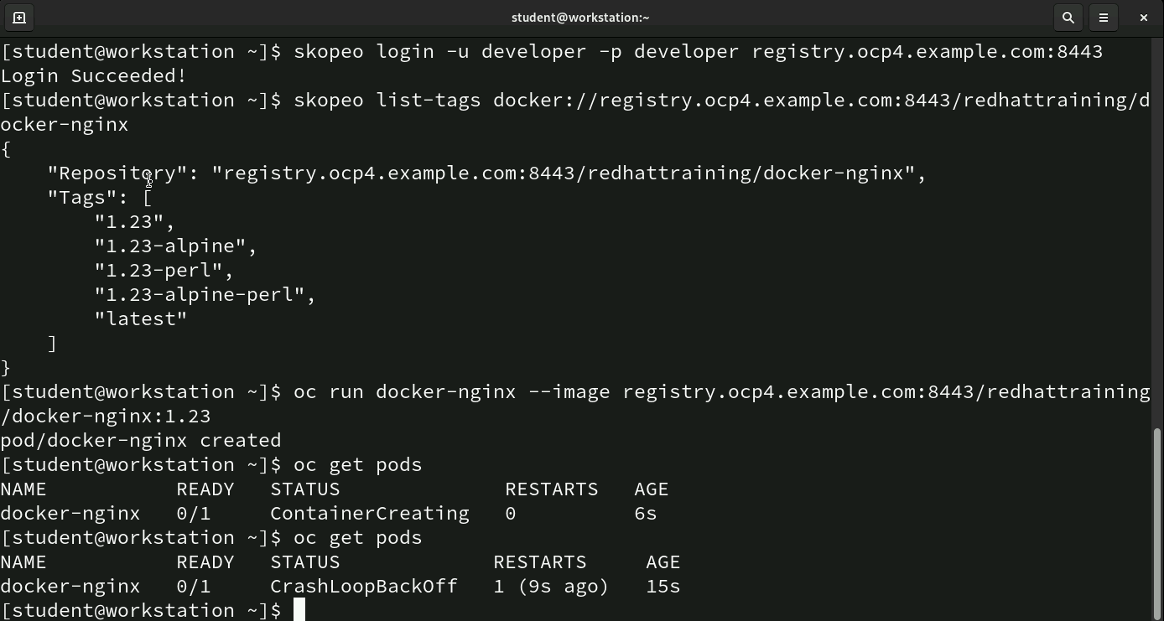
Command for deploying an Nginx Pod and handling CrashLoopBackOff using skopeo : skopeo list-tags, oc run, oc get
skopeo login -u developer -p developer registry.ocp4.example.com:8443: This command logs the user (developer) into the specified container image registry (registry.ocp4.example.com:8443) using the skopeo tool.
skopeo list-tags docker://registry.ocp4.example.com:8443/redhattraining/docker-nginx: This command lists all available tags for the docker-nginx image in the redhattraining repository on the specified registry (registry.ocp4.example.com:8443).

Slide 21
Command for deploying an Nginx Pod and handling CrashLoopBackOff using skopeo : skopeo list-tags, oc run, oc get
oc run docker-nginx --image registry.ocp4.example.com:8443/redhattraining/docker-nginx:1.23: This command creates a new pod named docker-nginx using the docker-nginx:1.23 image from the specified registry (registry.ocp4.example.com).
oc get pods: This command lists the status of the pods running in the current project. Initially, the docker-nginx pod is in the Container. Creating state, meaning the container is in the process of being created and started.
oc get pods (second run): After some time, the user runs the oc get pods command again to check the pod status. This time, the docker-nginx pod has moved into the CrashLoopBackOff state. The CrashLoopBackOff status means that the container inside the pod keeps crashing and is being restarted repeatedly, but the issue remains unresolved. The pod has restarted once (RESTARTS: 1) and has been running for 15 seconds since it was created.

Slide 22
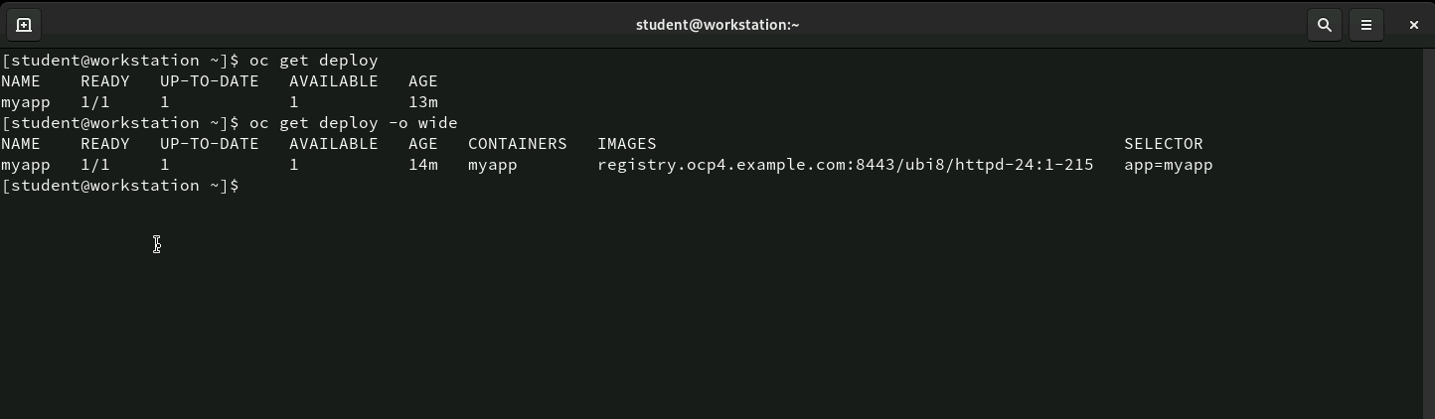
Command: oc get deploy
The oc get deploy command shows a quick overview of deployment status, including readiness, availability, and age. The oc get deploy -o wide command provides more details, such as container images and selectors, for a deeper look into the deployment’s configuration.

Slide 23
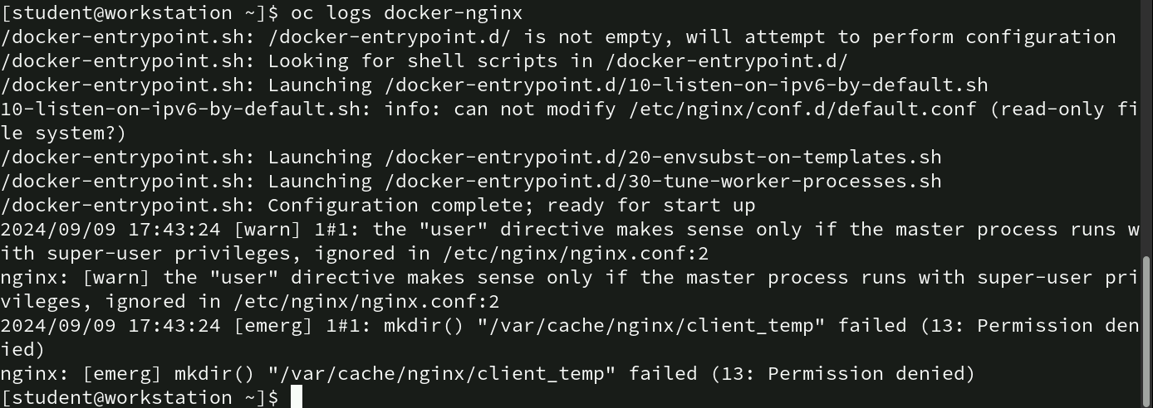
Command for debugging Nginx Pod Crash : oc logs
oc logs docker-nginx: This command retrieves the logs from the docker-nginx pod. The logs show the startup process of the Nginx container.
/docker-entrypoint.sh:: The container’s entrypoint script is executing various initialization tasks, including launching shell scripts from the /docker-entrypoint.d/ directory. These scripts are responsible for configuring Nginx before it starts.

Slide 24
Command for debugging Nginx Pod Crash : oc logs
emerg mkdir() "/var/cache/nginx/client_temp" failed (13: Permission denied): The most critical error occurs when Nginx tries to create a directory for its temporary files at /var/cache/nginx/client_temp. This fails because the process does not have the necessary permissions (as indicated by the (13: Permission denied) error).
This error is the likely cause of the CrashLoopBackOff state you observed earlier because Nginx cannot start properly due to these permission issues.

Slide 25
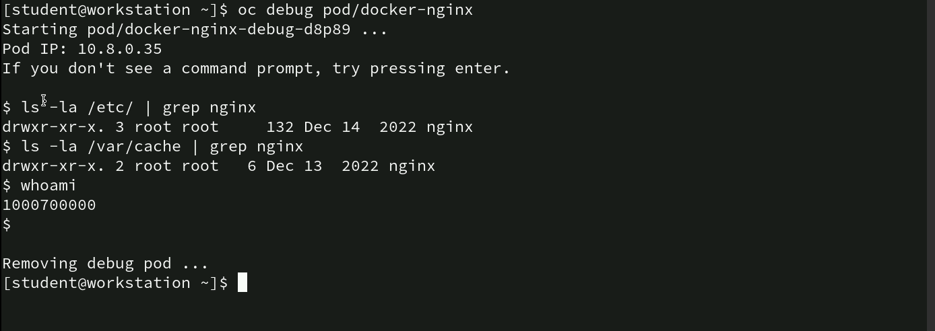
Command for Debugging Nginx Pod Permission issues: oc debug
oc debug pod/docker-nginx: This command starts a debug session for the docker-nginx pod. A temporary debug pod (docker-nginx-debug-d8p89) is created, which allows the user to run commands interactively within the context of the original pod.
ls -la /etc/ | grep nginx: This command lists the contents of the /etc/ directory and filters the output to show only entries related to nginx.

Slide 26
Command for Debugging Nginx Pod Permission issues: oc debug
ls -la /var/cache | grep nginx: This command lists the contents of the /var/cache/ directory and filters the output to show only entries related to nginx.
whoami: This command displays the current user running the shell inside the debug pod.
Exiting the Debug Pod: After running the necessary commands, the debug session is terminated, and the temporary debug pod is removed.

Slide 27
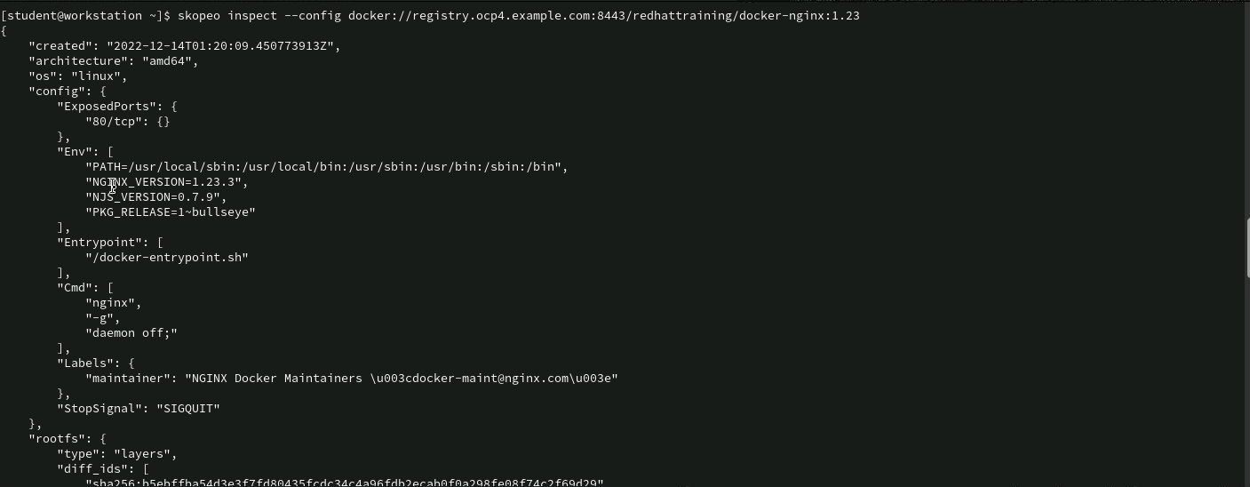
Command for inspecting Nginx Image with Skopeo
skopeo inspect --config docker://registry.ocp4.example.com:8443/redhattraining/docker-nginx:1.23: This command inspects the docker-nginx:1.23 image from the redhattraining repository on the specified registry (registry.ocp4.example.com:8443). The --config flag retrieves detailed configuration information about the image.
The output includes the creation time, architecture of the image built, image exposed ports, environment variables, nginx version, njs version and many others.

Slide 28
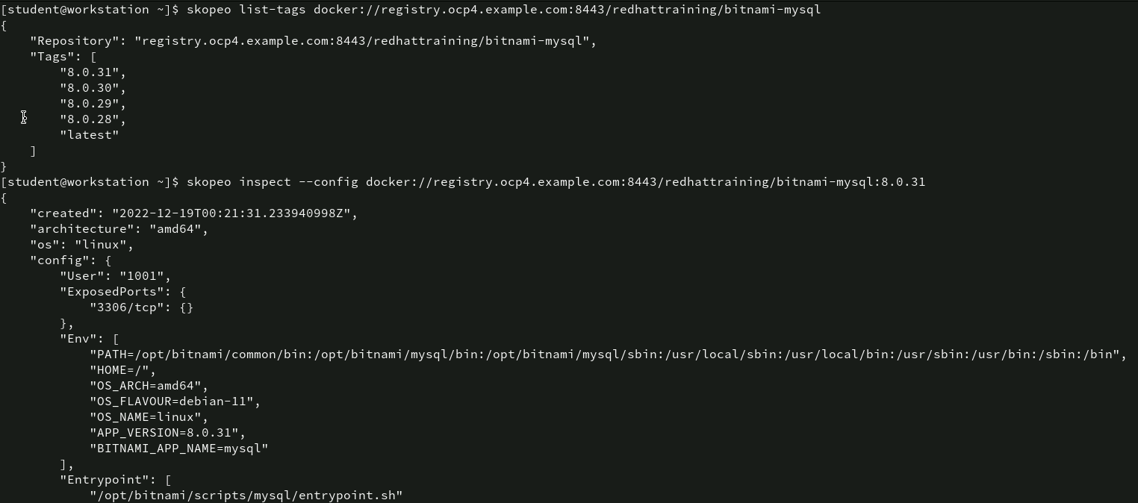
Command for inspecting Image with Skopeo
skopeo list-tags docker://registry.ocp4.example.com:8443/redhattraining/bitnami-mysql: This command lists all available tags for the bitnami-mysql image in the redhattraining repository on the specified registry (registry.ocp4.example.com:8443)
skopeo inspect –config docker://registry.ocp4.example.com:8443/redhattraining/bitnami-mysql:8.0.31: This command inspects the bitnami-mysql:8.0.31 image from the redhattraining repository on the specified registry. The --config flag retrieves detailed configuration information about the image.

Slide 29
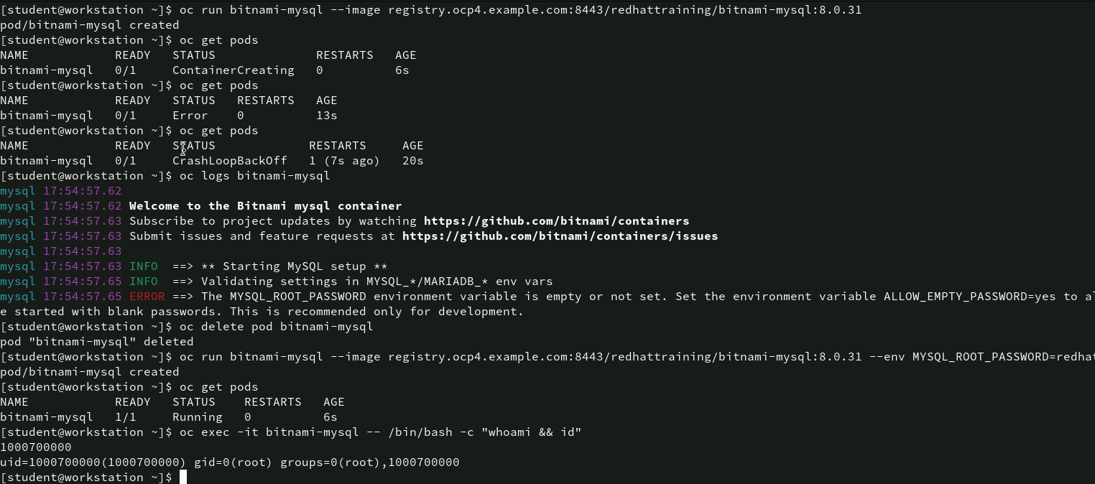
Command for deploying MySQL with Env variables and handling CrashLoopBackOff Errors
oc run bitnami-mysql --image registry.ocp4.example.com:8443/redhattraining/bitnami-mysql:8.0.31: This command creates a new pod named bitnami-mysql using the bitnami-mysql:8.0.31 image from the specified registry.

Slide 30
Command for deploying MySQL with Env variables and handling CrashLoopBackOff Errors
oc get pods: This command lists the pods and their status.
oc get pods (second run & third run): After a few seconds, the pod is now in the Error state, meaning it encountered an issue during startup. And on the third run the pod has entered the CrashLoopBackOff state, meaning the container repeatedly crashes and restarts. This is often caused by configuration or environment variable issues.
oc logs bitnami-mysql: This command retrieves the logs from the bitnami-mysql pod. In this key issue has been given i.e. the MYSQL_ROOT_PASSWORD environment variable is not set. MySQL cannot start without a root password, and this leads to the container crash.
oc delete pod bitnami-mysql: This command deletes the bitnami-mysql pod.
oc run bitnami-mysql --image registry.ocp4.example.com:8443/redhattraining/bitnami-mysql:8.0.31 --env MYSQL_ROOT_PASSWORD=redhat: This command is re-run but this time with the necessary environment variable MYSQL_ROOT_PASSWORD. This fixes the issue, allowing the pod to start with the required root password for MySQL.
oc get pods: After setting the environment variable, the pod is now in the Running state (READY 1/1), meaning the container has started successfully.
oc exec -it bitnami-mysql -- /bin/bash -c "whoami && id": This command runs an interactive session inside the bitnami-mysql pod and executes the whoami and id commands to check the user and group information.

Slide 31
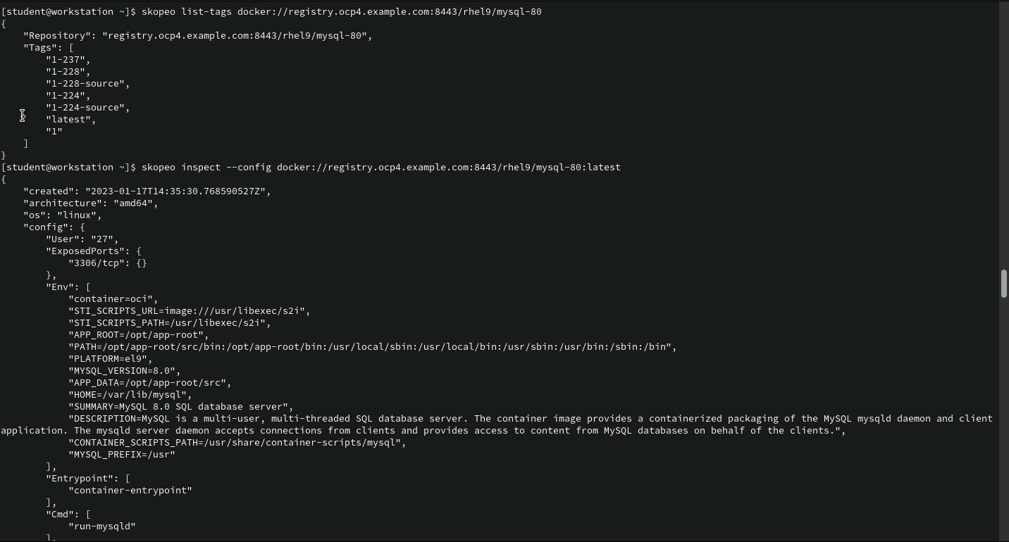
Command for inspecting MySQL Image Configuration Using Skopeo
skopeo list-tags docker://registry.ocp4.example.com:8443/rhel9/mysql-80: This command lists all available tags for the mysql-80 image from the rhel9 repository on the specified registry.
skopeo inspect --config docker://registry.ocp4.example.com:8443/rhel9/mysql-80:latest: This command inspects the mysql-80:latest image from the rhel9 repository on the specified registry. The --config flag retrieves the detailed configuration information about the image.

Slide 32
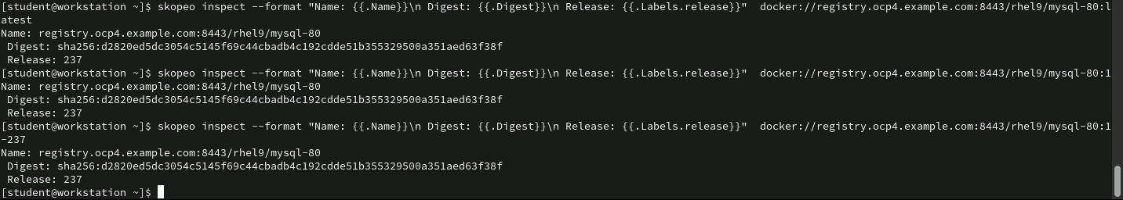
Command Inspecting MySQL Image Digests and Releases Using skopeo
skopeo inspect --format "Name: {{.Name}}\n Digest: {{.Digest}}\n Release: {{.Labels.release}}" docker://registry.ocp4.example.com:8443/rhel9/mysql-80:latest: This command inspects the mysql-80:latest image from the rhel9 repository using skopeo and formats the output to show the image name, digest, and release label.
skopeo inspect --format "Name: {{.Name}}\n Digest: {{.Digest}}\n Release: {{.Labels.release}}" docker://registry.ocp4.example.com:8443/rhel9/mysql-80:1-237: This command inspects the mysql-80:1-237 image from the same repository. The output format remains the same as the previous command.
Third identical skopeo inspect command: The third command is identical to the second one, inspecting the mysql-80:1-237 image, producing the same output.

Slide 33
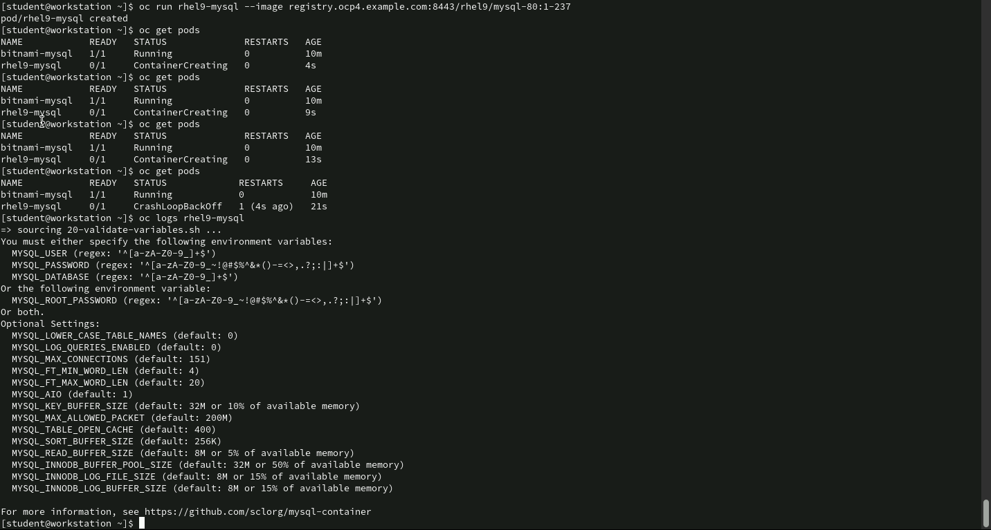
Commands for debugging MySQL Pod Initialization
oc run rhel9-mysql --image registry.ocp4.example.com:8443/rhel9/mysql-80:1-237: This command creates a pod named rhel9-mysql using the mysql-80:1-237 image from the rhel9 repository.
oc get pods (multiple runs): The oc get pods command is run several times to check the pod’s status.
Initially, the rhel9-mysql pod is in the ContainerCreating state, indicating it is being set up. Later, the pod transitions into the CrashLoopBackOff state, meaning it encountered an error and is repeatedly crashing and restarting.

Slide 34
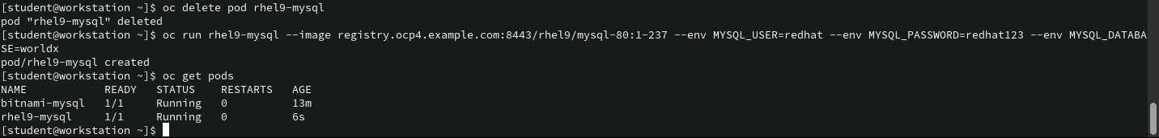
Commands of fixing MySQL Pod Crash by Adding Environment Variables
oc delete pod rhel9-mysql: This command deletes the existing rhel9-mysql pod, which was in a CrashLoopBackOff state due to missing environment variables.
oc run rhel9-mysql --image registry.ocp4.example.com:8443/rhel9/mysql-80:1-237 --env MYSQL_USER=redhat --env MYSQL_PASSWORD=redhat123 --env MYSQL_DATABASE=world: This command creates a new rhel9-mysql pod using the same mysql-80:1-237 image but this time includes the required environment variables.
oc get pods: This command checks the status of the running pods. The output shows that both the bitnami-mysql and rhel9-mysql pods are now in the Running state, indicating that the new rhel9-mysql pod has successfully started without any issues.

Slide 35
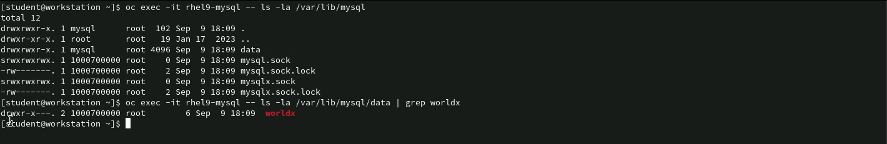
Command for verifying MYSQL Database : oc exec
oc exec -it rhel9-mysql -- ls -la /var/lib/mysql: This command runs an interactive session inside the rhel9-mysql pod and lists the contents of the /var/lib/mysql directory with detailed permissions.
oc exec -it rhel9-mysql -- ls -la /var/lib/mysql/data | grep worldx: This command lists the contents of the /var/lib/mysql/data directory and filters for the worldx directory to verify if the specified MySQL database exists.

Slide 36
Command for retrieving the Internal IP Address of MySQL Pod
oc get pods rhel9-mysql -o json | jq .status.podIP: This command retrieves detailed information about the rhel9-mysql pod in JSON format and uses jq (a tool for processing JSON data) to extract the pod’s IP address.
The pod’s IP address is 10.8.0.70, which is the internal IP address assigned to the rhel9-mysql pod within the OpenShift cluster.

Slide 37
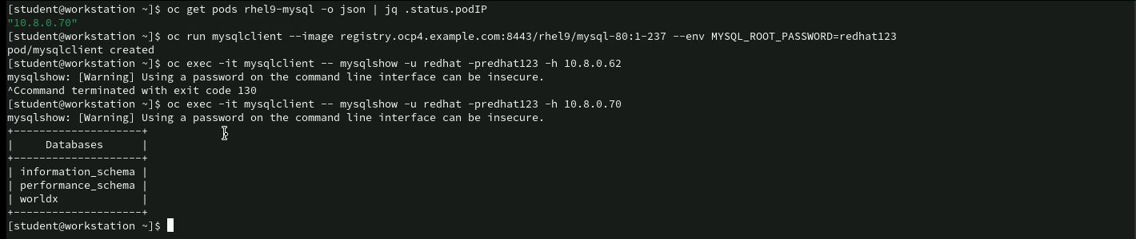
Commands for listening Databases using mysqlclient
oc get pods rhel9-mysql -o json | jq .status.podIP: This command retrieves the internal IP address of the pod.
oc run mysqlclient --image registry.ocp4.example.com:8443/rhel9/mysql-80:1-237 --env MYSQL_ROOT_PASSWORD=redhat123: This command creates a new pod named mysqlclient using the mysql-80:1-237 image and sets the MYSQL_ROOT_PASSWORD environment variable to redhat123.
oc exec -it mysqlclient -- mysqlshow -u redhat -predhat123 -h 10.8.0.62: This command attempts to execute the mysqlshow command inside the mysqlclient pod to list all MySQL databases using the credentials redhat/redhat123.
oc exec -it mysqlclient -- mysqlshow -u redhat -predhat123 -h 10.8.0.70: This command is similar to the previous one but connects to the correct MySQL server at 10.8.0.70 (the actual IP of the rhel9-mysql pod).

Slide 38
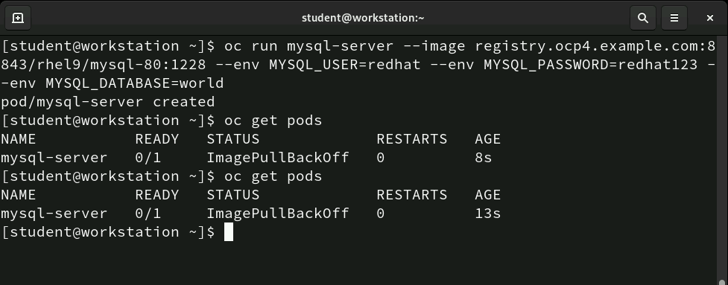
Commands troubleshooting Image Pull Issues
oc run mysql-server --image registry.ocp4.example.com:8443/rhel9/mysql-80:1-228 --env MYSQL_USER=redhat --env MYSQL_PASSWORD=redhat123 --env MYSQL_DATABASE=world: This command creates a pod named mysql-server using the MySQL image rhel9/mysql-80:1-228 from the specific registry.
oc get pods:The oc get pods command is run to check the status of the mysql-server pod. The pod is in the ImagePullBackOff state after the second run as well, meaning OpenShift is unable to pull the specified image from the registry.

Slide 39
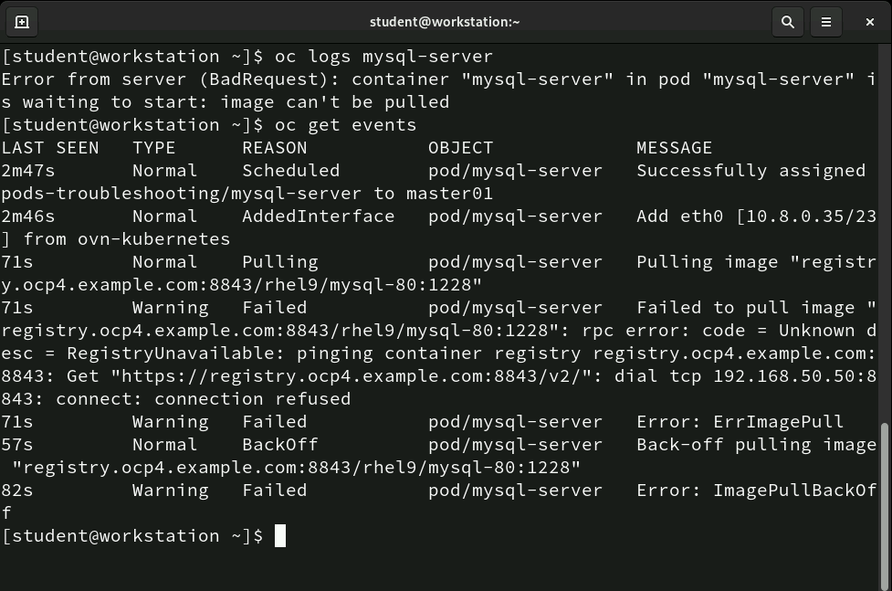
Commands for diagnosing Image Pull Failure
oc logs mysql-server: This command attempts to retrieve the logs for the mysql-server pod. The server responds with an error. This confirms that the container cannot start because the image cannot be pulled from the registry.
oc get events: This command lists the recent events for the mysql-server pod.The system tried to connect to the container registry, but the connection was refused, meaning the registry is unreachable. After failing to pull the image, the system entered a back-off state and tried to pull the image again, which also failed.

Slide 40
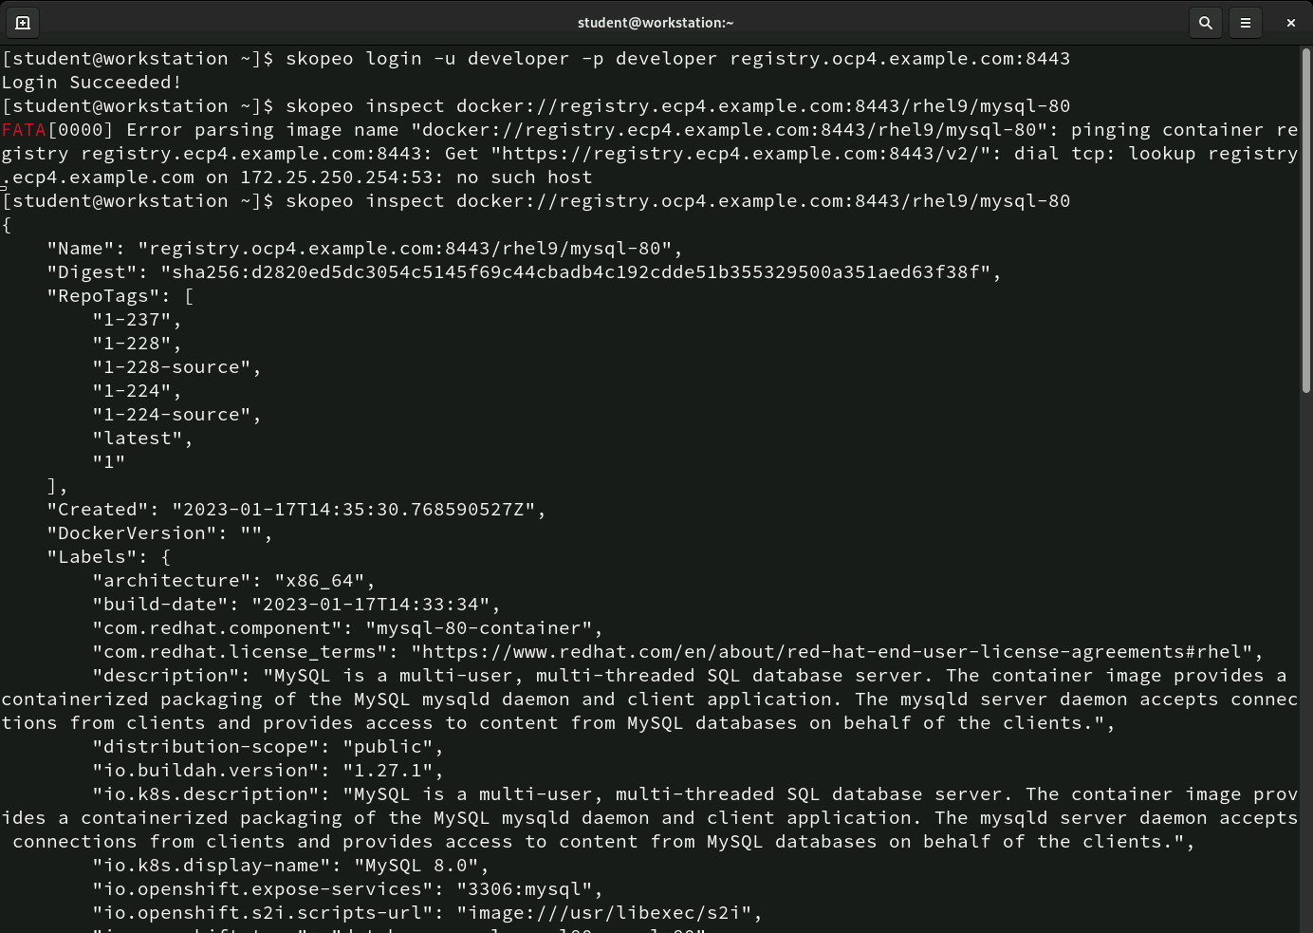
Commands for Inspecting Image Metadata
skopeo login -u developer -p developer registry.ocp4.example.com:8443: This command logs the user into the OpenShift image registry.
skopeo inspect docker://registry.ocp4.example.com:8443/rhel9/mysql-80: This command retries the skopeo inspect command with the correct registry URL (registry.ocp4.example.com).

Slide 41
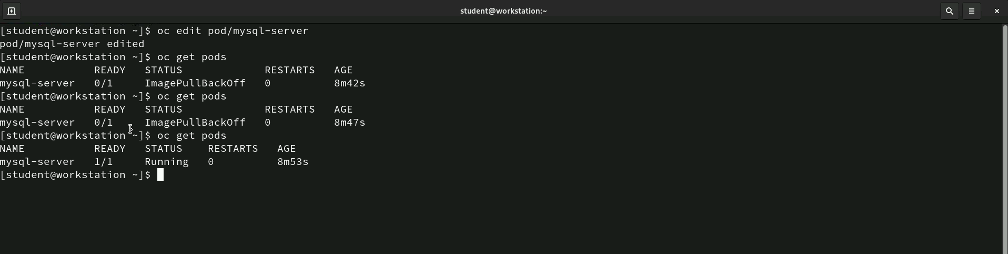
Commands for Inspecting Image Metadata
oc edit pod/mysql-server: This command opens the YAML file for the mysql-server pod in an editor, allowing the user to manually edit the pod’s configuration. After making changes and saving the file, the pod is updated.
oc get pods: After the pod was edited, the status of the mysql-server pod is checked. The pod is still in the ImagePullBackOff state, which means the system is still having issues pulling the image. Finally, the status is checked again, and the pod has successfully transitioned to the Running state, meaning the image was successfully pulled and the pod is now fully operational.

Slide 42
Commands for resolving ImagePullBackOff State by Editing Pod Configuration
oc edit pod/mysql-server: This command opens the YAML file for the mysql-server pod in an editor, allowing the user to manually edit the pod’s configuration. After making changes and saving the file, the pod is updated.
oc get pods: After the pod was edited, the status of the mysql-server pod is checked. The pod is still in the ImagePullBackOff state, which means the system is still having issues pulling the image. Finally, the status is checked again, and the pod has successfully transitioned to the Running state, meaning the image was successfully pulled and the pod is now fully operational.

Slide 43
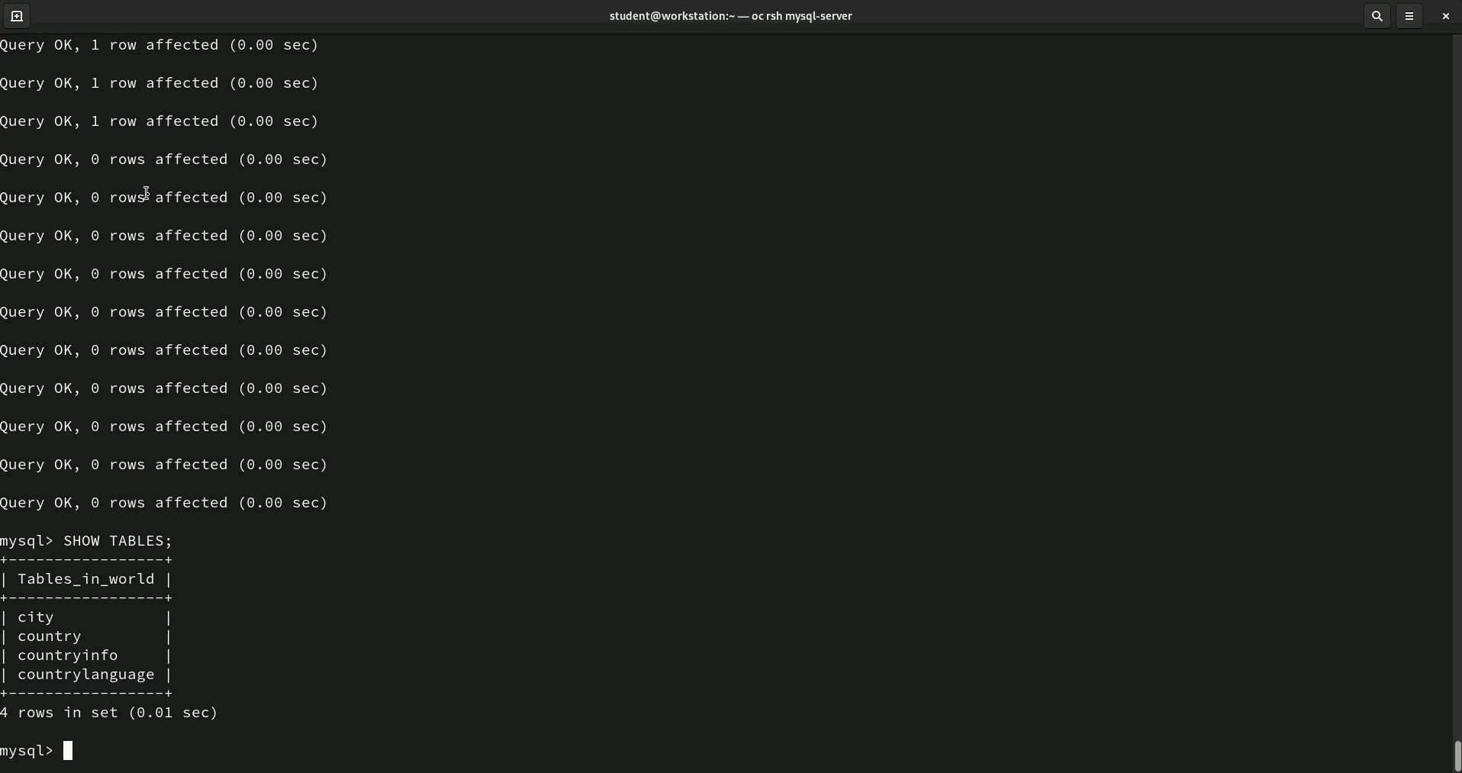
Commands for accessing and listing tables. Using oc rsh
oc rsh mysql-server: This command provides remote shell access to the pod.
Query Execution: Multiple SQL queries appear have been executed. The SQL command SHOW TABLES has been executed within a MySQL database. The list of tables in the database world is displayed.

Slide 44
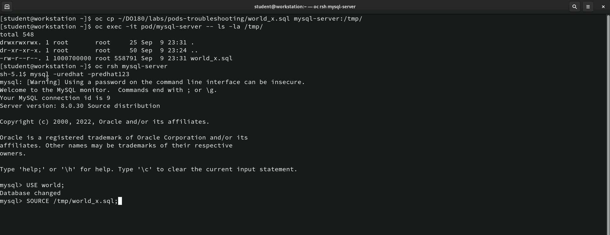
Commands for accessing and listing tables. Using oc rsh
oc cp ~/DO180/labs/pods-troubleshooting/world_x.sql mysql-server:/tmp/: This command copies the file world_x.sql from the local workstation to the /tmp/ directory of the mysql-server pod.
oc exec -it pod/mysql-server -- ls -la /tmp/: This command lists the contents of the /tmp/ directory in the mysql-server pod to confirm that the world_x.sql file was copied successfully.
oc rsh mysql-server: This command opens a remote shell session inside the mysql-server pod, allowing the user to interact with the MySQL database from within the pod.
MySQL Shell (mysql -u redhat -predhat123): Logged into MySQL using credentials and executed some commands.

Slide 45
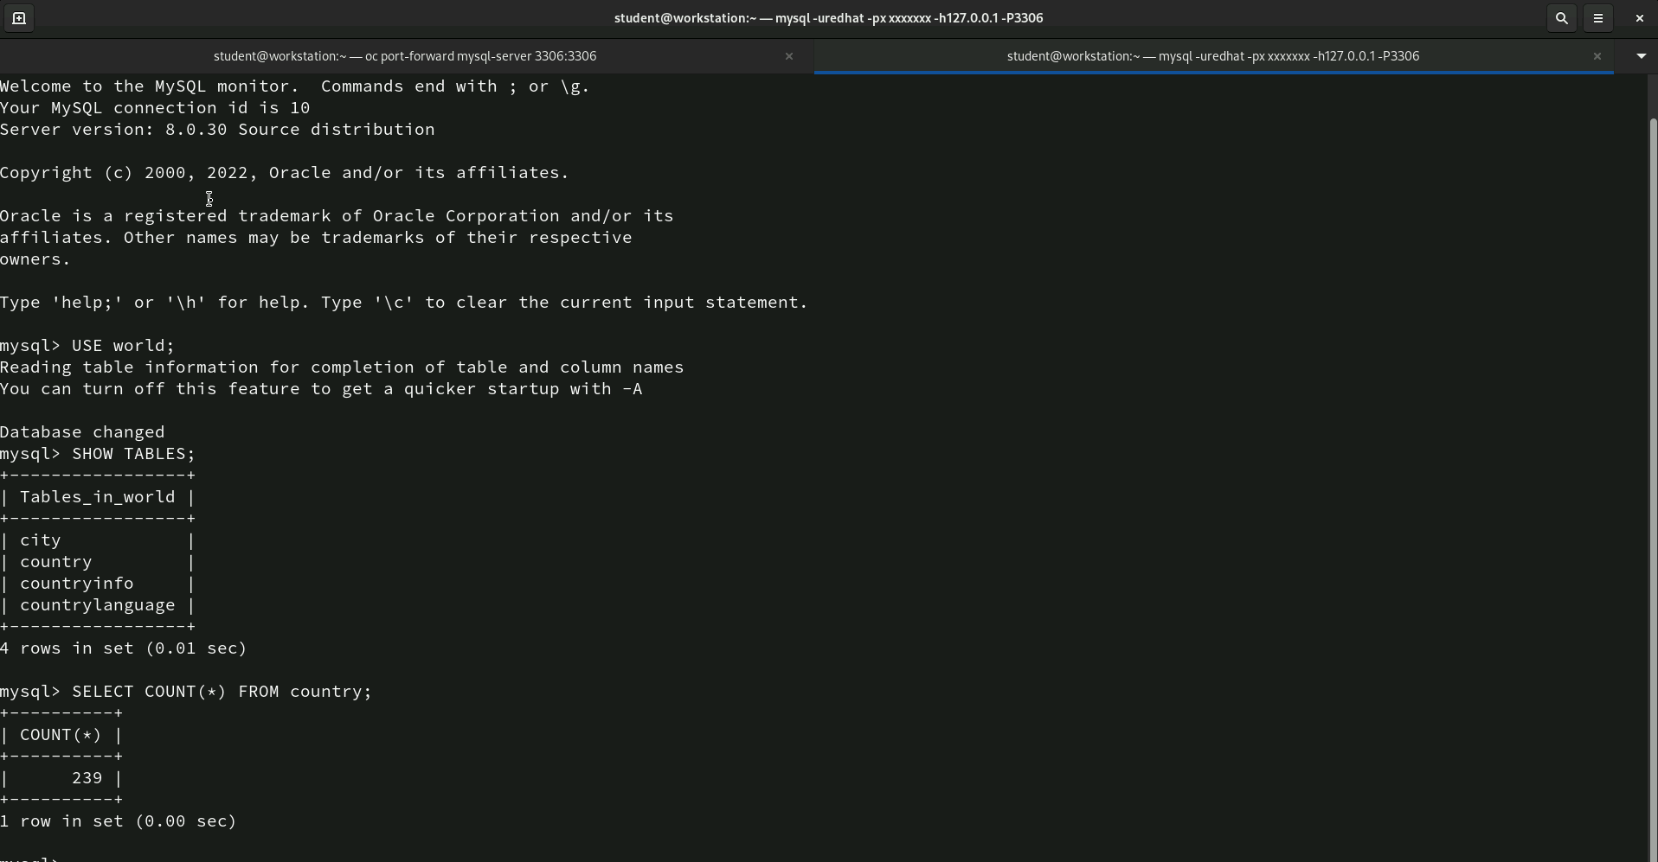
Commands for quering the database
The user has logged into MySQL, selected the world database, and listed the tables within it. The query to count the entries in the country table shows that there are 239 records. This confirms that the data from the world_x.sql file was successfully loaded and is now accessible for queries.

Slide 46
Thank You!

