Slide 1
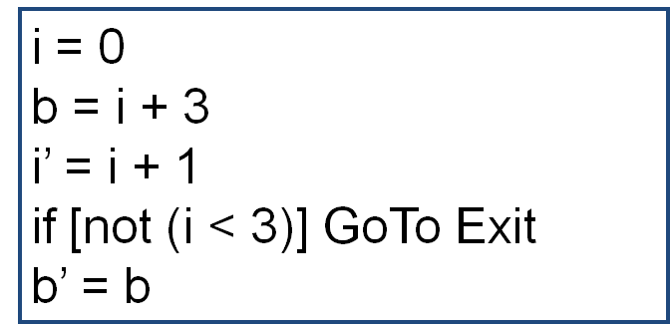

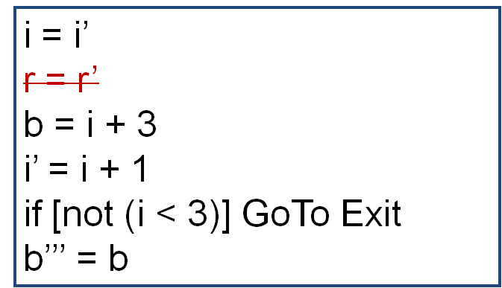
Entry
Y
r = 0
c = b’ + r
r’ = b’ + c
Z
Y
r = r’
c = b’‘ + r
r’ = b’’ + c
Z
r = r’
c = b’’’ + r
Y
Z
r’ = b’’’ + c
GoTo X

