Slide 1
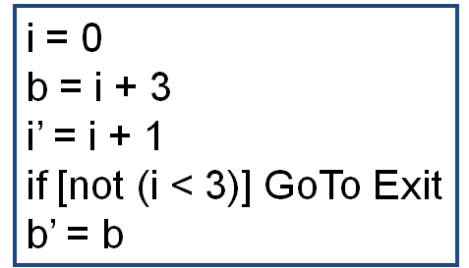
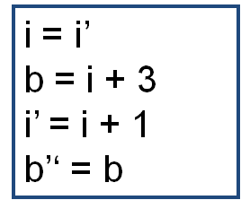
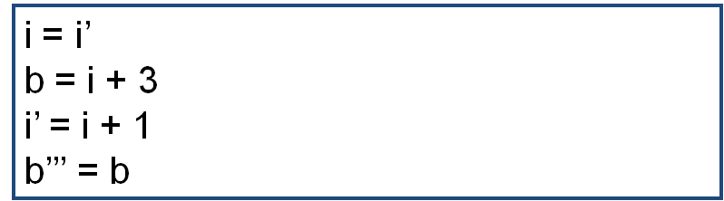
Entry
r = 0
c = b’ + r
r’ = b’ + c
if [not (i < 3)] GoTo Exit
r = r’
c = b’‘ + r
r’ = b’’ + c
if [not (i < 3)] GoTo Exit
r = r’
c = b’’’ + r
r’ = b’’’ + c
GoTo X

