Slide 1
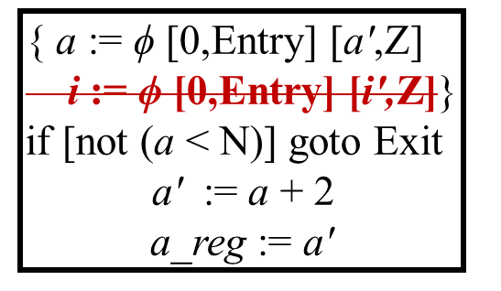
X₁
X₂
Y₁
c := i + 3
a_reg2 := a_reg
Y₂
i := i'
c := i + 3
a_reg2 := a_reg
Z₁
i' := a _reg2+ c
Z₂
i' := a _reg2+ c

