Slide 1
OPENING A
BAKERY
-Disha

Slide 2
Business problem
There are a lot of restaurants of various cuisines in this place. However it is observed that there is a lack of bakeries.
Therefore it is proposed to open a bakery called Delicious here. However this should be in a location where there are more young people and less number of other restaurants and bakeries.

Slide 3
Source and usage of data
To get the information various details like name of restaurant, pricing, rating is used. Also the two main API,s used are
-Zomato API
- Foursquare API
This will help us gather all information which also includes latitude and longitude

Slide 4
Data Cleaning
As we can see there is data asymmetry so the first task to be performed was data cleaning. This was done by matching places with the help of their longitude and latitude. This was done with the help of rounding up. After this all the outliers that were included in our dataset like parks, swimming pool, clothing stores were removed from our consideration set.

Slide 5
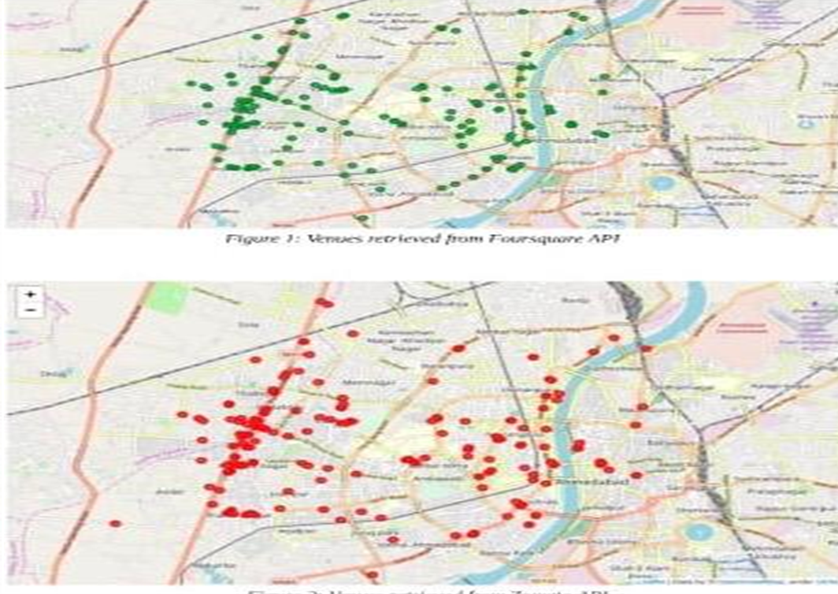

Slide 6
Data Model development and Methodology
In order to understand our competition we used rating and pricing of other restaurants. Places with 5km radius were chosen around the famous location and University. Zomato API was used to get the venue rating and the other API was used to get latitude and longitude.

Slide 7
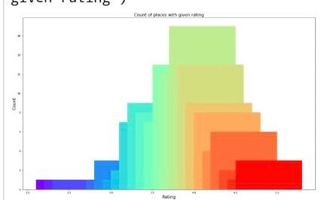
Identifying Places

Slide 8
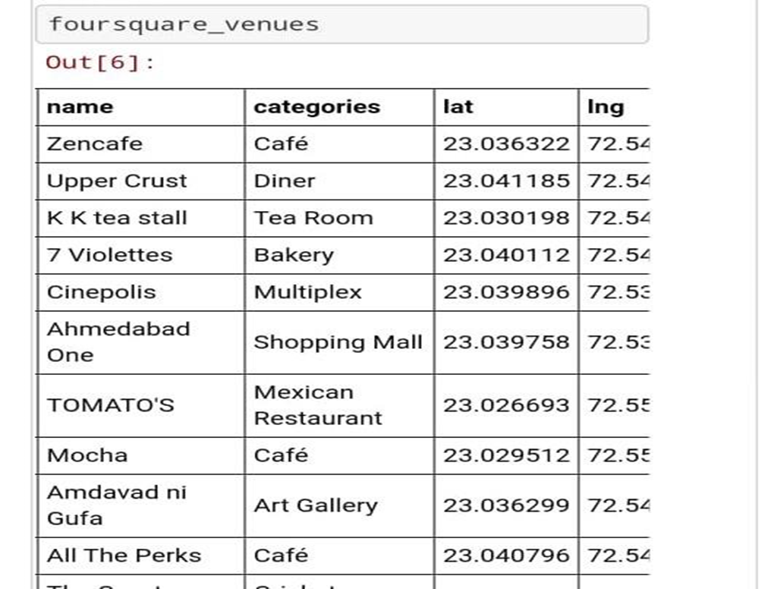

Slide 9
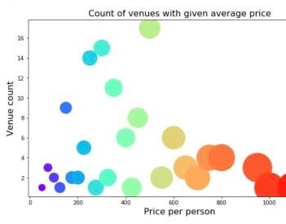
Studying the pricing per person of various places

Slide 10
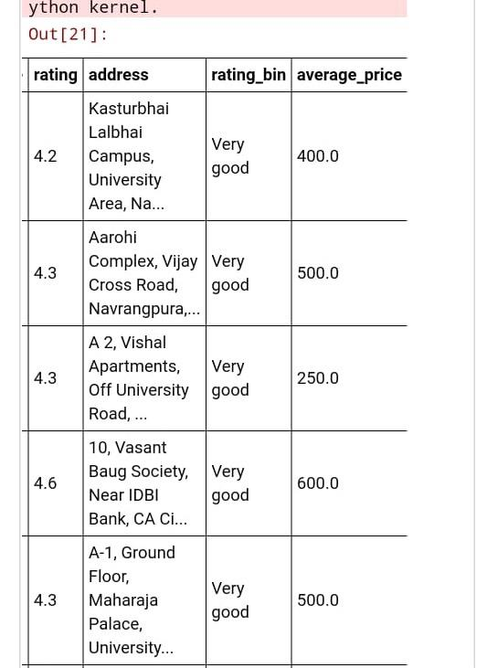

Slide 11
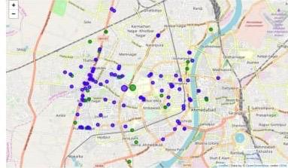
Use of K means
Finally K means was used to cluster the venues into different groups. The blue cluster has a low average rating and price range than the green cluster.

Slide 12
Result and conclusion
All the classification and clustering has revealed that we can locate our dessert place in this area but however keeping in view the competitors pricing we should ensure that the pricing should be around Rs.600 per person.

