Slide 1

A VOTING APP IN DJANGO FRAMEWORK
Conducting Elections and Polls
Student Name :
DISHA GOEL
Student ID :
STU61c6e098f0cc11640423576
College Name :
KIET Group of Institutions, Ghaziabad

Slide 2
CAPSTONE PROJECT SHOWCASE
Project Title
E-VOTING APP
Abstract | Problem Statement | Project Overview | Proposed Solution | Technology Used | Modelling & Results | Conclusion | Q&A

Slide 3
Abstract
1
Admin Interface: Administrators can manage the items available for voting, view voting results, and potentially moderate user voting activity.
2
Vote Counting: The system keeps track of the number of votes each item receives and displays the results to users.
3
Voting Interface: Users can view a list of items or options available for voting. Each item may have a corresponding vote button or form element that allows users to cast their vote.

Slide 4


Problem Statement
organization seeks to address the need for a straightforward online voting system through the development of a Django-based platform. The primary goal is to facilitate a user-friendly environment where participants can easily cast their votes among a predefined list of options, while administrators can efficiently manage the voting process.Using Django, a high-level Python web framework, the project intends to create an online voting platform that will enable safe, practical, and transparent voting procedures for a range of elections and surveys.

Slide 5

Project Overview
The project entails utilizing the well-liked Python web framework Django to create an online voting system. Voter registration, authentication, and involvement in a variety of elections and surveys will all be made possible by the platform. The creation of ballots, tracking results in real time, strong security features, improvements to accessibility, and an easy-to-use admin dashboard for effective management are some of the key features. Through the use of Django's features, this project aims to guarantee the integrity and transparency of electoral activities in the digital age, revolutionize voting, and encourage democratic participation.

Slide 6
Proposed Solution
User Authentication: Implement secure user authentication mechanisms to allow users to register, log in, and log out securely.
Voting Interface: Design an intuitive and accessible interface enabling users to view voting options and submit their preferences effortlessly.
Vote Counting: Develop robust algorithms to accurately tally votes for each option, ensuring transparency and reliability in the voting results.
Preventing Duplicate Votes: Incorporate measures to prevent users from submitting multiple votes for the same option, maintaining the fairness of the voting process.
Admin Management: Provide administrators with tools to manage voting options, monitor activity, and oversee the overall progress of the voting process.

Slide 7
Technology used
Django Framework: The projects are built using the Django web framework, a high-level Python web framework that encourages rapid development and clean, pragmatic design.
Python Programming Language: Python is the primary programming language used in these projects for backend development.
HTML, CSS, JavaScript: Knowledge of front-end technologies like HTML, CSS, and JavaScript is essential for developing user interfaces and interactive elements.
PostgreSQL Database: a lightweight relational database management system, for data storage.
Visual Studio Code: A code editor like Visual Studio Code is recommended for working on the projects.
Web Accessibility Standards: Projects aim to adhere to web accessibility standards to ensure the platform is accessible to all users, including those with disabilities.

Slide 9
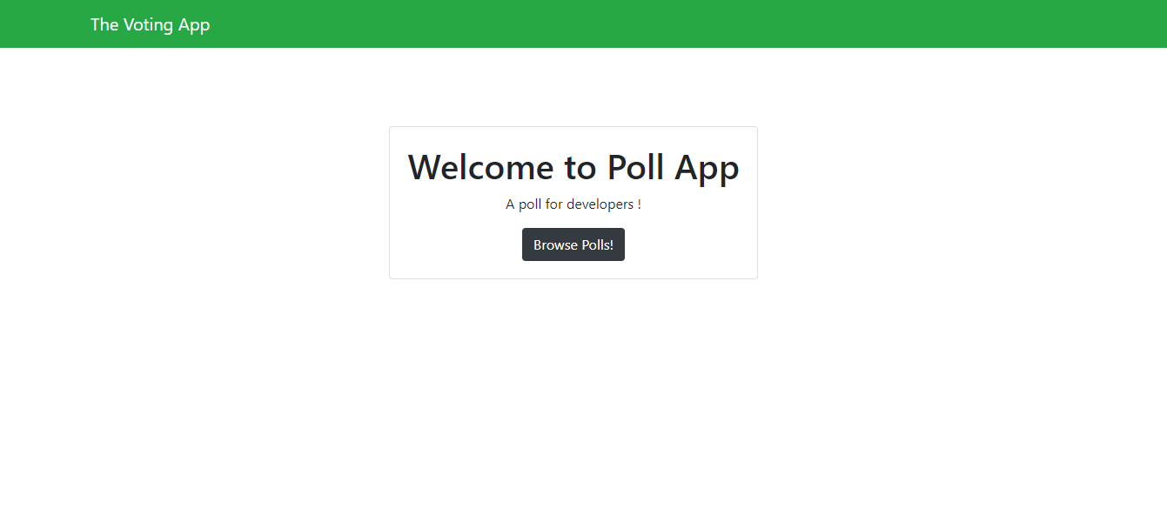

Slide 10
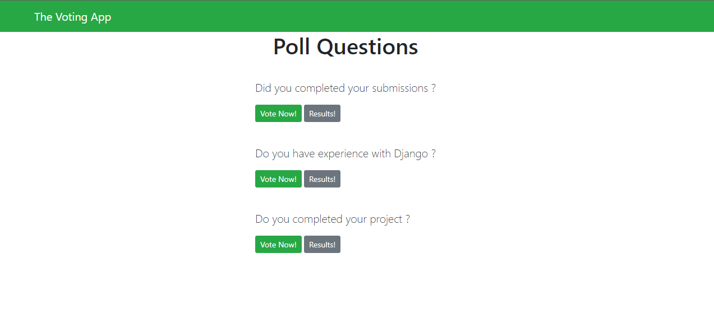

Slide 11
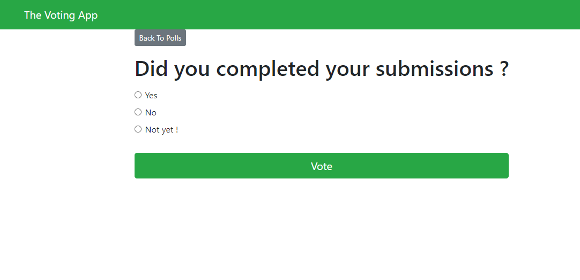

Slide 12
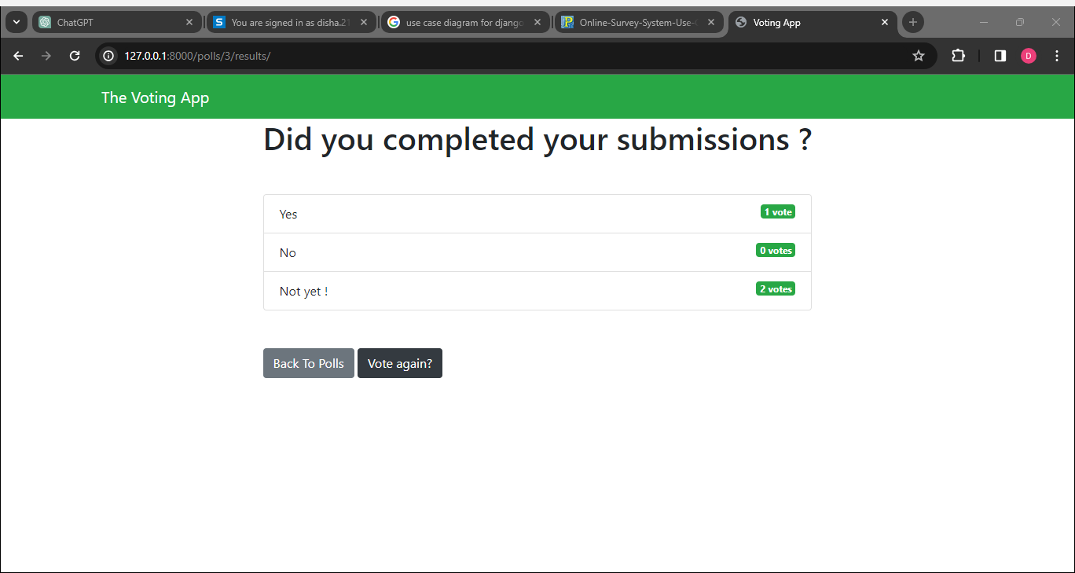
Modelling & Result

Slide 13
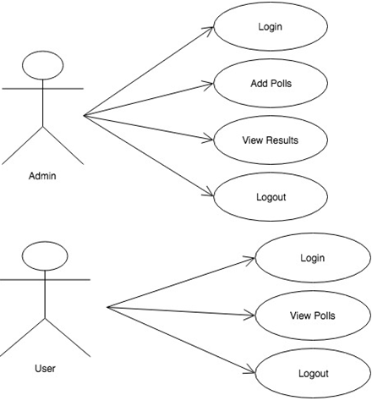
Modelling & Result

Slide 14

Conclusion
In conclusion, the Django-developed eVoting system provides a cutting-edge and effective platform for holding elections online. The election process is kept secret while maintaining transparency and accountability thanks to the system's user authentication, candidate registration, and streamlined election management features. Accessibility and system trust are improved by timely results publication, real-time updates on election progress, and candidate profiles. The e-Voting system advances democratic processes and improves civic engagement in the modern era by promoting stakeholder communication and upholding best practices in election administration.

Slide 15


Notes:
Thank You !!

