Slide 1
Solar Storm Prediction
Disha Sardana
Master’s Student
Department of Electrical and Computer Engg.
Virginia Tech

Slide 2
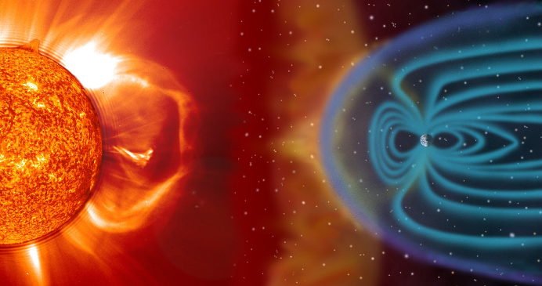
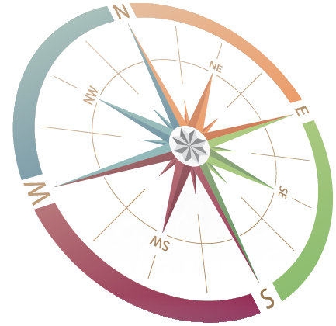
Problem Statement
Solar flares can produce strong x-rays that degrade or block high-frequency radio waves used for radio communication during events known as Radio Blackout Storms.
We thus predict the occurrence of solar storms based on Dst index over 16 years of publicly available dataset.

Slide 3
Data Description
The solar wind plasma and field measurements with 1 hour time resolution are obtained from the OMNI website: http://omniweb.gsfc.nasa.gov
OMNI data center provide average magnitude of interplanetary magnetic field IMF(nT), negative z-component of IMF Bz (nT), solar wind plasma number density n (cm⁻³) and the solar wind velocity V (km/s). All the field parameters are in Geocentric Solar Magnetospheric (GSM) coordinate system.
Hourly Dst indices are obtained from the world data center at the University of Kyoto database: http://wdc.kugi.kyoto-u.ac.jp/dstdir/index.html

Slide 4
Data Pre-processing
Input Values: The data from the OMNI data center needs no data pre-processing. There are no missing values or (####/ 9999) values. Normalization isn't needed since the input features' values are used as such to predict the Dst indices. The data is in .lst format, so no format conversions are needed as such.
Target Values: The data from Kyoto database is given in .dat format. It has to be converted to .csv format to use it in MATLAB code. Also, it has about 8-10 lines of text data after every month of data which needs to be cleaned. Apart from the data cleaning, there aren't any missing values or (#### / 9999) values. Normalization isn't needed here too.

Slide 5
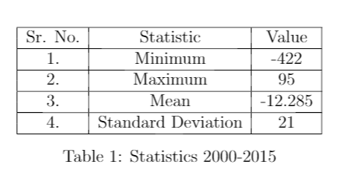
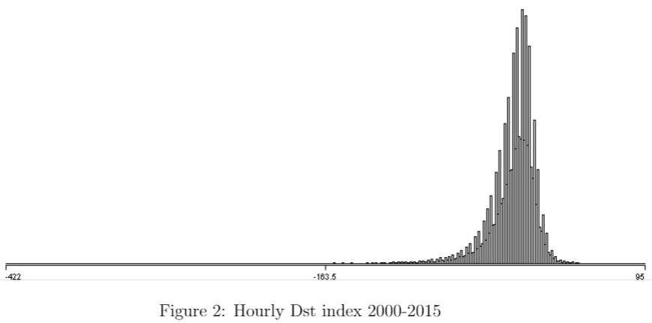
Data Exploration
Notes:
Using the Kyoto database, storms are identified on the basis on Dst index values. Those having Dst index less than -100 nT are identified as storms. Then these storms are classified on the basis of the year, month and their onset times using MATLAB. In total there are 91 storms and the whole solar cycle is covered. Figure 2 represents the hourly Dst index over the period 2000-2015 and is plotted using Weka. Figure 3,4,5 are the bar graphs showing the storm counts.(on next slide)

Slide 6
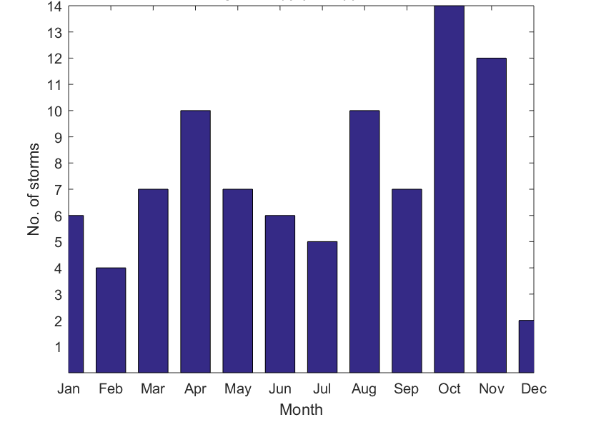
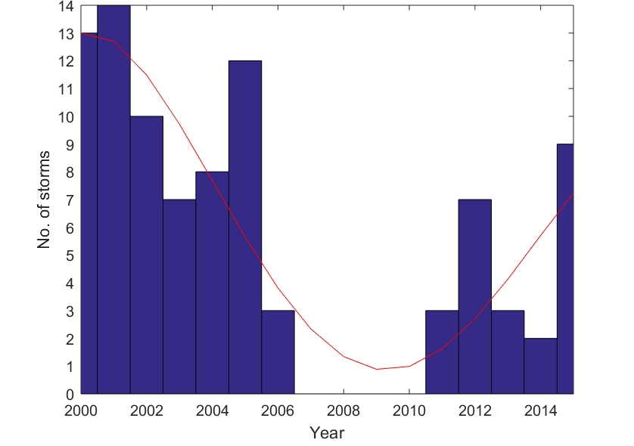
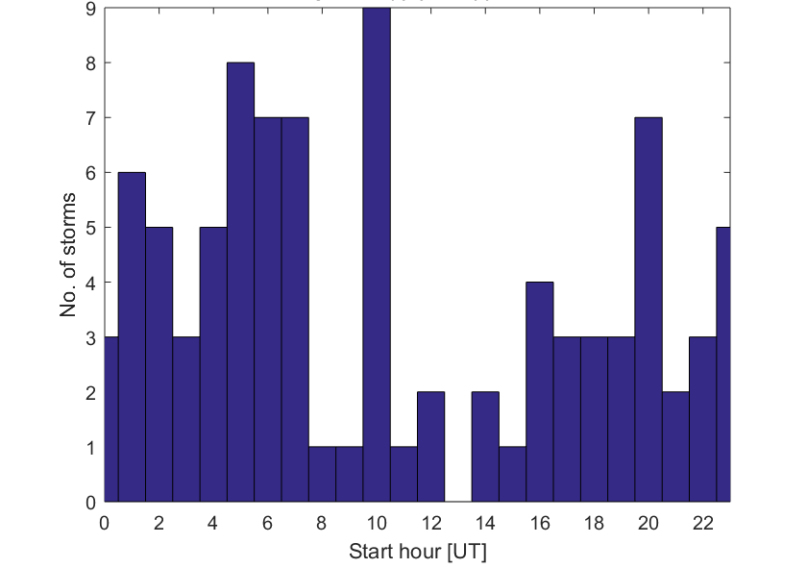
Data Exploration
The main idea is to identify a pattern on the month/ year/ onset times basis. It is observed that there are no storms from year 2007-2010, which ought to happen since that is a solar minimum phase.
Also it is observed that maximum number of storms happened in the month of Oct.

Slide 7
Model Building
The nonlinear autoregressive network with exogenous inputs (NARX) is a recurrent dynamic network, with feedback connections enclosing several layers of the network and is generally used in time-series prediction.
Training Algorithms
Levenberg-Marquardt is a popular alternative to the Gauss-Newton method of finding the minimum of a function that is a sum of squares of nonlinear functions.
Bayesian Regularization is a network training function that updates the weight and bias values according to Levenberg-Marquardt optimization. It produces a network that generalizes well.
SCG is a supervised learning algorithm for feedforward neural networks, and is a member of the class of conjugate gradient methods.

Slide 8
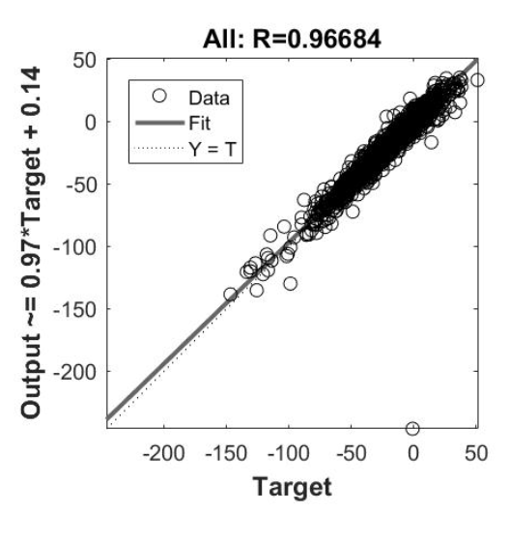
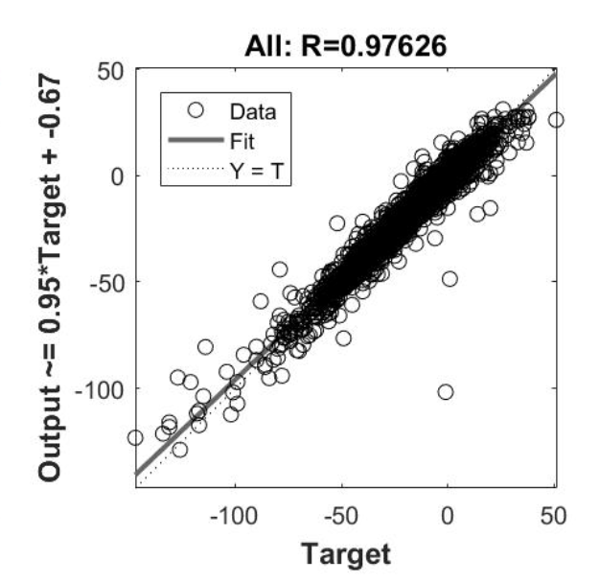
Model Evaluation
Our model is evaluated by computing MSE and Regression R-value by varying
number of hidden neurons ( 2, 4, 8 neurons)
the size of the dataset (1, 5, 10 and 16 years)
the number of features ( 4 vs 10 features)
Impact of varying features from 10 to 4:
Overall R-value increases from 0.96 to 0.97 and R-value of test improves from 0.89 to 0.97

Slide 9
Model Evaluation
Takeaways from MSE of test data
For Levenberg and Bayesian, MSE decreases as the number of neurons in the hidden layer increases.
SCG exhibits better performance with 2 neurons in hidden layer for 16 years and 10 years dataset
SCG for 5 years and 1 year dataset gives better performance with 4 neurons in hidden layer.
Takeaways from MSE of validation data
The pattern in MSE of validation data is similar to that of test data.
Levenberg converges faster and requires far lesser iterations even for larger datasets.
Bayesian takes more epochs to achieve the same MSE as Levenberg and is thus slower.
SCG is a little better than Bayesian in that it takes fewer epochs than Bayesian and is almost on par with Levenberg in terms of the number of epochs it takes in general.
Notes:
As can be seen from the table for MSE of test data , for Levenberg and Bayesian MSE decreases as the number of neurons in the hidden layer increases. On the contrary, SCG exhibits better performance with 2 neurons in hidden layer for 16 years and 10 years dataset whereas for 5 years and 1 year dataset 4 neurons in hidden layer gives better performance.
From the table of MSE for Validation data we observe that:

Slide 10
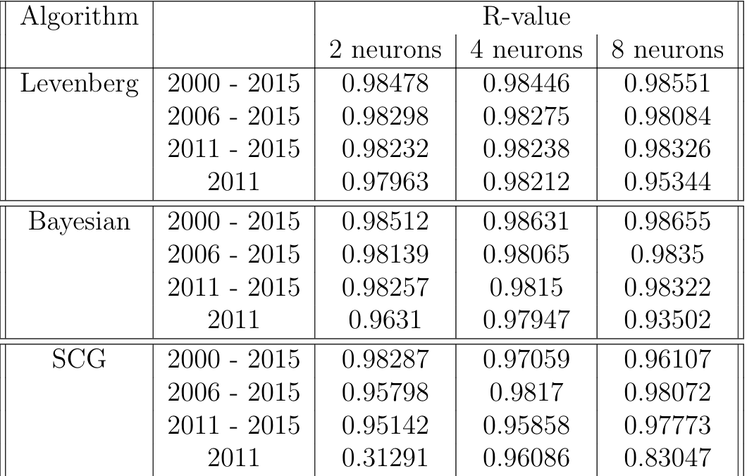
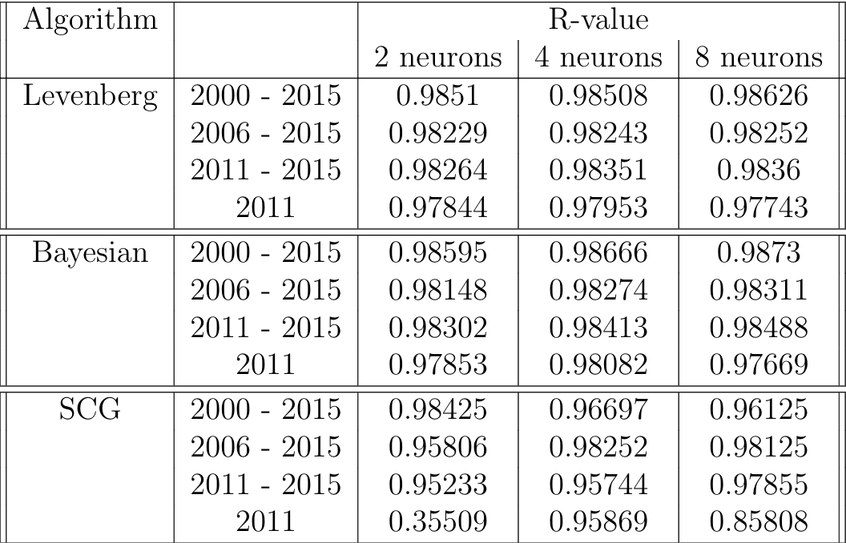
Model Evaluation
R-values: Test R-values: Overall
R-values are 0.98 for almost all the cases thus the model exhibits a strong correlation
Notes:
The R-values are 0.98 for almost all the cases.
Thus, our model exhibits a very strong correlation between predicted and actual values

Slide 11
Real-world Insights
There is a strong correlation between Dst index and the solar wind parameters.
Different types of space weather can affect different technologies on Earth.
Solar Energetic Particles (energetic protons)can penetrate satellite electronics and can cause electrical failure.
Our model predicts the Dst index with an R-value of 0.98 , therefore, we can identify the presence of a storm with high confidence.
Thus, necessary precautions can be taken and millions of dollars can be saved in terms of technology and communication failures.

Slide 12
Lessons Learned
We explored NARX model and learned about 3 different training algorithms that can be used in this model.
Our understanding about solar storms and their impact on the real-world was further enhanced.
Most of the current implementations make use of ANN but none of them have used NARX for DST index prediction.
Given another chance, we would try predicting storms on the basis of other indices too like Kp, AE and ap, therefore, giving better estimate of predicting a storm.
Instead of doing a binary classification, 0 : no storm &1 : storm, we would have made it a multi-class label problem i.e intense storms (Dst < −100 nT), moderate storms (−100 nT <Dst <−50 nT) and weak storms (Dst >−50 nT).

