Slide 1
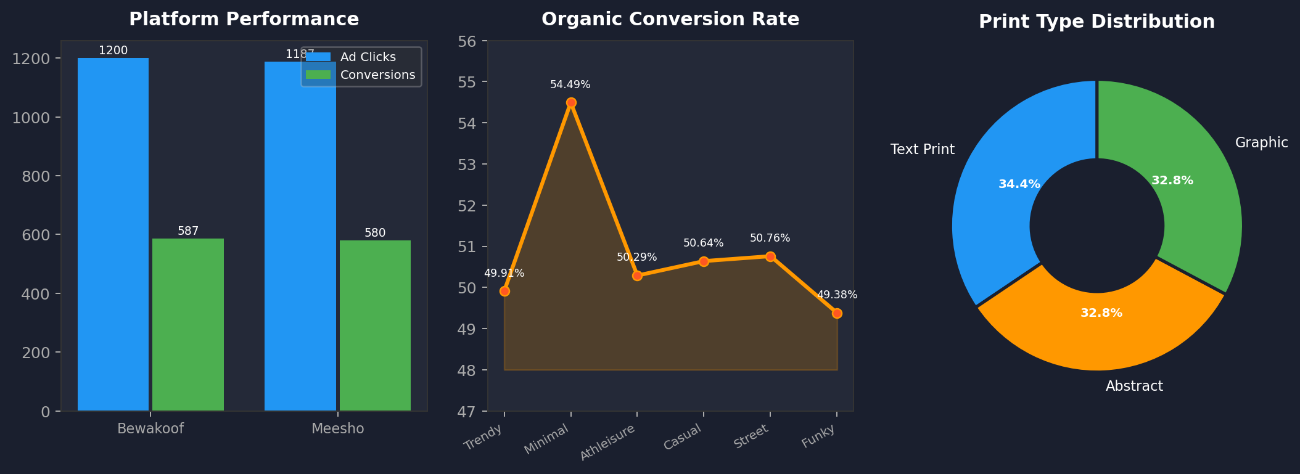

AD EFFECTIVENESS & WASTAGE DETECTION
Where Ads Work and Where Money Burns

Slide 2
    This case study contains 2 tables.
Customers Table: Contains demographic and acquisition details such as age, city, platform, and ad interaction before first purchase.
Orders Table: Captures transaction-level data including purchase behavior, platform performance, and order outcomes.
Case Study

Slide 3
Objectives
Identify where ad spend is generating conversions.
Detect platforms and segments with wasted ad spend.
Distinguish between paid vs organic performance.
Reduce acquisition cost while improving conversions

Slide 4
Strategic Questions for Reducing Ad Wastage
Which platforms have high ad clicks but low conversion rate?
Which cities generate high ad clicks but low delivered orders?
Which customer segments convert without ads?
Which ad-driven customers never purchase again?
Which print types require ads but still underperform?

Slide 5
Platforms with High Ad Clicks but Low Conversion Rate
Both Meesho (1,187) and Bewakoof (1,200) recorded high ad clicks but conversions stayed significantly lower at 580 and 587.
Conversion rates of 48.86% and 48.92% indicate that majority of clicks are not turning into purchases.
This pattern signals clear ad budget wastage on both platforms due to poor post-click conversion.

Slide 6
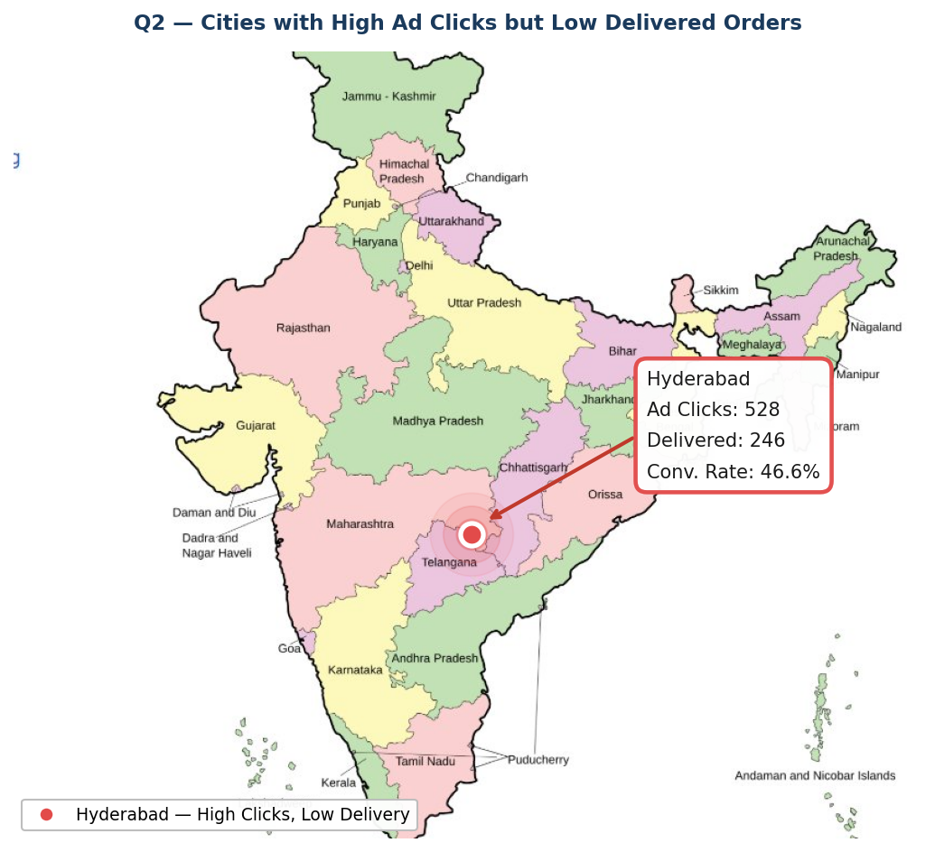
High Ad Clicks but Low Deliveries Indicate City-Level Ad Inefficiency
Out of 14 cities, only Hyderabad recorded high ad clicks (528) but low delivered orders (246), resulting in a conversion rate of just 46.6%

Slide 7
Funky style starts with the highest conversion rate (~52.2%) despite having fewer total orders (480), making it the strongest organic converter.
Casual style has the lowest conversion rate (~49.2%) with only 238 delivered orders, making it the weakest organic performer among all styles.

Slide 8
Customer segments converting without ads
(By Signup Platform)
SouledStore leads with the highest organic conversion rate (~54.7%) while Bewakoof performs the weakest at just (~47.6%) among all signup platforms.

Slide 9
Ad-Driven Customers Who Never Purchased Again
Total One-Time Buyers:
122
A total of 122 ad-driven customers made only one purchase and never returned, with the highest drop-off among customers who clicked 2 ads (23) and 6 ads (22) before their first purchase.

Slide 10
All three print types — Text Print (48.13%), Abstract (49.14%), and Graphic (49.32%) — fall below the average conversion rate of 49.5% despite high ad orders, indicating clear ad spend wastage across all print categories.

