Slide 1
Implementation of Custom Routing Algorithm in Cloud
By
Disha Bhattacharya
Biswajeet Chakraborty
Palash Dey
Ananya Laha

Slide 2
Basic Idea
Algorithm for distributing data to all nodes in a network based on the concept of percolation centrality (PC) or betweenness centrality (BC).
Enhancement of the controlled flooding algorithm
Adding concept of percolation centrality (Connectivity of nodes)

Slide 3
Purpose
The purpose of the routing algorithm is to make decisions for the router concerning the optimal paths for data distribution. The router uses the routing algorithm to get the path that would best serve to transport the data throughout the network.
The routing algorithm that our protocol uses is a major factor in the performance of our routing environment.
We check our algorithm by using Percolation Centrality, whether the highest PC node can deliver the packet, the fastest.

Slide 4
Broadcasting
Message is destined to all network devices
Most straightforward way: N-way-unicast : Needs no new network-layer routing protocol or forwarding functionality.
Broadcast Algorithms:
1. Uncontrolled Flooding
2. Controlled Flooding
3. Spanning tree Broadcast

Slide 5
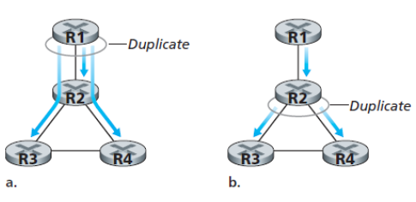
Broadcasting
Source duplication vs in-network duplication

Slide 6
Brief Description
Similar to the controlled flooding algorithm
Enhance the flooding algorithm using the concept of percolation centrality
Send a message that percolates via the nodes of the network
Time taken will be the least by using the concept of percolation centrality

Slide 7


Implementation
Tech Stack:

Slide 8
Algorithm Implementation
Algorithm 1
To start routing from node with highest Betweenness Centrality
procedure
graphPC = descending_PercCentrality(G)
for i <- 0, n-1 do
graphPC[i].MARK = False
for i <- 0, n-1 do
Call enhanced_flooding(graphPC[i])

Slide 9
Algorithm Implementation
Algorithm 2
Algorithm for controlled flooding mechanism
procedure enhanced_flooding(v)
if v.MARK = False then
v.MARK = True
Accept message in v
for each node k E v.adjacent() do
Call enhanced_flooding(k)
end for

Slide 10
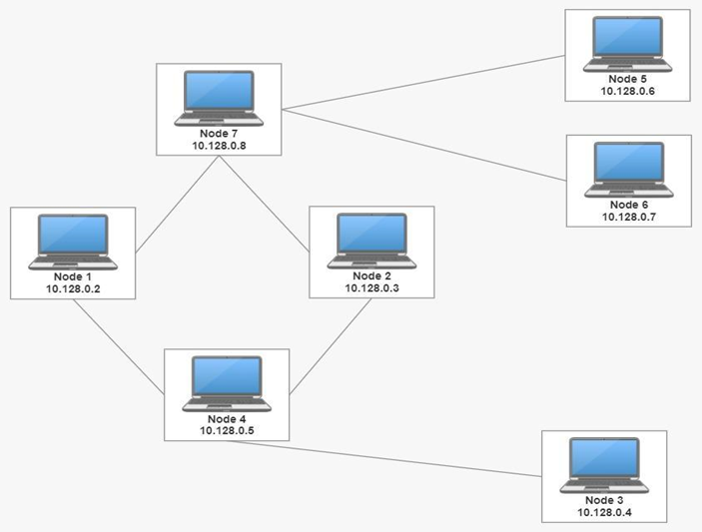
Network Formation

Slide 11
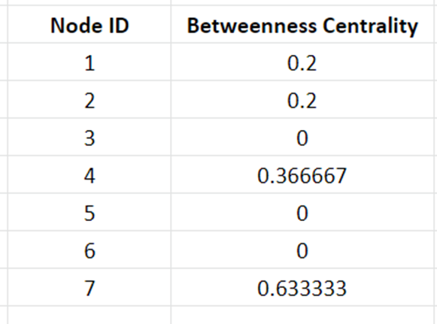
Betweenness Centrality of Nodes

Slide 12
Routing Starts From Node6 having lower Degree (Percolation Centrality)
Node5
10.128.0.6
Node7
10.128.0.8
0ms
Node6
10.128.0.7
Node1
Node2
10.128.0.2
10.128.0.3
Node4
10.128.0.5
Node3
10.128.0.4

Slide 13
Routing Starts From Node6 having lower Degree (Percolation Centrality)
Node5
1882ms
10.128.0.6
Node7
10.128.0.8
0ms
Node6
10.128.0.7
Node1
Node2
10.128.0.2
10.128.0.3
Node4
10.128.0.5
Node3
10.128.0.4

Slide 14
Routing Starts From Node6 having lower Degree (Percolation Centrality)
Node5
1882ms
10.128.0.6
Node7
10.128.0.8
0ms
3621ms
Node6
10.128.0.7
Node1
Node2
10.128.0.2
10.128.0.3
Node4
10.128.0.5
Node3
10.128.0.4

Slide 15
Routing Starts From Node6 having lower Degree (Percolation Centrality)
4346ms
Node5
1882ms
10.128.0.6
Node7
10.128.0.8
0ms
3621ms
Node6
10.128.0.7
Node1
Node2
10.128.0.2
10.128.0.3
Node4
10.128.0.5
Node3
10.128.0.4

Slide 16
Routing Starts From Node6 having lower Degree (Percolation Centrality)
4346ms
Node5
1882ms
10.128.0.6
Node7
10.128.0.8
0ms
3621ms
4363ms
Node6
10.128.0.7
Node1
Node2
10.128.0.2
10.128.0.3
Node4
10.128.0.5
Node3
10.128.0.4

Slide 17
Routing Starts From Node6 having lower Degree (Percolation Centrality)
4346ms
Node5
1882ms
10.128.0.6
Node7
10.128.0.8
0ms
3621ms
4363ms
Node6
10.128.0.7
Node1
Node2
10.128.0.2
10.128.0.3
5644ms
Node4
10.128.0.5
Node3
10.128.0.4

Slide 18
Routing Starts From Node6 having lower Degree (Percolation Centrality)
4346ms
Node5
1882ms
10.128.0.6
Node7
10.128.0.8
0ms
3621ms
4363ms
Node6
10.128.0.7
Node1
Node2
10.128.0.2
10.128.0.3
5644ms
Node4
8885ms
10.128.0.5
Node3
10.128.0.4

Slide 19
Routing Starts From Node7 having higher Degree (Percolation Centrality)
Node5
0ms
10.128.0.6
Node7
10.128.0.8
Node6
10.128.0.7
Node1
Node2
10.128.0.2
10.128.0.3
Node4
10.128.0.5
Node3
10.128.0.4

Slide 20
Routing Starts From Node7 having higher Degree (Percolation Centrality)
Node5
0ms
10.128.0.6
Node7
10.128.0.8
1171ms
Node6
10.128.0.7
Node1
Node2
10.128.0.2
10.128.0.3
Node4
10.128.0.5
Node3
10.128.0.4

Slide 21
Routing Starts From Node7 having higher Degree (Percolation Centrality)
Node5
0ms
10.128.0.6
Node7
10.128.0.8
1171ms
2292ms
Node6
10.128.0.7
Node1
Node2
10.128.0.2
10.128.0.3
Node4
10.128.0.5
Node3
10.128.0.4

Slide 22
Routing Starts From Node7 having higher Degree (Percolation Centrality)
2508ms
Node5
0ms
10.128.0.6
Node7
10.128.0.8
1171ms
2292ms
Node6
10.128.0.7
Node1
Node2
10.128.0.2
10.128.0.3
Node4
10.128.0.5
Node3
10.128.0.4

Slide 23
Routing Starts From Node7 having higher Degree (Percolation Centrality)
2508ms
Node5
0ms
10.128.0.6
Node7
10.128.0.8
2561ms
1171ms
2292ms
Node6
10.128.0.7
Node1
Node2
10.128.0.2
10.128.0.3
Node4
10.128.0.5
Node3
10.128.0.4

Slide 24
Routing Starts From Node7 having higher Degree (Percolation Centrality)
2508ms
Node5
0ms
10.128.0.6
Node7
10.128.0.8
2561ms
1171ms
2292ms
Node6
10.128.0.7
Node1
Node2
10.128.0.2
10.128.0.3
3670ms
Node4
10.128.0.5
Node3
10.128.0.4

Slide 25
Routing Starts From Node7 having higher Degree (Percolation Centrality)
2508ms
Node5
0ms
10.128.0.6
Node7
10.128.0.8
2561ms
1171ms
2292ms
Node6
10.128.0.7
Node1
Node2
10.128.0.2
10.128.0.3
3670ms
Node4
5717ms
10.128.0.5
Node3
10.128.0.4

Slide 26
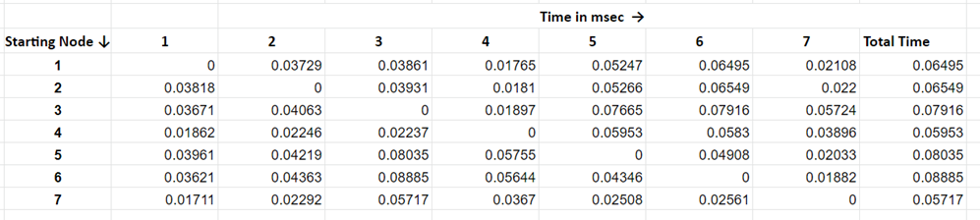
Observation
Time taken for distribution:

Slide 27
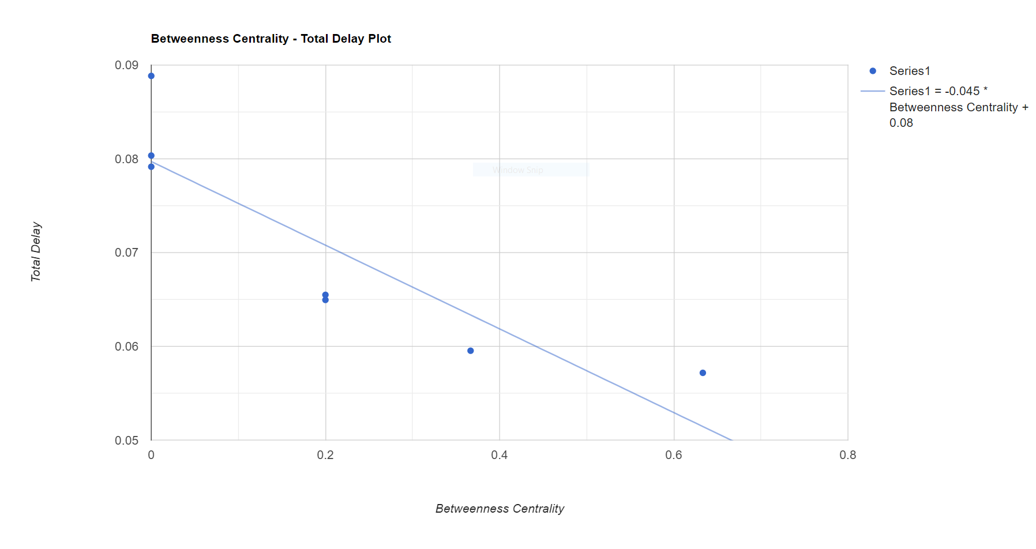
Betweenness Centrality vs. Total Delay

Slide 28
Conclusion
It can be concluded from the scatter plot that the node having higher value of betweenness centrality will distribute the data/file in lesser time than the one having lower value of betweenness centrality.

Slide 29
Future Scope
Introduction of automation to minimize the number of manual steps to run the scripts for each routing.
Distributing resources with complex format.

Slide 30
Thank You

