Slide 1
SORTING

Slide 2
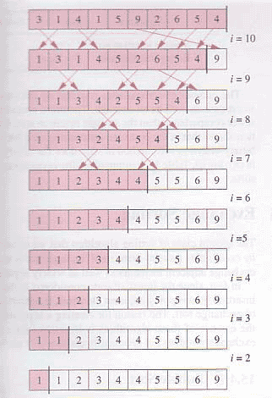
Working of Bubble Sort

Slide 3
Bubble sort
for(int x=0; x<n; x++) {
for(int y=0; y<n-x; y++) {
if(array[y] > array[y+1]) {
int temp = array[y+1];
array[y+1] = array[y];
array[y] = temp;
}
}
}

Slide 4
Working of Selection Sort
64 25 12 22 11
11 25 12 22 64
11 12 25 22 64
11 12 22 25 64

Slide 5
Selection Sort
for(int x=0; x<n; x++) {
int index_of_min = x;
for(int y=x; y<n; y++) { if(array[index_of_min]>array[y]) { index_of_min = y;
}
}
int temp = array[x];
array[x] = array[index_of_min]; array[index_of_min] = temp;
}

Slide 6
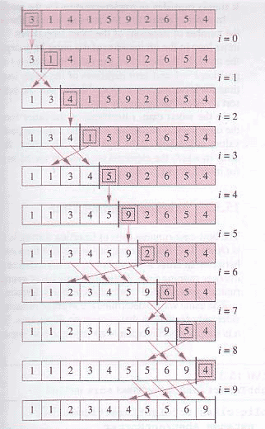
Working of insertion sort

Slide 7
Insertion Sorting
For (j=1 ;j< length(A);j++){
key=A[j];
i=j-1;
while(i>=0 and A[i]>key){
A[i+1] = A[i];
i=i-1;
}
A[i+1]=key;
}

Slide 8
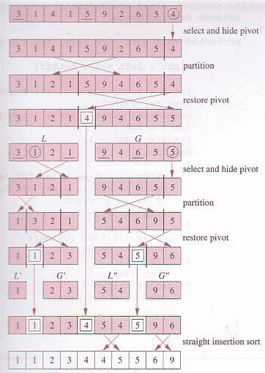
Working of Quick sort

Slide 9
Quick Sort
Algorithm QuickSort(Arr, up, down){
if(up < down) {
pivotIndex = partition(Arr, up, down);
QuickSort(Arr, up, pivotIndex-1);
QuickSort(Arr, pivotIndex+1, down);
}

Slide 10
Algorithm partition(Arr, startIndex, LastIndex){
up = startIndex;
pivot = Arr[up];
down = LastIndex;
do{
do {
up++;
}while(Arr[up] < pivot);
while(Arr[down ] >= pivot && up <= down);
{
down--;
}
if(up < down)
swap(Arr[up], Arr[down]);
}while(up < down);
swap(Arr[down],Arr[startIndex]);
return down;
}

Slide 11
Performance Analysis
1.Balanced partition
2T(n/2)+ O(n)
a=2; b=2; d(n)=n so d(b)=2;
H.S T(n) = O(n)
P.S T(n) = O(nlogn)
2. Unbalanced partition
T(n) = T(n-1) + O(n)
T(n) = O(n²)

Slide 12
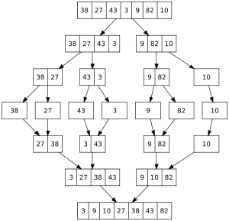
Working of Merge Sort

Slide 13
Algorithm Merge_Sort(low, high)
{
if(low < high)
{
mid = (low + high) / 2;
Merge_Sort(low, mid);
Merge_Sort(mid+1, high);
Merge(low, mid, high);
}

Slide 14
Contd …
Algorithm Merge(low, mid, high)
{
h = low;
i = low;
j = mid + 1;
while(h <= mid && j <= high) {
if(a[h] <= a[j]) {
b[i] = a[h];
h++;
}
else {
b[i] = a[j];
j++;
}
i++;
}
If(h > mid)
{
for k=j to high {
b[i] = a[k];
i++;
}
}
else {
for k=h to mid {
b[i] = a[k];
i++;
}
}
for k=low to high
a[k] = b[k];
}

Slide 15
Heap Sort
void Heap_Sort(int arr[], int size)
{
Build_Heap(arr, size);
for(; size>0; size--)
{
swap(arr[size], arr[1]);
heapify(arr, 1, size-1);
}
}

Slide 16
Void Build_heap(int arr[], int size)
{
for(i=size/2; i>0; i--)
heapify(arr, i, size);
}
void heapify(int arr[], int i, int size) {
j=2*i;
while(j <= size) {
if(j+1 <=size)
if(a[j+1] < a[j])
j++;
if(a[i] <= a[j])
return;
swap(a[i], a[j];
i = j;
j = 2*i;
}
}

