Slide 1
Time complexity of algorithms
Dependency of
  the time it takes to solve a problem
  as a function of the problem dimension/size
Examples:
  Sorting a list of length n
  Searching a list of length n
  Multiplying a n×n matrix by an n×1 vector
Time to solve problem might depend on data
  Average-case time
  Best-case time
    data is well suited for algorithm (can’t be counted on)
  Worst-case time
    data is such that algorithm performs poorly (time-wise)
Worst-Case gives an upper bound as to how much time will be needed to solve any instance of the problem.

Slide 2
Example: N-by-N matrix, N-by-1 vector, multiply
(3 accesses, 1 add, 1 multiply)
Y = zeros(N,1);
for i=1:N
Y(i) = 0.0;
for j=1:N
Y(i) = Y(i) + A(i,j)*x(j);
end
end
initialize space, c₁N
initialize “for” loop, c₂N
Scalar assignment, c₃
initialize “for” loop, c₂N
c₄
N times
End of loop, return/exit, c₅
N times
End of loop, return/exit, c₅
Total = c₁N+c₂N+N(c₃+c₂N+N(c₄+c₅)+c₅)
= (c₂+c₄+c₅)N² + (c₁+c₂+c₃+c₅)N
= c₆N² + c₇N

Slide 3
Asymptotic Time complexity of algorithms
Dependency of
  the time it takes to solve a problem
  as a function of the problem dimension/size
but
  formula may only be valid for “large” problems
So, we keep track of “growth rates” of the computational workload as a function of problem dimension

Slide 4
Order, called “big O” notation
Given two functions, f and g, say that “f is of order g” if
  there is a constant c, and
  a value x₀
such that
So, apart from a fixed multiplicative constant, the function g is an
  upper bound on the function f
  valid for large values of its argument.
Notation: write to mean “f is of order g”.

Slide 5
Not equality,but “belongs to a class”
Recall that means that
  there is a constant c, and
  a value n₀
such that
The = sign does not mean equality!
It means that f is an element of the set of functions which are eventually bounded by (different) constant multiples of g.
Therefore, it is correct/ok to write

Slide 6
Big O: Examples
Example:
Note:
For all n, f is bounded above by 31g
Write
or

Slide 7
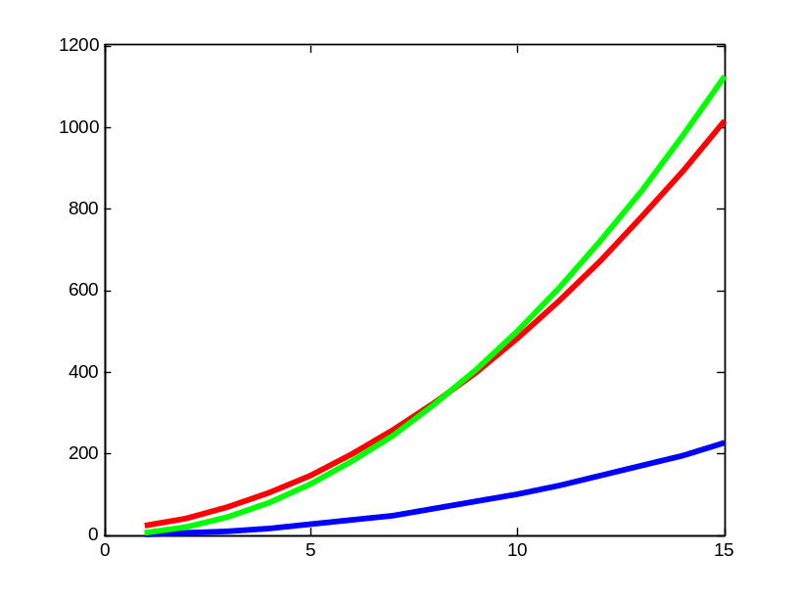
Big O: Examples
Example:
Note:
For large enough n
  f is bounded above by 5g
Write
or
or

Slide 8
Example: N-by-N matrix, N-by-1 vector, multiply
Y = zeros(N,1);
for i=1:N
Y(i) = 0.0;
for j=1:N
Y(i) = Y(i) + A(i,j)*x(j);
end
end
initialize space, c₁N
initialize “for” loop, c₂N
Scalar assignment, c₃
initialize “for” loop, c₂N
c₄
N times
End of loop, return/exit, c₅
N times
End of loop, return/exit, c₅
Total = c₆N² + c₇N
  Problem size affects (is, in fact) N
  Processor speed, processor and language architecture, ie., technology, affect c₆ and c₇
Hence, “this algorithm of matrix-vector multiply has O(N²) complexity.”

Slide 9
Time complexity familiar tasks
Task
  Matrix/vector multiply
  Getting a specific element from a list
  Dividing a list in half, dividing one halve in half, etc
  Binary Search
  Scanning (brute force search) a list
  Nested for loops (k levels)
  MergeSort
  BubbleSort
  Generate all subsets of a set of data
  Generate all permutations of a set of data
Growth rate
O(N²)
O(1)
O(log₂N)
O(log₂N)
O(N)
O(N^{k})
O(N log₂N)
O(N²)
O(2^{N})
O(N!)

