Slide 1

Doubly linked
Lists

Slide 2
Doubly-Linked Lists
It is a way of going both directions in a linked list, forward and reverse.
Many applications require a quick access to the predecessor node of some node in list.

Slide 3
Advantages over Singly-linked Lists
Quick update operations:
such as: insertions, deletions at both ends (head and tail), and also at the middle of the list.
A node in a doubly-linked list store two references:
  A next link; that points to the next node in the list, and
  A prev link; that points to the previous node in the list.

Slide 4
Doubly Linked List
A doubly linked list provides a natural implementation of the List ADT
Nodes store:
  element
  link to the previous node
  link to the next node
Special trailer and header nodes
prev
next
elem
node
header
nodes/positions
trailer
elements

Slide 5
Sentinel Nodes
To simplify programming, two special nodes have been added at both ends of the doubly-linked list.
Head and tail are dummy nodes, do not store any data elements.
Head: header sentinel has a null-prev reference (link).
Tail: trailer sentinel has a null-next reference (link).

Slide 6
What we see from a Douby-linked List?
A doubly-linked list object would need to store the following:
Reference to sentinel head-node;
Reference to sentinel tail-node; and
Size-counter that keeps track of the number of nodes in the list (excluding the two sentinels).

Slide 7
Empty Doubly-Linked List:
Using sentinels, we have no null-links; instead, we have:
head.next = tail
tail.prev = head
Singl Node List:
Size = 1
This single node is the first node, and also is the last node:
first node is head.next
last node is tail.prev
header
trailer
first
last
header
trailer
Dr Zeinab Eid

Slide 8
Insertion into a Doubly-Linked List
AddFirst Algorithm
To add a new node as the first of a list:
Algorithm addFirst()
new(T)
T.data ← y
T.next ← head.next
T.prev ← head
head.next.prev ← T {Order is important}
head.next ← T
Size++
This Algorithm is valid also in case of empty list.

Slide 9
Insertion into a Doubly-Linked List (Cont.)
AddLast Algorithm
To add a new node as the last of list:
Algorithm addLast()
new(T)
T.data ← y
T.next ← tail
T.prev ← tail.prev
tail.prev.next ← T {Order is important}
tail.prev ← T
Size++
This Algorithm is valid also in case of empty list.

Slide 10
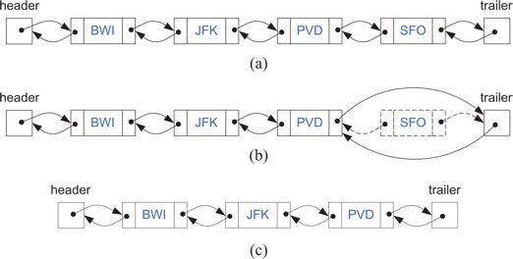
Removal from a Doubly-Linked List
RemoveLast Algorithm
Notice that before removal, we must check for empty list. If not, we will remove the last node in the list, as shown in Figure above.

Slide 11
Algorithm removeLast()
If size = 0 then output “error”
else { T ← tail.prev
y ← T.data
T.prev.next ← tail
tail.prev ← T.prev
delete(T) {garbage collector}
size--
return y
}
This algorithm is valid also in case of a single node, size=1, in which case we’ll get an empty list.

Slide 12
Insertion
We visualize operation AddAfter(p, X), which returns position q
p
A
B
C
p
A
B
q
C
X
p
q
A
B
X
C

Slide 13
Insertion Algorithm
Algorithm insertAfter(p,e):
Create a new node v
v.setElement(e)
v.setPrev(p) {link v to its predecessor}
v.setNext(p.getNext()) {link v to its successor}
(p.getNext()).setPrev(v) {link p’s old successor to v}
p.setNext(v) {link p to its new successor, v}
return v {the position for the element e}

Slide 14
Deletion
We visualize remove(p), where p = last()
p
A
B
C
D
A
B
C
p
D
A
B
C

Slide 15
Deletion Algorithm
Algorithm remove(p):
t = p.element {a temporary variable to hold the return value}
(p.getPrev()).setNext(p.getNext()) {linking out p}
(p.getNext()).setPrev(p.getPrev())
p.setPrev(null) {invalidating the position p}
p.setNext(null)
return t

Slide 16
Performance
In the implementation of the List ADT by means of a doubly linked list
  The space used by a list with n elements is O(n)
  The space used by each position of the list is O(1)

