Slide 1
Knapsack problem

Slide 2
We are given n objects and a knapsack or bag.
Object i has a weight wi.
Knapsack has a capacity m.
If a fraction xi, 0<= xi <= 1, of object i is placed into the knapsack, then a profit pi.xi is earned.
The objective is to obtain a filling of knapsack that maximizes the total profit earned.
Since the knapsack capacity is m, we require total weight of all chosen object to be at most m.

Slide 3
Consider the following instance of the knapsack problem: n=3; m=20; (p1, p2, p3) = (25, 24, 15) and (w1, w2, w3) = (18, 15, 10)
Four feasible solution are:
(x1, x2, x3) Σ wi.xi Σ pi.xi
(1/2, 1/3, 1/4) 16.5 24.25
(1, 2/15, 0) 20 28.2
(0, 2/3, 1) 20 31
(0, 1, 1/2) 20 31.5

Slide 4
Algorithm
Algorithm GreedyKnapsack(m, n)
/* p[1:n] and w[1:n] contains the profits and weights respectively of the n objects ordered such that p[i]/w[i] >= p[i+1]/ w[i+1]. m is the knapsack size and x[1:n] is the solution vector. */
{
for i=1 to n do x[i] = 0.0;
u = m;
for i=1 to n do
{
if(w[i] > u) then break;
x[i] = 1; u = u – w[i];
}
if(i < n) then x[i] = u/ w[i];
}

Slide 5
Optimal Storage on Tapes
There are n programs that are to be stored on a computer tape of length l.
Associated with each program i is a length li, 1<=i<=n.
We assume that whenever a program is to be retrieved from this tape, the tape is initially positioned at the front.
If all programs are retrieved often, then the expected or mean retrieval time (MRT) is (1/n)Σ_{1<= j <=n} t _{j}.
We are required to find a permutation for the n programs so that when they are stored on the tape in this order the MRT is minimized.

Slide 6
Example
Let n=3 and (l1, l2, l3) = (5, 10, 3).
Ordering I d(I)
1, 2, 3 (5)+(5+10)+(5+10+3) = 38
1, 3, 2 (5)+(5+3)+(5+3+10) = 31
2, 1, 3 10+10+5+10+5+3 = 43
2,3,1 10+10+3+10+3+5 = 41
3,1,2 (3)+(3+5)+(3+10+5) = 29
3,2,1 3+3+10+3+10+5 = 34

Slide 7
Algorithm

Slide 8
Job Sequencing with Deadlines
Given a set of n problems associated with job i is an integer deadline >=0 and a profit > 0.
For any job i the profit pi is earned iff the job is completed by its deadline.
To complete a job, one has to process the job on a machine for one unit of time.
Only one machine is available for processing.
A feasible solution for this problem is a subset J of jobs such that each job in this subset can be completed by its deadline.
An Optimal solution is a feasible solution with maximum profit value.

Slide 9
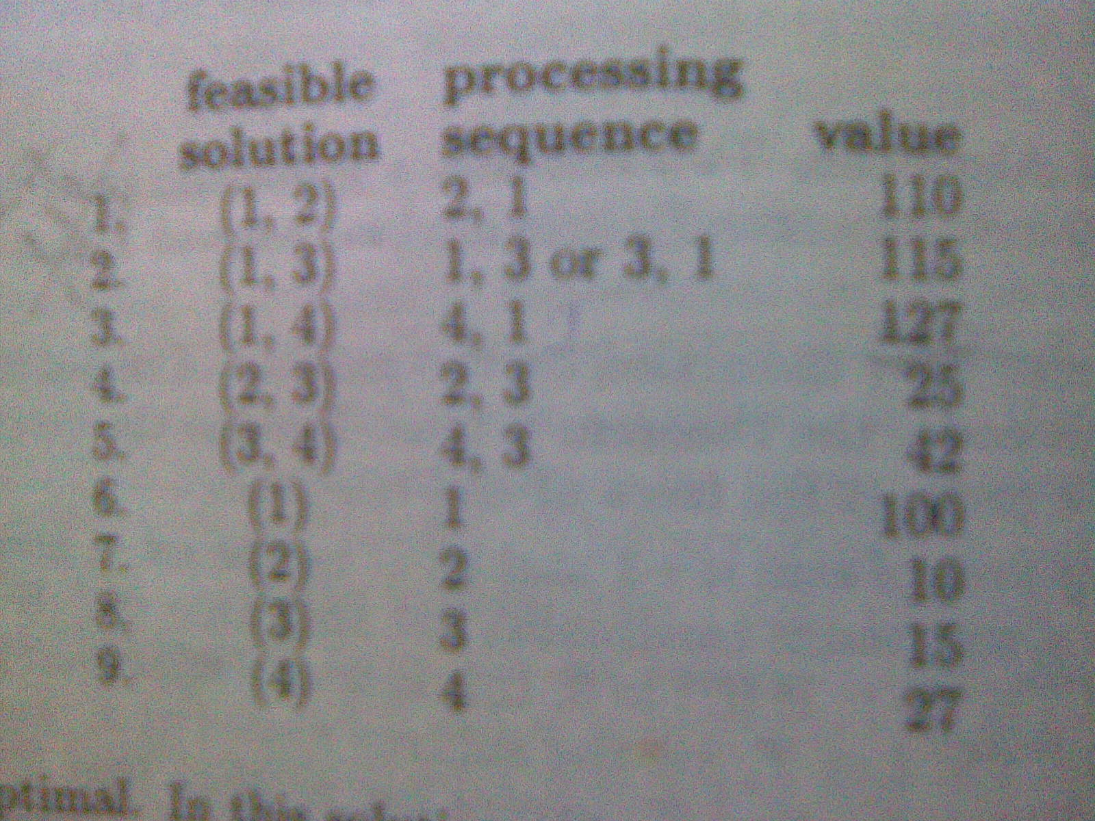
Example
Let n=4, (p1, p2, p3, p4) = (100, 10, 15, 27) and
(d1, d2, d3, d4) = (2, 1, 2, 1). The feasible solutions are:

Slide 10
Dijkstra’s Algorithm
Shortest Path Algorithm
(Single source all destinations)

Slide 11
Algorithm Shortestpaths(v, cost, dist, n)
/* dist[j], 1<=j<=n, is set to the length of the shortest path from vertex j in a digraph G with n vertices. dist[v] is set to 0. G is represented by its cost adjacency matrix cost[1:n, 1:n].
*/
{
for(i=1 to n) do { // initialize
found[i] = false; dist[i] = cost[v, i]; }
found[v] = true; dist[v] = 0.0;
for( num = 2 to n-1) do { //Determine n-1 paths from u
choose u from among those vertices not in found such that dist[u] is minimum;
found[u] = true;
for( each w adjacent to u with found[w] = false) do
if(dist[w] > dist[u] + cost[u, w]; //update distance
dist[w] = dist[u] + cost[u, w];
}
}

Slide 12
Priority Queue
Typedef struct HeapStructure
{
int capacity;
int size;
ElementType *Elements;
} PriorityQueue;
/* Initialization */
PriorityQueue intialization(int MaxElements)
{
PriorityQueue H;
H = malloc(sizeof(struct HeapStructre));
H->Elements = malloc(MaxElements)sizeof(Element type));
H->Capacity = MaxElements;
H->Size = 0;
H->Elements[size] = MinEle;
return H;
}

Slide 13
void Insert(Element type x, PriorityQueue H)
{
int i;
if(IsFull(H))
{
printf(“FULL”);
return;
}
for(i = ++H->size; H->Elemets[i/2] > x; i=i/2)
H->Elements[i] = H->Elements[i/2];
H->Elements[i] = x;
}

Slide 14
Element Type Delete(PriorityQueue H)
{
int i, child;
Elementtype minElement, lastElement;
if(IsEmpty(H))
{
printf(“Empty”);
return H->Element[0];
}
MinElement = H->Element[1];
lastElement = H->Element[H->size--];
for(i=1; 2i <= H->size; i=child)
{
child = 2xi;
if(child != H-size && H->Elements[child+1] < H->Elements[child])
child++;
if(lastElement > H->Element[child])
H->Elements[i] = H->Elements[child];
else
break;
}
H->Element[i] = lastElement;
return MinElement;
}

