Slide 1
Linked List
Alternate approach to maintaining an array of elements
Rather than allocating one large group of elements, allocate elements as needed
Q: how do we know what is part of the array?
  A: have the elements keep track of each other
  use pointers to connect the elements together as a LIST of things

Slide 2
Limitation of Arrays
An array has a limited number of elements
  routines inserting a new value have to check that there is room
Can partially solve this problem by reallocating the array as needed (how much memory to add?)
  adding one element at a time could be costly
  one approach - double the current size of the array
A better approach: use a Linked List

Slide 3
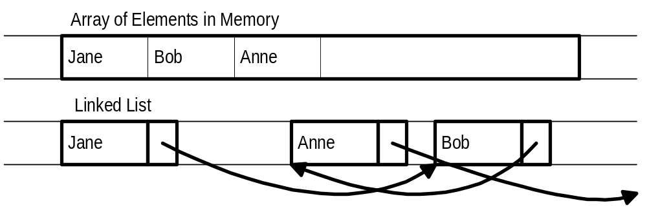
Dynamically Allocating Elements
Allocate elements one at a time as needed, have each element keep track of the next element
Result is referred to as linked list of elements, track next element with a pointer

Slide 4
Linked List Notes
Need way to indicate end of list (NULL pointer)
Need to know where list starts (first element)
Each element needs pointer to next element (its link)
Need way to allocate new element (use malloc)
Need way to return element not needed any more (use free)
Divide element into data and pointer

Slide 5
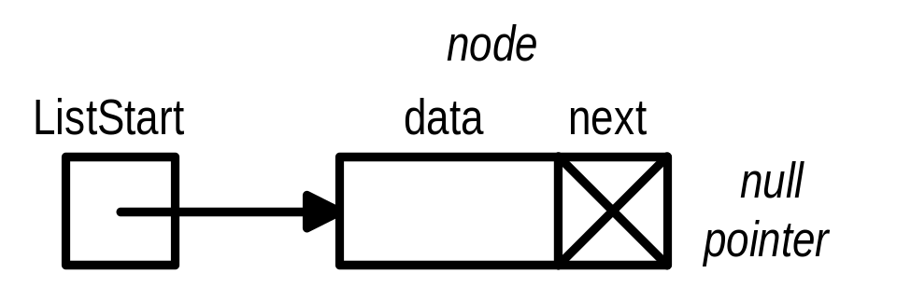
Linked List Type
Type declaration:
  typedef struct ESTRUCT {
  DataType data; /* DataType is type for element of list */
  struct ESTRUCT *next;
  } EStruct, *EPtr;
Pointer to first element:
  EPtr ListStart;
  /* ListStart points to first element of list
  *ListStart is first element struct
  ListStart->data is data of first element
  ListStart->next points to second element */

Slide 6

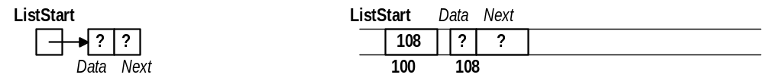
Sample Linked List Operations
void main() { /* Assume data is int */
EPtr ListStart = NULL;
/* safest to give ListStart an initial legal
value -- NULL indicates empty list */
ListStart = (EPtr) malloc(sizeof(EStruct));
/* ListStart points to memory allocated at
location 108 */

Slide 7
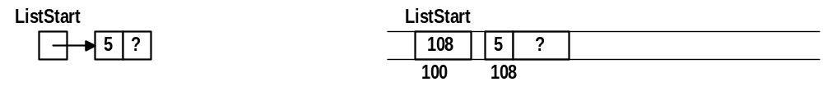

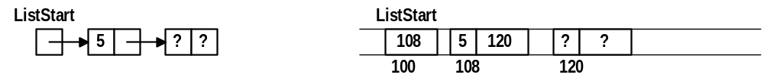
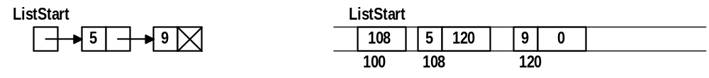
Sample Linked List Ops (cont)
ListStart->data = 5;
ListStart->next = NULL;
ListStart->next = (EPtr) malloc(sizeof(EStruct));
ListStart->next->data = 9;
ListStart->next->next = NULL;

Slide 8
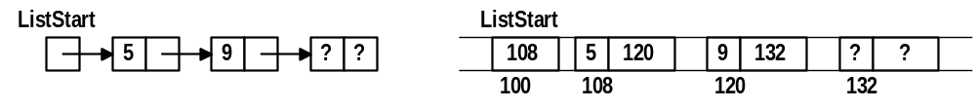
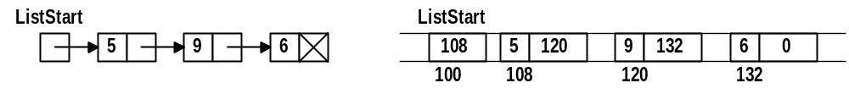
Sample Linked List Ops (cont)
ListStart->next->next = (EPtr) malloc(sizeof(EStruct));
ListStart->next->next->data = 6;
ListStart->next->next->next = NULL;
/* Linked list of 3 elements (count data values):
ListStart points to first element
ListStart->next points to second element
ListStart->next->next points to third element
and ListStart->next->next->next is NULL to
indicate there is no fourth element */

Slide 9
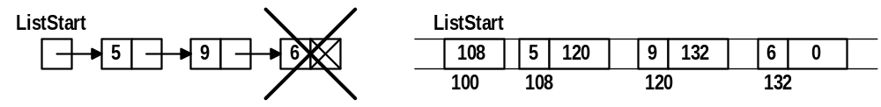
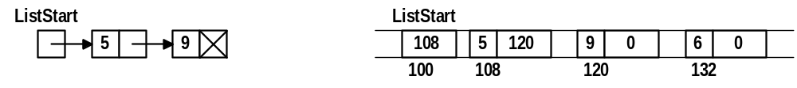
Sample Linked List Ops (cont)
/* To eliminate element, start with free operation */
free(ListStart->next->next);
/* NOTE: free not enough -- does not change memory
Element still appears to be in list
But C might give memory away in next request
Need to reset the pointer to NULL */
ListStart->next->next = NULL;
/* Element at 132 no longer part of list (safe to
reuse memory) */

Slide 10
Common Mistakes
Dereferencing a NULL pointer
  ListStart = NULL;
  ListStart->data = 5; /* ERROR */
Using a freed element
  free(ListStart->next);
  ListStart->next->data = 6; /* PROBLEM */
Using a pointer before set
  ListStart = (EPtr) malloc(sizeof(EStruct));
  ListStart->next->data = 7; /* ERROR */

Slide 11
List Initialization
Certain linked list ops (init, insert, etc.) may change element at start of list (what ListStart points at)
  to change what ListStart points to could pass a pointer to ListStart (pointer to pointer)
  alternately, in each such routine, always return a pointer to ListStart and set ListStart to the result of function call (if ListStart doesn’t change it doesn’t hurt)
  EPtr initList() {
  return NULL;
  }
  ListStart = initList();

Slide 12
A Helper Function
Build a function used whenever a new element is needed (function always sets data, next fields):
  EPtr newElement(DataType ndata, EPtr nnext) {
  EPtr newEl = (EPtr) malloc(sizeof(EStruct));
  newEl->data = ndata;
  newEl->next = nnext;
  return newEl;
  }

Slide 13
List Insertion (at front)
Add new element to list:
  Make new element’s next pointer point to start of list
  Make pointer to new element start of list
  EPtr insertF(EPtr start, DataType dnew) {
  return newElement(dnew,start);
  }
  To use, get new value to add (ask user, read from file, whatever), then call insertF:
  ListStart = insertF(ListStart,NewDataValue);

Slide 14
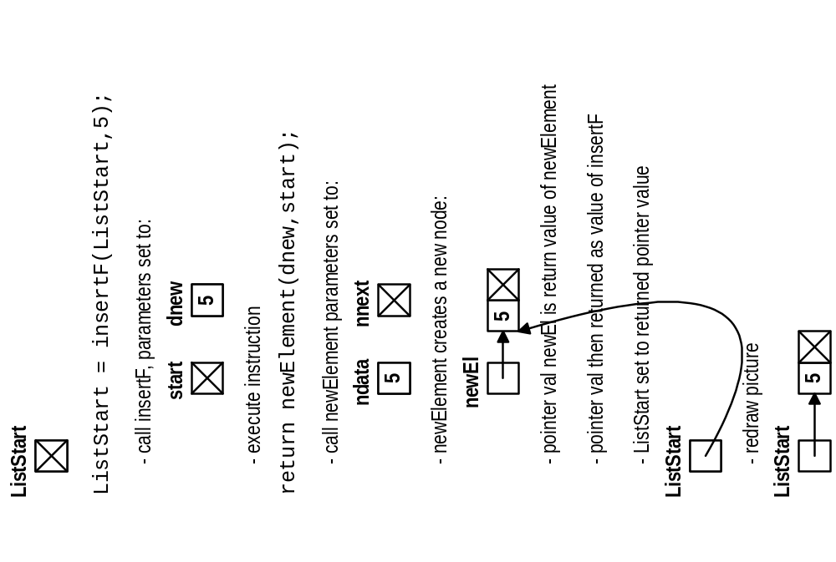
Insert at Front Example

Slide 15
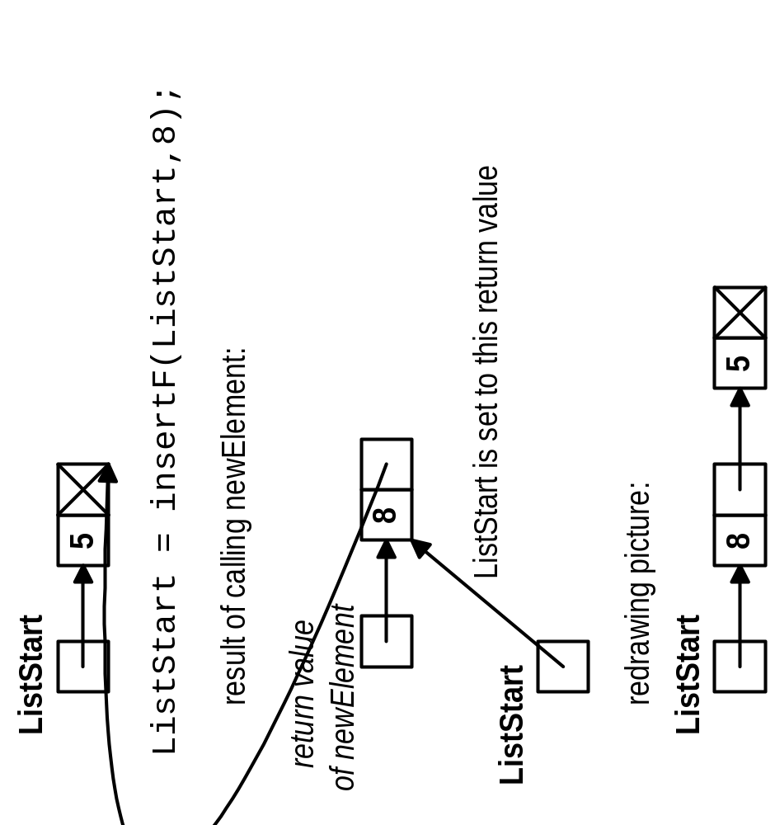
Insert at Front (Again)

Slide 16
Insert at End
Need to find end of list -- use walker (temporary pointer) to “walk” down list
  EPtr insertE(EPtr start, DataType dnew) {
  EPtr last = start; /* Walker */
  if (start == NULL) /* if list empty, add at */
  return newElement(dnew,NULL); /* start */
  else {
  while (last->next != NULL) /* stop at */
  last = last->next; /* last item */
  last->next = newElement(dnew,NULL);
  return start; /* start doesn’t change */
  }
  }

Slide 17
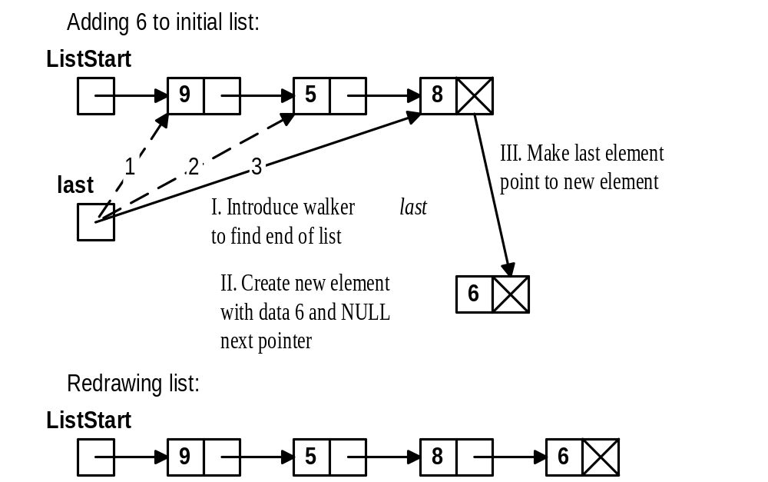
Insert at End Example

Slide 18
Printing a List
Use a walker to examine list from first to last
  void printList(EPtr start) {
  EPtr temp = start;
  while (temp != NULL) {
  printData(temp->data);
  temp = temp->next;
  }
  }

Slide 19
Finding an Element in List
Return pointer to item (if found) or NULL (not found)
  EPtr findE(EPtr start, DataType findI) {
  EPtr findP = start; /* walker */
  while ((findP != NULL) &&
  (findP->data is not the same as findI))
  findP = findP->next;
  return findP;
  }

Slide 20
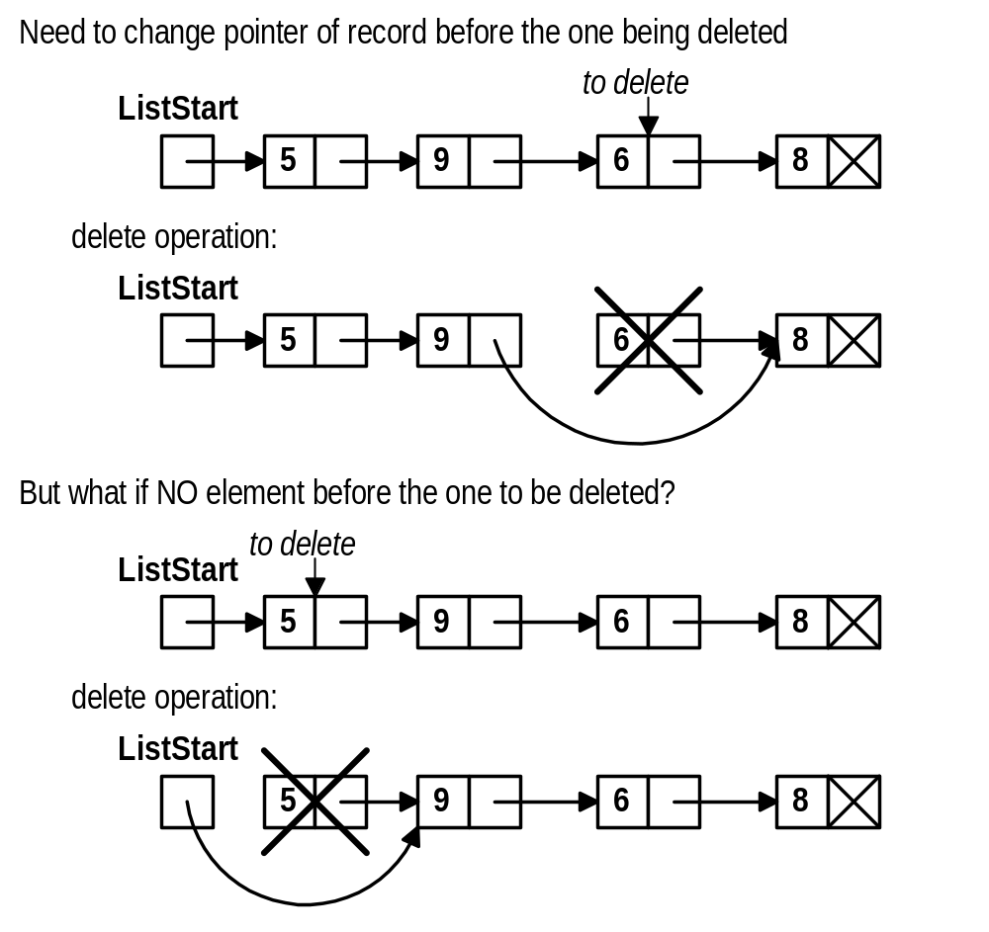
Deleting an Element

Slide 21
Deletion Code
EPtr delete(EPtr start, DataType delI) {
EPtr prev = NULL;
EPtr curr = start;
while ((curr != NULL) && (curr->data is not delI)) {
prev = curr;
curr = curr->next;
}
if (curr == NULL)
printf(“Item to delete not found\n”);
else {
if (prev == NULL)
start = start->next;
else
prev->next = curr->next;
free(curr);
}
return start;
}

Slide 22
Selection Sorting Linked List
EPtr sort(EPtr unsorted) {
EPtr sorted = NULL;
EPtr largest, prev;
while (unsorted != NULL) {
prev = findItemBeforeLargest(unsorted);
if (prev == NULL) {
largest = unsorted;
unsorted = unsorted->next;
}
else {
largest = prev->next;
prev->next = largest->next;
}
largest->next = sorted;
sorted = largest;
}
return sorted;
}

Slide 23
Item Before Largest
EPtr findItemBeforeLargest(EPtr start) {
EPtr prevlargest = NULL;
EPtr largest = start;
EPtr prev = start;
EPtr curr = start->next;
while (curr != NULL) {
if (curr->data bigger than largest->data) {
prevlargest = prev;
largest = curr;
}
prev = curr;
curr = curr->next;
}
return prevlargest;
}

Slide 24
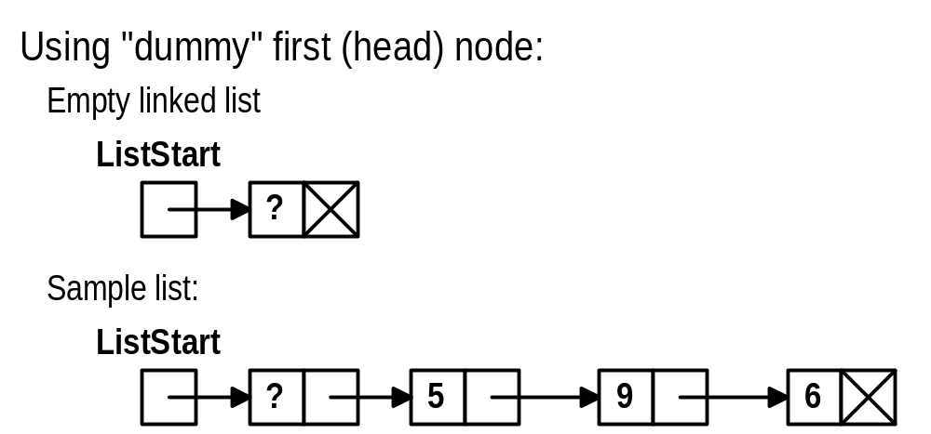
Linked List Variation: Dummy Head Node
Why?
  No special case for inserting/deleting at beginning
  ListStart does not change after it is initialized
Disadvantage
  cost of one extra element

Slide 25
DH List Initialization/Insert
EPtr initList() {
EPtr ListStart =
(EPtr) malloc(sizeof(EStruct));
ListStart->next = NULL;
return ListStart;
}
void insertF(EPtr start, DataType dnew) {
start->next =
newElement(dnew,start->next);
}

Slide 26
DH Inserting at End
void insertE(EPtr start, DataType dnew) {
EPtr last = start; /* Walker */
/* No special list is empty case */
while (last->next != NULL)
last = last->next;
last->next = newElement(dnew,NULL);
}

Slide 27
DH Printing a List
Have walker start at second element
  void printList(EPtr start) {
  EPtr temp = start->next;
  while (temp != NULL) {
  printData(temp->data);
  temp = temp->next;
  }
  }

Slide 28
DH Deletion Code
void delete(EPtr start, DataType delI) {
EPtr prev = start;
EPtr curr = start->next;
while ((curr != NULL) && (curr->data is not delI)) {
prev = curr;
curr = curr->next;
}
if (curr == NULL)
printf(“Item to delete not found\n”);
else {
prev->next = curr->next;
free(curr);
}
}

Slide 29
Linked List Variation: Sorted List
Idea: keep the items on the list in a sorted order
  sort based on data value in each node
  advantages:
    already sorted
    operations such as delete, find, etc. need not search to the end of the list if the item is not in list
  disadvantages
    insert must search for the right place to add element (slower than simply adding at beginning)

Slide 30
Sorted Insert (with Dummy Head)
void insertS(EPtr start, DataType dnew) {
EPtr prev = start;
EPtr curr = start->next;
while ((curr != NULL) &&
(dnew is bigger than curr->data)) {
prev = curr;
curr = curr->next;
}
prev->next = newElement(dnew,curr);
}

