Slide 1

Recursion

Slide 2




Ex. 1: The Handshake Problem
There are n people in a room. If each person shakes hands once with every other person. What is the total number h(n) of handshakes?
h(n) = h(n-1) + n-1
h(4) = h(3) + 3
h(3) = h(2) + 2
h(2) = 1
h(n): Sum of integer from 1 to n-1 = n(n-1) / 2

Slide 3
Recursion
In some problems, it may be natural to define the problem in terms of the problem itself.
Recursion is useful for problems that can be represented by a simpler version of the same problem.
Example: the factorial function
6! = 6 * 5 * 4 * 3 * 2 * 1
We could write:
6! = 6 * 5!

Slide 4
Example 2: factorial function
In general, we can express the factorial function as follows:
n! = n * (n-1)!
Is this correct? Well… almost.
The factorial function is only defined for positive integers. So we should be a bit more precise:
n! = 1 (if n is equal to 1)
n! = n * (n-1)! (if n is larger than 1)

Slide 5


factorial function
The C++ equivalent of this definition:
int fac(int numb){
if(numb<=1)
return 1;
else
return numb * fac(numb-1);
}
recursion means that a function calls itself

Slide 6
factorial function
Assume the number typed is 3, that is, numb=3.
fac(3) :
  3 <= 1 ? No.
  fac(3) = 3 * fac(2)
  fac(2) :
    2 <= 1 ? No.
    fac(2) = 2 * fac(1)
    fac(1) :
      1 <= 1 ? Yes.
      return 1
int fac(int numb){
if(numb<=1)
return 1;
else
return numb * fac(numb-1);
}
    fac(2) = 2 * 1 = 2
    return fac(2)
  fac(3) = 3 * 2 = 6
  return fac(3)
fac(3) has the value 6

Slide 7
factorial function
For certain problems (such as the factorial function), a recursive solution often leads to short and elegant code. Compare the recursive solution with the iterative solution:
Iterative solution
int fac(int numb){
int product=1;
while(numb>1){
product *= numb;
numb--;
}
return product;
}
Recursive solution
int fac(int numb){
if(numb<=1)
return 1;
else
return numb*fac(numb-1);
}

Slide 8
Recursion
We have to pay a price for recursion:
  calling a function consumes more time and memory than adjusting a loop counter.
  high performance applications (graphic action games, simulations of nuclear explosions) hardly ever use recursion.
In less demanding applications recursion is an attractive alternative for iteration (for the right problems!)

Slide 9
Recursion
If we use iteration, we must be careful not to create an infinite loop by accident:
for(int incr=1; incr!=10;incr+=2)
...
int result = 1;
while(result >0){
...
result++;
}
Oops!
Oops!

Slide 10
Recursion
Similarly, if we use recursion we must be careful not to create an infinite chain of function calls:
int fac(int numb){
return numb * fac(numb-1);
}
Or:
int fac(int numb){
if (numb<=1)
return 1;
else
return numb * fac(numb+1);
}
Oops!
No termination condition
Oops!

Slide 11
Recursion
We must always make sure that the recursion bottoms out:
A recursive function must contain at least one non-recursive branch.
The recursive calls must eventually lead to a non-recursive branch.

Slide 12
Recursion
Recursion is one way to decompose a task into smaller subtasks. At least one of the subtasks is a smaller example of the same task.
The smallest example of the same task has a non-recursive solution.
  Example: The factorial function
  n! = n * (n-1)! and 1! = 1

Slide 13

How many pairs of rabbits can be produced from a single pair in a year's time?
Assumptions:
  Each pair of rabbits produces a new pair of offspring every month;
  each new pair becomes fertile at the age of one month;
  none of the rabbits dies in that year.
Example:
  After 1 month there will be 2 pairs of rabbits;
  after 2 months, there will be 3 pairs;
  after 3 months, there will be 5 pairs (since the following month the original pair and the pair born during the first month will both produce a new pair and there will be 5 in all).

Slide 14
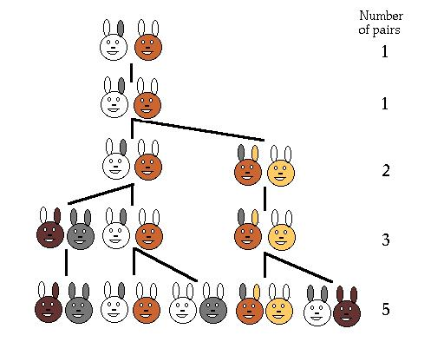
Population Growth in Nature
Leonardo Pisano (Leonardo Fibonacci = Leonardo, son of Bonaccio) proposed the sequence in 1202 in The Book of the Abacus.
Fibonacci numbers are believed to model nature to a certain extent, such as Kepler's observation of leaves and flowers in 1611.

Slide 15
Direct Computation Method
Fibonacci numbers:
  0, 1, 1, 2, 3, 5, 8, 13, 21, 34, ...
where each number is the sum of the preceding two.
Recursive definition:
  F(0) = 0;
  F(1) = 1;
  F(number) = F(number-1)+ F(number-2);

Slide 16
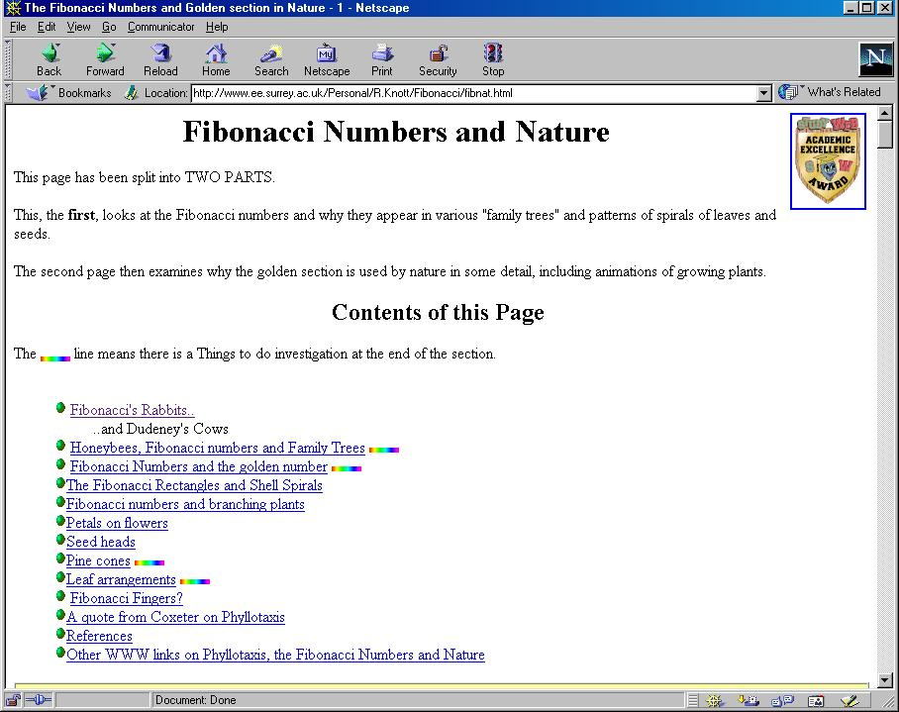

Slide 17
Example 3: Fibonacci numbers
//Calculate Fibonacci numbers using recursive function.
//A very inefficient way, but illustrates recursion well
int fib(int number)
{
if (number == 0) return 0;
if (number == 1) return 1;
return (fib(number-1) + fib(number-2));
}

Slide 18
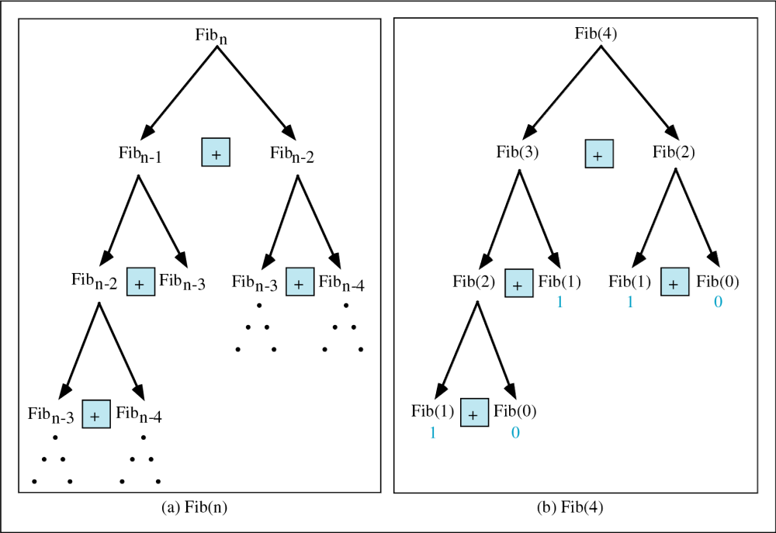
Copyright © 2000 by Brooks/Cole Publishing Company
A division of International Thomson Publishing Inc.

Slide 19
Trace a Fibonacci Number
int fib(int num)
{
if (num == 0) return 0;
if (num == 1) return 1;
return
(fib(num-1)+fib(num-2));
}
Assume the input number is 4, that is, num=4:
fib(4):
  4 == 0 ? No; 4 == 1? No.
  fib(4) = fib(3) + fib(2)
  fib(3):
    3 == 0 ? No; 3 == 1? No.
    fib(3) = fib(2) + fib(1)
    fib(2):
      2 == 0? No; 2==1? No.
      fib(2) = fib(1)+fib(0)
    fib(1):
    1== 0 ? No; 1 == 1? Yes.
    fib(1) = 1;
    return fib(1);

Slide 20
Trace a Fibonacci Number
fib(0):
    0 == 0 ? Yes.
    fib(0) = 0;
    return fib(0);
    fib(2) = 1 + 0 = 1;
    return fib(2);
  fib(3) = 1 + fib(1)
fib(1):
    1 == 0 ? No; 1 == 1? Yes
    fib(1) = 1;
    return fib(1);
  fib(3) = 1 + 1 = 2;
  return fib(3)

Slide 21
Trace a Fibonacci Number
fib(2):
      2 == 0 ? No; 2 == 1? No.
      fib(2) = fib(1) + fib(0)
      fib(1):
    1== 0 ? No; 1 == 1? Yes.
    fib(1) = 1;
    return fib(1);
    fib(0):
    0 == 0 ? Yes.
    fib(0) = 0;
    return fib(0);
    fib(2) = 1 + 0 = 1;
    return fib(2);
  fib(4) = fib(3) + fib(2)
  = 2 + 1 = 3;
  return fib(4);

Slide 22
Example 4: Fibonacci number w/o recursion
//Calculate Fibonacci numbers iteratively
//much more efficient than recursive solution
int fib(int n)
{
int f[100];
f[0] = 0; f[1] = 1;
for (int i=2; i<= n; i++)
f[i] = f[i-1] + f[i-2];
return f[n];
}

Slide 23
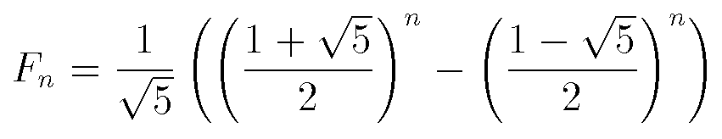
Fibonacci Numbers
Fibonacci numbers can also be represented by the following formula.

Slide 24
Example 5: Binary Search
  Search for an element in an array
    Sequential search
    Binary search
  Binary search
    Compare the search element with the middle element of the array
    If not equal, then apply binary search to half of the array (if not empty) where the search element would be.
see applet

Slide 25
Binary Search with Recursion
// Searches an ordered array of integers using recursion
int bsearchr(const int data[], // input: array
int first, // input: lower bound
int last, // input: upper bound
int value // input: value to find
)// output: index if found, otherwise return –1
{ //cout << "bsearch(data, "<<first<< ", last "<< ", "<<value << "); "<<endl;
int middle = (first + last) / 2;
if (data[middle] == value)
return middle;
else if (first >= last)
return -1;
else if (value < data[middle])
return bsearchr(data, first, middle-1, value);
else
return bsearchr(data, middle+1, last, value);
}

Slide 26
Binary Search
int main() {
const int array_size = 8;
int list[array_size]={1, 2, 3, 5, 7, 10, 14, 17};
int search_value;
cout << "Enter search value: ";
cin >> search_value;
cout << bsearchr(list,0,array_size-1,search_value)
<< endl;
return 0;
}

Slide 27
Binary Search w/o recursion
// Searches an ordered array of integers
int bsearch(const int data[], // input: array
int size, // input: array size
int value // input: value to find
){ // output: if found,return
// index; otherwise, return -1
int first, last, upper;
first = 0;
last = size - 1;
while (true) {
middle = (first + last) / 2;
if (data[middle] == value)
return middle;
else if (first >= last)
return -1;
else if (value < data[middle])
last = middle - 1;
else
first = middle + 1;
}
}

Slide 28
Recursion General Form
How to write recursively?
int recur_fn(parameters){
if(stopping condition)
return stopping value;
// other stopping conditions if needed
return function of recur_fn(revised parameters)
}

Slide 29

Example 6: exponential func
How to write exp(int numb, int power) recursively?
int exp(int numb, int power){
if(power ==0)
return 1;
return numb * exp(numb, power -1);
}

Slide 30
Example 6: number of zero
Write a recursive function that counts the number of zero digits in an integer
zeros(10200) returns 3.
int zeros(int numb){
if(numb==0) // 1 digit (zero/non-zero):
return 1; // bottom out.
else if(numb < 10 && numb > -10)
return 0;
else // > 1 digits: recursion
return zeros(numb/10) + zeros(numb%10);
}
zeros(10200)
zeros(1020) + zeros(0)
zeros(102) + zeros(0) + zeros(0)
zeros(10) + zeros(2) + zeros(0) + zeros(0)
zeros(1) + zeros(0) + zeros(2) + zeros(0) + zeros(0)

Slide 31
Problem Solving Using Recursion
Let us consider a simple problem of printing a message for n times. You can break the problem into two subproblems: one is to print the message one time and the other is to print the message for n-1 times. The second problem is the same as the original problem with a smaller size. The base case for the problem is n==0. You can solve this problem using recursion as follows:
void nPrintln(char * message, int times)
{
if (times >= 1) {
cout << message << endl;
nPrintln(message, times - 1);
} // The base case is n == 0
}

Slide 32
Think Recursively
Many of the problems can be solved easily using recursion if you think recursively. For example, the palindrome problem can be solved recursively as follows:
bool isPalindrome(const char * const s)
{
if (strlen(s) <= 1) // Base case
return true;
else if (s[0] != s[strlen(s) - 1]) // Base case
return false;
else
return isPalindrome(substring(s, 1, strlen(s) - 2));
}

Slide 33
Recursive Helper Methods
The preceding recursive isPalindrome method is not efficient, because it creates a new string for every recursive call. To avoid creating new strings, use a helper method:
bool isPalindrome(const char * const s, int low, int high)
{
if (high <= low) // Base case
return true;
else if (s[low] != s[high]) // Base case
return false;
else
return isPalindrome(s, low + 1, high - 1);
}
bool isPalindrome(const char * const s)
{
return isPalindrome(s, 0, strlen(s) - 1);
}

Slide 34
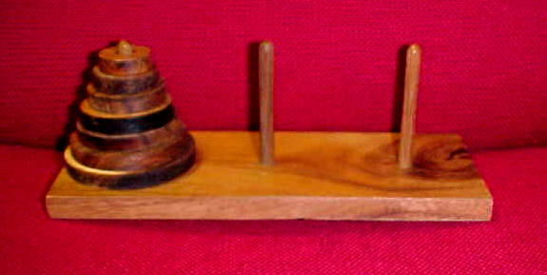
Example 7: Towers of Hanoi
  Only one disc could be moved at a time
  A larger disc must never be stacked above a smaller one
  One and only one extra needle could be used for intermediate storage of discs
see applet

Slide 35
Towers of Hanoi
void hanoi(int from, int to, int num)
{
int temp = 6 - from - to; //find the temporary
//storage column
if (num == 1){
cout << "move disc 1 from " << from
<< " to " << to << endl;
}
else {
hanoi(from, temp, num - 1);
cout << "move disc " << num << " from " << from
<< " to " << to << endl;
hanoi(temp, to, num - 1);
}
}

Slide 36
Towers of Hanoi
int main() {
int num_disc; //number of discs
cout << "Please enter a positive number (0 to quit)";
cin >> num_disc;
while (num_disc > 0){
hanoi(1, 3, num_disc);
cout << "Please enter a positive number ";
cin >> num_disc;
}
return 0;
}

Slide 37
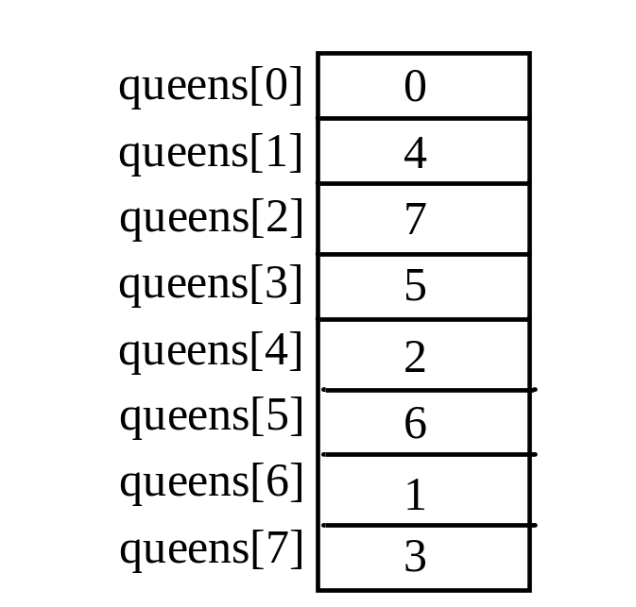
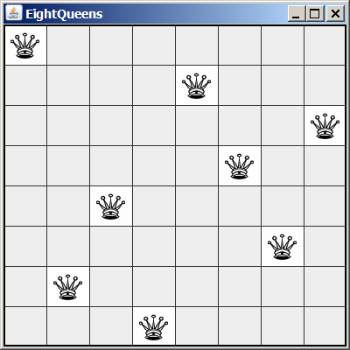
Eight Queens
Place eight queens on the chessboard such that no queen attacks any other one.

Slide 38
bool empty(int t[], int row, int col) {
for( int j = 0; j < row; j++) {
if (t[j] == col) //same column
return false;
if (abs(t[j] - col) == (row - j)) //on cross line
return false;
}
return true;
}
bool queens(int t[], int row, int col) {
if (row == SIZE) // found one answer
return true;
for (col = 0; col <SIZE; col++)
{
t[row] = col;
if (empty(t, row, col) && queens(t, row +1, 0)) return true;
}
return false;
}

Slide 39
void print(int t[]){
// print solution
for(int i = 0; i < SIZE; i++) {
for(int j = 0; j < SIZE; j++) {
if (j == t[i])
cout << " Q ";
else
cout << " _ ";
}
cout << endl;
}
}
int main() {
int t[SIZE]={0};
for (int i= 0; i <SIZE; i++){
t[0] = i; //on first row, Queen on different column
cout << endl << endl <<"i is: " << i << endl;
if (queens(t, 1,0))
print(t);
}
}

