Slide 1
Image Document Optimization - SBI
Powered By - Microsoft Corporation Pvt Ltd.
TEAM KALAM
Abha Porwal
Sambit Kumar Mishra

Slide 2

Problem Being Solved
The customers of SBI are increasing on a daily basis. This increase in the number results in increase in the size of the database required to store the documents of the customers.
The documents are generally in the image format uploaded by the customers themselves.
The raw format of the documents are typically of sizes of few MBs.
Storing the raw format of the uploaded data in the database is an inefficient approach because it increases the POST and FETCH latency. It also increases the cost of maintaining the database.
Scaling is very inefficient if such inefficient storage methods are implemented.

Slide 3
Approach taken to create the model
The major focus is kept on reducing the size and white space of the document without compromising with the quality much.
There are various options available for image compression like -
K-Means Clustering
PCA
GAN
Computer Vision
Azure CDN

Slide 4
Approach taken to create the model
Among the various possible approaches, the implementation of the solution is currently done using PCA.
Principal Component Analysis or PCA is a method of reducing the dimensions of the given dataset while still retaining most of its variance.
Eg. In one of the iterations, the original image of an ID Card of size 1.5 MB was compressed to 45 KB without significant loss of resolution of text and image in the ID.

Slide 5
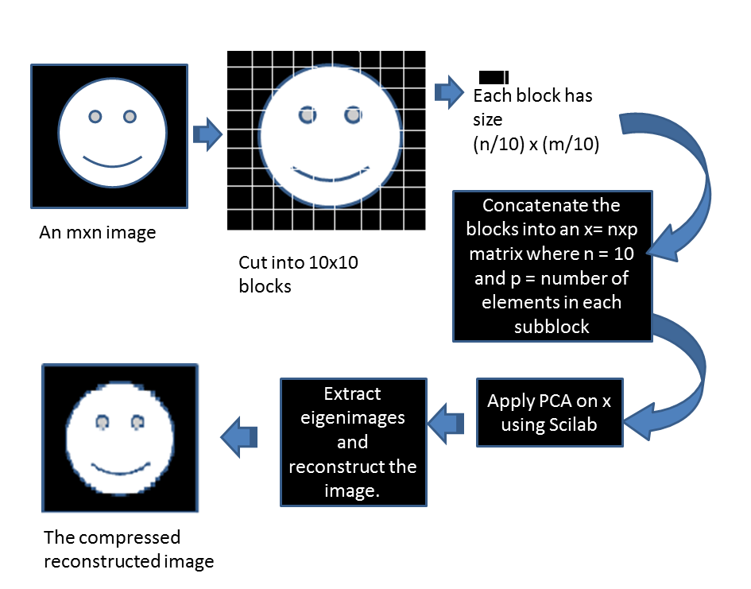
PCA Model Visualization

Slide 6
Approach for improvement of model
Although PCA would help to achieve the desired goal, but there are advanced methods which can optimize the compression.
GAN (Generative Adversarial Network)
Azure CDN (Content Delivery Network)
GAN is one of the advanced methods.
Azure CDN (Content Delivery Network) can also be leveraged to achieve significant image compression without losing the quality significantly.

Slide 7
GAN (Generative Adversarial Network)
GANs are generative models: they create new data instances that resemble your training data.
GANs achieve this level of realism by pairing a generator, which learns to produce the target output, with a discriminator, which learns to distinguish true data from the output of the generator. The generator tries to fool the discriminator, and the discriminator tries to keep from being fooled.

Slide 8
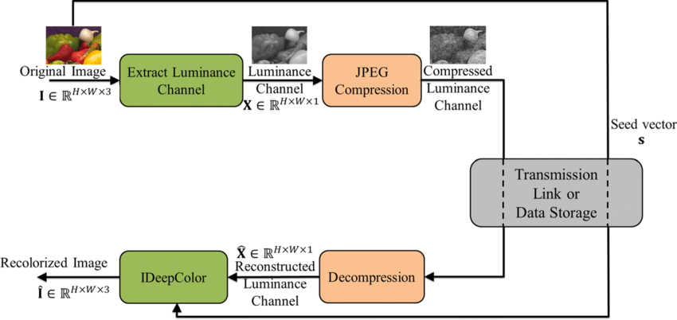
GAN (Generative Adversarial Network)

Slide 9
Azure CDN (Content Delivery Network)
Enable compression on your origin server. In this case, Azure CDN passes along the compressed files and delivers them to clients that request them.
Enable compression directly on the CDN POP servers (compression on the fly). In this case, the CDN compresses the files and serves them to the end users, even if they were not compressed by the origin server.

Slide 10
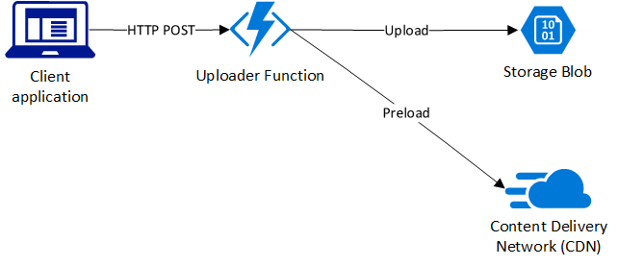
Azure CDN (Content Delivery Network)

Slide 11
FR (Functional Requirements)
Reduced latency
Response time should be less than 1 minute
Minimum system overhead
High compression ratio
No significant reduction in image resolution
POST and FETCH operations should be available for multiple concurrent users without latency.
ACID/BASE principle should be followed
Highly scalable database

Slide 12
NFR (Non-Functional Requirements)
Improved UI and UX
Hints and instructions in the webpage for guiding the new customers
Timely removal of documents of ex-users from the database to free up space
Success/Failure message to the customer after uploading the documents

Slide 13
Reason why the solution should be considered
Most optimized model selected for the implementation of the solution.
PCA implemented as of now, but the final model would be based on GAN which would improve the compression efficiency.
Entire database size will reduce significantly.
This method is applicable to all the types of document images uploaded by the user.

Slide 14
Source code (Github Repository Link)
https://www.github.com/MAVIN-07/sbi-hackathon/

Slide 15
Working of the solution.
The proposed PCA model works in the following manner -
Read image
Splitting the image into BGR
Normalizing the BGR Components
Transforming BGR into PCA with 50 Components
Inverse transformation of BGR and reducing the image

Slide 16
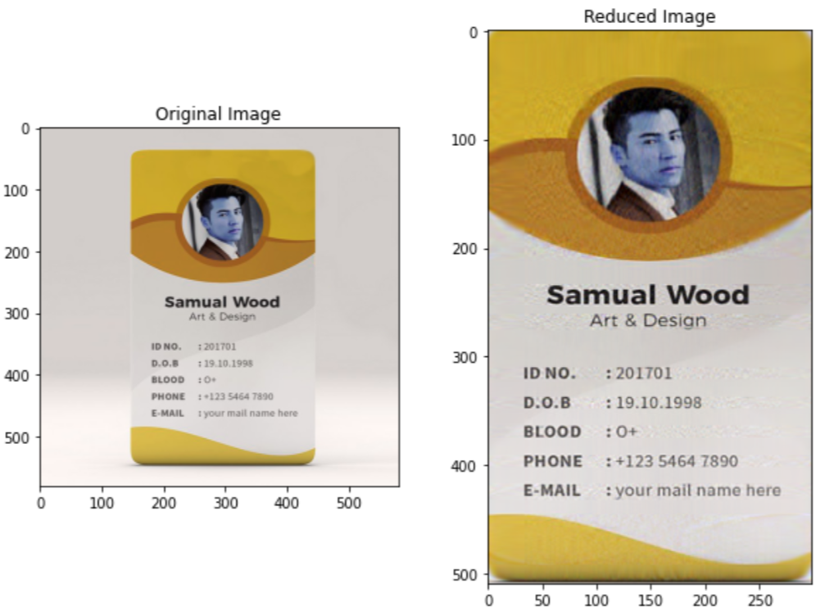
OUTPUT OF THE PROPOSED MODEL

Slide 17

Submitted By : Abha Porwal , Sambit Kumar Mishra
Email : abhaporwal12@gmail.com , sambitmishra1968@gmail.com
Mobile No: 9111027570 , 9630185553

