Slide 1

Team Name : Code Crusaders
Team Details: Disha Himani
P.S.Geethanjali

Slide 2



Problem Statement
Fashion Fatigue: From Inspiration to Frustration
Social media overflows with fashion inspiration, leaving Gen Z overwhelmed with choices. Endless browsing leads to decision fatigue and a disconnect between inspiration and actual purchase. Current online shopping platforms offer limited tools for outfit building, making it difficult to translate trendy pieces into cohesive looks. Gen Z desires a platform that allows them to curate "Outfit of the Day" looks (OOTD) for various occasions (casual, formal, party) and have one stop platform for all fashion trends and advices.
Existing platforms often fall short in providing a seamless experience where users can mix and match clothing items, accessories, and footwear to create a cohesive look. Additionally, there is a lack of personalized style recommendations backed by AI, which can keep up with the fast-paced changes in fashion trends. This gap in the market results in a fragmented and less engaging shopping experience for Gen Z, who crave a more interactive and personalized approach to fashion.

Slide 3

Solution : Creating a Fashion Website
Topics/Use Case: Trend-centric recommendation and Engagement on shopping platform.
Trend Monitoring and Suggestions: The platform will continuously monitor social media and other fashion-forward sources to identify the latest trends in clothing styles, appearances, and complete outfits.
AI-powered Virtual Stylist: AI curates trendy styles and where individuals can mix and match various tops, pants, accessories, and footwear from a wide range of trendy items to create their own outfit look.
3D Avatar Creation: Users can create personalized 3D avatars that reflect their body type and skin tone. This allows for a more realistic visualization of how clothes will look on them.
Simulation feature: Allow users to visualize their chosen outfits on virtual models, helping them see how different products look together.

Slide 4
Solution
Topics/Use Case:Trend-centric recommendation and Engagement on shopping platform.
AI powered recommendations: The AI will analyze user behavior and preferences to suggest new looks and items that align with their style.
Engaging Content and Community Features: The platform will feature content on trending dresses, fashion tips, hairstyle trends, and more to keep users engaged.
Personalized Chatbot Assistance: A chatbot available for users to ask for personal style recommendations, outfit ideas, and fashion advice.
Seamless Shopping Integration with Myntra: All fashion products will be sourced from Myntra, ensuring a wide selection of trendy items.Users can create their look on the platform and click on links to purchase items that directly takes them to Myntra app from where they can directly purchase.

Slide 5
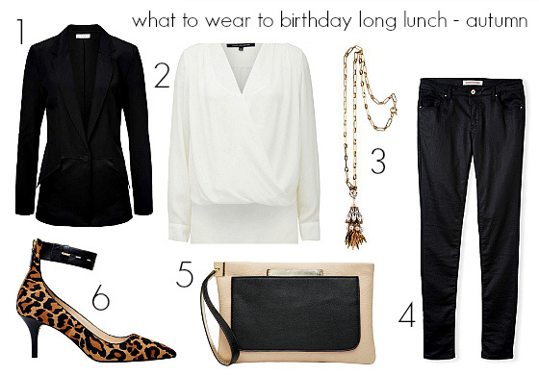
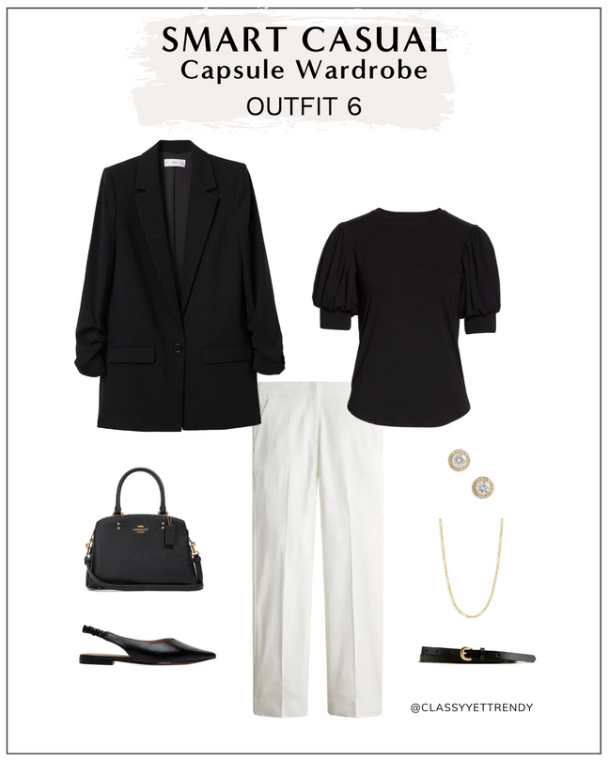
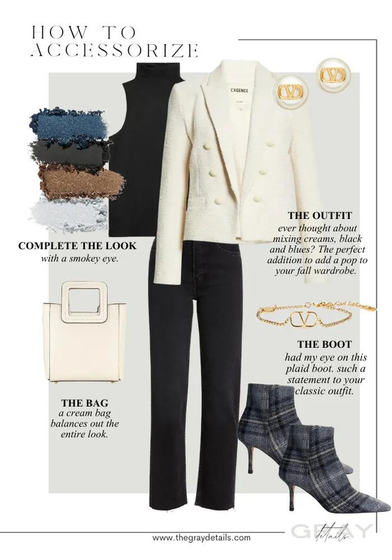
Pictorial Representation of Our Idea
It will create and suggest various looks for different events and even give fashion tips to stay up to date.

Slide 6
Tech Stack
Artificial Intelligence
Deep Learning
Computer Vision
Data Analysis
Benefits
A one stop soution for all fashion problems,advices,outfits,recommendations and trends for GenZ.
Brings a revolution in the fashion industry and makes online shopping more fun and convenient, hence viewing a shift from offline to online shopping.
By providing a realistic preview of how clothes will look on their specific body type and skin tone, personalized recommendations that lead to satisfied customers.

Slide 7
Benefits
3D avatars and recommendations ensures that each customer receives personalized fashion advice that aligns with their unique preferences and body shapes, therefore making customer journey more comfortable and convenient.
Increased Traffic and Sales for Myntra as the platform supports sales growth and opens opportunities for strategic partnerships and collaborations.
Helps in bringing more engagement, more successful purchases (higher conversion rate)by boosting sales and increased profitability for myntra.
Gives a competitive advantage to Myntra over other online brands

