Slide 1

AI-Powered Code Reviewer and Quality Assistant
Automated Python code review that combines static analysis, code embeddings, and LLMs to surface style, performance, and bug risks — integrated into CLI, Git hooks, CI, and an optional Streamlit UI.

Slide 2

Problem & Purpose
Challenge
Solution
Interfaces
Manual reviews are slow and inconsistent across fast-evolving codebases.
An AI-assisted tool to analyze Python code, provide actionable feedback, and reduce reviewer workload.
Interact via CLI or optional Streamlit UI; integrate into PRs and CI pipelines.

Slide 3
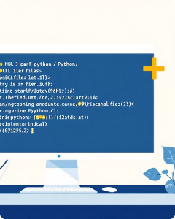
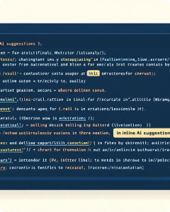
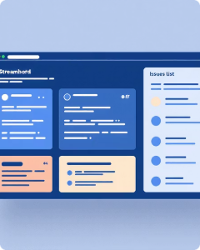
Core Outcomes
CLI Tool
Actionable Feedback
Streamlit UI (Optional)
Scan, review, apply fixes, and export reports.
Natural-language suggestions for style, naming, tests, and bugs.
Visualize issues, accept/reject changes, and browse reports.

Slide 4
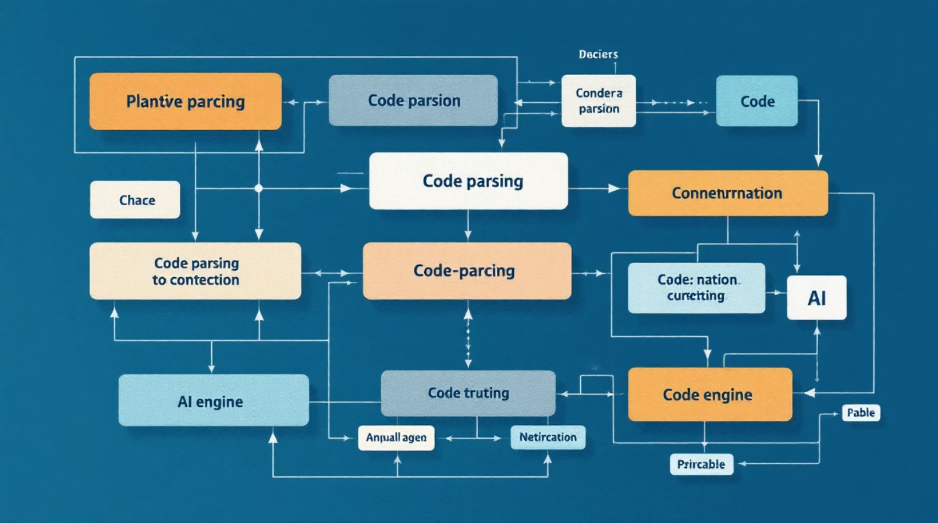
Modules — Overview
1
1. Code Parsing & Analysis
AST extraction, complexity, imports, and smell detection.
2
2. AI Review Engine
LLM templates, severity ranking, optional autofixes.
3
3. Validation & Metrics
Quality scores, maintainability, coverage hints, CSV/HTML exports.
4
4. CLI, VCS & CI
Commands, pyproject config, pre-commit and CI templates.

Slide 5
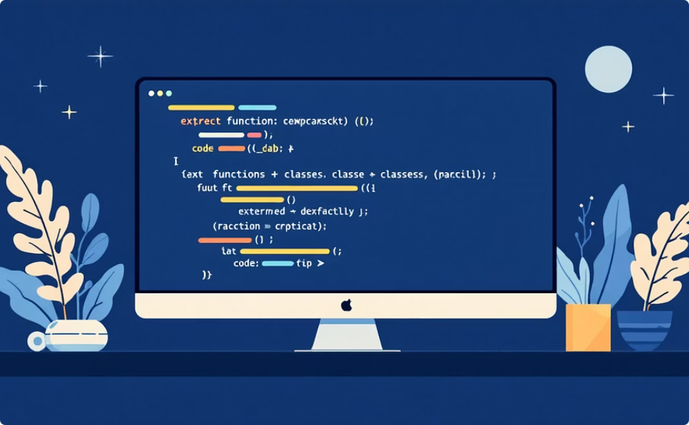
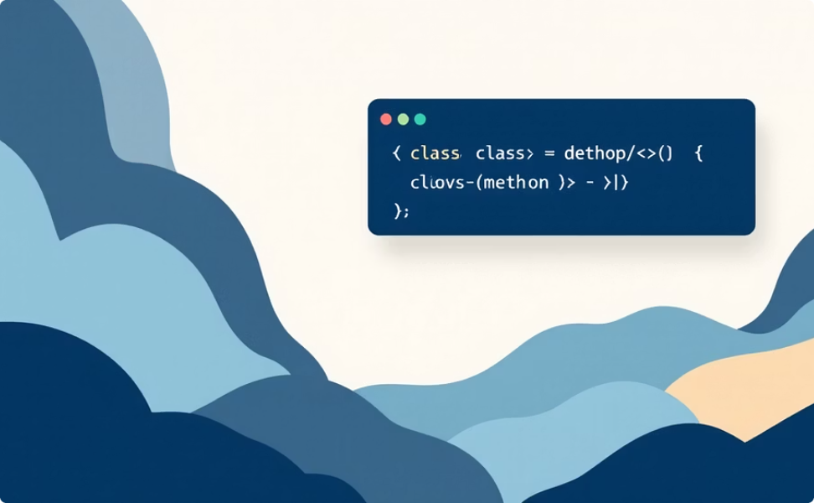
Milestone 1 — Weeks 1–2
Parsing & baseline generation: AST-based extractor, baseline Google-style docstrings, and initial docstring coverage report.
Implementation Output
Example
Files scanned, parser accuracy ~95%, generated baseline docstrings for missing cases.
DataProcessor.__init__: Initialize the DataProcessor with data. Args: data (list)

Slide 6
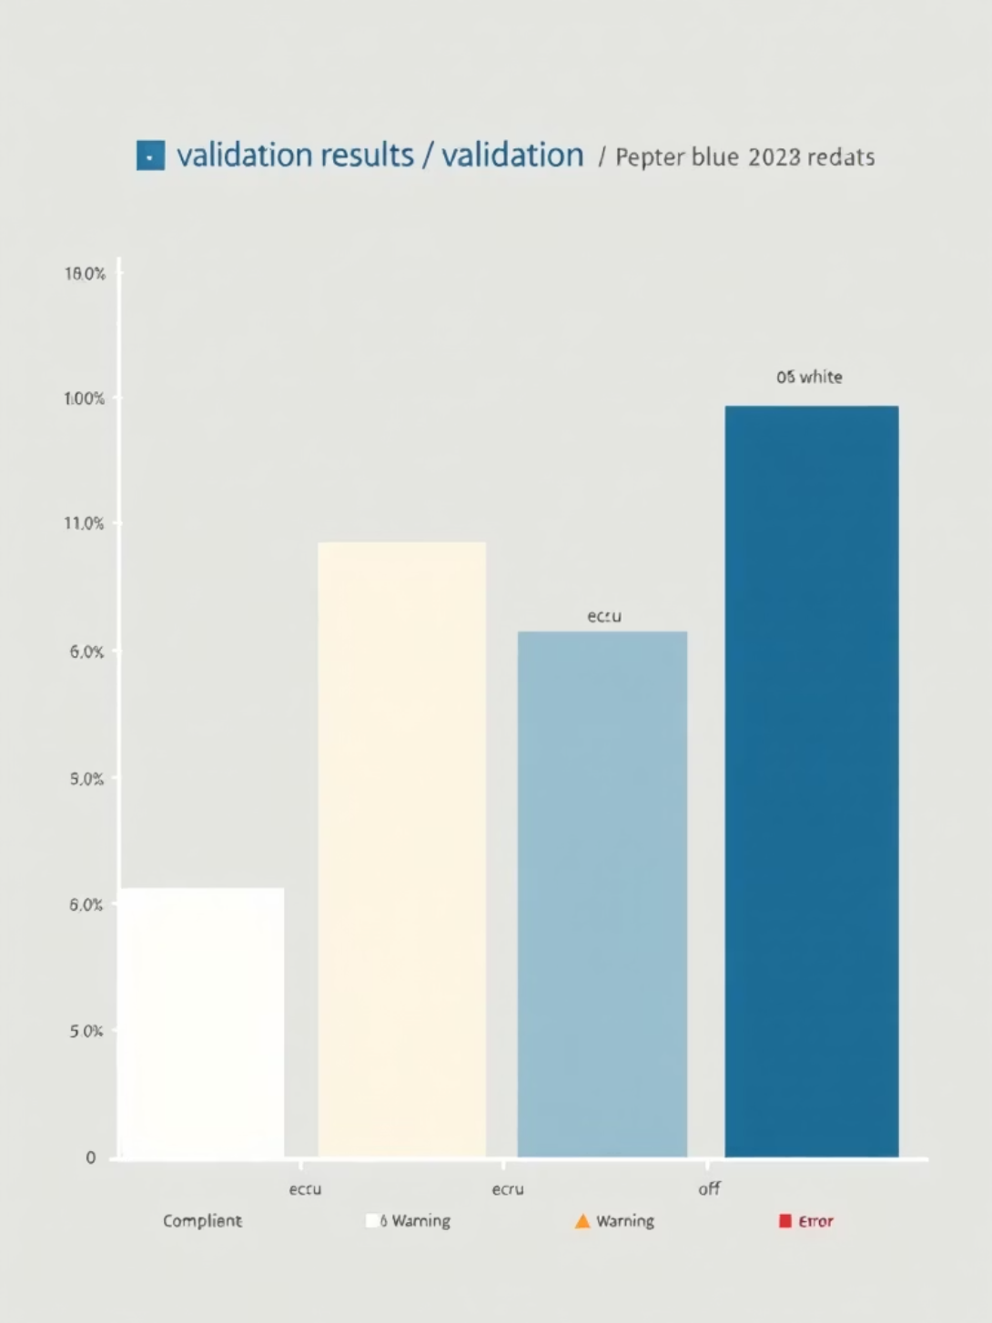
Milestone 2 — Weeks 3–4
Synthesis & validation: add NumPy/reST styles, Raises/Yields/Attributes sections, integrate pydocstyle checks and coverage reporting.
Support for Google, NumPy, reST styles — 90% coverage target.
Validation flagged specific files: utils.py (D400) and api.py (D205).
CLI validator produced detailed compliance report and categories.

Slide 7

Milestone 3 — Weeks 5–6
Workflow & CI: pre-commit hook, CI workflows with coverage gates, Streamlit review UI prototype and side-by-side diffs.
Pre-commit & CI
Fast pre-commit (<5s) and CI steps to block builds under threshold.
Streamlit Prototype
Preview, accept/reject docstrings; per-file counts (data_processor.py:3, utils.py:2, api.py:1).
Commands
scan, review, apply, report, diff — configurable via pyproject.toml.

Slide 8
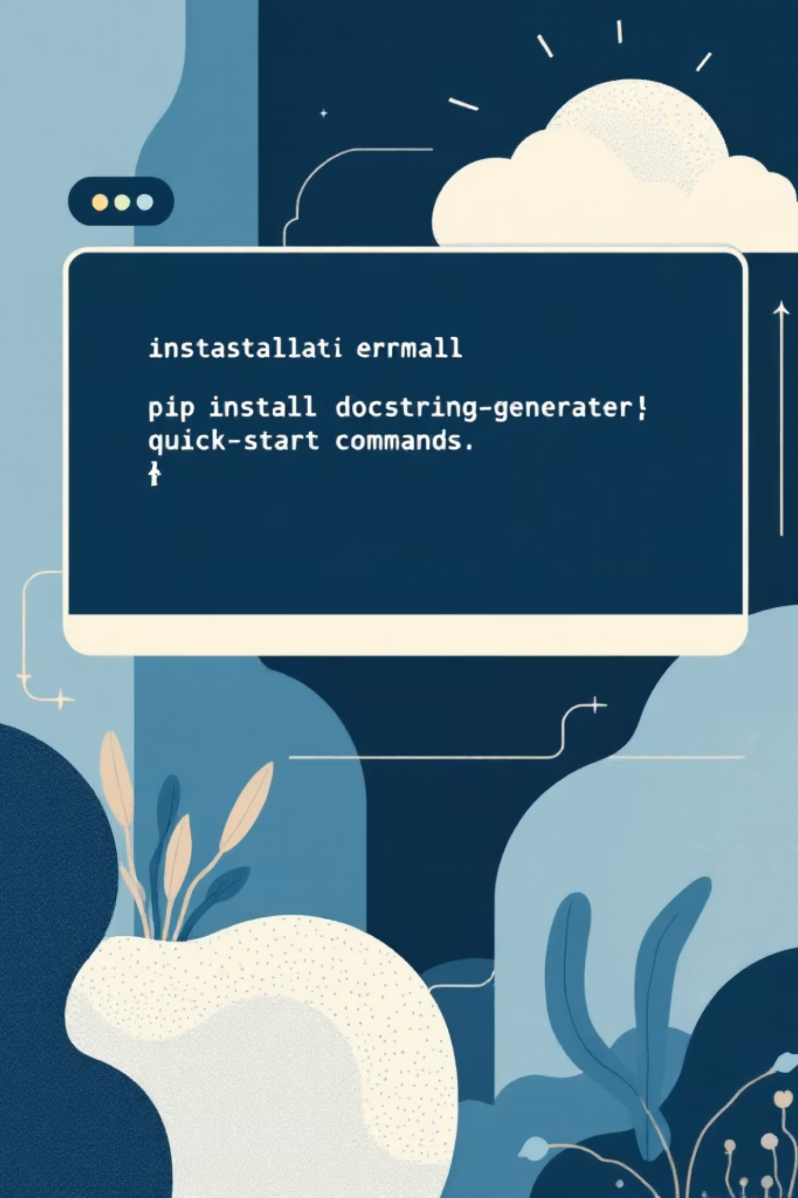
Milestone 4 — Weeks 7–8
Packaging & finalization: pip-installable package, robust tests, improved Streamlit UI (filters, search), published docs and guides.
80%
3min
100%
Acceptance Rate
End-to-End Time
CI Success
Developers report ≥80% acceptance of generated docstrings.
Works on medium projects (<2k functions) in under 3 minutes.
CI success rate reported for sample run: 100% across 24 files.

Slide 9

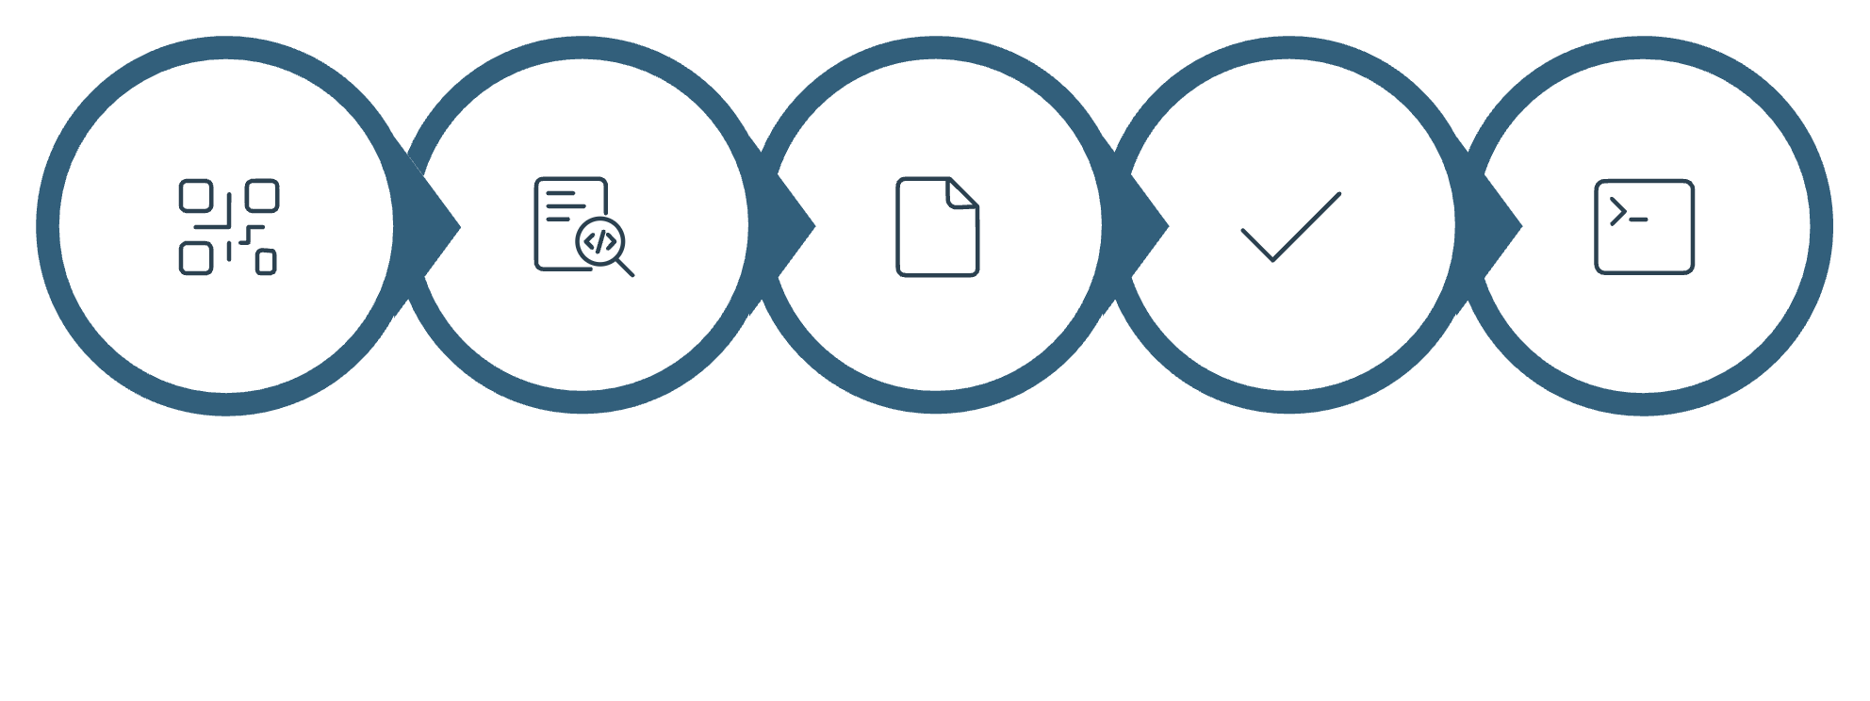





Architecture & Data Flow
Source Code
Parser
Docstring Gen
Validation
CLI / UI / CI
The core engine processes parsed source code, generates docstrings, validates them, and exposes results to CLI, Streamlit UI, pre-commit hooks, and CI pipelines.

Slide 10
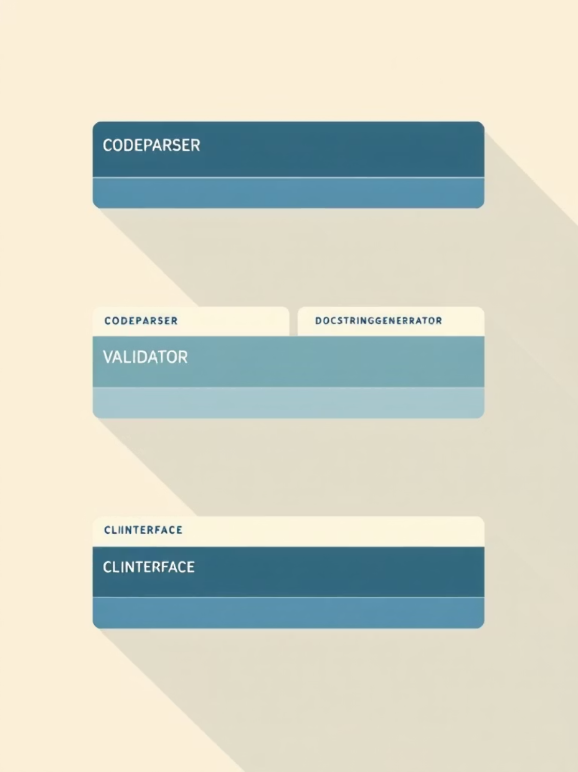
Database, Schema & Evaluation
Schema Highlights
Evaluation Criteria
Tables for parsed artifacts, generator templates, validation results, and CLI interactions.
Milestone 1: ≥95% extraction & baseline docstrings
Milestone 2: PEP 257 compliance, ≥90% coverage
Milestone 3: Pre-commit <5s, CI enforcement
Milestone 4: pip package, ≥80% docstring acceptance

