Slide 1
Loan Data Model
Data Cleaning And Analytics

Slide 2

Data Columns Overview
This dataset encompasses various demographic, financial, and loan-related attributes, providing a comprehensive view of loan applications and their outcomes. Analysis of this data can offer valuable insights into factors influencing loan approval and help in developing strategies for risk assessment and loan management.

Slide 3





Data Model Steps
Data Cleaning
Data Analysis
Gather the dataset containing the required information.
Perform various analyses to gain insights into Kohli's performance.
Data Visualization
Create visualizations to present your analysis effectively.

Slide 4
Some data from data set
Loan_id | Gender | Married | Dependents | Education | Self_ Employed | ApplicantIncome | Coapplicant Income | Loan Amount | Loan_ Amount_ Term | Credit_ History | Property_ Area | Loan_ Status
LP001002 | Male | No | 0 | Graduate | No | 5849 | 0 |  | 360 | 1 | Urban | Y
LP001003 | Male | Yes | 1 | Graduate | No | 4583 | 1508 | 128 | 360 | 1 | Rural | N
LP001005 | Male | Yes | 0 | Graduate | Yes | 3000 | 0 | 66 | 360 | 1 | Urban | Y
LP001006 | Male | Yes | 0 | Not Graduate | No | 2583 | 2358 | 120 | 360 | 1 | Urban | Y
LP001008 | Male | No | 0 | Graduate | No | 6000 | 0 | 141 | 360 | 1 | Urban | Y
LP001011 | Male | Yes | 2 | Graduate | Yes | 5417 | 4196 | 267 | 360 | 1 | Urban | Y
LP001013 | Male | Yes | 0 | Not Graduate | No | 2333 | 1516 | 95 | 360 | 1 | Urban | Y
LP001014 | Male | Yes | 3+ | Graduate | No | 3036 | 2504 | 158 | 360 | 0 | Semiurban | N
LP001018 | Male | Yes | 2 | Graduate | No | 4006 | 1526 | 168 | 360 | 1 | Urban | Y

Slide 5
Description of Data Columns
Loan_ID: This field likely represents a unique identifier for each loan application.
Gender: Indicates the gender of the applicant, possibly categorized as male, female, or other.
Married: Indicates whether the applicant is married or not, typically categorized as 'Yes' or 'No'.
Dependents: This field likely represents the number of dependents the applicant has, which could include children, elderly parents, or other family members financially dependent on the applicant.
Education: Indicates the level of education attained by the applicant, possibly categorized as 'Graduate' or 'Not Graduate'.
Self_Employed: Indicates whether the applicant is self-employed or not, typically categorized as 'Yes' or 'No'.
ApplicantIncome: Represents the income of the applicant.
CoapplicantIncome: Represents the income of the co-applicant, if any. A co-applicant is someone who applies for income.
LoanAmount: Represents the amount of loan requested by the applicant.
Loan_Amount_Term: Indicates the term or duration of the loan, typically expressed in months.
Credit_History: Indicates the credit history of the applicant, possibly categorized as '1' for good credit history and '0' for poor credit history.
Property_Area: Indicates the location or area where the property for which the loan is sought is located, possibly categorized as urban, semi- urban, or rural.
Loan_Status: Represents whether the loan was approved or not, typically categorized as 'Y' for Yes and 'N’ for No.

Slide 6
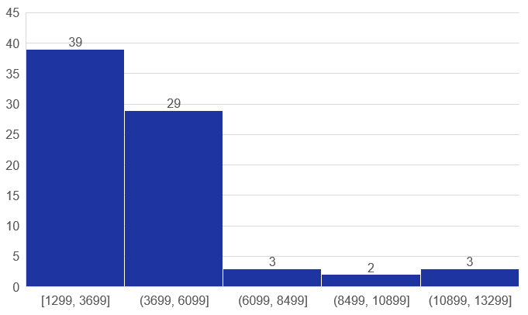
ApplicantIncome Distribution
Description
There are between 1299 to 3699 more applicants in this data
There are between 8499 to 10899 less applicants in this data

Slide 7
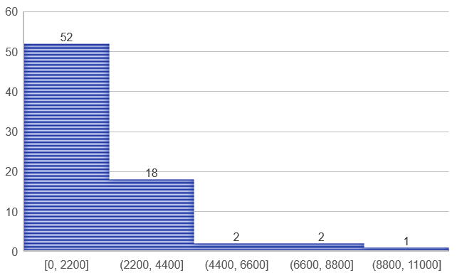
CoapplicantIncome Distribution
Description
There are between 0 to 2200 more applicants in this data.

Slide 8
Credit_history Distribution
Defination
Credit history in the data has a value of 1 greater than 0

Slide 9
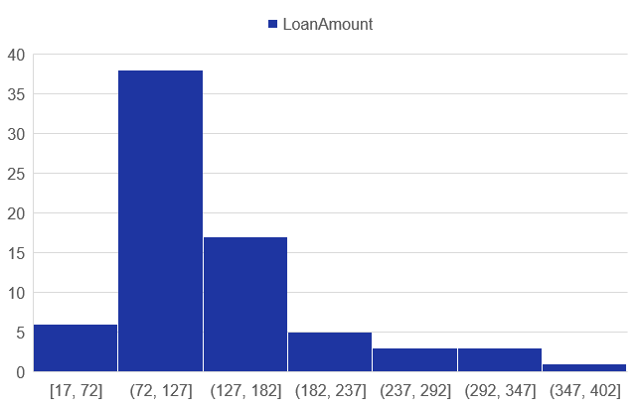
Loan amount Distribution
Description
In this data of loan amount, there is more amount between 72 and 127.

Slide 10
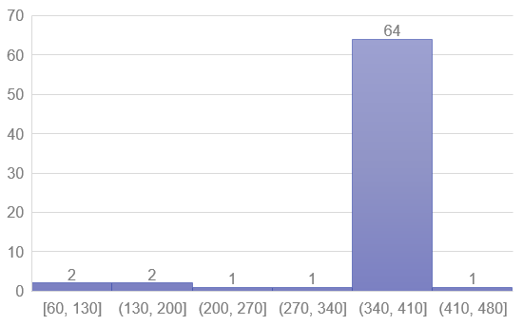
Loan_amount_term Distribution
Discription
In this data of loan amount term, there is more month between 340 to 410.

Slide 11
Dependents Distribution
Description
8% of people who are employees 3+ People upper dependents.
Description
59% of people who are employees 0 People upper dependents.

Slide 12
Loan Status by Gender
From this data it can be said that among the people who can get loans, the number of males is more than females

Slide 13
Loan Status by Married
Description
From this data it can be said that the number of loan borrowers is more among married people than notmarried people.

Slide 14
Loan Status by Education
Description
From this data it can be said that the number of loan borrowers is more among educated people than uneducated people.
Graduate
Yes 340 (70.83%)
No 140 (29.16%)
Not Graduate
Yes 82 (61.19%)
No 52 (38.80%)

Slide 15
Loan Status by Property Area
There are 3 commons in this data, Urban, Semi-Urban, Rural, then the number of loans received by Semi-Urban is more than that of Rubal and Urban.
Description

Slide 16
Loan Status by Self Employed
In this data, the number of self-employed people is 'ha' and the number of people getting loans is low.
Yes
No
In this data, the number of people who are self-employed is 'no' and the number of people getting loans is high

Slide 17
How many people are eligible to take a loan from all this data
Description
From this data it can be said that
The number of people who can get loans is more.

Slide 18
Data Prediction
Now to make data prediction from this data, it is necessary to convert the object common to 1,0 so that the Machine can understand it.
one Hot encoding of ['Gender','Married','Dependents','Education’,
'Self_Employed','Property_Area','Loan_States'] so column
Now to send the data to the train

Slide 19
Thank You…!

