Slide 1
Virat Kohli Data Model
Here the data about Virat Kohli's data is presented

Slide 2
Virat Kohli’s Columns Overview
The dataset under consideration presents a detailed examination of Virat Kohli's batting performance across various cricket matches. Comprising multiple dimensions of his innings, this dataset serves as a rich repository for analyzing and understanding Kohli's prowess with the bat.

Slide 3
Some data from dataset
Runs | BF | 4S | 6S | SR | Pos | Dismissal | Inns | Opposition | Ground | Start Date
12 | 22 | 1 | 0 | 54.54 | 2 | lbw | 1 | V Sri Lanka | Dambulla | 18-Aug-08
37 | 67 | 6 | 0 | 55.22 | 2 | Caught | 2 | V Sri Lanka | Dambulla | 20-Aug-08
25 | 38 | 4 | 0 | 65.78 | 1 | Run out | 1 | V Sri Lanka | Colombo (RPS) | 24-Aug-08
54 | 66 | 7 | 0 | 81.81 | 1 | Bowled | 1 | V Sri Lanka | Colombo (RPS) | 27-Aug-08
31 | 46 | 3 | 1 | 67.39 | 1 | lbw | 2 | V Sri Lanka | Colombo (RPS) | 29-Aug-08
2 | 2 | 0 | 0 | 100 | 7 | Not out | 1 | V Sri Lanka | Vadodra | 25-Oct-09
10 | 16 | 1 | 0 | 62.5 | 3 | Caught | 2 | V Austrlia | Mohali | 2-Nov-09
27 | 19 | 0 | 4 | 142.1 | 7 | Bowled | 1 | V Sri Lanka | Rajkot | 15-Dec-09

Slide 4
Virat Kohli’s Runs - Scored

Slide 5
1
Most runs are 154 Less than all runs is 0.
The average value of this data is 46.49.

Slide 6
Virat Kohli’s Runs - Average Scored

Slide 7
2
All values ​​are far from the average value.
The average value of this data is 46.49.

Slide 8
Virat Kohli’s batting position

Slide 9
3
Virat Kohli's batting position is 91 at number 3.
The batting position of number 6 is upper less number 1.

Slide 10
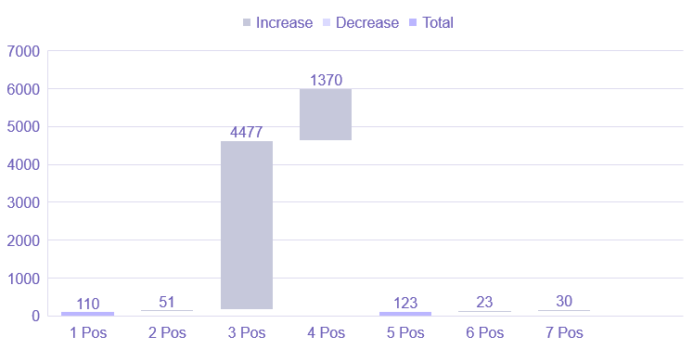
Virat Kohli’s batting position runs

Slide 11
4
Virat Kohli's batting position runs is 4477 at number 3.
The batting position of number 6 is upper less runs 23.

Slide 12
Virat Kohli’s centuries scored

Slide 13
5
Virat Kohli has more centuries in the second innings than 15
Virat Kohli has more centuries in the first innings than 8

Slide 14
Dismissals Virat Kohli faced most

Slide 15
6
Virat Kohli is most likely to be caught out
Virat Kohli is most likely to be hit wicket and stumped out

Slide 16
Against which team Virat Kohli scored most

Slide 17
Awesome words

Slide 18
198,300,000
Big numbers catch your audience’s attention

Slide 19

Phone mockup
You can replace the image on the screen with your own work. Just right-click on it and select “Replace image”

Slide 20
Thanks!
Do you have any questions?
youremail@freepik.com
+34 654 321 432
yourwebsite.com
Please keep this slide for attribution

Slide 21


