Slide 1
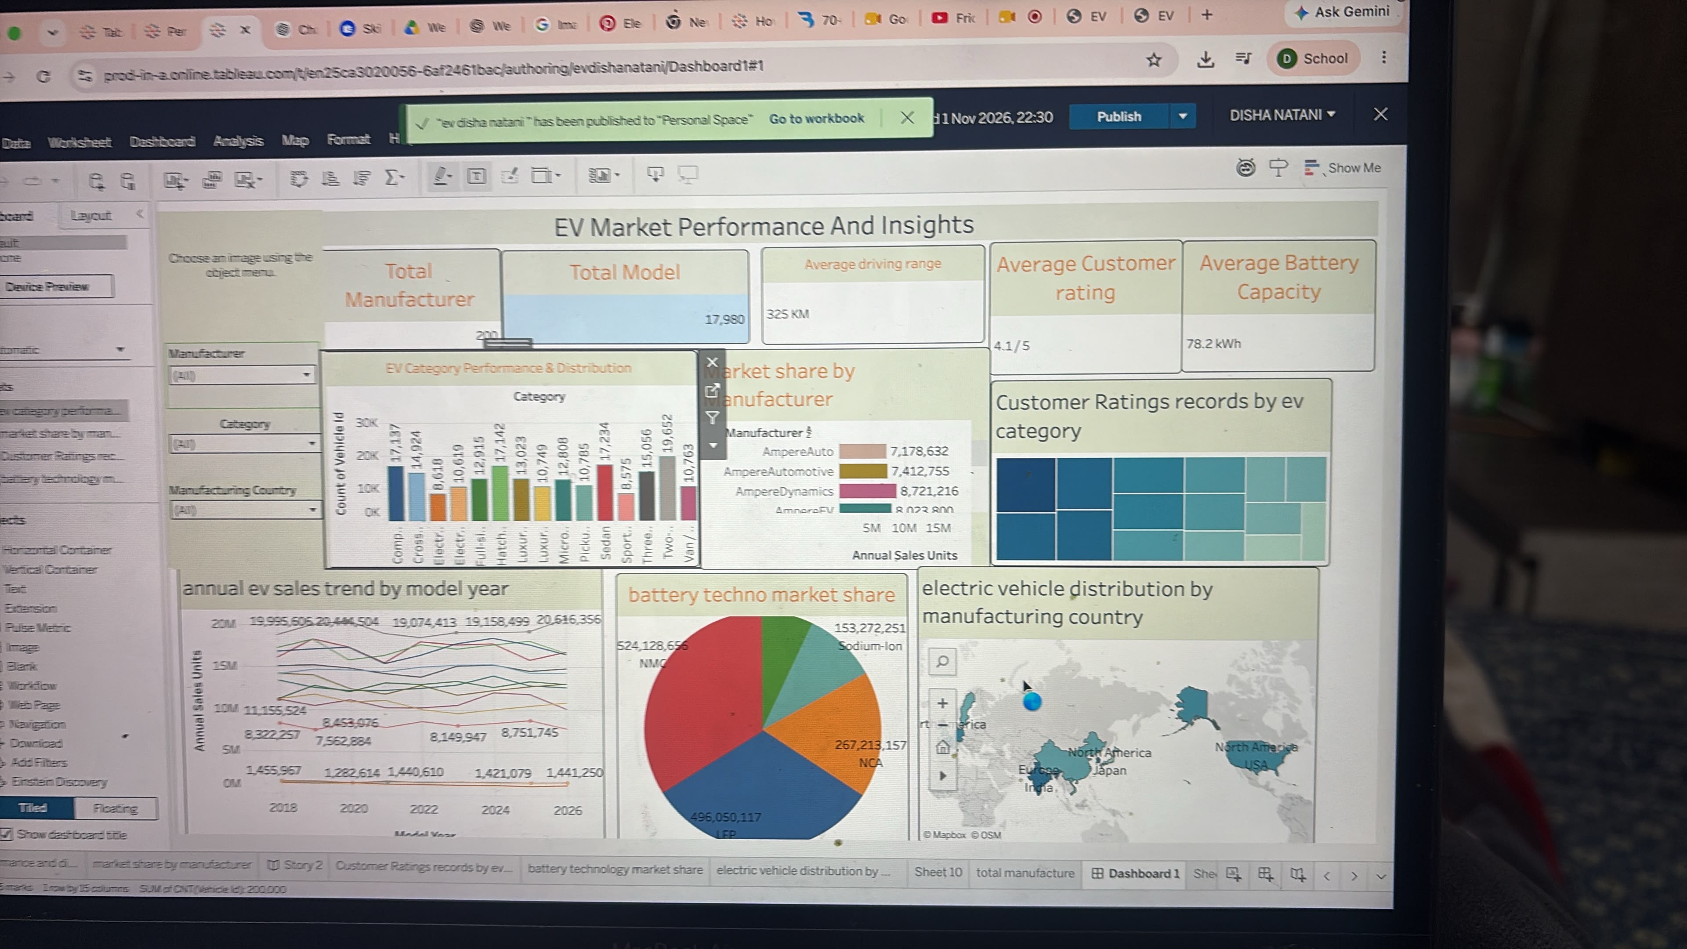
FINAL PROJECT PRESENTATION
EV MARKET PERFORMANCE & INSIGHTS
Understanding vehicle segments, manufacturers, sales, battery technology and geography
TABLEAU DASHBOARD
Presentation based on the workbook shown in the submitted screenshots.
Source: uploaded Tableau screenshots • visible values only
Notes:
Hello everyone. Today I will present our project, Electric Vehicle Market Performance and Insights. We used Tableau to explore EV categories, manufacturers, annual sales trends, battery technologies, and manufacturing geography. The visuals and key metrics in this presentation come from our Tableau workbook screenshots.

Slide 2
01 / OVERVIEW
Project objectives and analytical workflow
01
Connect and prepare
02
Explore the market
Build a consistent dataset for comparison
Evaluate categories, manufacturers and model years
03
Visualize performance
04
Tell the story
Use trends, bar charts, treemaps, pie charts and maps
Combine worksheets in one dashboard and interpret results
Source: uploaded Tableau screenshots • visible values only
Notes:
Our workflow has four main stages: data preparation, market exploration, visualization, and storytelling. We arranged the worksheets so viewers can see the overall picture first and then investigate specific categories and regions.

Slide 3
02 / KEY PERFORMANCE INDICATORS
Dashboard highlights
Manufacturers
Models
Avg driving range
200*
17,980
325 km
Avg customer rating
Avg battery capacity
4.1 / 5
78.2 kWh
* Manufacturer value is partly obscured in the dashboard screenshot and should be checked in Tableau.
Source: uploaded Tableau screenshots • visible values only
Notes:
The Tableau dashboard shows 17,980 models, an average driving range of 325 kilometers, an average customer rating of 4.1 out of 5, and an average battery capacity of 78.2 kilowatt-hours. The manufacturer figure is partly obscured in the photo, so it should be checked before quoting it as final. These are workbook-reported metrics, not independently audited figures.

Slide 4
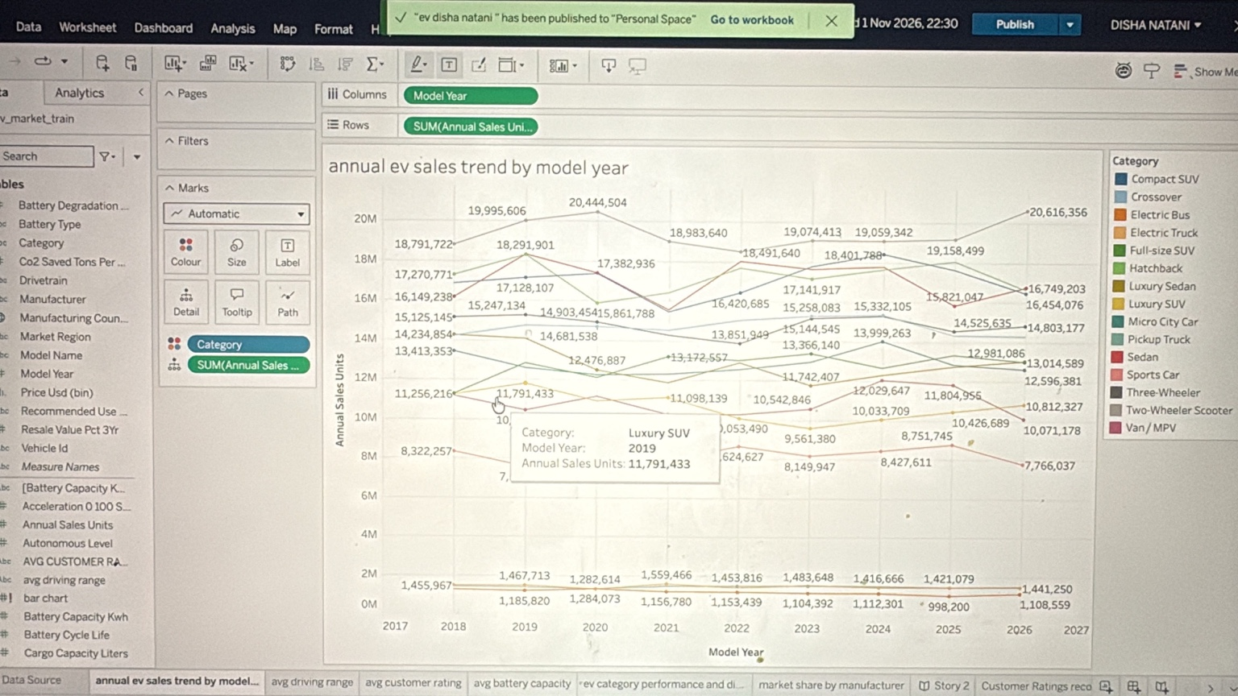
03 / TREND ANALYSIS
Annual EV sales by model year
WHAT THE CHART SHOWS
• Category-level annual sales from model years 2017–2026
• Different segments follow different patterns
• Comparisons work best when category and year are filtered
Source: uploaded Tableau screenshots • visible values only
Notes:
This line chart displays annual EV sales units by model year and EV category. The lines vary across 2017 to 2026. Some segments remain at a high level throughout the chart, while others are much smaller. We should not interpret model year as the year in which vehicles were sold without confirming the data definition. The useful takeaway is the difference in category-level patterns.

Slide 5
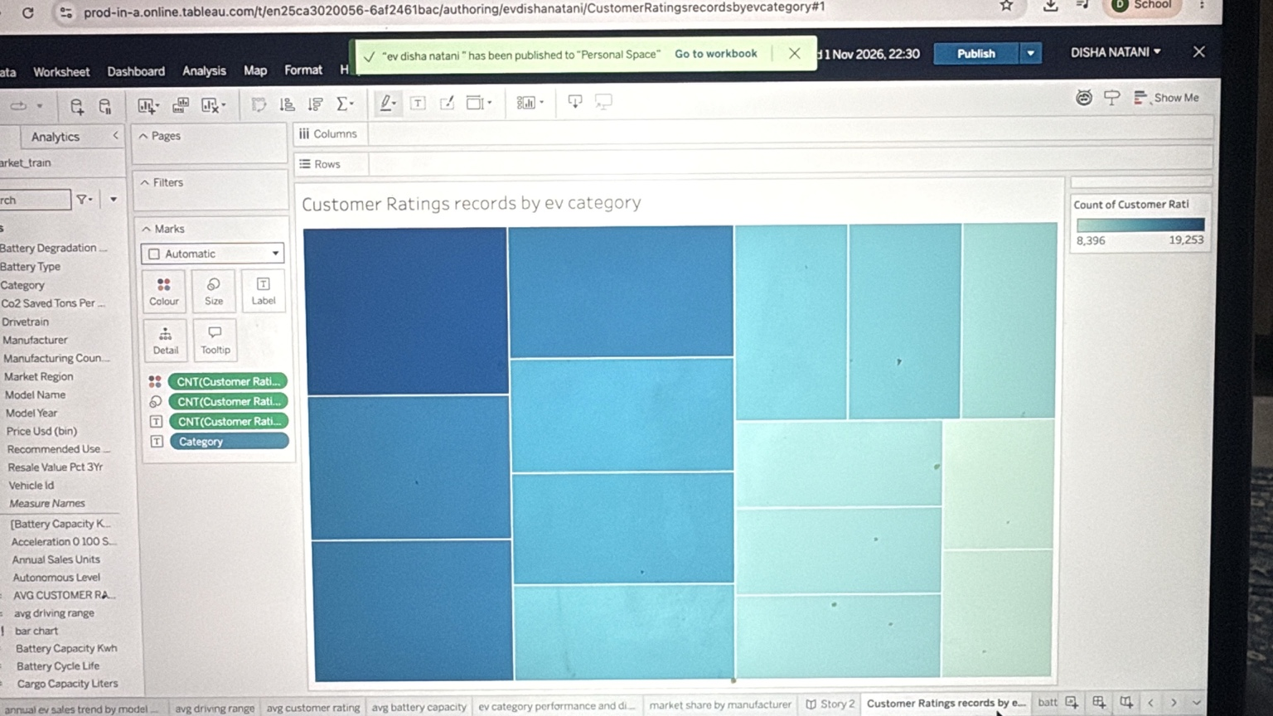
04 / SEGMENT COMPOSITION
EV category & customer-rating records
The treemap represents the count of customer-rating records in each EV category — not the rating score itself.
Source: uploaded Tableau screenshots • visible values only
Notes:
Here we compare category distribution and the number of customer-rating records. Larger treemap rectangles mean more records, not necessarily better customer satisfaction. The accompanying category bar chart helps compare the volume of vehicle records across segments. This distinction is important because counting rating records differs from averaging rating scores.

Slide 6
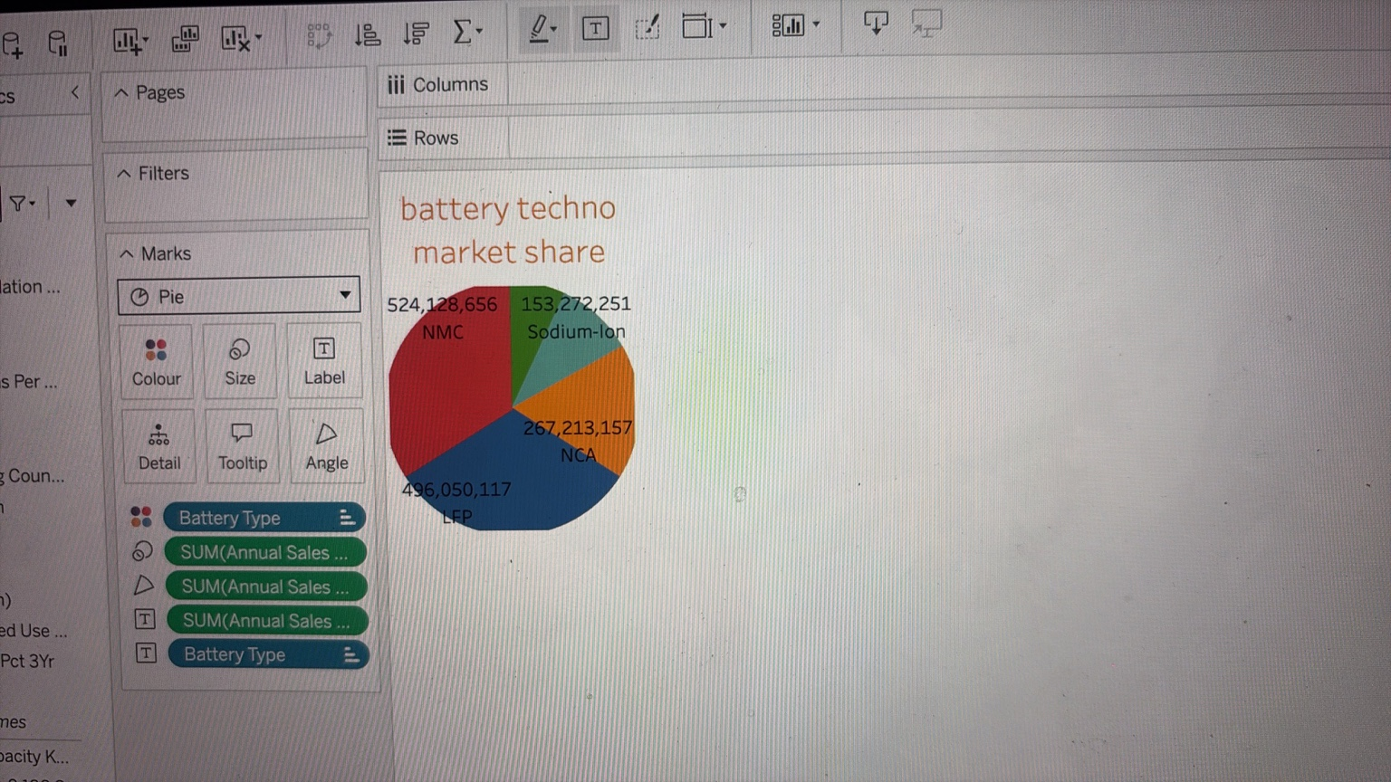
05 / TECHNOLOGY INSIGHTS
Battery technology composition
TECHNOLOGIES SHOWN
NMC
LFP
NCA
Sodium-ion
Pie slices use SUM(Annual Sales Units).
Source: uploaded Tableau screenshots • visible values only
Notes:
The battery-technology pie chart divides annual sales units across NMC, LFP, NCA, and sodium-ion. It is a comparison of recorded sales-unit totals, not a count of individual batteries. In the visible pie chart, NMC and LFP occupy the largest slices. The dataset behind this sheet should be reviewed for overlapping repeated annual figures before these totals are interpreted as unique vehicle sales.

Slide 7
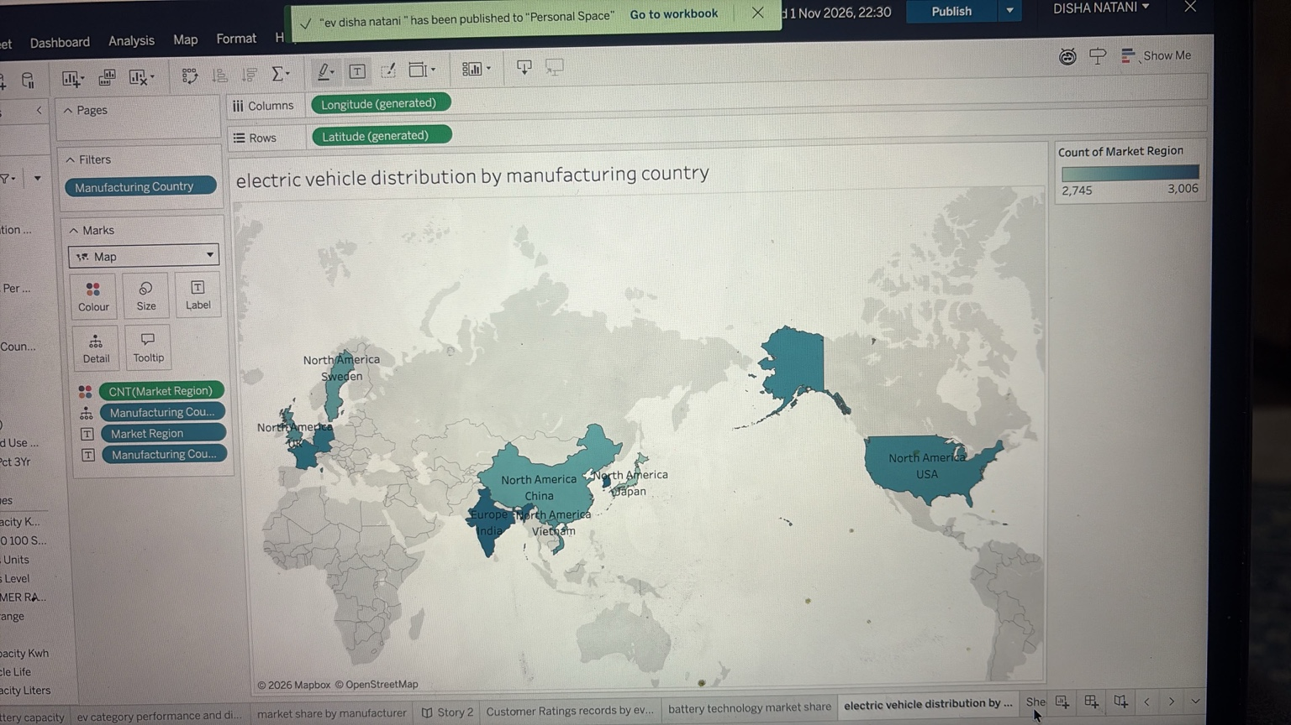
06 / GEOGRAPHIC ANALYSIS
Manufacturing-country distribution
MAP INTERPRETATION
Geographic patterns are visible across multiple regions.
Country labels and geographic roles should be checked for ambiguity before publication.
Source: uploaded Tableau screenshots • visible values only
Notes:
The filled map provides a global view of manufacturing-country distribution. In Tableau it is important to assign manufacturing country a geographic role and distinguish countries from broad market-region labels. The screenshot shows some labels such as North America appearing over country locations, so these labels should be cleaned up before the final public dashboard is published.

Slide 8
07 / DASHBOARD AND INTERACTION
Integrated Tableau dashboard
EXPLORE USING FILTERS
Manufacturer
Category
Manufacturing country
Source: uploaded Tableau screenshots • visible values only
Notes:
Our integrated dashboard brings together KPI cards and the category, manufacturer, sales-trend, battery and map visuals. The filter controls allow viewers to focus on a manufacturer, category or manufacturing country. During a live Tableau demo, we can select a category, observe which charts change, and reset the filters to return to the full market overview.

Slide 9
08 / CONCLUSION
Findings, limitations and next steps
Finding
The dashboard provides a multi-dimensional view of EV market performance.
Caution
Screenshots alone cannot establish original data quality or validate reported totals.
Improve
Fix map labels, avoid overcrowded data labels and clarify sales vs registration measures.
Next step
Publish the verified Tableau dashboard and link it from the companion website.
Source: uploaded Tableau screenshots • visible values only
Notes:
To conclude, Tableau helps bring several aspects of the EV market into one place. The strongest part of the project is its combination of KPI summaries, segments, trends, technology and geography. Before the final submission, we should verify ambiguous totals and geographic labels, and publish the workbook so the audience can explore the interactive views themselves. Thank you.

Slide 10
09 / QUESTIONS
Thank you
Electric Vehicle Market Performance & Insights
Questions and discussion
Source: uploaded Tableau screenshots • visible values only
Notes:
Thank you for your time. I would be happy to answer questions about our Tableau worksheets, dashboard interactions, EV category comparisons, and the limitations of the underlying data.

