Slide 1

AQI analysis of india using python
Presented By :
Ankita Pattanayak(250301370221)
Disha Nitran Sundi(250301370232)
Course : Data Analysis and visualization using python
Domain: Environment and climate

Slide 2
INTRODUCTION
What is AQI ?
AQI stands for Air Quality Index.
It indicates the level of air pollution.
It helps us understand the potential health effects of polluted air.
Air pollution is a major environmental concern in Indian cities.
Data analysis helps identify pollution patterns and trends.

Slide 3
﻿PROBLEM STATEMENT
Air pollution levels vary across Indian cities.
Pollutants such as PM2.5, PM10, NO₂, SO₂ and CO affect air quality.
Large datasets make it difficult to identify pollution patterns manually.
We need data visualization to compare cities and understand trends.
Our project analyzes historical AQI data to generate useful insights.

Slide 4
﻿OBJECTIVES
Analyze AQI levels across Indian cities.
Compare average AQI among cities.
Study yearly and monthly AQI trends.
Examine relationships between AQI and pollutants.
Detect potential outliers in the data.
Build an interactive dashboard using Python.
Generate an AI-assisted environmental policy brief.

Slide 5
﻿dataset description
DataSet : Air Quality Data in India(2015-2020)
Source: Kaggle — Rohan Rao
Open Dataset on Kaggle
Main file: city_day.csv
Original dataset: 29,531 rows and 16 columns.
Coverage: 26 Indian cities.
Date range: 1 January 2015 to 1 July 2020.
Important columns: City, Date, AQI, AQI_Bucket and
pollutant measurements.

Slide 6





TOOLS AND TECHNOLOGIES
Python
Main programming language used for data analysis.
Jupyter Notebook
Used for data cleaning, analysis and visualizations.
Pandas, NumPy
Used for data manipulation and numerical operations.
Plotly and Dash
Used to create interactive charts and the dashboard.
Visual Studio Code
Used to develop and run the dashboard application.

Slide 7
﻿Project workflow
DataSet Collection - Kaggle
Data Cleaning and preprocessing.
Exploratory Data Analysis(EDA).
Data Visualization and Outlier Detection.
Interactive Dashboard in VS Code
Insights , AI policy Brief and Conclusion

Slide 8
﻿data cleaning and preprocessing
Loaded the dataset using Pandas.
Checked missing values in the dataset.
Removed rows with missing AQI or AQI category.
Converted the Date column into datetime format.
Filled missing pollutant values using median imputation.
Created additional Year and Month columns.
Saved the cleaned dataset for further analysis.
Result: The cleaned dataset contains 24,850 rows and 17 columns.

Slide 9
﻿Exploratory Data Analysis (EDA)
Calculated average AQI for each city.
Analyzed yearly average AQI.
Studied pollutant concentrations.
Examined AQI category distribution.
Identified relationships between AQI and PM2.5.Used descriptive statistics to understand the dataset.
Used descriptive statistics to understand the dataset.

Slide 10
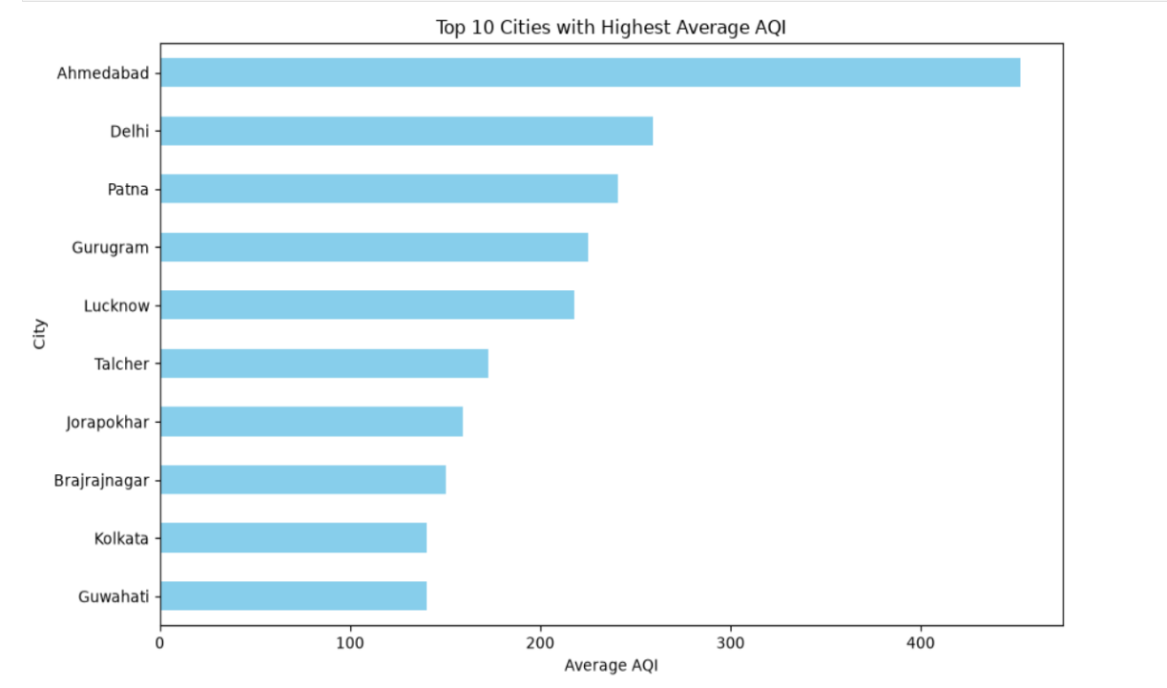
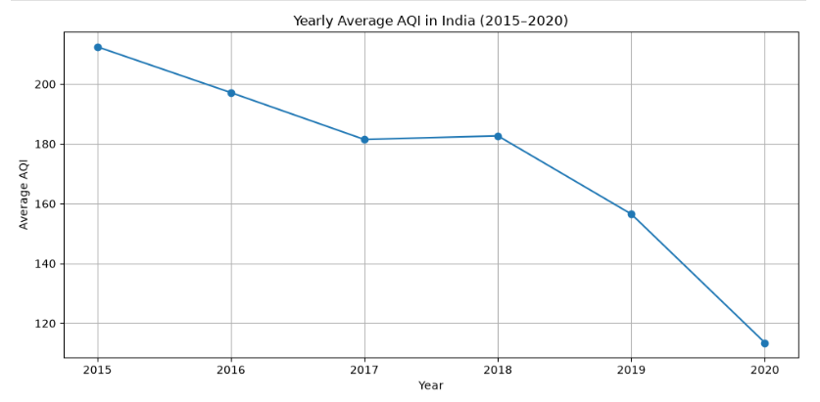
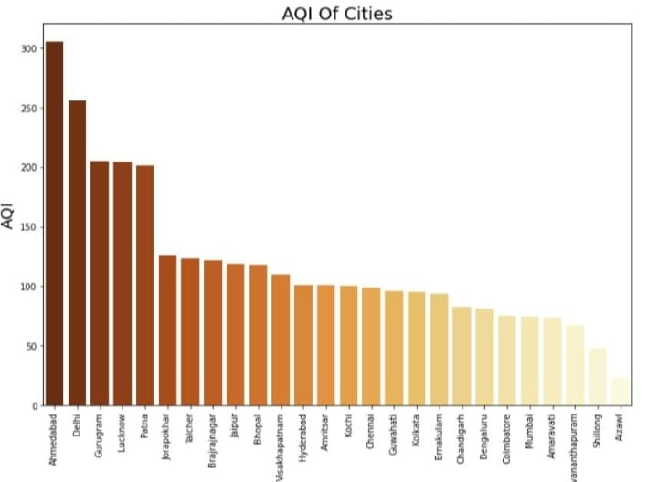
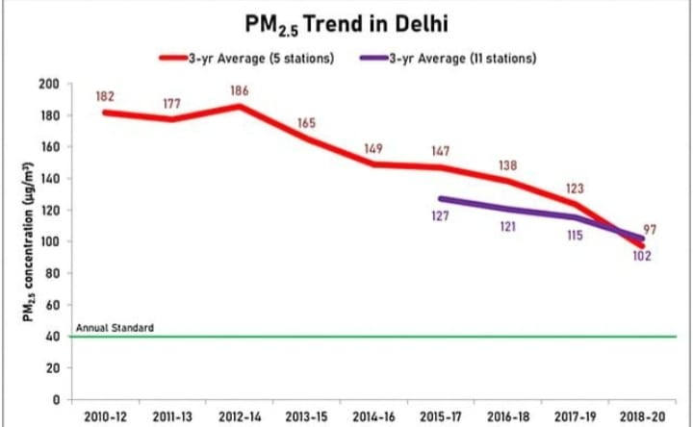
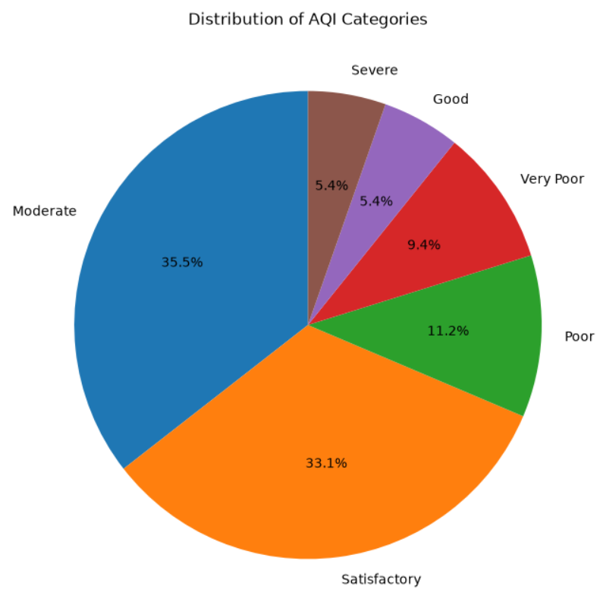
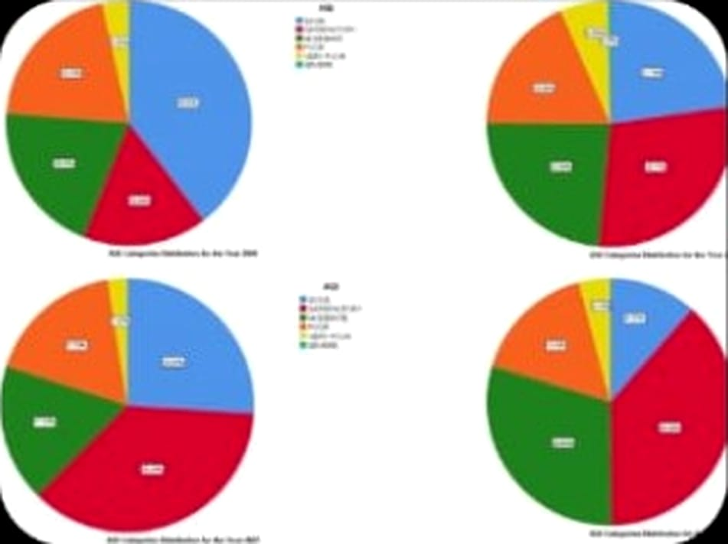
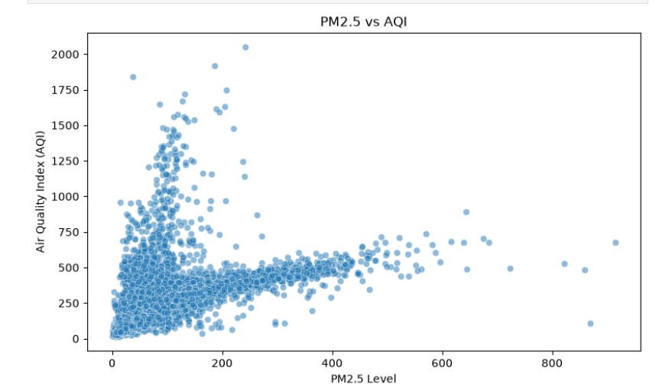
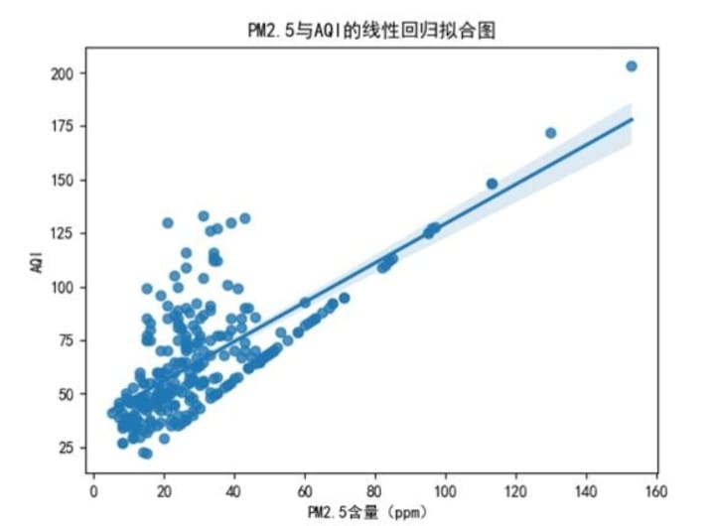
﻿Data VISUALIZATION
Line Chart:
Shows AQI trends over time.
Bar Chart:
Compares average AQI across cities.
Donut Chart:
Displays AQI category distribution.
Scatter Plot:
Explores PM2.5 and AQI relationships.

Slide 11
﻿key findings
Ahmedabad had the highest average AQI in our cleaned dataset, approximately 452.12.
Delhi had an average AQI of approximately 259.49.
PM10 showed the highest average concentration among the selected pollutants.
PM10 had a positive correlation with AQI in our analysis.
The yearly average AQI showed a decreasing pattern in the available data.
Note: The 2020 dataset ends on 1 July, so the 2020 yearly average is based on partial-year data. Historical results do not necessarily represent current air quality.

Slide 12
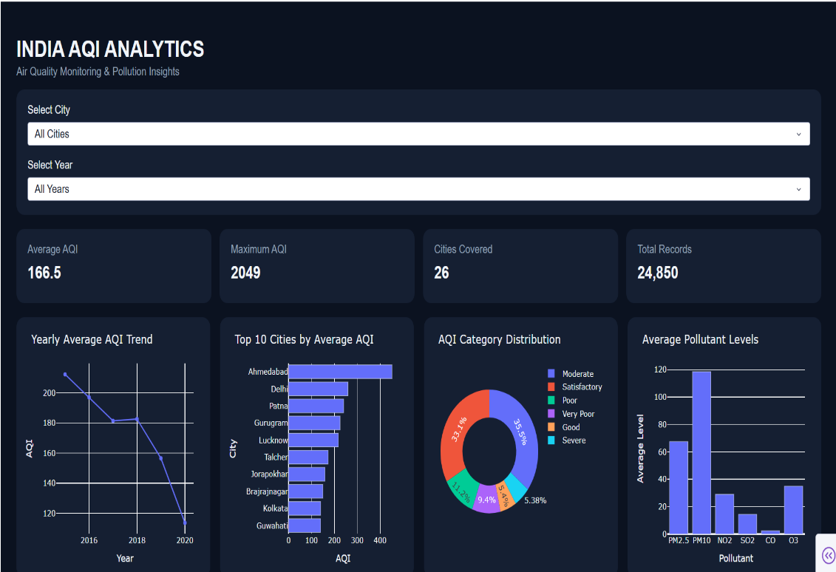
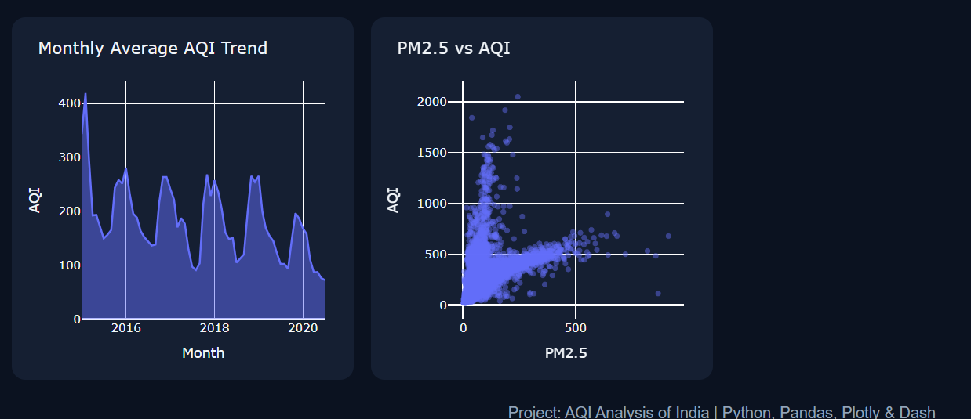
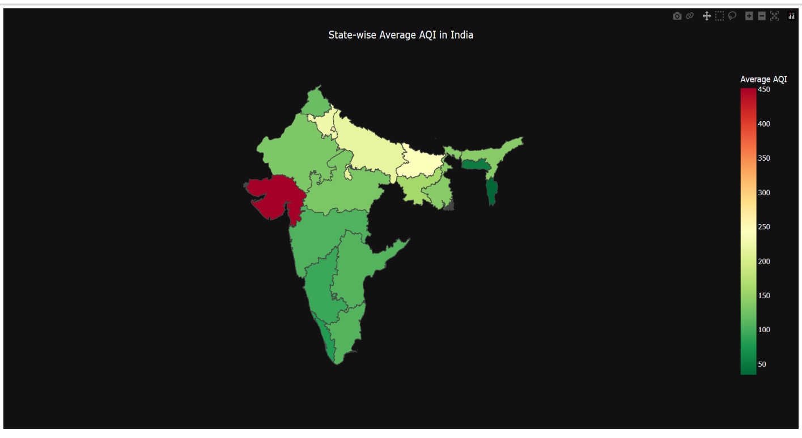
INTERACTIVE DASHBOARD
Dashboard Features:
Modern dark-themed interface.
Four summary cards: Average AQI, Maximum AQI, Cities Covered and Total Records.
Six graphs for different AQI analysis tasks.
City selection dropdown.
Year selection dropdown.
Interactive charts that update according to selected filters.
Technology: Python, Pandas, Plotly Express and Dash.

Slide 13
AI INTEGRATION USING GEMINI
Used Google Gemini to assist in preparing an environmental policy brief.
Provided the AI tool with findings from our AQI analysis.
Generated possible recommendations for reducing air pollution.
Used AI to help summarize the findings in a readable format.
AI-generated content should be checked against the actual dataset and reliable sources.
Purpose: To connect data analysis findings with possible environmental actions

Slide 14
Limitations and future scope
Limitations:
Future Scope:
t.
The dataset covers a historical period from 2015 to July 2020.
Some pollutant values were missing.
Outliers may affect average AQI calculations. Historical data cannot describe current air quality.
Historical data cannot describe current air quality.
Add more recent AQI data.
Integrate a map of India showing city-wise AQI.
Add real-time air quality monitoring.
Improve prediction using machine learning.
Add more filters and downloadable reports.

Slide 15
conclusion
Python helped us clean, analyze and visualize air quality data.
Visualizations made it easier to compare cities and identify patterns.
The interactive dashboard allows users to explore AQI data through city and year filters.
AI-assisted summarization helped us prepare environmental recommendations.

Slide 16
Thank you

