Slide 1
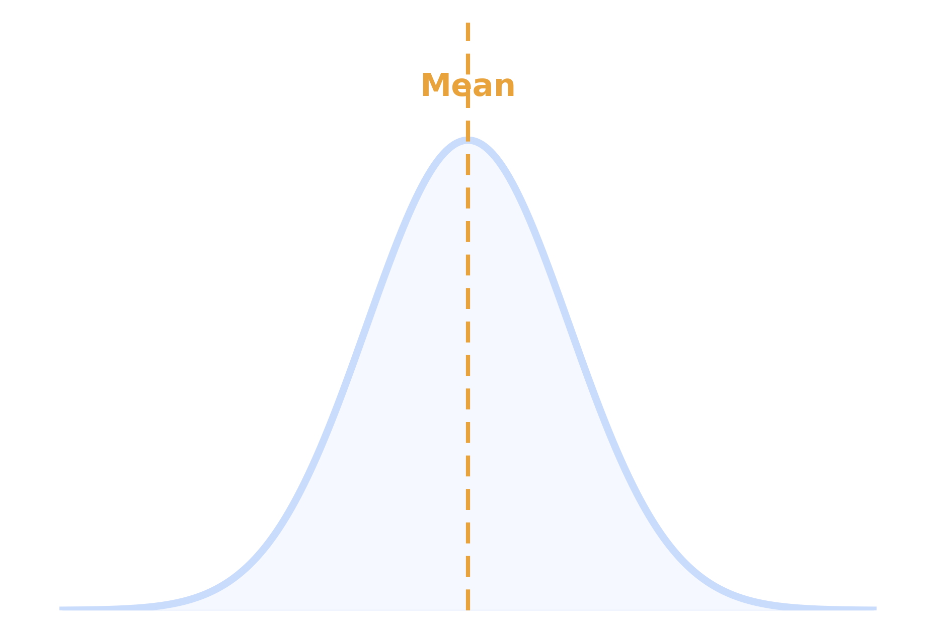
STATISTICS · SESSION 9
Normal Distribution
Understanding the bell curve, its properties, and why it powers modern statistics
STATUS
Completed
FORMAT
Concept + Demo
FOCUS
Bell curve intuition
SESSION 9 · NORMAL DISTRIBUTION
01

Slide 2
SESSION RECAP
What we covered today
01
What is Normal Distribution
02
Bell Curve Shape
Defining the concept and where it comes from
Reading the signature symmetric curve
03
Mean = Median = Mode
04
Standard Deviation's Role
Why the three measures coincide at the center
How spread shapes the curve's width
05
The 68-95-99.7 Rule
06
Real-World Examples & Why It's Used
Estimating probability from spread
Applications and hands-on graph demo
SESSION 9 · NORMAL DISTRIBUTION
02

Slide 3
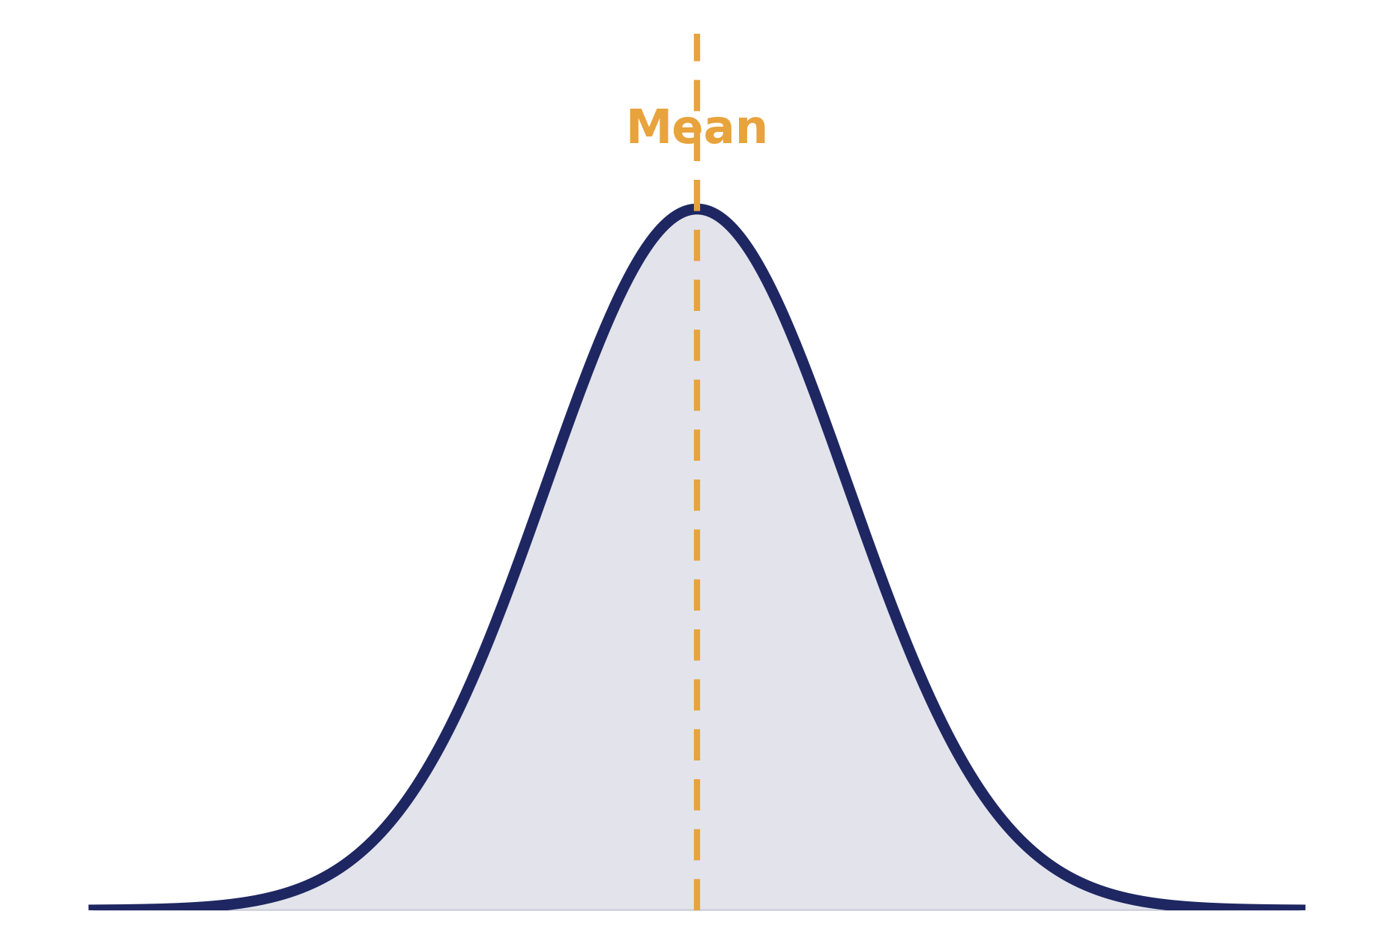
01 · CONCEPT
What is Normal Distribution?
A normal distribution is a probability pattern where most values cluster around a central average, and the frequency tapers off symmetrically the farther a value is from that center.
Symmetric
Left and right halves mirror each other around the mean.
Continuous
Describes numeric data that can take any value in a range.
Predictable
Its shape follows one exact mathematical formula.
Also called the “Gaussian distribution,” after mathematician Carl Friedrich Gauss.
SESSION 9 · NORMAL DISTRIBUTION
03

Slide 4
02 · SHAPE
The Bell Curve Shape
Rises smoothly
from low values on either tail toward the middle
Peaks at the center
where the mean, median, and mode sit together
Falls away symmetrically
mirroring the rise on the opposite side
Never touches zero
the tails extend infinitely, just get thinner
SESSION 9 · NORMAL DISTRIBUTION
04

Slide 5
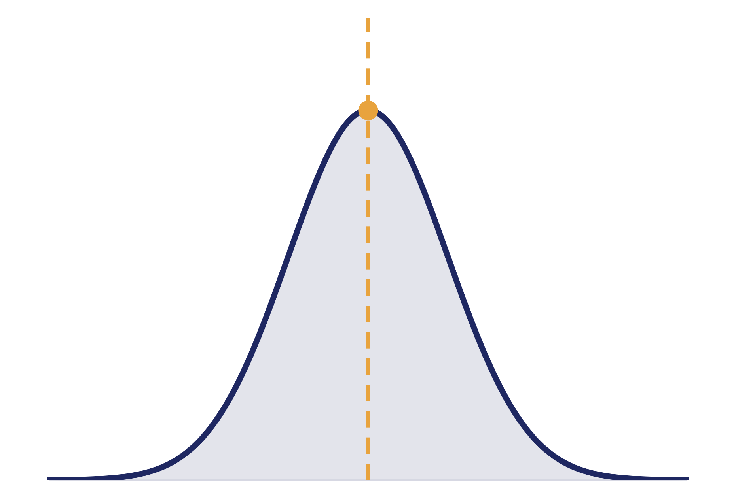
03 · CENTRAL TENDENCY
Mean = Median = Mode
Mean
The mathematical average of all data points.
Median
The exact middle value when data is sorted.
Mode
The value that occurs most frequently.
All three measures land on the exact same point at the peak.
This overlap only holds for perfectly symmetric distributions like the normal curve — it breaks down in skewed data.
SESSION 9 · NORMAL DISTRIBUTION
05

Slide 6
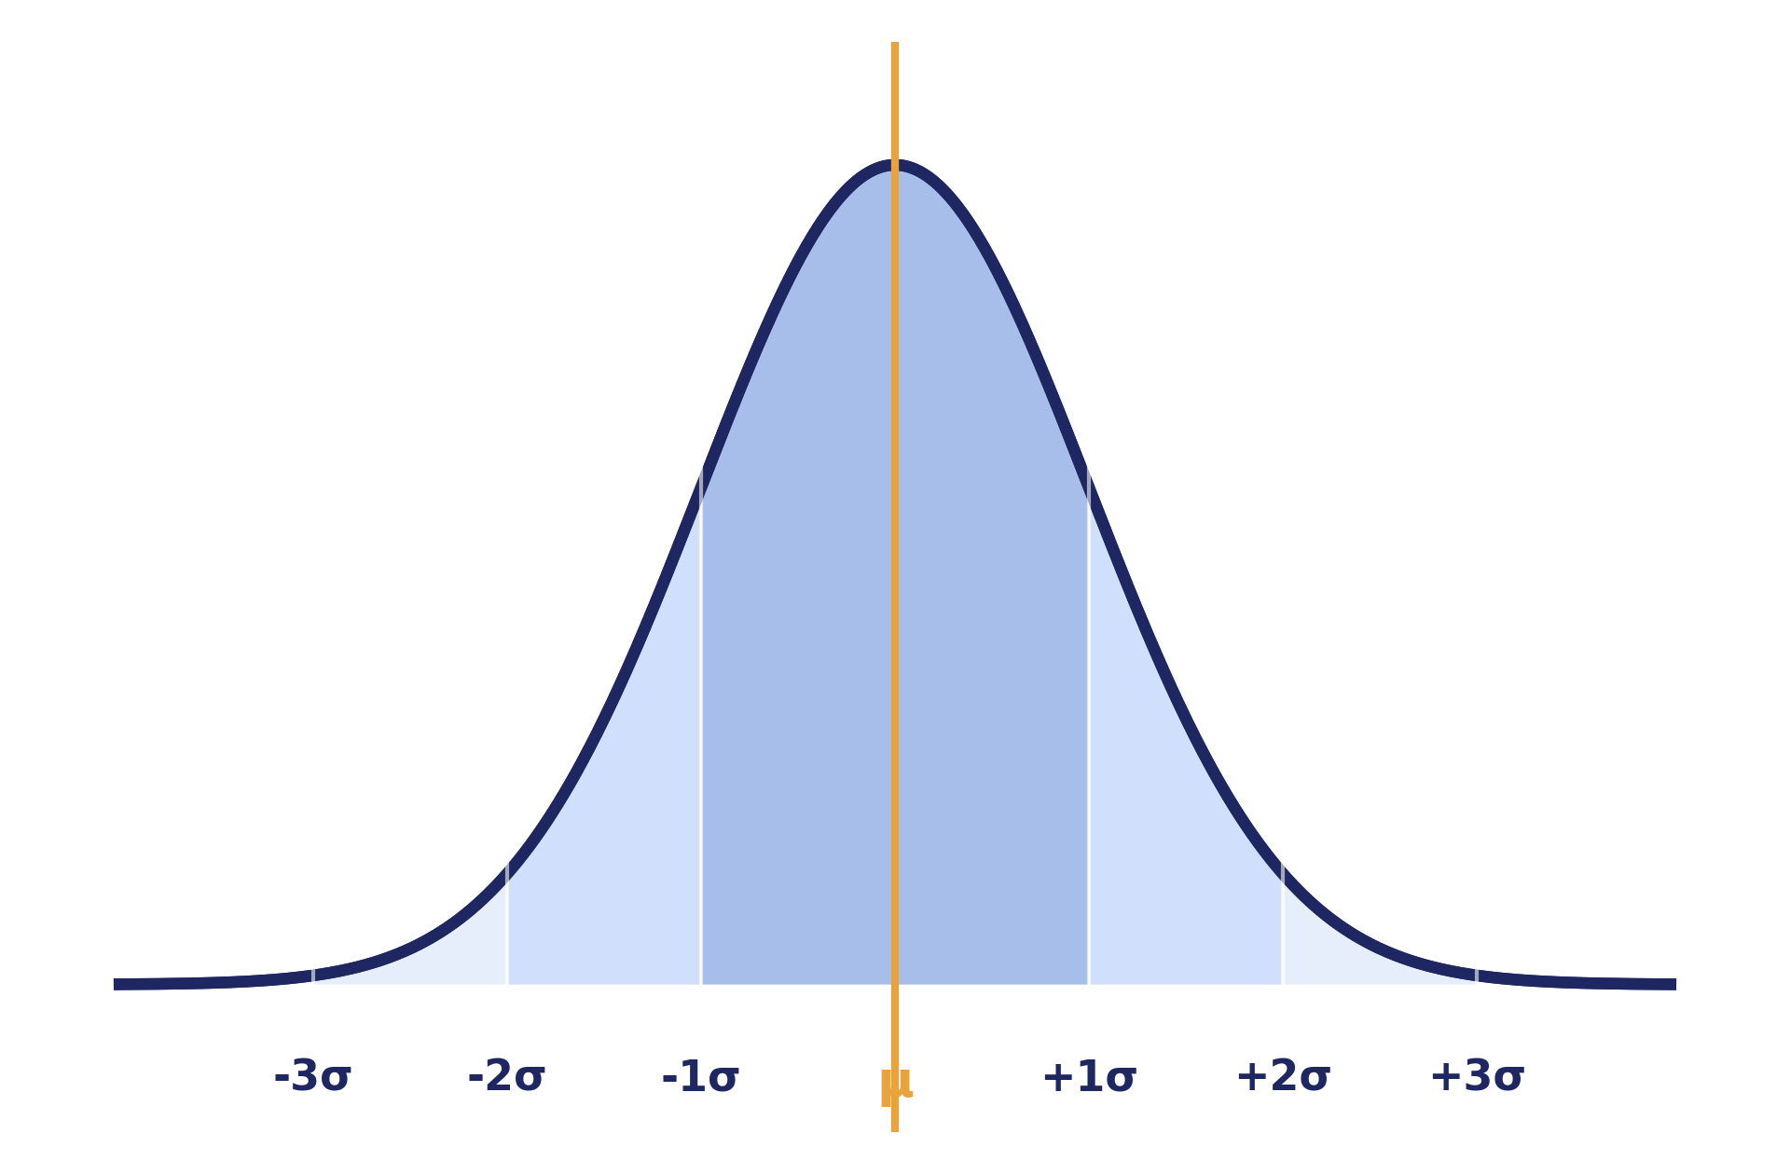
04 · SPREAD
The Role of Standard Deviation
Standard deviation (σ) measures how spread out the values are around the mean (μ). It's the ruler that gives the bell curve its width.
Small σ
Tall, narrow curve — values tightly clustered near the mean
Large σ
Short, wide curve — values spread far from the mean
SESSION 9 · NORMAL DISTRIBUTION
06

Slide 7
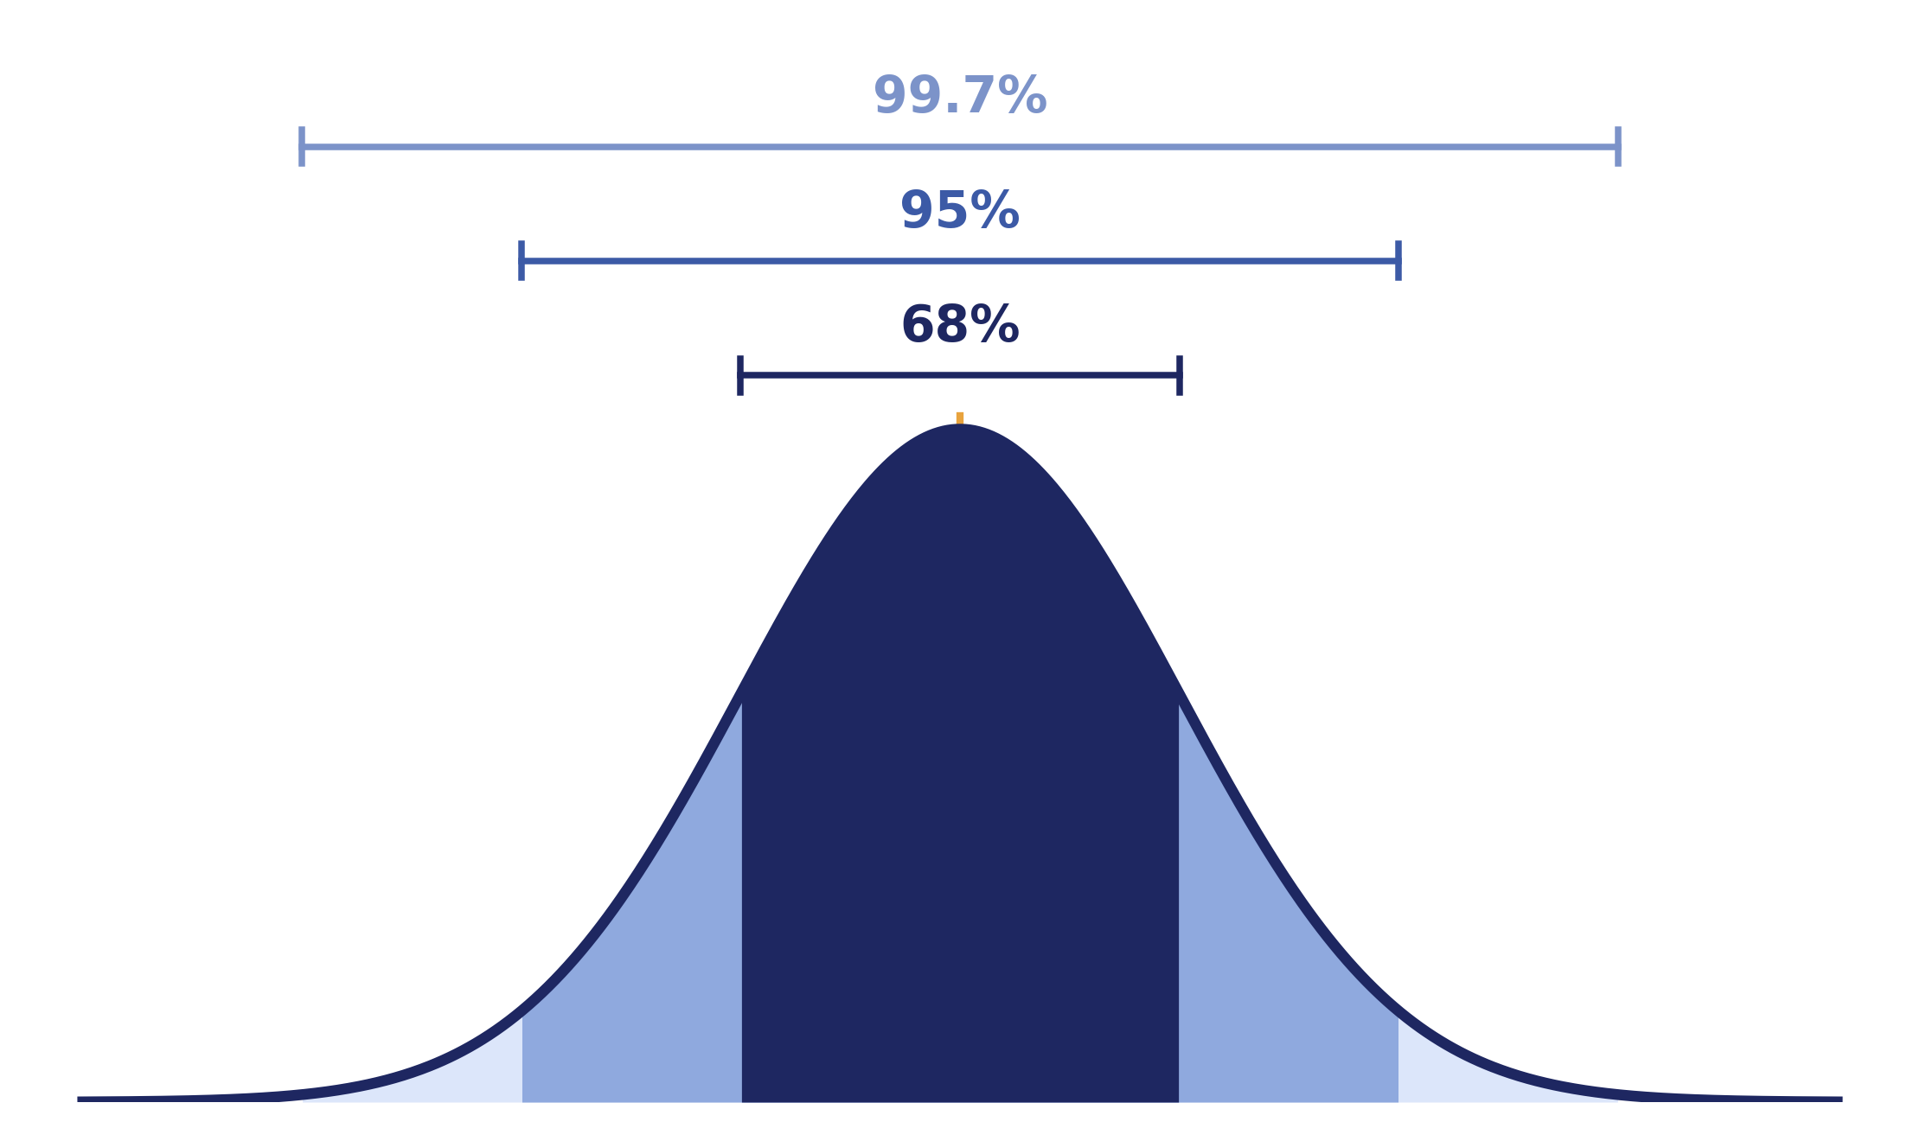
05 · EMPIRICAL RULE
The 68-95-99.7 Rule
68%
of data falls within 1 standard deviation of the mean (μ ± 1σ)
95%
of data falls within 2 standard deviations (μ ± 2σ)
99.7%
of data falls within 3 standard deviations (μ ± 3σ)
SESSION 9 · NORMAL DISTRIBUTION
07

Slide 8
06 · APPLICATIONS
Real-World Examples
1
2
3
Human Height
Exam Scores
Measurement Error
Adult heights within a population cluster tightly around an average.
Standardized test results across large groups of students.
Small random errors in scientific or industrial measurements.
4
5
6
Blood Pressure
IQ Scores
Manufacturing Tolerances
Readings across a large, healthy population.
Intelligence test results are deliberately scaled to be normal.
Slight variation in machine-produced part dimensions.
SESSION 9 · NORMAL DISTRIBUTION
08

Slide 9
07 · SIGNIFICANCE
Why It's Used in Statistics
Central Limit Theorem
Simplifies Analysis
Averages of large samples tend toward a normal shape, regardless of the original data's distribution.
One well-understood formula lets us calculate probabilities without complex case-by-case work.
Foundation for Inference
Comparable Across Fields
Confidence intervals, hypothesis tests, and control charts all assume or approximate normality.
The same 68-95-99.7 logic applies whether the data is scores, prices, or measurements.
SESSION 9 · NORMAL DISTRIBUTION
09

Slide 10
HANDS-ON · DEMO
Graph Explanation Walkthrough
In the live demo, we plotted a real dataset and walked through the curve step by step:
1
2
3
4
5
Plot the data
Overlay the curve
Mark the center
Mark the spread
Read probabilities
Build a histogram of raw values to see the emerging shape.
›
Fit the smooth normal curve on top of the histogram.
›
Locate the mean and confirm it aligns with the peak.
›
Draw the ±1σ, ±2σ, ±3σ bands across the curve.
›
Use the 68-95-99.7 rule to estimate real chances.
SESSION 9 · NORMAL DISTRIBUTION
10

Slide 11
SESSION 9 · WRAP-UP
Key Takeaways
A normal distribution is a symmetric, bell-shaped spread of data centered on its mean.
Mean, median, and mode all converge at the same central peak.
Standard deviation controls how wide or narrow the bell curve is.
The 68-95-99.7 rule turns standard deviations into quick probability estimates.
It shows up everywhere — from heights and test scores to manufacturing — because of the Central Limit Theorem.
Next session: Introduction to Probability Distributions beyond Normal
SESSION 9 · NORMAL DISTRIBUTION
11

