Slide 1
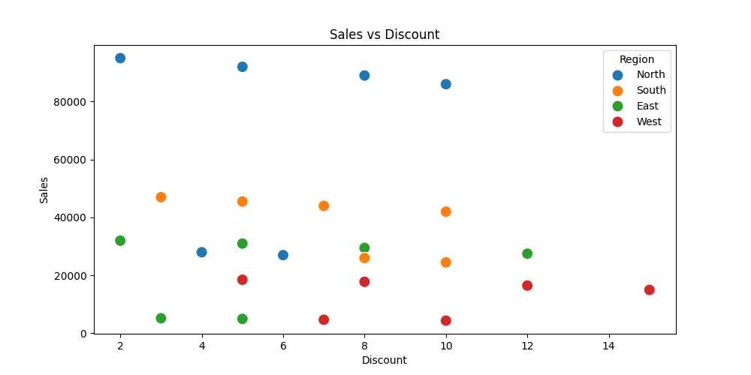
Sales vs Discount

