Slide 1
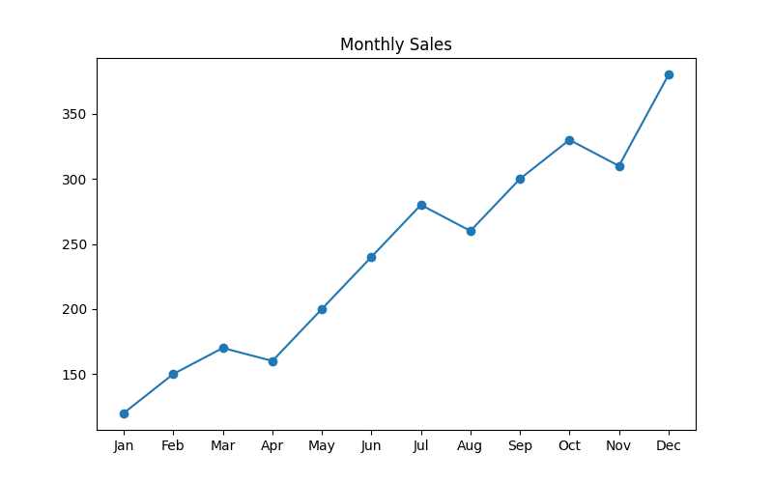
Monthly Sales Report

