Slide 1
DEEP LEARNING · SEQUENCE MODELS
Gated Recurrent Unit
A simpler, faster alternative to LSTM for learning long-term dependencies in sequential data
ARCHITECTURE
2 gates — Update & Reset
BUILT ON
Recurrent Neural Networks
COMMON USES
Time-series, text, speech, sensors
GRU · GATED RECURRENT UNIT
01

Slide 2
OVERVIEW
What we'll cover
01
What is GRU?
02
Why We Need It
Definition, intuition, and where it's used
The vanishing gradient problem in plain RNNs
03
RNN → LSTM → GRU
04
Update & Reset Gates
How the architecture evolved for efficiency
The two mechanisms that make GRU work
05
Math & Comparison
06
Hands-On Example
Equations, GRU vs LSTM, and training speed
Code, input shapes, and interview questions
GRU · GATED RECURRENT UNIT
02

Slide 3
01 · INTRODUCTION
What is GRU?
GRU (Gated Recurrent Unit)
THE CORE IDEA
A type of Recurrent Neural Network designed to handle long-term dependencies in sequential data — similar to LSTM, but with a simpler architecture and fewer gates.
Sequential Input
SIMPLE DEFINITION
Update Gate
Reset Gate
An improved RNN that uses gates to decide what information to remember and what to forget.
COMMONLY USED FOR
Time-series prediction
Text classification
New Hidden State
Text generation
Speech processing
Gates control what passes from one step to the next.
Anomaly detection
Sensor data forecasting
GRU · GATED RECURRENT UNIT
03

Slide 4
02 · MOTIVATION
Why Do We Need GRU?
A basic RNN struggles to remember information from far back in a sequence — the vanishing gradient problem.
EXAMPLE
GRU SOLVES THIS
“I started learning Python in 2022.”
using gates
...
Gates actively decide which information is worth carrying forward across many time steps, instead of letting it fade passively.
...
...
“I am very good at ______.”
To predict the answer, the model needs information from much earlier — but a normal RNN gradually loses that old information.
GRU · GATED RECURRENT UNIT
04

Slide 5
03 · EVOLUTION
RNN → LSTM → GRU
RNN
LSTM
GRU
BASELINE
THE FIX
THE REFINEMENT
Simple recurrence; struggles with long-term memory (vanishing gradient)
Adds 3 gates + a cell state; powerful but complex and slower to train
Simplifies LSTM to 2 gates; fewer parameters, usually faster training
Each step trades some representational power for simplicity and speed — GRU lands on a practical middle ground.
GRU · GATED RECURRENT UNIT
05

Slide 6
04 · ARCHITECTURE
Inside the GRU Cell
A GRU mainly uses two gates working together to produce the new hidden state.
Previous Hidden State (hₜ₋₁)
Update Gate
Reset Gate
“What to remember?”
“What to forget?”
Input xₜ
GRU Cell
New Hidden State
GRU · GATED RECURRENT UNIT
06

Slide 7
05 · UPDATE GATE
The Update Gate
How much old information should I keep?
KEY INSIGHT
The update gate acts like a combination of LSTM's forget gate and input gate — one mechanism doing both jobs.
The update gate controls the flow of information from the previous hidden state into the new hidden state.
EXAMPLE
z
= σ(W
xₜ + Uz hₜ₋₁)
t
z
Previous: “I studied Python.”
Output is a value between 0 and 1 — the closer to 1, the more of the past is preserved.
Current: “I am learning TensorFlow.”
Keep old information?
Yes
Replace with new info?
Partially
GRU · GATED RECURRENT UNIT
07

Slide 8
06 · RESET GATE
The Reset Gate
How much of the past should I ignore right now?
KEY INSIGHT
Reset gate = controls how much previous information is used when forming the new candidate memory.
The reset gate decides how much of the previous hidden state should be ignored when processing the current input.
EXAMPLE
r
= σ(W
xₜ + Ur hₜ₋₁)
t
r
Previous: “The weather yesterday was terrible.”
Determines how much previous information influences the current candidate state.
Current: “Today I am learning Python.”
The old weather info isn't useful here — the reset gate reduces its influence on the new candidate state.
GRU · GATED RECURRENT UNIT
08

Slide 9
07 · QUICK COMPARE
Update Gate vs Reset Gate
Update Gate
Reset Gate
What information should I KEEP?
What previous information should I IGNORE?
Keep / replace information across time steps
Forget old information that's not relevant now
Easy way to remember: UPDATE → keep / replace · RESET → forget old
GRU · GATED RECURRENT UNIT
09

Slide 10
08 · SEQUENCE PROCESSING
How Information Flows Through GRU
The GRU processes one token at a time, carrying a hidden state forward through the sequence.
STEP 1
STEP 2
STEP 3
STEP 4
"I"
"love"
"machine"
"learning"
+ h₁
+ h₂
+ h₃
GRU
GRU
GRU
GRU
h₁
h₂
h₃
h₄
Each hidden state carries forward the useful information the gates decided to keep.
GRU · GATED RECURRENT UNIT
10

Slide 11
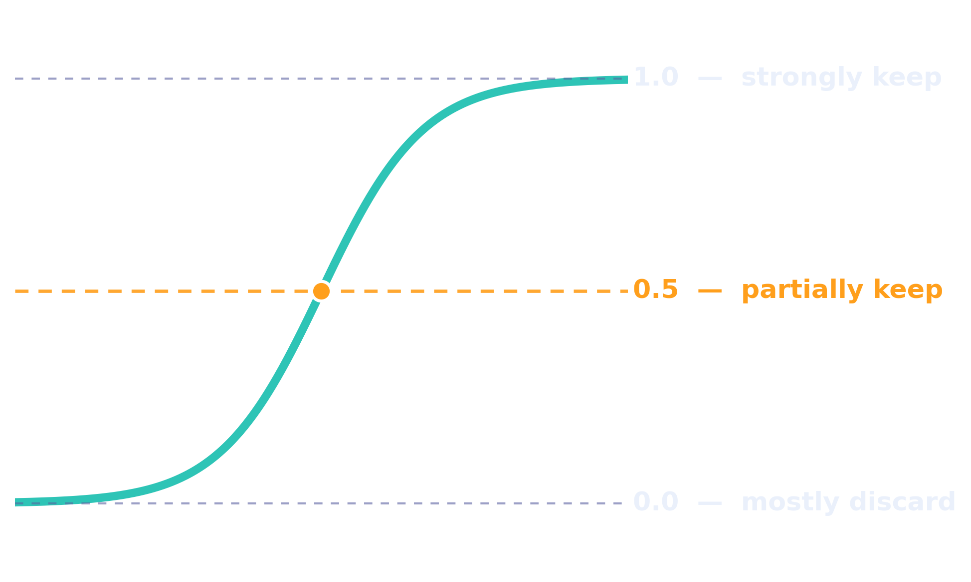
09 · THE MATH
GRU: The Mathematical Idea
Both gates share the same shape — a weighted mix of the current input and previous state, squashed through a sigmoid.
Update gate: zₜ = σ(Wz xₜ + Uz hₜ₋₁)
SIGMOID OUTPUT RANGE
Reset gate: rₜ = σ(Wr xₜ + Ur hₜ₋₁)
xₜ
current input
hₜ₋₁
previous hidden state
zₜ / rₜ
update / reset gate
σ
sigmoid activation
GRU · GATED RECURRENT UNIT
11

Slide 12
10 · COMPARISON
RNN vs LSTM vs GRU
Feature
RNN
LSTM
GRU
Long-term memory
Poor
Excellent
Good
Gates
None
3 main gates
2 gates
Cell state
No
Yes
No
Hidden state
Yes
Yes
Yes
Complexity
Low
High
Medium / Low
Training speed
Fast
Slower
Usually faster than LSTM
Parameters
Few
More
Fewer than LSTM
GRU · GATED RECURRENT UNIT
12

Slide 13
11 · EFFICIENCY
Why Does GRU Train Faster?
GRU has a simpler architecture, which cascades into real training-time savings.
LSTM
GRU
More gates
Fewer gates
More parameters
Fewer parameters
More calculations
Fewer calculations
More computational cost
Usually faster training
Not guaranteed for every dataset, model, or hardware setup — but GRU is often faster in practice.
GRU · GATED RECURRENT UNIT
13

Slide 14
12 · PRACTICAL EXAMPLE
Temperature Prediction
Suppose we have a week of daily temperatures and want to predict the next value from the last three days.
Day
1
2
3
4
5
6
7
THE MODEL LEARNS
Temp (°C)
30
31
32
33
35
36
37
Previous Temperatures
SEQUENCES CREATED
[30, 31, 32] → 33
GRU
[31, 32, 33] → 35
[32, 33, 35] → 36
Predicted Next Temperature
[33, 35, 36] → 37
GRU · GATED RECURRENT UNIT
14

Slide 15
13 · IMPLEMENTATION
A Simple TensorFlow GRU Model
import numpy as np
import tensorflow as tf
from tensorflow.keras.models import Sequential
from tensorflow.keras.layers import GRU, Dense
# Dataset
data = np.array([30, 31, 32, 33, 35, 36, 37, 38, 40, 41], dtype=float)
# Create sequences of length 3
X, y = [], []
for i in range(len(data) - 3):
X.append(data[i:i+3])
y.append(data[i+3])
X = np.array(X).reshape((-1, 3, 1))
y = np.array(y)
# Build & train the GRU model
model = Sequential([GRU(32, input_shape=(3, 1)), Dense(1)])
model.compile(optimizer="adam", loss="mse")
model.fit(X, y, epochs=100, verbose=1)
GRU · GATED RECURRENT UNIT
15

Slide 16
14 · KEY DETAIL
Understanding GRU Input Shape
This is the most important line to understand when working with RNN, LSTM, or GRU layers.
GRU(32, input_shape=(3, 1))
GRU(32)
Create a GRU layer with 32 hidden units.
input_shape=(3, 1)
3 = sequence length (timesteps) · 1 = number of features
THE GENERAL SHAPE
samples
timesteps
features
number of training sequences
time steps per sequence
values recorded per step
Example: X.shape → (7, 3, 1) — 7 training sequences, 3 timesteps, 1 feature (temperature)
GRU · GATED RECURRENT UNIT
16

Slide 17
15 · APPLICATIONS
Real-World Use & When to Choose GRU
A factory temperature sensor is a good mental model — a GRU learns from past sensor values to anticipate what's next.
Predictive Maintenance
Anomaly Detection
Machine Monitoring
Sensor Forecasting
Anticipate equipment failure from sensor trends
Flag unusual patterns in streaming data
Track evolving readings from industrial systems
Predict future values from historical sensor data
USE GRU WHEN YOU HAVE SEQUENTIAL DATA
Time series
Text sequence
Sensor readings
Speech sequence
GRU — captures dependencies without LSTM's complexity
GRU · GATED RECURRENT UNIT
17

Slide 18
16 · INTERVIEW PREP
Frequently Asked Questions
Q1
What is GRU?
Q2
How many main gates does GRU have?
An RNN architecture that captures short- and long-term dependencies using update and reset gates.
Two — the Update Gate and the Reset Gate.
Q3
What does the update gate do?
Q4
What does the reset gate do?
Controls how much previous information is retained vs. replaced with new information.
Controls how much of the previous hidden state is ignored when processing the current input.
Q5
GRU vs LSTM?
GRU is simpler, with fewer gates and parameters, and often trains faster; LSTM has a separate cell state and more gating.
GRU · GATED RECURRENT UNIT
18

Slide 19
SUMMARY
Key Takeaways
GRU is a simplified RNN that uses two gates — Update and Reset — to manage long-term dependencies.
The update gate decides what to keep; the reset gate decides what previous context to ignore.
GRU trades some of LSTM's power for fewer parameters and usually faster training.
It expects input shaped as (samples, timesteps, features).
Common uses: time-series, text, speech, and sensor data — anywhere order matters.
Next: Bidirectional & Stacked GRU architectures
GRU · GATED RECURRENT UNIT
19

