Slide 1
PRODUCT ANALYTICS / GROWTH
Swiggy Food Delivery Funnel
& Retention Analytics
Finding conversion friction and shaping a measurable repeat-order hypothesis
01 FUNNEL ANALYSIS
02 RETENTION
03 EXPERIMENT DESIGN
Map the journey from app open to order placement.
Separate order frequency from matured 7-day repeat behaviour.
Propose Quick Reorder with a primary metric and guardrails.
Dishant Kumar • Associate Product Manager portfolio case study
INDEPENDENT PORTFOLIO PROJECT • SYNTHETIC DATA • NOT SWIGGY INTERNAL METRICS
01

Slide 2
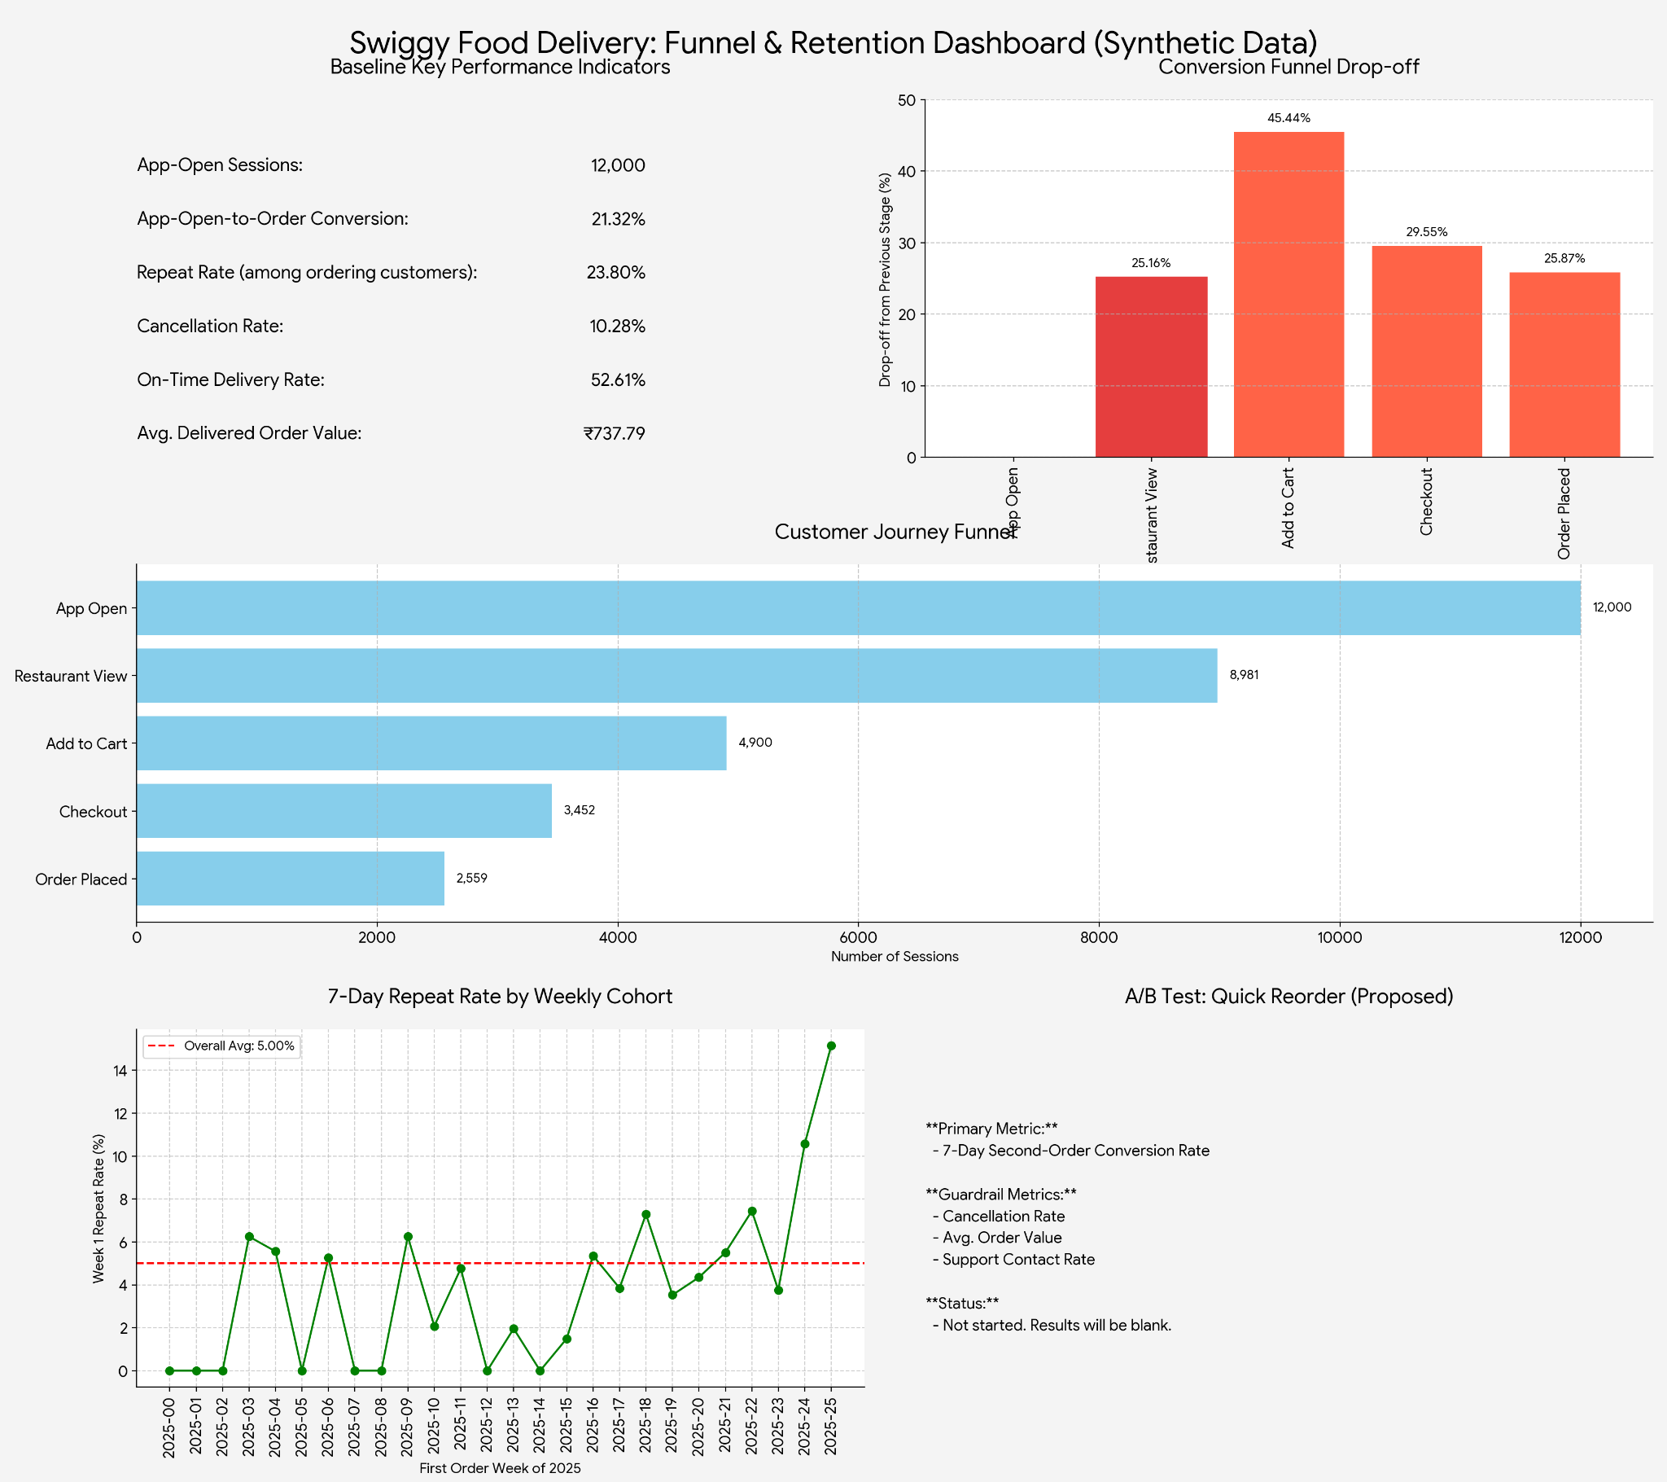
BASELINE ANALYSIS
Funnel & Retention Dashboard
Synthetic dataset overview • visual summary of the analysis
INDEPENDENT PORTFOLIO PROJECT • SYNTHETIC DATA • NOT SWIGGY INTERNAL METRICS
02

Slide 3
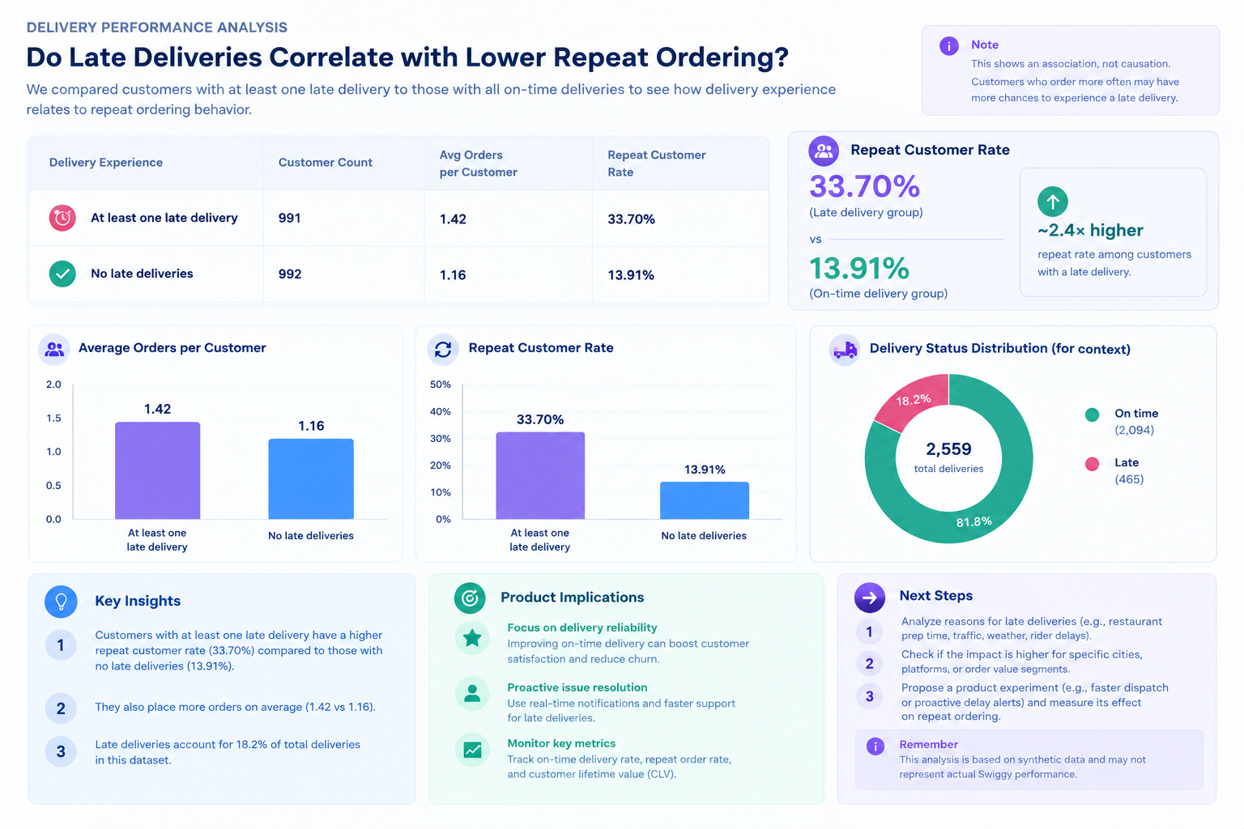
DELIVERY PERFORMANCE ANALYSIS
Do Late Deliveries Correlate with Repeat Ordering?
Association in this synthetic dataset; this comparison does not establish causation.
INDEPENDENT PORTFOLIO PROJECT • SYNTHETIC DATA • NOT SWIGGY INTERNAL METRICS
03

Slide 4
WHAT THE FUNNEL SAYS
The largest observed drop-off is before add-to-cart
The data identifies where to investigate, not the underlying reason for abandonment.
APP OPEN
RESTAURANT VIEW
ADD TO CART
CHECKOUT
ORDER PLACED
12,000
Starting sessions
›
8,981
74.84% from prior stage
›
4,900
54.56% from prior stage
›
3,452
70.45% from prior stage
›
2,559
74.13% from prior stage
APP-OPEN → ORDER
LARGEST STEP DROP-OFF
HYPOTHESES TO VALIDATE
21.33%
45.44%
• Dish discovery or menu fit
• Price, fees, or delivery-time uncertainty
• Customization friction
Next: validate through event diagnostics and user research.
2,559 / 12,000 sessions
Restaurant view → add-to-cart
Platform differences were modest in this synthetic dataset; this alone does not justify a platform-specific fix.
INDEPENDENT PORTFOLIO PROJECT • SYNTHETIC DATA • NOT SWIGGY INTERNAL METRICS
04

Slide 5
RETENTION ANALYSIS
Use the right denominator for each retention question
Repeat-customer share and 7-day repeat rate answer different questions.
REPEAT CUSTOMERS
7-DAY REPEAT RATE
ONE-ORDER CUSTOMERS
DELIVERED ORDERS
23.80%
5.00%
76.20%
2,296
472 / 1,983 ordering customers
78 / 1,561 eligible customers
1,511 / 1,983 ordering customers
2,559 placed; 263 cancelled
WHAT WE CAN SAY
WHAT WE SHOULD NOT CLAIM
• Most ordering customers placed only one order in the observed period.
• A 7-day repeat metric needs a full follow-up window.
• Delivery, price, food quality, and customer needs are possible factors—not proven causes.
• These are not Swiggy's internal metrics.
• Repeat behaviour alone does not explain motivation.
• A retrospective baseline is not an A/B-test control result.
INDEPENDENT PORTFOLIO PROJECT • SYNTHETIC DATA • NOT SWIGGY INTERNAL METRICS
05

Slide 6
PRODUCT PROPOSAL
Quick Reorder: reduce effort without removing customer control
Proposed experience for eligible customers after one delivered order; not yet tested.
USER EXPERIENCE
TRUST REQUIREMENTS
EDGE CASES
Home-screen card shows previous restaurant/order summary and current availability.
CTA: Review and reorder
Refresh prices, taxes, fees, address, and item availability. Let users edit the cart and confirm checkout.
Closed restaurant • unavailable item • price change • invalid customization • existing cart • serviceability failure
EXPERIMENT DESIGN
MEASUREMENT
Control: existing experience
Treatment: Quick Reorder card + reviewable cart
Randomization: customer-level, stable assignment
Analysis: intention-to-treat; full 7-day follow-up
Primary: second delivered order within 7 days
Guardrails: cancellation rate, delivered order value, discount cost, support contacts, validation errors
Illustrative target only: 5% → 7%; not a result.
Instrument assignment, impression, click, cart create/update, order placed, status update, and support contact.
INDEPENDENT PORTFOLIO PROJECT • SYNTHETIC DATA • NOT SWIGGY INTERNAL METRICS
06

Slide 7
DECISION & LEARNING
From observed pattern to a testable product decision
The goal is to decide what to investigate and measure next, not to claim a cause prematurely.
1 OBSERVE
2 INVESTIGATE
3 TEST
A 45.44% step-level drop-off occurs from restaurant view to add-to-cart in the synthetic funnel.
Validate likely friction through event diagnostics and customer research before committing to a fix.
Evaluate Quick Reorder with customer-level randomization, a defined 7-day metric, and guardrails.
PORTFOLIO TAKEAWAY
I used SQL-based analysis to define the problem space, distinguish evidence from hypotheses, and translate a retention opportunity into product requirements and an experiment plan.
Full case study: app.notion.com/p/Swiggy-Food-Delivery-Funnel-Retention-Analytics-Dishant-Kumar
INDEPENDENT PORTFOLIO PROJECT • SYNTHETIC DATA • NOT SWIGGY INTERNAL METRICS
07

