Slide 1
Introduction to Async programming
Name: Dishant Sethi
Email: dishantsethi14@gmail.com
Linkedin: https://linkedin.com/in/dishantsethi
Twitter: https://twitter.com/Dishantsethi14

Slide 2
What and Why?

Slide 3
How does Python do multiple things at once?
Multiprocessing
Multithreading
Asyncio
Celery and Redis

Slide 4
Synchronous Example
Takes around 1 min

Slide 5
Multiprocessing
OS takes care of sharing your CPU resources to multiple processes
Provides Process class to create process
Queue class to share data between processes
Took only 10 seconds
Core 0 PROCESS 0
Core 1 PROCESS 1
Core 2 PROCESS 2
Core 3 PROCESS 3

Slide 6
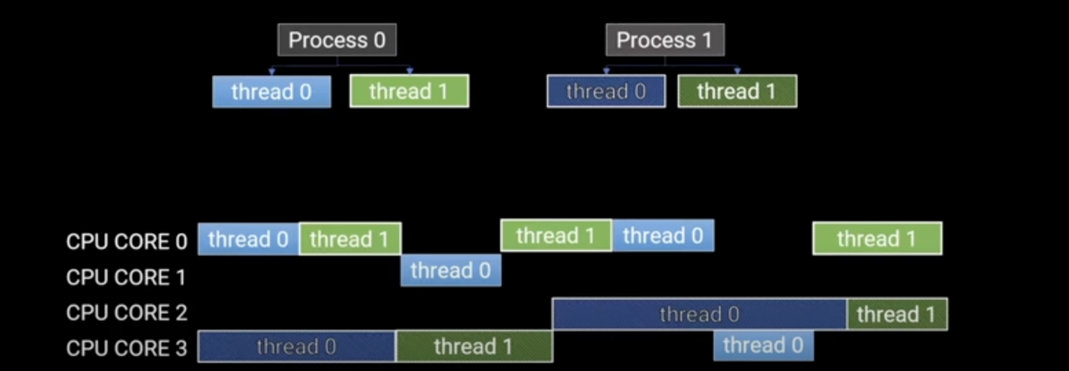
Multithreading
Multiple threads inside one process
OS takes care of sharing your CPU resources to multiple processes
GIL prevents multi core concurrency
Took only 3 seconds

Slide 7
Asyncio
One process one thread, yet so fast
No OS involved
Coroutines: async/await
Eventloop
Took only 2 seconds
Process
Thread

Slide 8
Celery and Redis
Works with older version of python
Celery: Task queues
Message Broker: Redis, Rabbitmq, aws sqs
Took only 0.1 seconds

Slide 9
Thank You
@Dishantsethi14
https://linkedin.com/in/dishantsethi
dishantsethi14@gmail.com
https://github.com/dishantsethi/pyconde-2023

