Slide 1
AI Enabled Automatic Ticket Assignment Tool
Submitted By
Disha Palan
Parita Desai
Gloria Kamal

Slide 2
Problem Statement
In any of the IT industry, incident management plays an important role in delivering quality and timely support to its customers across the globe.
The incidents are generally created by various stakeholders like end users, vendors, IT users, etc. They might not have right information as to which team the ticket should go to. Hence, to improve and retain customer satisfaction, it is very important that the ticket is assigned to the right group of people for faster and appropriate resolution. In many Organizations this is still a manual process. There are few problems with the manual process:
Manual assignment of incidents is time consuming
It requires human efforts
There may be mistakes due to human errors and resource consumption is carried out ineffectively because of the misaddressing
Manual assignment increases the response and resolution times which result in user satisfaction deterioration / poor customer service
L1 / L2 needs to spend time to review Standard Operating Procedures (SOPs) before assigning to Functional teams (Minimum 25–30% of incidents needs to be reviewed for SOPs before ticket assignment).
15 mins are being spent for SOP review for each incident. Minimum of 1 FTE effort needed only for incident assignment to L3 teams.
During the process of incident assignments by L1 / L2 teams to functional groups, there were multiple instances of incidents getting assigned to wrong functional groups.
Around 25% of Incidents are wrongly assigned to functional teams. Additional effort needed for Functional teams to re-assign to right functional groups
During this process, some of the incidents are in queue and not addressed timely resulting in poor customer service and loss of business.
Hence with the AI enabled ticketing tool we need to classify the tickets in the correct assignment group

Slide 3
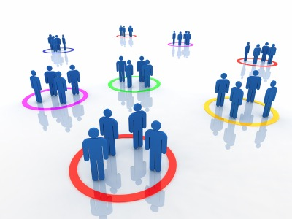



Traditional approach
Customers, vendors, end users
Customer representative
Is your customer happy ? - Maybe
Minimum 25–30% of incidents needs to be reviewed for SOPs before ticket assignment
15 mins are being spent for SOP review for each incident. Minimum of 1 FTE effort needed only for incident assignment to L3 teams
Around 25% of Incidents are wrongly assigned to functional teams
During this process, some of the incidents are in queue and not addressed timely resulting in poor customer service and loss of business
AI ENABLED TICKETING TOOL COMES FOR RESCUE WITH ALL THE ABOVE PROBLEMS

Slide 4
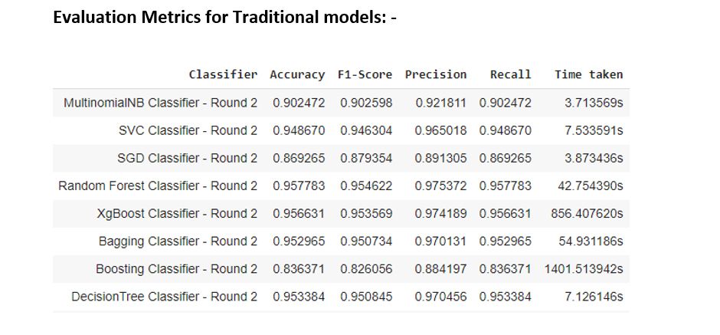
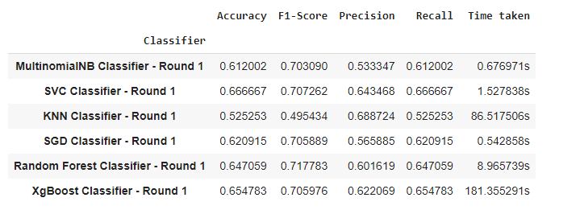
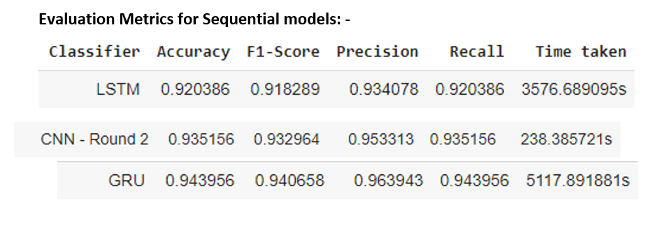
Solution
Below approach is taken to determine the assignment groups based on the ticket description and short description.
Exploratory data analysis
Visualized different patterns in the dataset and performed further analysis
Performed target column i.e. assignment group analysis
Dealt with inconsistencies like treating the missing values and merging the short description and long description to determine the assignment group for ticket
Text pre- processing done by fixing the encoding, detecting different languages and translating to English
Performed data cleaning by removing stop words, lemmatization and creating tokens
Performing Named Entity recognition and find POS tags for description
Modelling : Modelling was performed in two rounds:
Round I - Before treating class imbalance : Below Models are employed
Round II - After treating class imbalance : Below Models are employed
Hyperparameter Tuning was done for above models
Transfer learning is employed with DISTILBERT with LinearSVC with resampled data
DistilBERT, used to create the features and labels using pretrained model gives an accuracy of 92.82%. This can be further improved by fine tuning

Slide 5

Future approach with AI enabled tool
Customers, vendors, end users
AI ChatBot / software
Is your customer happy ? - Yes
Previous learning and training helps AI ticketing tool to find appropriate assignment groups
The incidents will be assigned to correct group and hence timely resolution is guaranteed
You save dollars because of less human errors and also less human intervention corresponds to requirement of small team size and less resources
Your Customer is Happy ☺

Slide 6
Detailed Solution
Data
Exploratory Data Analysis
Generate EDA reports
Removing duplicates
Treating null values
Merging short description and description
Further Data Analysis
Word Cloud
N Gram analysis
Assignment Group analysis
Caller analysis
Word Cloud
Data Pre-processing
Fix Encoding
Detecting Language
Translation
Data Cleaning
Removal of stop words
Lemmatization
Data Preparation
Named Entity Recognition
POS Tagging
Label Encoding
TFIDF Vectorizer
GloVe Embeddings
Treating class imbalance
Modelling / Classifiers
Multinomial Naïve Bayes
SVM
KNN
SGD
Random Forest
XgBoost
Bagging
Boosting
Decision Tree
Stacking
CNN
LSTM
GRU
DISTILBERT
Hyperparameter Tuning
Ensemble Method
Model comparison charts
Model Evaluation Metrics
Accuracy
F1 score (Precision Recall )
Type I errors
Type II Errors
Loss

Slide 7
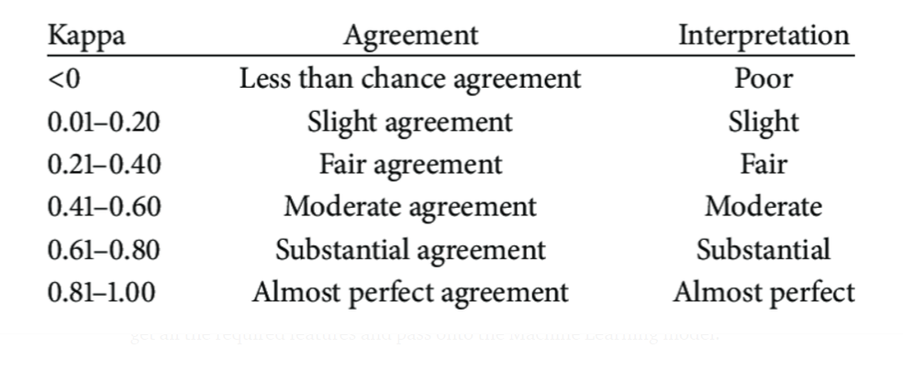
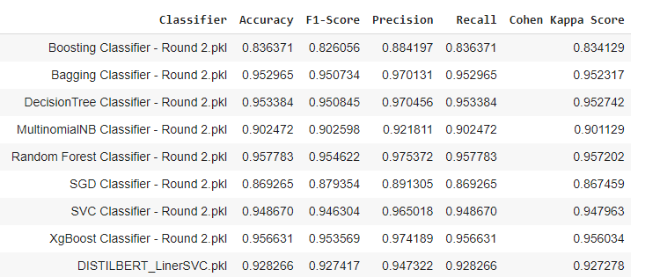
Models comparison to Benchmark
Cohen Kappa Benchmark
From above we see that the above classifiers based on the Cohen Kappa benchmark has an agreement of almost perfect and The interpretation is also almost perfect.

Slide 8
Improvement and Limitations
Improvement
We worked on balancing the classes with Random Over sampler and under sampler, SMOTE, Random Over sampler as Resampling strategies. We were unable to use SMOTE due to less number of resources available. In case we have high number of resources we can utilize smote to generate new synthetic records to treat class imbalance
We could use grid search, random search and do hyper parameter tuning and use more EPOCS etc.
With hyper parameter tuning, using Randomised search CV gave better results for traditional models in terms of the time consumed and performance compared to GridsearchCV, which was mote times consuming for execution.
Plotting the accuracy graphs has been performed
Limitations
We also tried embedding implementations with focal loss as a loss function to handle the class imbalance problem, which helps in giving more weightage to groups with less samples, but the results were not satisfactory
So, while building models, we decided not to drop any groups instead use the resampling from utils package to oversample the groups which are less in numbers. We tried SMOTE, but due to high numbers of features and less resources we were unable to use it.
In our dataset, ‘texts’ are domain specific, and texts are quite rough in nature
Further dissecting, Resample was used and hence for classes with 2 tickets, they were balanced with duplicated records. There is contribution of 1.35 per group and there are 645 records per class.
During hyperparameter tuning we had there was an interruption due to cache or we had to interrupt process as the server got busy and was not response. This was major hardware limitation throughout.

Slide 9
Closing Reflections
Data
We found the data was present in multiple languages and in various formats such as emails, chat, etc. bringing in a lot of variability in the data to be analyzed.
The Business can improve the process of raising tickets via a common unified IT Ticket Service Portal which reduces the above-mentioned variability. By doing this, the model can perform better which can help businesses to identify the problem area for relevant clusters of topics.
Recommendation
Dealing with high volume IT service requests? Interested in reducing operational costs? Looking to elevate the user experience? Look no further.
In 2019, more than 50,000 tickets submitted; Every ticket costs the IT organization $13, despite an average accuracy score (chance of reaching the desired target) of only 40%; Incorrectly assigned tickets bounce between business groups for an average of 21 days before landing in the right place.
Cost, latency and accuracy are a huge concern, and lead to poor user experiences.¹
Additionally reduce effort to run flawless execution of ticket assignments will promote firms to invest in a solution like this.
The final model will perform around the range of 80% to 90% accurate in making predictions for all tickets flowing into the production environment. SLA response times would be cut in half, accuracy more than doubled (40%->85%) and annual cost savings could rack in nearly $500,000 while circumventing the 3rd party vendor ensuring leadership is better equipped to strategize and staff data science projects in the future

Slide 10
Libraries Used
Pandas : This profiling is an open source Python module with which we can quickly do an exploratory data analysis with just a few lines of code. In short, what pandas profiling does is save us all the work of visualizing and understanding the distribution of each variable. It generates a report with all the information easily available
NumPy : Library needed for numerical calculations. It is a is a library for the Python programming language, adding support for large, multi-dimensional arrays and matrices, along with a large collection of high-level mathematical functions to operate on these arrays
matplotlib.pyplot : Needed for graphs and charts during data analysis. Matplotlib is a plotting library for the Python programming language and its numerical mathematics extension NumPy. It provides an object-oriented API for embedding plots into applications using general-purpose GUI toolkits like Tkinter, wxPython, Qt, or GTK
seaborn : Needed for graphs and charts during data analysis. Seaborn is a Python data visualization library based on matplotlib. It provides a high-level interface for drawing attractive and informative statistical graphics.
plotly : Visualization library to generate graphs. The plotly Python library is an interactive, open-source plotting library that supports over 40 unique chart types covering a wide range of statistical, financial, geographic, scientific, and 3-dimensional use-cases.
cufflinks : Required to link plotly to pandas dataframe and add the iplot method. It can plot various graphs and charts like histogram, barplot, boxplot, spreadplot and many more. It is mainly used in data analysis as well as financial analysis. plotly is an interactive visualization library. cufflink connects plotly with pandas to create graphs and charts of dataframes directly.
plotly.io : It is a package that specifies how the plotly.js library is included/loaded in the output div string.
Sweetviz : It’s an open-source Python library that generates beautiful, high-density visualizations to kickstart EDA (Exploratory Data Analysis) with just two lines of code. Output is a fully self-contained HTML application. The system is built around quickly visualizing target values and comparing datasets. Needed for EDA and generating report
Sklearn : Scikit-learn is a free machine learning library for Python. It features various algorithms like support vector machine, random forests, and k-neighbours, and it also supports Python numerical and scientific libraries like NumPy, SciPy and cohen_kappa_score
Tensorflow : TensorFlow is a free and open-source software library for machine learning. It can be used across a range of tasks but has a particular focus on training and inference of deep neural networks. Tensorflow is a symbolic math library based on dataflow and differentiable programming
Keras : It’s an open-source software library that provides a Python interface for artificial neural networks. Keras acts as an interface for the TensorFlow library. Up until version 2.3, Keras supported multiple backends, including TensorFlow, Microsoft Cognitive Toolkit, Theano, and PlaidML.
ftfy : Fixes Text For You :- Library to detect and fix Mojibakes. It fixes Unicode that’s broken. The goal of ftfy is to take in bad Unicode and output good Unicode.
langdetect : Detects language of a given text. The langdetect library, module is a port of Google's language-detection library that supports 55 languages. This module doesn't come with Python's standard utility modules. So, it is needed to be installed externally
wordcloud : Needed to display word clouds. Word Cloud is a data visualization technique used for representing text data in which the size of each word indicates its frequency or importance. The dataset used for generating word cloud is collected from UCI Machine Learning Repository
Transformers : This is to fetch the DistilBERT pretrained model for transfer learning
Torch : As DistilBERT used torch tensors we needed this library as well
Pickle : This is used to save the models for later use
H5py : This is used to save the sequential models

