Slide 1

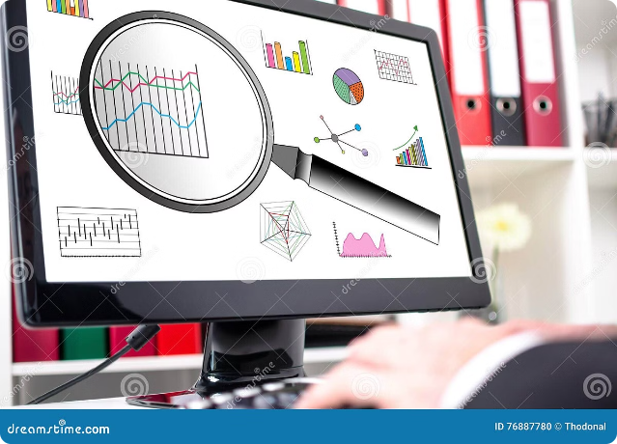
Cloud & AI-based Hedge Fund Management Bot
Welcome! This presentation outlines the development of a cutting-edge, automated stock prediction and trading system powered by cloud computing and artificial intelligence.

Slide 2

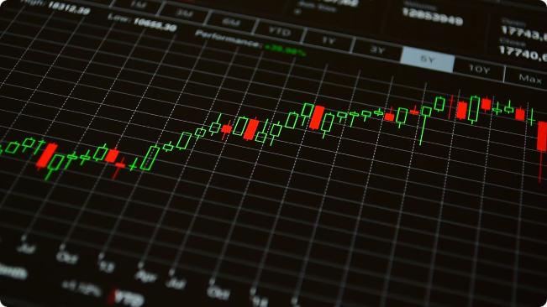
Problem Statement
Inaccurate Predictions
Traditional methods struggle to predict stock price fluctuations with sufficient accuracy, leading to suboptimal trading decisions.
Human Limitations
Constant human monitoring and intervention are required for traditional trading strategies, making them time-consuming and prone to error.
Market Volatility
The stock market is highly volatile and unpredictable, requiring a system that can adapt to changing conditions in real time.

Slide 3

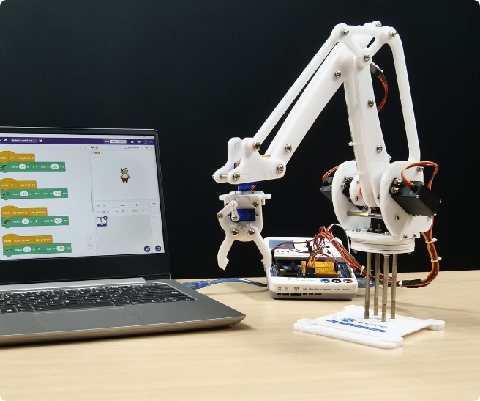
Purpose, Scope, and Objectives
1
AI-driven Stock Prediction
Train a sophisticated AI model capable of predicting stock prices based on historical data and real-time market trends.
2
Cloud-based System
Develop a cloud infrastructure for continuous model operation, enabling real-time data analysis and automated decision-making.
3
User-friendly Mobile App
Create a seamless mobile app interface for users to manage trades, monitor performance, and access real-time data.

Slide 4

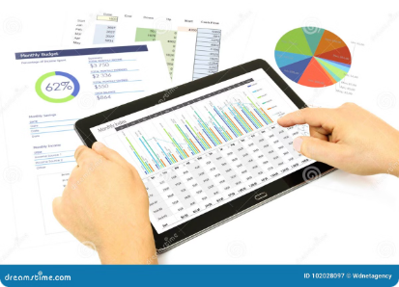
Abstract (System Overview)
1
Data Acquisition & Preprocessing
2
Model Training & Evaluation
Gather historical stock market data and prepare it for model training using data cleaning, normalization, and feature engineering techniques.
Train the AI model using machine learning algorithms to identify patterns and relationships in the data, then evaluate its performance using various metrics.
3
Prediction & Decision-making
4
Trade Execution & Monitoring
The trained model generates predictions on future stock prices, and the system uses these predictions to make automated trading decisions.
The system automatically executes trades based on the model's predictions, and the mobile app allows users to monitor trade performance and adjust settings.

Slide 5
Requirements & Test Environment/Tools
Mobile App
Backend
Database
Flutter, a cross-platform framework, will be used to create the user interface. Syncfusion Flutter Charts will provide interactive data visualization.
Python frameworks like Flask or Django will be used for server-side logic and API development. Libraries like scikit-learn, Keras, and TensorFlow will be used for model training and prediction.
Firebase and MySQL will be used as the primary databases for storing real-time data, user information, and trade history. This ensures scalability and reliable data management.

Slide 6
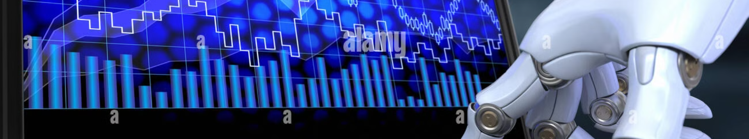



System Overview - Proposed System & Outcome
AI Model
Backend Server
Mobile App
A sophisticated AI model trained on historical stock market data using advanced machine learning algorithms.
A robust backend system that enables continuous model operation, prediction generation, and API communication.
A user-friendly mobile application providing real-time trade monitoring, performance analytics, and account management.

Slide 7

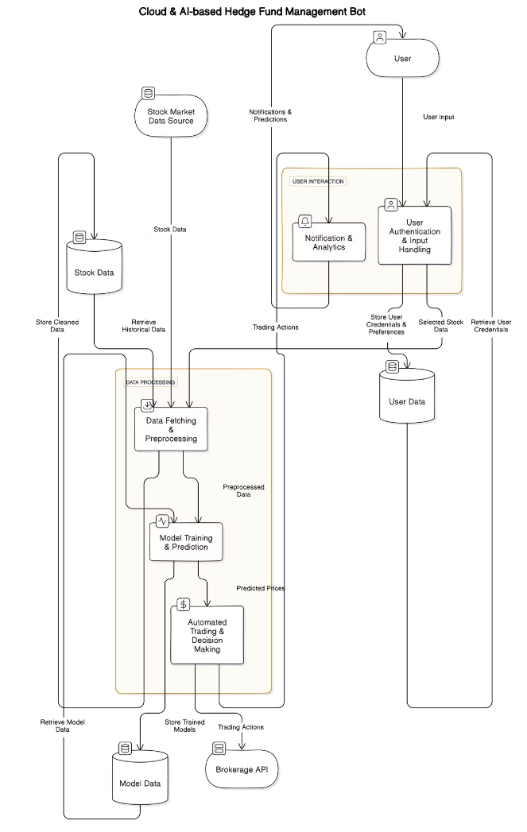





Architecture & Data Flow Diagram (DFD)
User Input
Users interact with the mobile app to select stocks, set trading parameters, and monitor performance.
Data Fetching
The backend server retrieves real-time market data from reliable financial sources, such as Yahoo Finance API.
Model Inference
The trained AI model analyzes the fetched data and generates predictions on future stock price movements.
Automated Trading
Based on the model's predictions, the system automatically executes trades in the stock market.
Monitoring & Reporting
Users can track the progress of their trades and access detailed reports on portfolio performance via the mobile app.

Slide 8

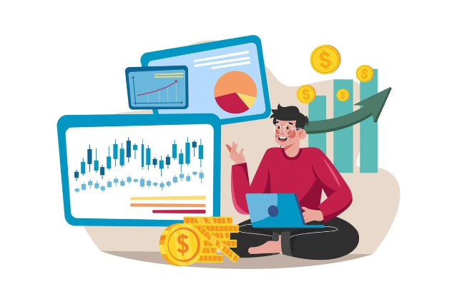
References
Yahoo Finance API
For real-time stock market data retrieval.
Kaggle Datasets
Provides access to various financial datasets for model training and evaluation.
TensorFlow Documentation
Essential resources for building and deploying deep learning models for stock price prediction.

Slide 9
Project Plan
Research & Requirement Gathering
1
Thorough research into existing stock prediction methods, data sources, and industry trends to determine project requirements.
2
Model Development & Testing
Train and evaluate various machine learning models on historical stock market data to determine the most effective approach.
Backend Development
3
Develop the backend server for model inference, data storage, API communication, and trade execution.
4
Integration & Deployment
Integrate the mobile app with the backend server and deploy the system to a cloud environment for continuous operation.
Testing & Debugging
5
Conduct comprehensive testing to ensure the system's accuracy, reliability, and efficiency, and resolve any bugs or issues encountered.
6
Final Deployment & User Training
Finalize deployment, implement security measures, and provide user training and documentation for seamless interaction.

