Slide 1
EduAgent: Agentic AI Learning Assistant Supporting
SDG 4 – Quality Education
Submitted by: Disha Patare

Slide 2
Introduction
EduAgent is an AI-powered learning assistant developed as a React web application. It helps students create study plans, understand difficult topics, take quizzes, and monitor their learning progress. The project supports SDG 4 (Quality Education) by making learning more interactive and personalized.

Slide 3
Problem Statement
Students often struggle to organize their studies.
They require personalized guidance and continuous practice.
Traditional learning methods do not always provide instant support.
An AI-based learning assistant can improve learning efficiency.

Slide 4
Objectives
Develop an AI-inspired learning assistant.
Generate personalized study plans.
Provide topic explanations through an AI Tutor.
Conduct quizzes for self-assessment. Track student learning progress.
Support Sustainable Development Goal 4 (Quality Education).

Slide 5
Technology Stack
React.js
JavaScript
HTML5
CSS3
Vite

Slide 6
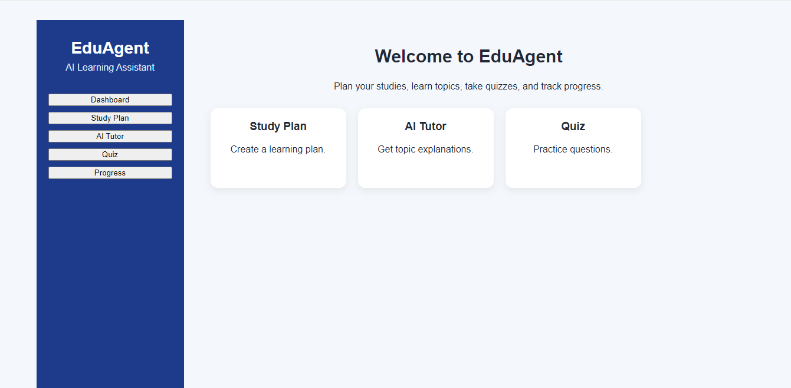
Dashboard
Features
User-friendly interface
Easy navigation
Quick access to all learning modules

Slide 7
Study Plan Module
The Study Plan module allows students to enter a subject and automatically generates a structured learning plan.
Features
Subject input
Daily learning plan
Easy-to-follow schedule

Slide 8
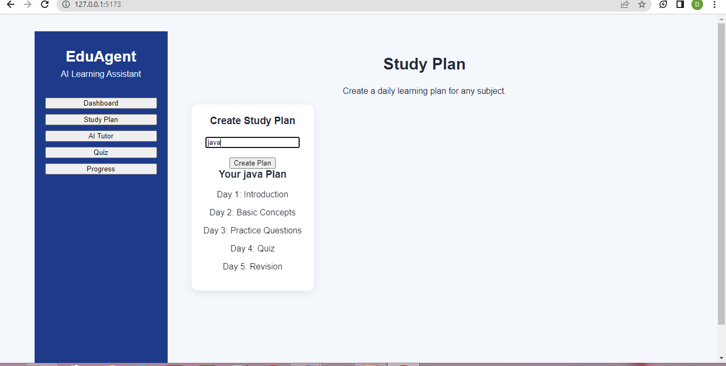

Slide 9
AI Tutor
The AI Tutor provides simple explanations for learning topics and guides students through important concepts.
Features
Topic input
AI-style explanation
Easy language

Slide 10
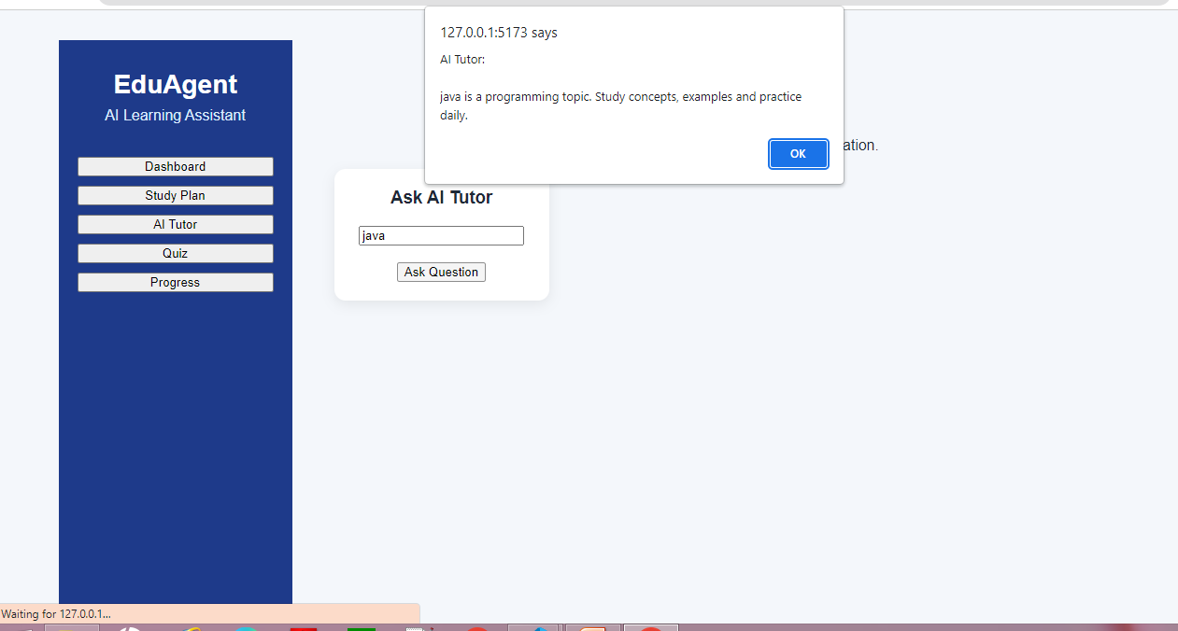

Slide 11
Quiz Module
Students can test their knowledge using multiple-choice questions.
Features
Multiple-choice questions
Score calculation
Restart quiz

Slide 12
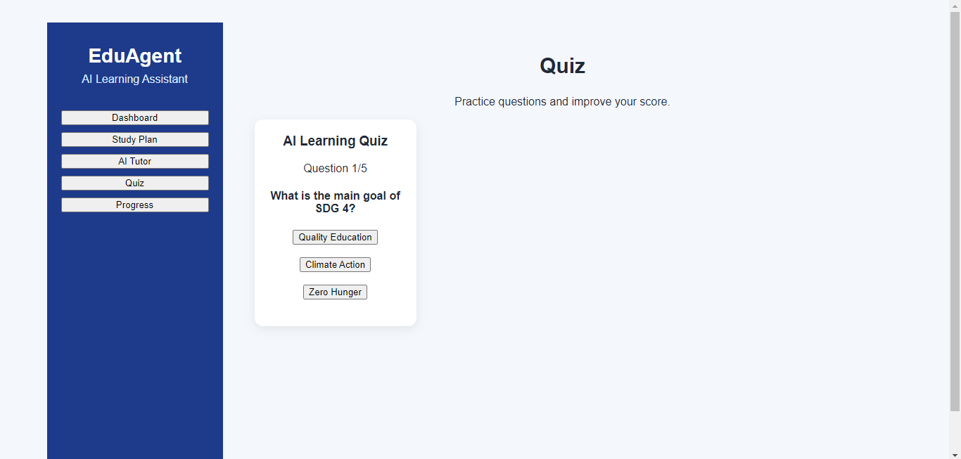


Slide 13
Progress Tracking
The Progress module helps students monitor their completed lessons and overall learning progress.
Features
Completed lessons
Progress percentage
Progress bar

Slide 14
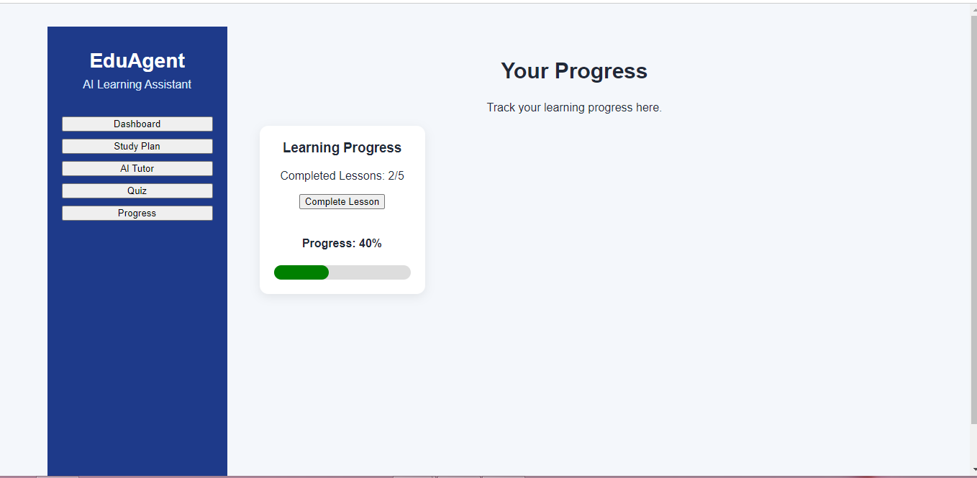

Slide 15
Conclusion
EduAgent demonstrates how AI-inspired technology can improve education by providing study planning, topic guidance, quizzes, and progress tracking. This project contributes toward achieving SDG 4 – Quality Education by making learning more personalized and accessible.

