Slide 1



AgriWebHub
A BRIDGE BETWEEN FARMER AND CONSUMER

Slide 2
AgriWebHub
A BRIDGE BETWEEN FARMER AND CONSUMER
Prepared by

Slide 3

AgriWebHub
Page 01
Introduction
AgriWebHub is an easy-to-use web application that provides important information about farmers and consumers in agriculture. The platform allows both farmers and consumers to create profiles, so users can search for and access details about each other. This helps users make informed decisions about agricultural products and manually reach out to farmers or consumers based on their profiles.

Slide 4
AgriWebHub
Page 01
Our Vision
Our vision is to create a helpful resource that connects farmers and consumers by sharing information. AgriWebHub aims to be the top platform for agricultural insights, allowing users to easily navigate the agricultural world and make better choices. By promoting connections through shared profiles, we want to strengthen the agricultural community and support fair trade.

Slide 5

AgriWebHub
Page 03
Idea that lead to the concept
farmer
middlemen
consumer
In traditional agricultural practices, farmers often face challenges in accessing markets directly.
Middlemen often exploit farmers by offering low prices for their produce, resulting in unfair compensation.
Consumers struggle to find reliable sources of fresh, locally sourced agricultural products.

Slide 6


AgriWebHub
Page 05
Functionality
1. Add Farmer
Farmers can create profiles with details about themselves and their products. This increases their visibility and allows them to share information about what they offer.
2. Add Consumer
Consumers can register profiles to show their interests. When someone searches for a farmer or consumer, they can view their information and contact them manually.
3. Calculate MSP (Minimum Support Price)
The MSP calculator helps farmers determine the minimum price they should receive for their crops, based on production costs and market trends.

Slide 7
AgriWebHub
Page 05
Functionality
4. Find Farmer
Consumers can search for local farmers by location, crop type, and available quantities. This feature helps them discover local produce and make informed choices.
5. Find Consumer
Farmers can view information about potential consumers interested in their crops. This helps farmers understand what consumers want.

Slide 8

AgriWebHub
Page 06
MERITS
DEMERITS
Informed Choices
Market Awareness
Empowerment
Encourages local buying,
supporting a sustainable
agricultural system.
No Direct Connections
Information Overload
Data Privacy Concerns.

Slide 9




AgriWebHub
Page 07
Future Scope
FUTURE SCOPE
Login Signup Functionalities
E commerce Platform
Social Media Platform
Prediction Platform
Additional Services

Slide 10
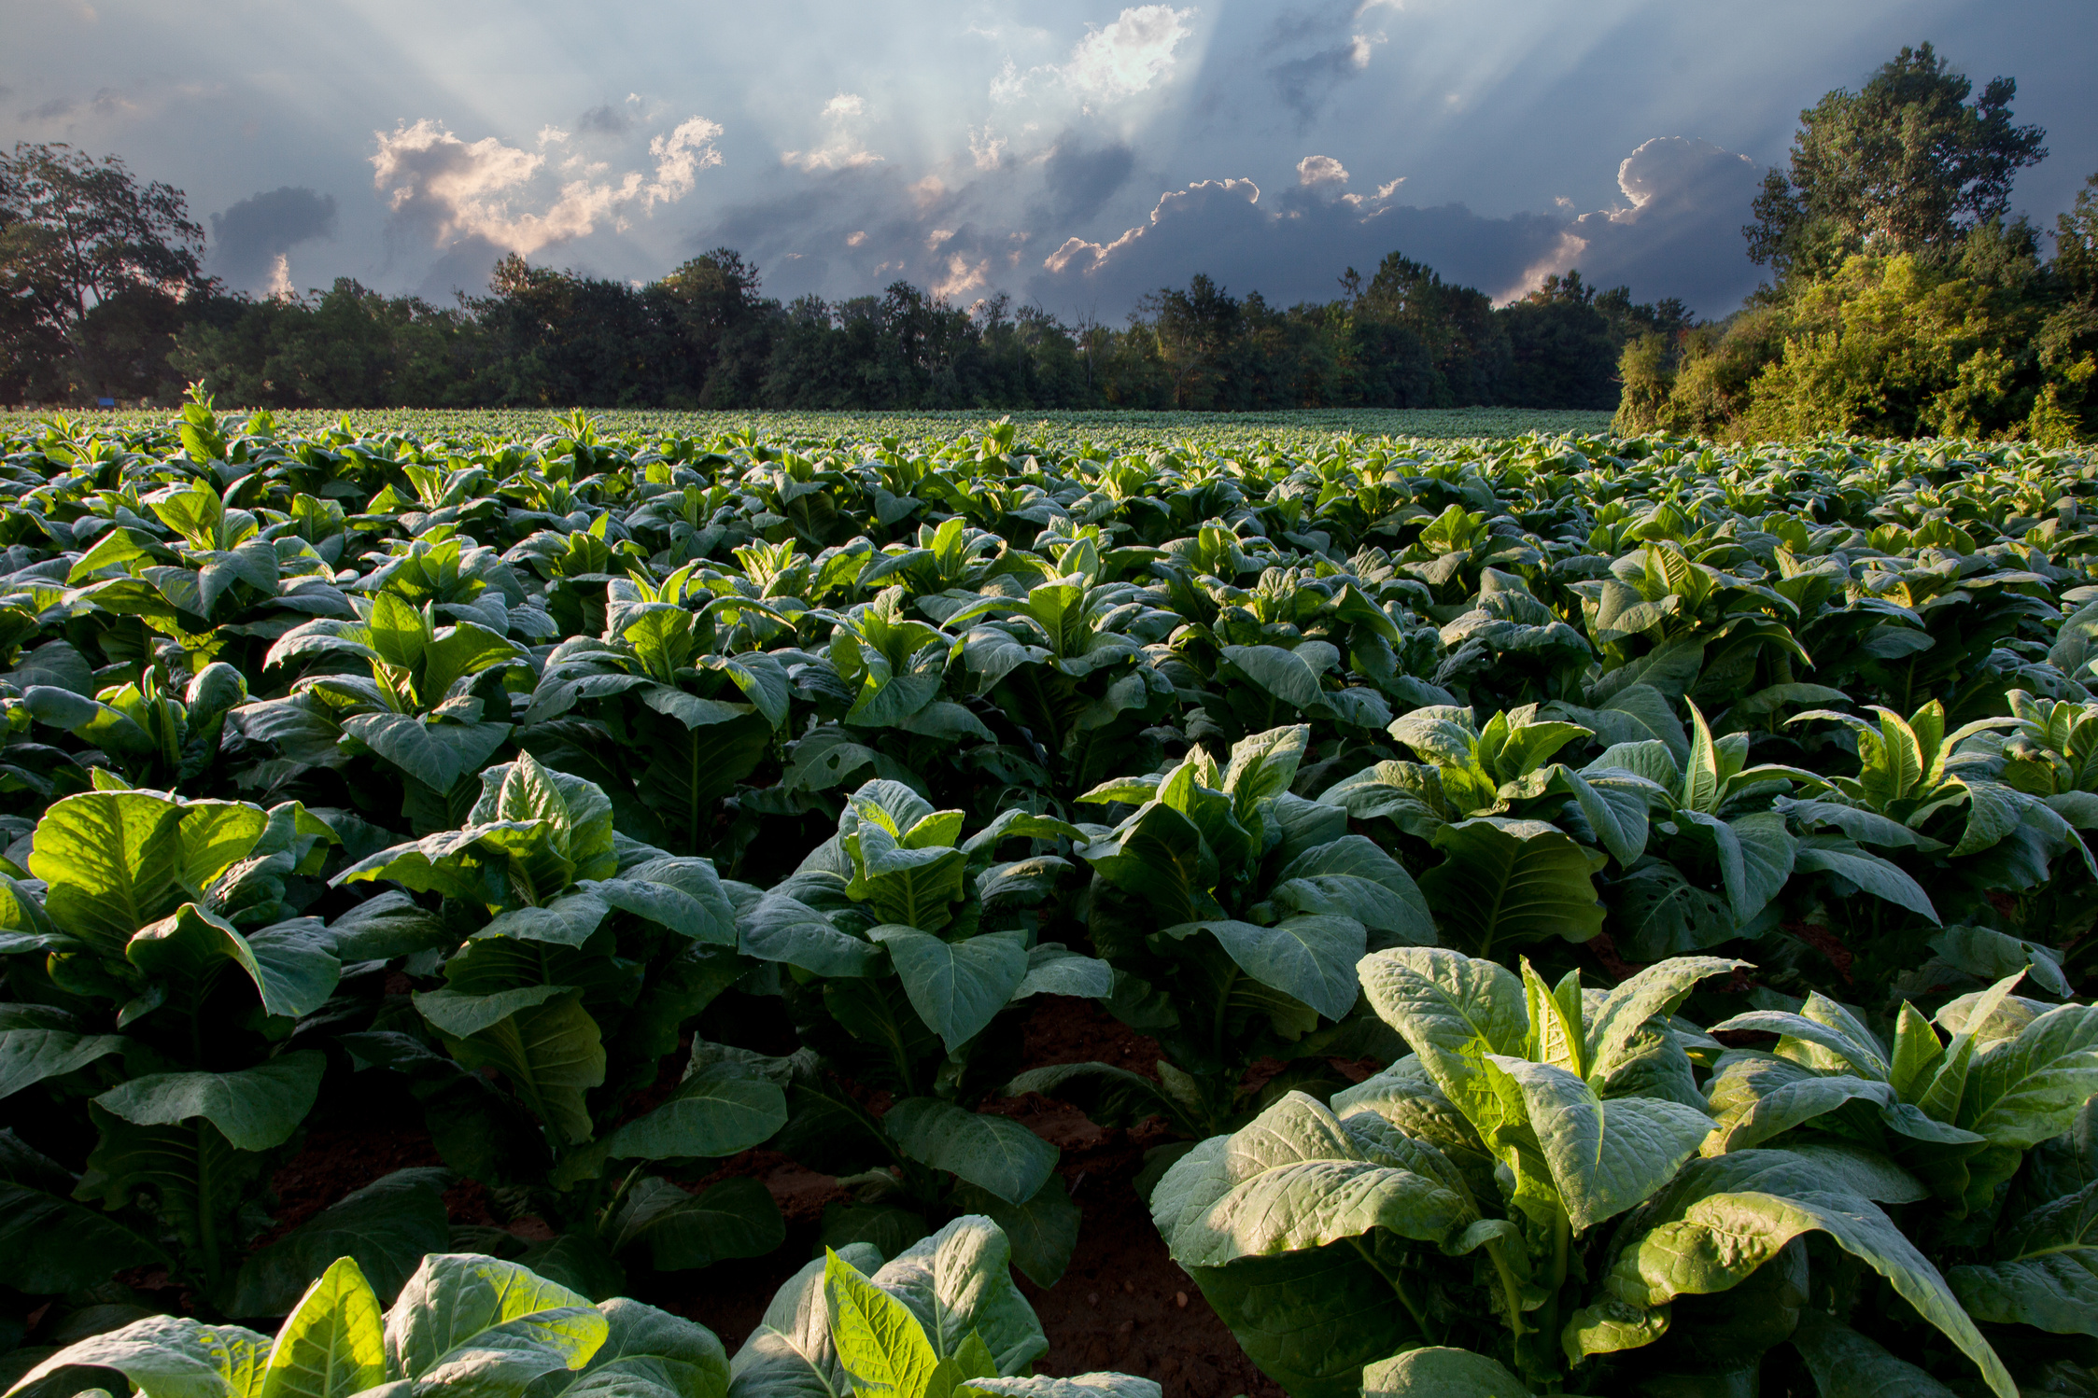
AgriWebHub
A BRIDGE BETWEEN FARMER AND CONSUMER
THANK YOU

Slide 11
AgriWebHub
A BRIDGE BETWEEN FARMER AND CONSUMER
THANK YOU

