Slide 1
Organize Your Files with Python
Tired of digital clutter? Learn to automate file organization using Python. No coding experience is required to get started!
Created By Dishari Dutta Chowdhury

Slide 2





Why Automate File Organization?
Saves Time
Reduces Stress
Improves Efficiency
Automate repetitive tasks in seconds.
Declutter your digital life with ease.
Find files quickly and effortlessly.
Increases Productivity
Focus on important tasks.
Imagine sorting 100 files in mere seconds, freeing up valuable time for what truly matters.

Slide 3
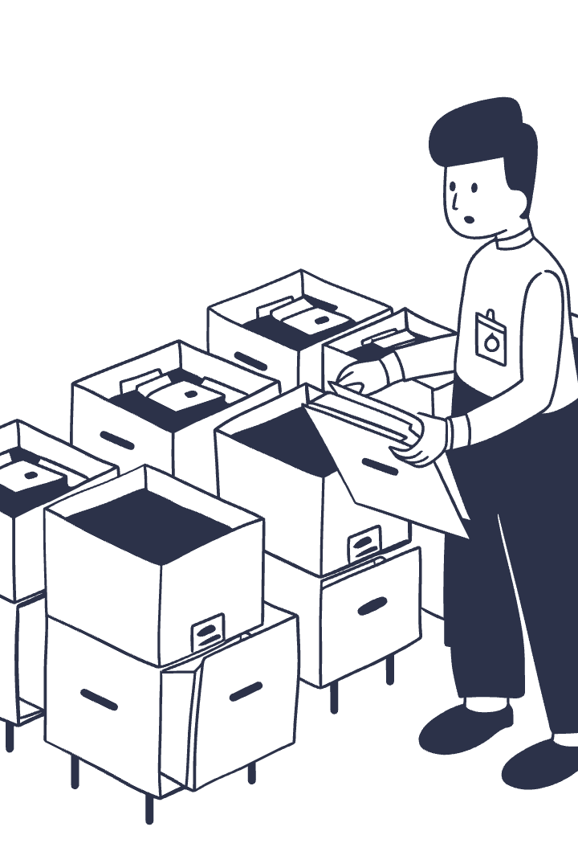



Core Concept: Rules-Based Sorting
Define Rules
Sort by file type, date, or name.
Python Monitors
Script watches a specified folder.
Apply Rules
Files are moved automatically.
For example, move all .pdf files to a "Documents" folder. Or organize photos by the year they were taken.

Slide 4
Setting Up Your Python Environment
Install Python
Install Libraries
Choose Editor
Folder Structure
Get Python version 3.7 or later from python.org.
Use pip install watchdog for file monitoring.
Use VS Code, Sublime Text, or any text editor.
Set up a main folder with destination subfolders.
These steps ensure your system is ready for automated file organization.

Slide 5

Basic Python Script Structure
Import Libraries
Include os, time, shutil, watchdog.
Define Directories
Specify source and destination paths.
Create Function
Develop logic to move files by rules.
Monitor Changes
Use watchdog for real-time tracking.
This structured approach ensures your script runs efficiently and reliably.

Slide 6


Running Your Python Organizer
Save Your Code
Save the Python script as file_organizer.py. Choose an easy-to-find location.
Set Target Directory
Edit the `target_directory` path. Provide the full absolute path to your folder.
Test Safely First
Create a temporary folder. Populate it with dummy files for testing your script.
Execute the Script
Open your terminal or command prompt. Run `python file_organizer.py` from its directory.

Slide 7
What the Code Does
Move to Organized Folders
Scan and Classify Files
Files are moved to their matching category folder. New destination folders are created automatically if needed.
Import Core Libraries
It iterates through every item in the source directory. Each file's extension is extracted and identified.
The script imports `os` and `shutil` for file system operations. It defines categories for file types.

Slide 8
Next Steps & Improvements
Dynamic Control
Robust Operations
Expand file types for more versatility. Allow users to input target directories.
Add confirmation prompts for safety. Implement logging for all file actions.
Advanced Features
Interactive Interface
Develop undo capability for changes. Manage duplicate files effectively.
Build a graphical user interface. Use libraries like Tkinter or PyQt.

