Slide 1


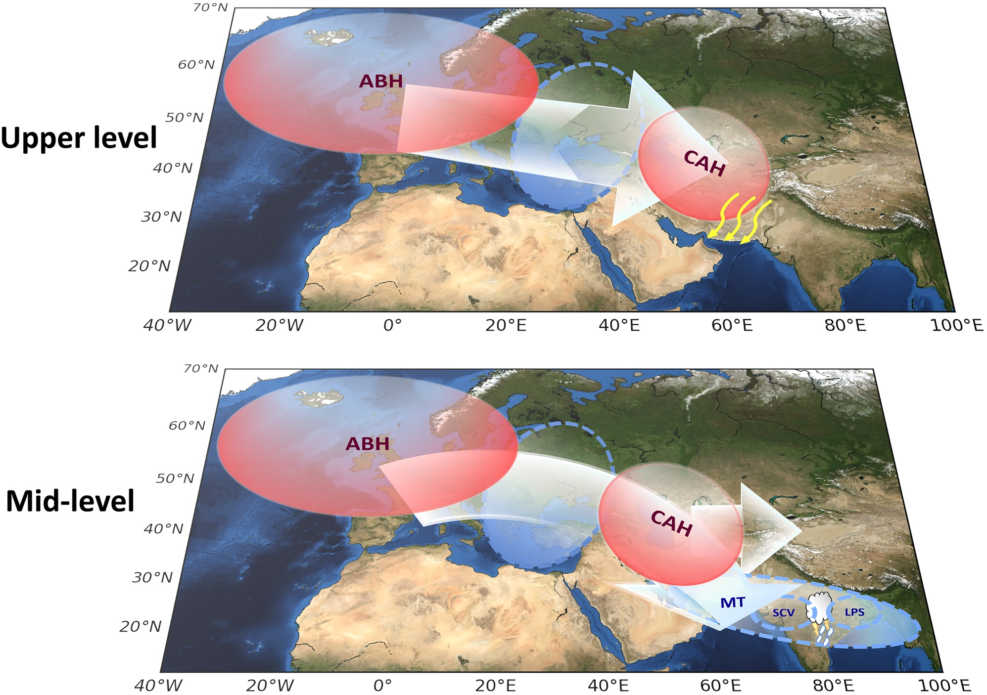
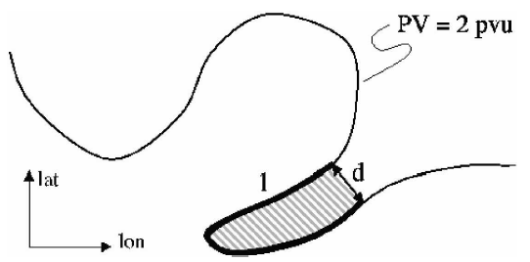
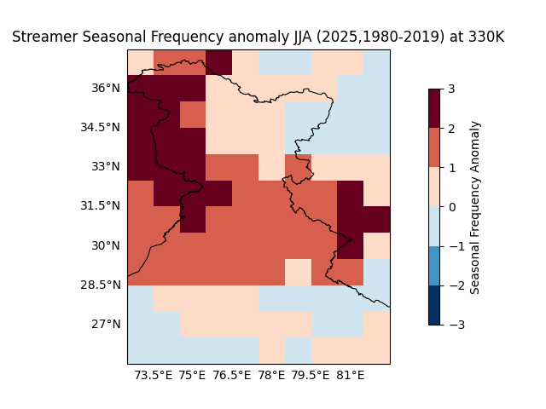
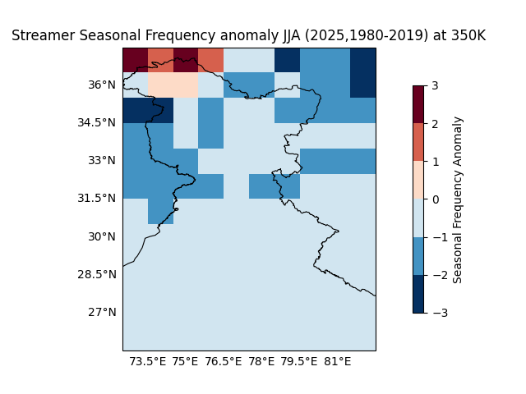
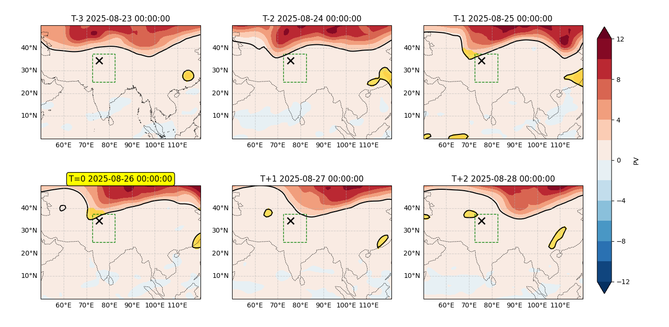
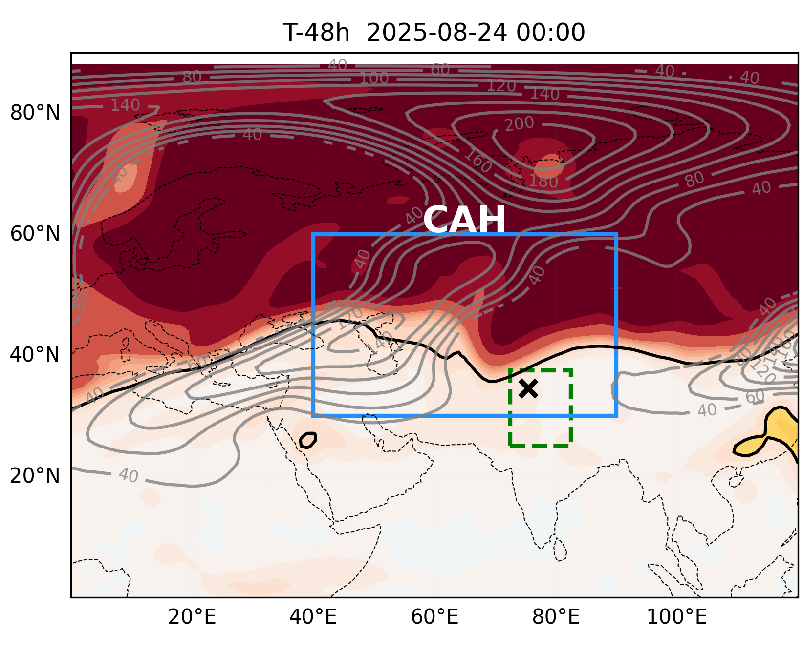
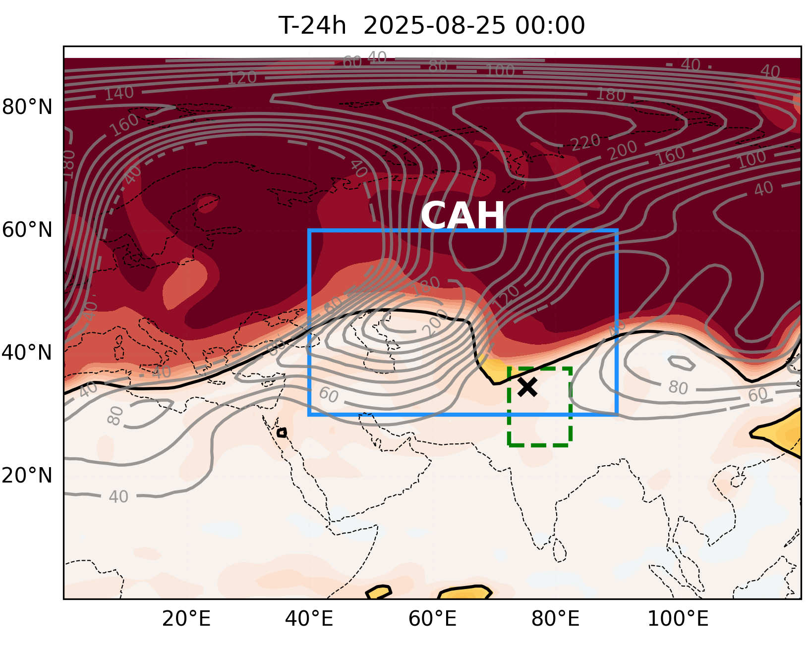
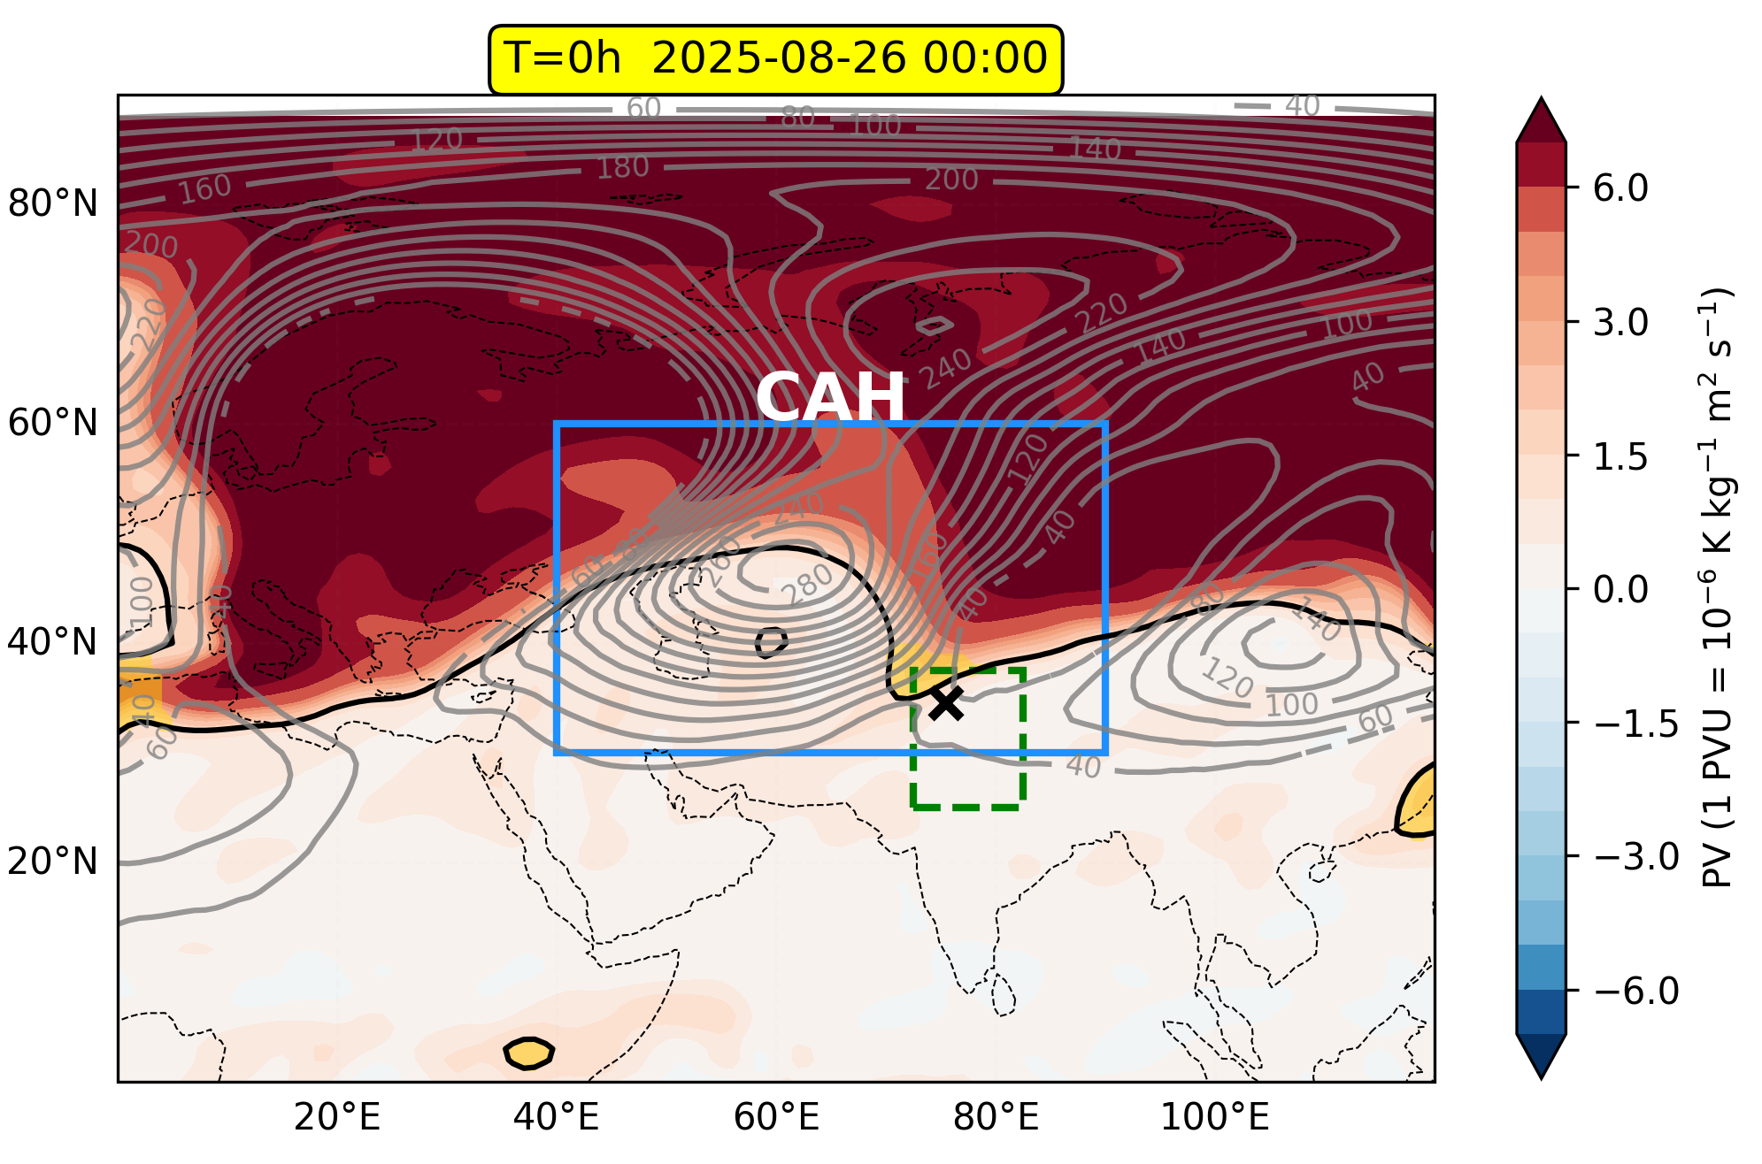
Revisiting 2025 Himalayan Extremes
Through Tropical-Extratropical Interactions
¹Disha Virmalwar; ¹Akshaya Nikumbh; ¹Anirudh Peri
¹Center for Climate Studies, IIT Bombay,
*Correspondence to 30006814@iitb.ac.in
1. Introduction and Motivation
Extreme rainfall events in the Himalayan region during 2025 present a compelling case study for understanding tropical-extratropical interactions during the Indian summer monsoon. Past literature demonstrates that Rossby wave breaking (RWB), characterized by equatorward intrusion of high potential vorticity (PV ≥1.5 PVU) air masses, can trigger organized convection and extreme precipitation. However, the dynamical mechanisms enabling such intrusions remain unclear. Previous work by Nikumbh et. al. (2023) has established that quasi-stationary atmospheric blocking highs over Central Asia facilitate RWB events by creating persistent flow patterns that allow extratropical PV streamers to penetrate equatorward. Building on this framework, this study examines four documented extreme rainfall events in 2025, investigating the co-occurrence of RWB signals and blocking highs days prior to local extremes, thereby establishing atmospheric blocking as a key mechanism linking tropical and extratropical dynamics during high-impact monsoon events.
ABH: Atmospheric Blocking High
CAH : Central Asian High
RWB : Rossby Wave Breaking
MT: Monsoon Trough
Nikumbh et. al. (2023)
2.Data and Methodology
2.1 Rossby Wave Breaking
2.2 Atmospheric Blocking High
Potential Vorticity at 330K, 350K
1980-2019,2025 ERA5
Dynamical Tropopause = 1.5 PVU
l : Contour length ( >1500 km )
d = geometric distance ( < 800 km)
Geopotential height anomalies at 200 hPa
1980-2025 ERA5
Contour Tracking (ConTrack Algorithm)
Blocking High | ABH | CAH
Threshold | 95th percentile | 30
Persistence | 2 days | 2 days
Region | 10°–80°N, 70°W–10°E | 30°–60°N, 40°–90°E
Streamer and Cut off Index
(Wernli and Sprenger 2007)
3. Preliminary Results
3.1 Streamer Frequency Anomaly percentage of 2025 relative to 1980-2019 (JJA)
3.3 Jammu & Kashmir Landslide (26-08-2025)
Equatorward stratospheric PV streamer intrusions at 350 K were detected west of the high-impact locations on the event day and preceding day
Relative enhancement of RWB streamers during JJA 2025 is slightly pronounced at 330K compared to climatological base line (1980-2019)
3.2 2025 Monsoon High-Impact Extreme Precipitation Events Over Himalayan Region
3.4 RWB at 350K and CAH at 200hpa during J&K Landslide
Date | Disaster Subtype | Origin | Location
2025-06-20 | Flash flood | Monsoonal rains | Himachal Pradesh, Uttarakhand
2025-08-05 | Mudslide | Violent cloudburst | Dharali village (Uttarkashi district)
2025-08-14 | Flash flood | Heavy rain | Kishtwar (Jammu and Kashmir state)
2025-08-26 | Landslide (wet) | Heavy rain | Jammu and Kashmir region
2025-08-15 | Flood (General) | Monsoon rain | Punjab state
Presence of the Central Asian High (CAH) promoted recurving of the Rossby wave pathway, favoring Rossby Wave Breaking (RWB) prior to the extreme event
Data Source : https://www.emdat.be/
Summary and Discussion
RWB activity in JJA 2025 showed relative enhancement at 330 K compared to climatology, though signals at 350 K were less distinct
All identified Himalayan high-impact events showed signatures of extratropical forcing through either stratospheric cutoffs or equatorward PV streamer intrusions
Preliminary results suggest a compelling mechanism involving co-evolution of Rossby wave breaking and Central Asian atmospheric blocking triggering extreme precipitation in Himalayan regions
Future Work : Perform statistical and quantitative analyses to investigate the dynamical linkage between RWB, CAH variability, ENSO conditions and High impact extreme events
References
1. Nikumbh, A. C., Thakur, A. B. S., Chakraborty, A., Bhat, G. S., & Sukhatme, J. (2023). The role of the North Atlantic blocking high during large-scale heavy rainfall events over Central India. Journal of the Atmospheric Sciences, 80(7), 1815-1827.2.
2. Wernli, H., & Sprenger, M. (2007). Identification and ERA-15 climatology of potential vorticity streamers and cutoffs near the extratropical tropopause. Journal of the atmospheric sciences, 64(5), 1569-1586.
3. Steinfeld, D., 2020: ConTrack - Contour Tracking. GitHub, https://github.com/steidani/ConTrack.
4. Kaderli, S., 2023. WaveBreaking - Detection, Classification and Tracking of Rossby Wave Breaking. https://doi.org/10.5281/zenodo.14214463

