Slide 1

Bookmark
Book Trade Website
Designed and Produced by Dishen Zhu

Slide 2
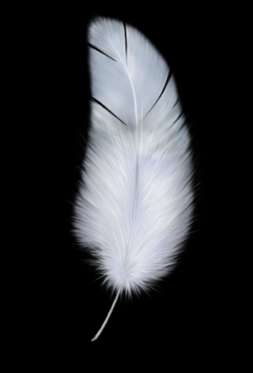
Inspiration
The oldest bookmarks are normally made by feather. The feather means light, people want to bring their beloved people with hope.
I hope the Bookmark website can let people send their best wishes while exchanging their loved books.

Slide 3
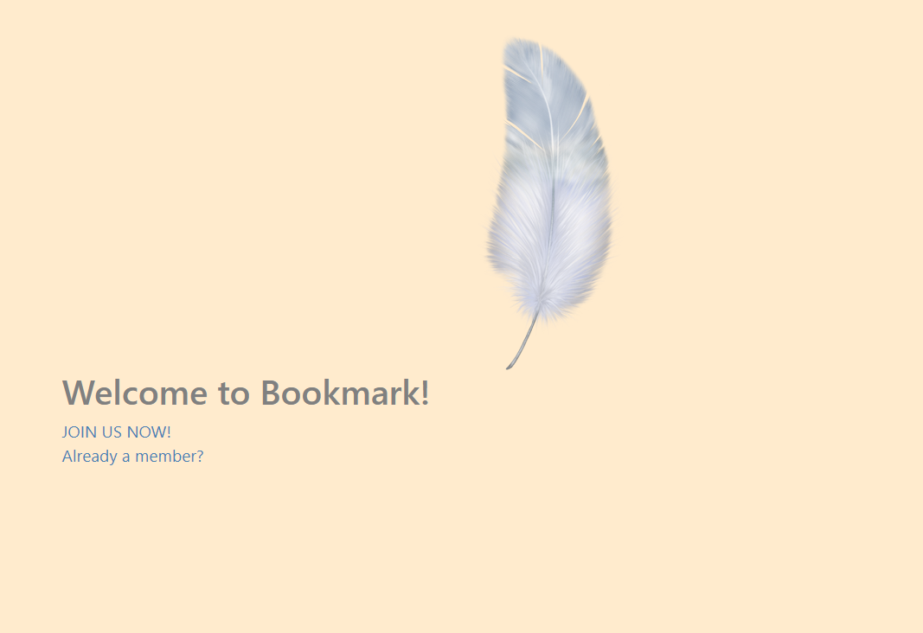
Index Page
Simple design
Classical style
Feather as a symbol of website

Slide 4
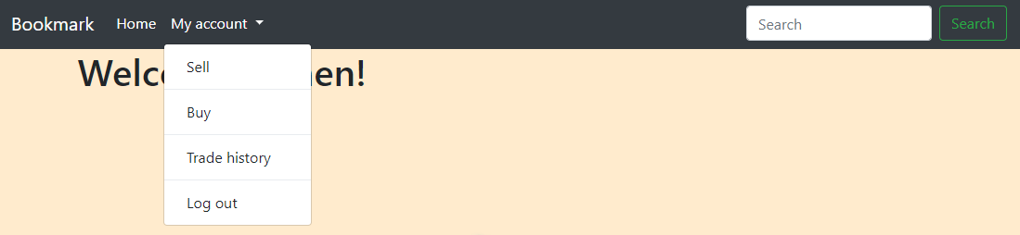
Navigation Bar
Go back to home page anytime
Easy to use
Searching engine

Slide 5
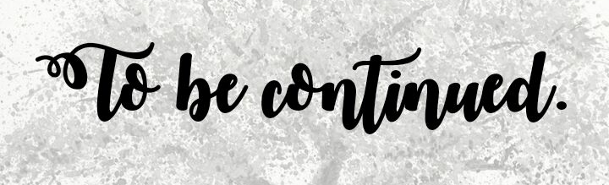
Features in the Future
Payment system
Including: cart, paypal, refund, etc
Better searching engine
Search with key words or authors
Official bookmark store
Pick a special bookmark as a gift as well !

