Slide 1


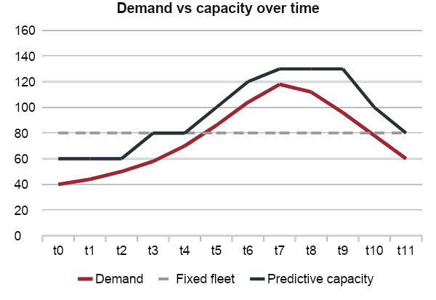
CONTAINER IMAGE SUPPLY CHAIN SECURITY USING DIGITAL SIGNATURES
TrustDeploy: Verify Before You Deploy
Integrity is the “I” in the confidentiality, integrity, availability (CIA) triad. TrustDeploy deploys a container image only when its origin is cryptographically proven, using three building blocks:
Image tag
localhost:5001/trustdeploy/sample-app:1.0.0
Immutable digest
sha256:deffd203… (resolved first)
1
Cosign signing – approved images signed with a dedicated ECDSA P-256 key
2
Digest-pinned verification – tag resolved to its digest, checked against the trusted public key
Signature check
cosign verify against trusted/cosign.pub
3
Fail-closed gate + audit – ACCEPT / REJECT with reason codes, JSONL log and HTML report
ACCEPT
deploy the exact digest
REJECT
deny + audit record
GROUP MEMBERS
Under the guidance of Prof. Sheetal Pereira
Archit Singh
16010123057
Anish Patni
16010123045
Amrit Nigam
16010123038
Rishi Shanbhag
16010123256
Fails closed. A missing signature, an untrusted key, a tool error or an unreachable registry all mean REJECT.
TrustDeploy: Container Image Supply Chain Security | Integrity in the CIA triad
1
Notes:
Our project is TrustDeploy: container image supply chain security using digital signatures. It protects integrity, the I in the CIA triad, by placing a verification gate in front of deployment. Approved images are signed with Cosign; before anything is deployed, TrustDeploy resolves the tag to its immutable digest, verifies the signature against our trusted public key, and accepts or rejects. Anything it cannot prove is rejected, and every decision is audited.

Slide 2
THE PROBLEM
A tag is not proof of origin
Compromised pipeline
A tampered build system or CI step ships an altered image under a trusted name
MUTABLE TAG
1
sample-app:1.0.0
can be re-pointed
approved image
tampered image
Malicious public image
Typosquatted or backdoored images pulled from a public registry
IMMUTABLE DIGEST + SIGNATURE
2
sha256:deffd203…
content address
exactly one image
Image swapped after build
The registry tag is re-pointed to a different image after approval
A digest names the bytes; a signature on that digest proves who approved them.
3
The gap: deploying by mutable tag gives no cryptographic proof of origin, so a swapped image deploys silently.
TrustDeploy: Container Image Supply Chain Security | Integrity in the CIA triad
2
Notes:
Containers are built in one place and run in another. Three things can go wrong in between: the build pipeline can be compromised, a malicious public image can be pulled, or the image can be swapped after it was approved. Most deployments reference a mutable tag such as 1.0.0, and a tag can be re-pointed at any time, so it gives no cryptographic proof of who built the image or that it is the approved one.

Slide 3
PROPOSED SOLUTION
A verification gate before deployment
TRUSTDEPLOY GATE
Registry
localhost:5001
Resolve
tag → sha256 digest
Verify
cosign + trusted key
Decide
policy: verified?
ACCEPT
deploy image@digest
Any error on the way → REJECT
REJECT
deny + audit
1
2
3
4
Fail closed
Tool error, unreachable registry or missing signature means REJECT
Digest-pinned
Deploys the verified sha256 digest, never the mutable tag
Trusted key only
Signature must verify against trusted/cosign.pub
Fully audited
JSONL log exported as HTML dashboard, CSV and JSON
TrustDeploy: Container Image Supply Chain Security | Integrity in the CIA triad
3
Notes:
TrustDeploy sits between the registry and the deployment target. For each request it resolves the tag to a digest, verifies the Cosign signature on that digest with the trusted public key, and applies the policy. Only a verified image is deployed, and it is deployed by digest. Everything else is rejected and logged. Four properties define the design: fail closed, digest-pinned, trusted key only, and fully audited.

Slide 4
SYSTEM ARCHITECTURE
From build to verified deployment
SIGNING PATH (BUILD TIME)
Docker image builder
app/Dockerfile → image
Local registry
registry:2 at localhost:5001
Cosign signer
private key in ~/.trustdeploy/keys
Signature in registry
OCI referrer / Sigstore bundle
DEPLOY PATH (VERIFICATION GATE)
Trusted key + policy
trusted/cosign.pub, policy.json
Verification engine
verifier.py: cosign verify + digest check
Policy gate
policy.py: ACCEPT only if verified
Deploy
exact verified digest, never the tag
Data / component
Audit logger + report
JSONL: timestamp, image, digest, decision, reason, key fingerprint → HTML, CSV, JSON
TrustDeploy logic
Decision output
Key isolation: the encrypted private key stays in ~/.trustdeploy/keys, outside the repo and the image; the gate trusts only the public key.
TrustDeploy: Container Image Supply Chain Security | Integrity in the CIA triad
4
Notes:
The signing path runs at build time. The sample app image is built with Docker and pushed to the local registry; once approved, Cosign signs its digest with our private key and stores the signature in the registry as an OCI referrer. The deploy path is the gate: the verification engine in verifier.py calls cosign verify with the trusted public key and policy, and also checks that the signed payload names the same digest we resolved. The policy gate accepts only if verified is true; the deployer uses the exact digest, and the audit logger records every decision for the report.

Slide 5
VERIFICATION ENGINE
How one ACCEPT / REJECT decision is made
1
Registry allowed? Image must come from a registry in policy.json
Fail closed by design
Resolve tag → digest :1.0.0 becomes sha256:… before any check
Cosign missing or crashes
REJECT · VERIFICATION_TOOL_ERROR
2
Registry unreachable
REJECT · IMAGE_RESOLUTION_FAILED
3
cosign verify Signature checked against trusted/cosign.pub, with a timeout
No signature attached
REJECT · NO_SIGNATURE
4
Digest double-check Signed payload digest must equal the resolved digest
Signed by another key
REJECT · UNTRUSTED_SIGNER
5
Policy gate ACCEPT only if verified is True
Signature for another digest
REJECT · SIGNATURE_IMAGE_MISMATCH
6
Record and deploy Audit entry written; deploy image@sha256 digest
Registry not on allow-list
REJECT · REGISTRY_NOT_ALLOWED
Default answer is REJECT: ACCEPT is returned only when every step succeeds and verified is True.
TrustDeploy: Container Image Supply Chain Security | Integrity in the CIA triad
5
Notes:
Each request goes through six steps. The registry must be on the allow-list. The tag is resolved to a digest, so everything afterwards refers to fixed bytes. Cosign verifies the signature with the trusted key, and we double-check that the digest inside the signed payload equals the digest we resolved, which catches a genuine signature copied onto another image. The policy gate accepts only if verified is true, and the decision is written to the audit log before the digest is deployed. Any failure along the way is a reject.

Slide 6
DECISION OUTCOMES
Seven reason codes explain every decision
REASON CODE
MEANING
DECISION
SIGNATURE_VERIFIED
Valid signature from the trusted key for the resolved digest
ACCEPT
NO_SIGNATURE
No Cosign signature is attached to the image
REJECT
UNTRUSTED_SIGNER
A signature exists, but not from a trusted key
REJECT
SIGNATURE_IMAGE_MISMATCH
Signed payload names a different digest than the image being deployed
REJECT
IMAGE_RESOLUTION_FAILED
Tag could not be resolved to a digest (missing image or registry down)
REJECT
VERIFICATION_TOOL_ERROR
Cosign failed, timed out or returned an unexpected result
REJECT
REGISTRY_NOT_ALLOWED
Image is from a registry outside the policy allow-list
REJECT
Traceable: every code is written to the audit log together with the image digest and key fingerprint.
TrustDeploy: Container Image Supply Chain Security | Integrity in the CIA triad
6
Notes:
Every decision carries one of seven reason codes. Only SIGNATURE_VERIFIED leads to ACCEPT; the other six are all rejections, each explaining why, so an operator reading the audit log knows whether the image was unsigned, signed by the wrong key, signed for a different digest, unresolvable, blocked by a tool error, or from a registry outside the policy.

Slide 7
TECHNOLOGY STACK
Local-first tooling with zero cloud cost
0
cloud cost
Docker, registry, Cosign and the gate all run locally
Docker 29.8 CORE
Builds the sample-app image and runs the local registry
Cosign v3.1.3 CORE
Sigstore signing and verification; signature stored as OCI referrer / bundle
Python 3 (stdlib only) CORE
verifier, policy, audit and report modules; no third-party packages
registry:2 CORE
Local OCI registry at localhost:5001 for images and signatures
kind + Policy Controller K8S
Kubernetes admission: only images signed by our key are admitted
AWS ECR OPTIONAL
Same signing and verification flow against a cloud registry
Local-first: the full sign → verify → deploy loop runs offline; cloud services are optional add-ons.
TrustDeploy: Container Image Supply Chain Security | Integrity in the CIA triad
7
Notes:
Everything runs locally on a laptop. Docker builds the image and runs a registry:2 container on localhost port 5001. Cosign v3.1.3 from Sigstore signs and verifies, storing the signature next to the image as an OCI referrer. TrustDeploy itself is plain Python 3 with only the standard library. On a kind cluster, the Sigstore Policy Controller enforces the same rule at admission; AWS ECR is an optional extension.

Slide 8
KEY MANAGEMENT AND AUDIT
Protect the signer, record every decision
Signing keys and policy
Audit record
one JSONL line per decision
1
Private key
Encrypted cosign.key in ~/.trustdeploy/keys, outside the repo and the image
timestamp
image
digest
decision
2
Public key
trusted/cosign.pub is the only trust anchor the gate uses
reason code
key fingerprint
Policy
trusted/policy.json: trusted keys, allowed registries, timeout
tool evidence
never key material
3
Exported reports
4
Fingerprint
SHA-256 key fingerprint stored with every decision
HTML
dashboard
CSV
spreadsheet
JSON
machine-readable
Why it matters: a reviewer can trace exactly which digest was accepted or rejected, when, and under which key.
TrustDeploy: Container Image Supply Chain Security | Integrity in the CIA triad
8
Notes:
The private key is the root of trust, so it is generated as an encrypted Cosign key and kept in a dot-folder in the home directory, outside the repository and outside the image. The project only contains the public key and the policy file. Each decision becomes one JSON line in the audit log with timestamp, image, digest, decision, reason code, key fingerprint and the tool's evidence, but never key material. The log is exported as an HTML dashboard, a CSV and a JSON file.

Slide 9
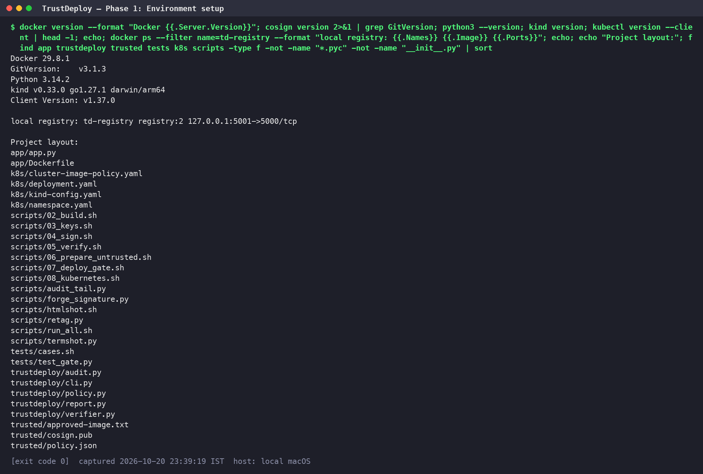
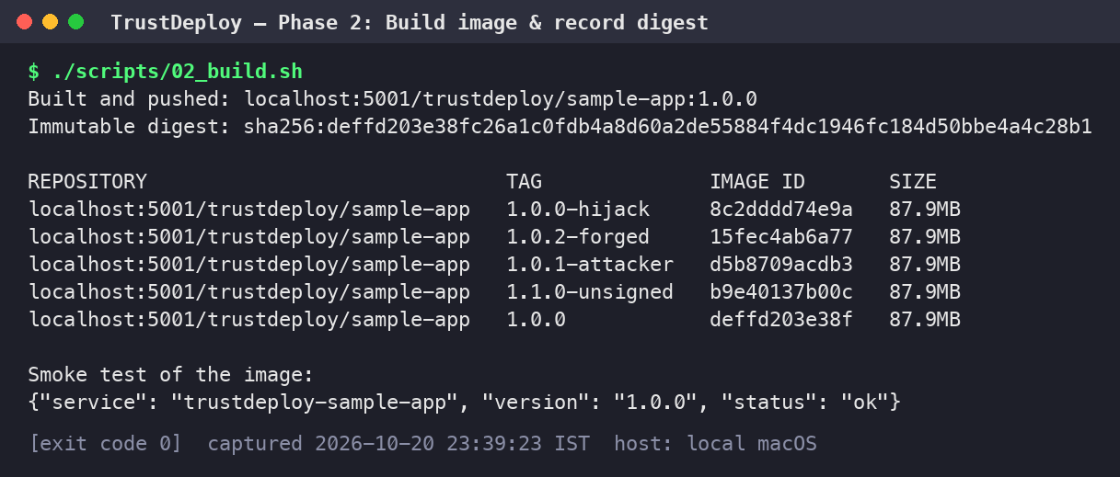
IMPLEMENTATION EVIDENCE
Toolchain, local registry and image build
Phase 2: build, push and record the digest
Registry: td-registry (registry:2) on 127.0.0.1:5001
Approved image: sample-app:1.0.0, digest sha256:deffd203…
Smoke test: service returns status “ok”
Phase 1: toolchain versions, local registry, project layout
TrustDeploy: Container Image Supply Chain Security | Integrity in the CIA triad
9
Notes:
This is the real environment from one clean run: Docker 29.8.1, Cosign v3.1.3, Python 3.14.2, kind and kubectl, plus a registry:2 container on port 5001, so there is no cloud cost. The project layout shows the app, the trustdeploy package, the trusted folder, Kubernetes manifests, scripts and tests. The build script pushes sample-app:1.0.0 and records its immutable digest, deffd203, which every later step refers to; the attack images used in the negative tests sit in the same registry.

Slide 10
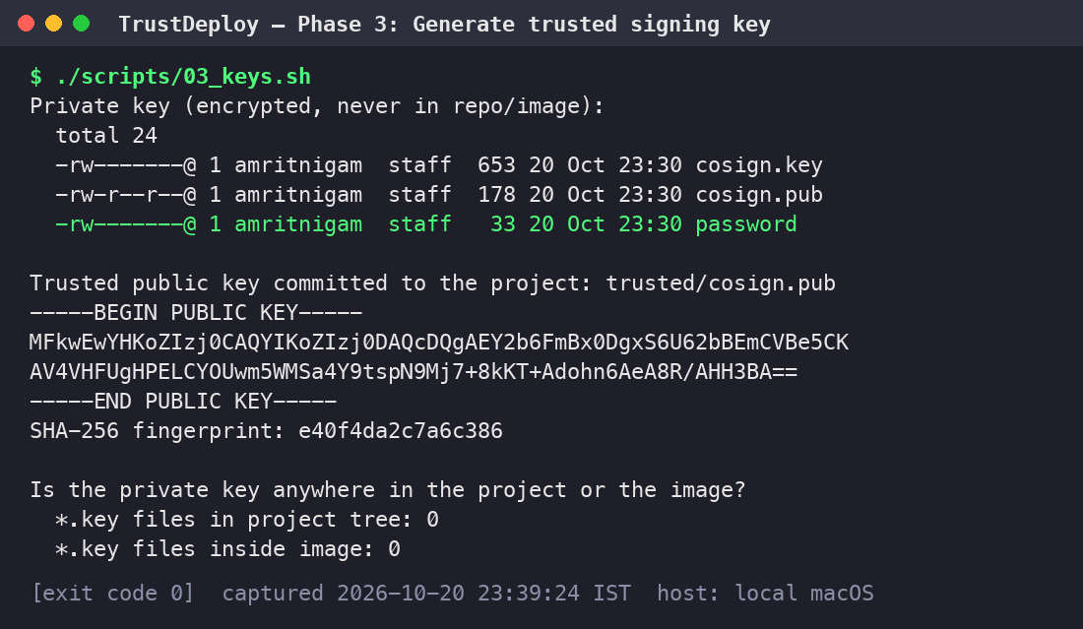
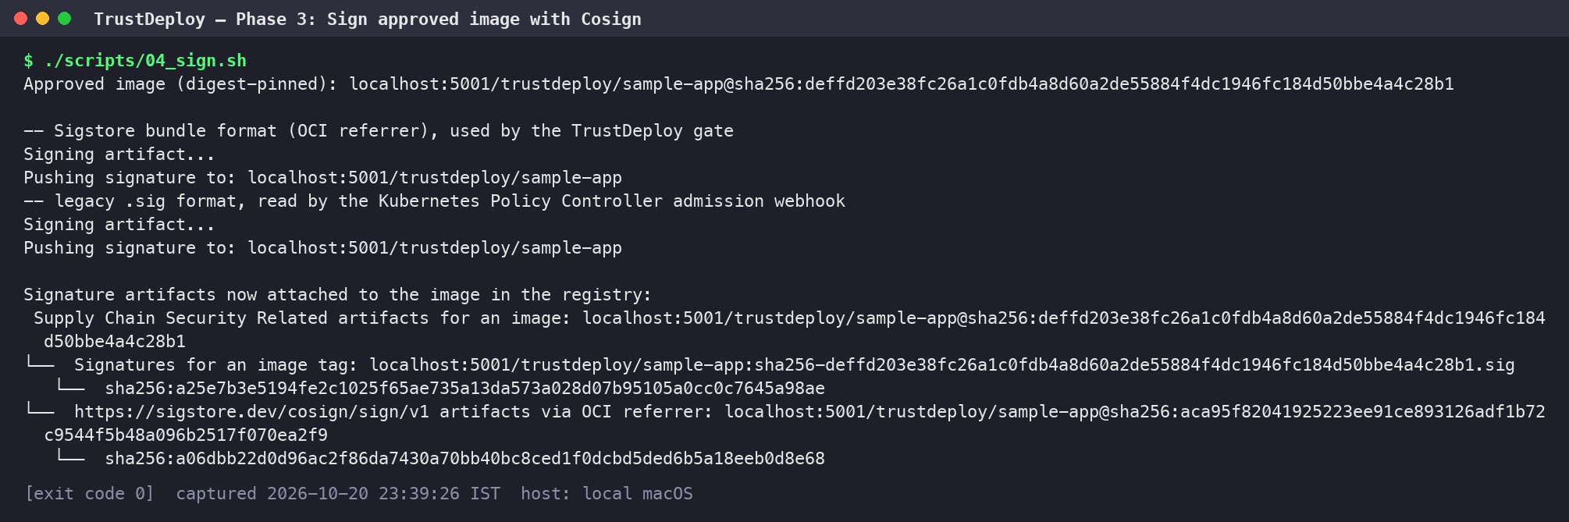
IMPLEMENTATION EVIDENCE
Key generation and signing the approved image
Phase 3: digest-pinned signing, two signature formats
Leak check: 0 *.key files in the project tree, 0 inside the image
Trusted key fingerprint: e40f4da2c7a6c386
Signed: sample-app@sha256:deffd203… as Sigstore bundle (OCI referrer) and legacy .sig
Phase 3: encrypted key pair; public key trusted
TrustDeploy: Container Image Supply Chain Security | Integrity in the CIA triad
10
Notes:
The key script creates an encrypted Cosign key pair. The private key and password file sit in the home directory with owner-only permissions, and the leak check shows zero key files in the project tree and inside the image. Only the public key, fingerprint e40f4da2c7a6c386, is committed as trusted/cosign.pub. The signing script signs the approved image by digest, twice: once in the Sigstore bundle format used by the TrustDeploy gate, attached as an OCI referrer, and once in the legacy .sig format read by the Kubernetes Policy Controller.

Slide 11
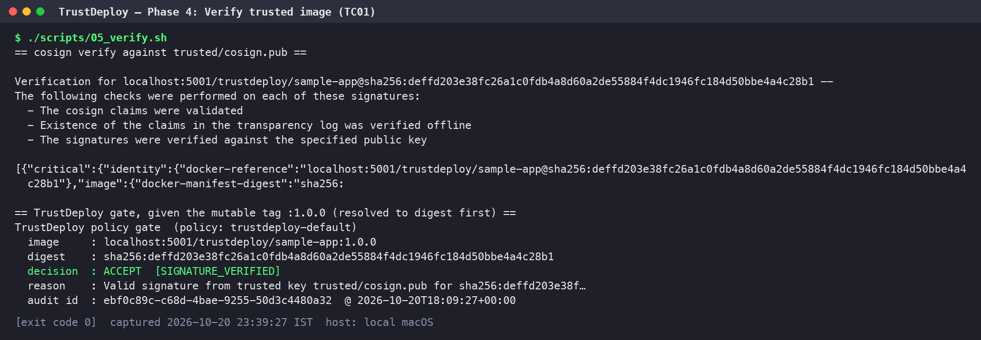
IMPLEMENTATION EVIDENCE
TC01: a correctly signed image is accepted
OBSERVED RESULT
ACCEPT
SIGNATURE_VERIFIED
Tag resolved first: :1.0.0 → sha256:deffd203…
Key: trusted/cosign.pub
Audited: id ebf0c89c… with timestamp
Phase 4: cosign verify, then the TrustDeploy gate on tag :1.0.0
Takeaway: the gate verified the digest the tag pointed to, not the tag itself, before accepting.
TrustDeploy: Container Image Supply Chain Security | Integrity in the CIA triad
11
Notes:
Test case 1. Cosign verifies the signature against trusted/cosign.pub. Then the TrustDeploy gate is given the mutable tag 1.0.0; it resolves the tag to the digest first and returns ACCEPT with reason SIGNATURE_VERIFIED. The decision is written to the audit log with its own audit id and timestamp.

Slide 12
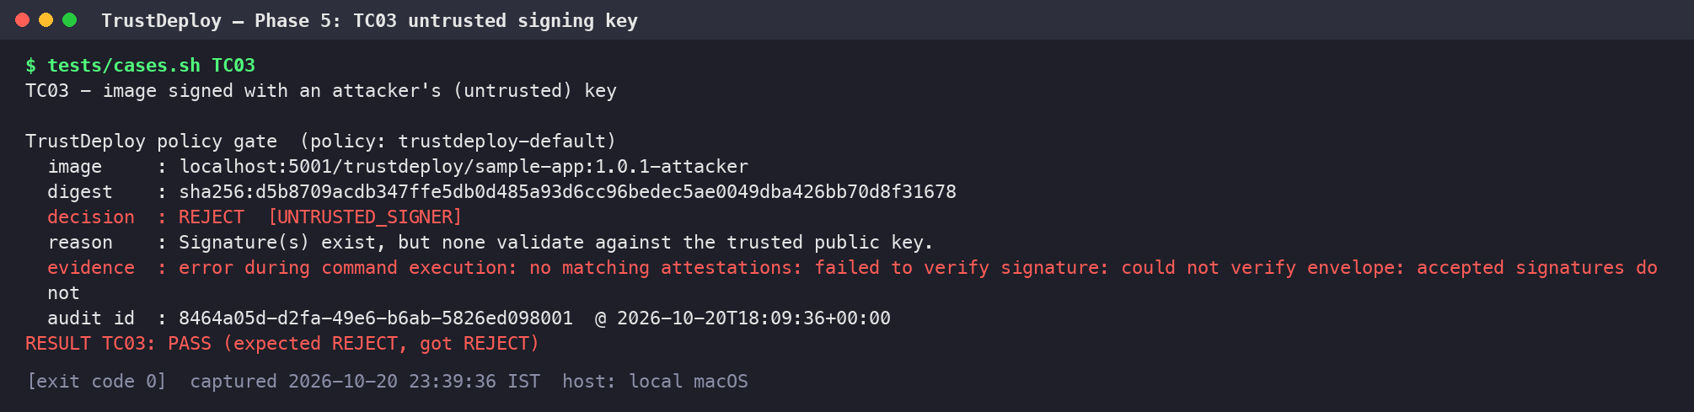
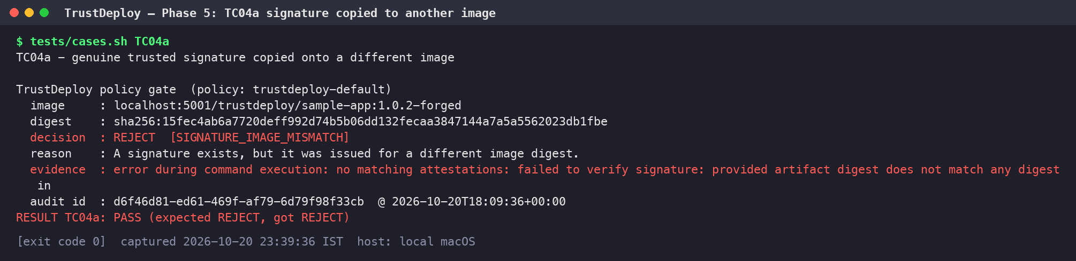
IMPLEMENTATION EVIDENCE
Attacks rejected: wrong key, copied signature
Unsigned image
REJECT · NO_SIGNATURE
TC02
Attacker’s own key
REJECT · UNTRUSTED_SIGNER
TC03
TC03: image signed with the attacker’s key
Copied genuine signature
REJECT · SIGNATURE_IMAGE_MISMATCH
TC04a
Tampered build over :1.0.0
REJECT · NO_SIGNATURE
TC04b
TC04a: genuine signature copied onto a different image
TrustDeploy: Container Image Supply Chain Security | Integrity in the CIA triad
12
Notes:
The negative tests use attack images pushed to the same registry. Top: TC03, an image the attacker signed with their own key, is rejected as UNTRUSTED_SIGNER. Bottom: TC04a, where the genuine signature bundle was copied onto a different image; Cosign finds that the signed digest does not match, and the gate rejects it as SIGNATURE_IMAGE_MISMATCH. On the right are all four attack cases with the reason codes from the audit log: the unsigned image, and the tampered build pushed over the trusted 1.0.0 tag, both have no valid signature for their digest.

Slide 13
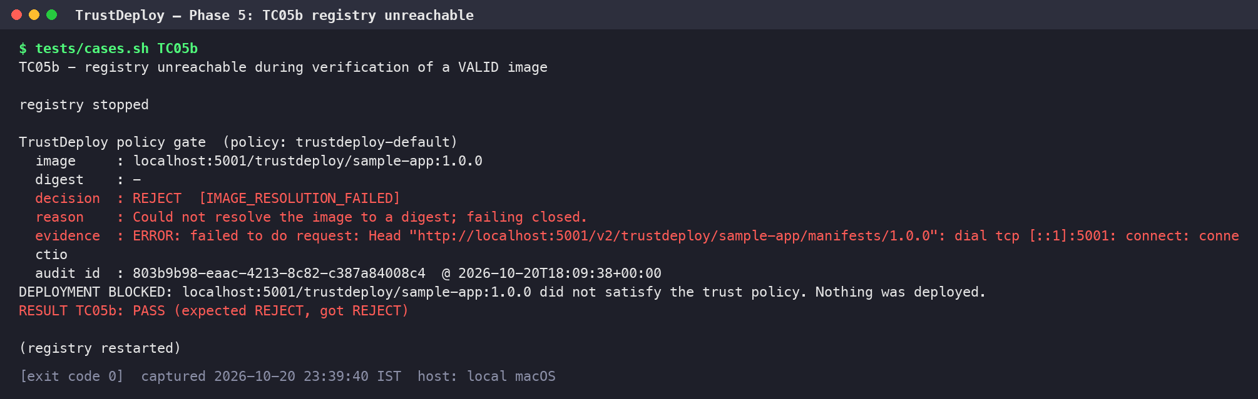
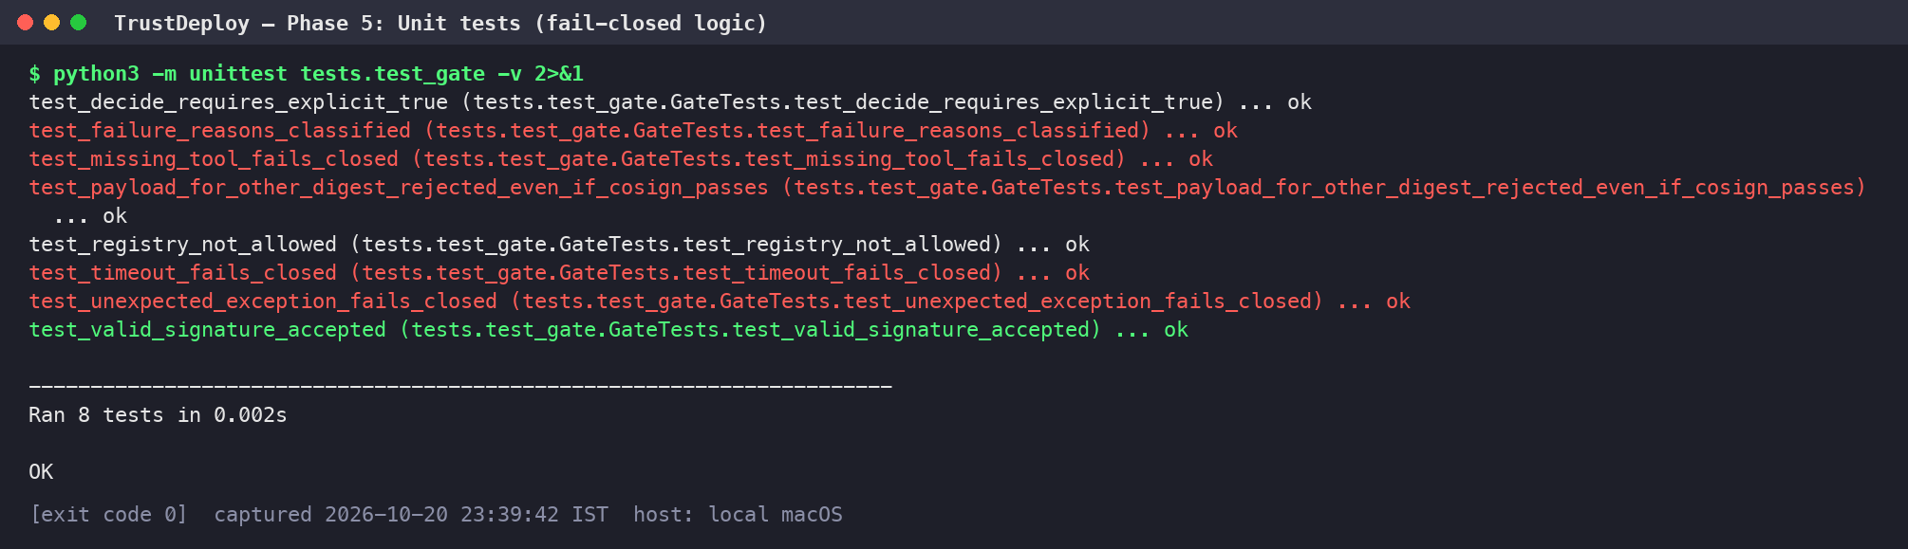
IMPLEMENTATION EVIDENCE
Fail closed: errors deny deployment
TC05a
Cosign missing
VERIFICATION_TOOL_ERROR
TC05b
Registry down
IMAGE_RESOLUTION_FAILED
TC05c
nginx from docker.io
REGISTRY_NOT_ALLOWED
TC05b: registry unreachable during verification of a valid image
8/8
unit tests pass
timeouts, missing tool and exceptions all fail closed
Unit tests: fail-closed decision logic (8 tests, OK)
TrustDeploy: Container Image Supply Chain Security | Integrity in the CIA triad
13
Notes:
Top: TC05b. The registry is stopped while a valid image is being verified. The tag cannot be resolved to a digest, so the gate rejects with IMAGE_RESOLUTION_FAILED and prints DEPLOYMENT BLOCKED: nothing was deployed. TC05a, with Cosign missing, is rejected as VERIFICATION_TOOL_ERROR, and TC05c, an nginx image from Docker Hub, as REGISTRY_NOT_ALLOWED. Bottom: the eight unit tests for the decision logic, including timeout, missing tool and unexpected exceptions failing closed, all pass.

Slide 14
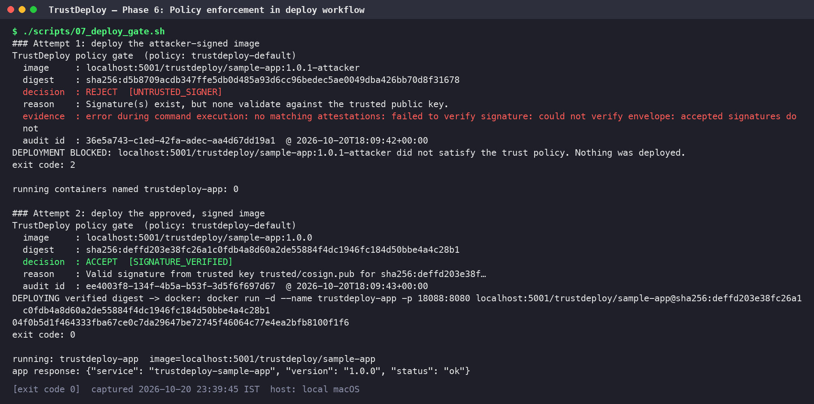
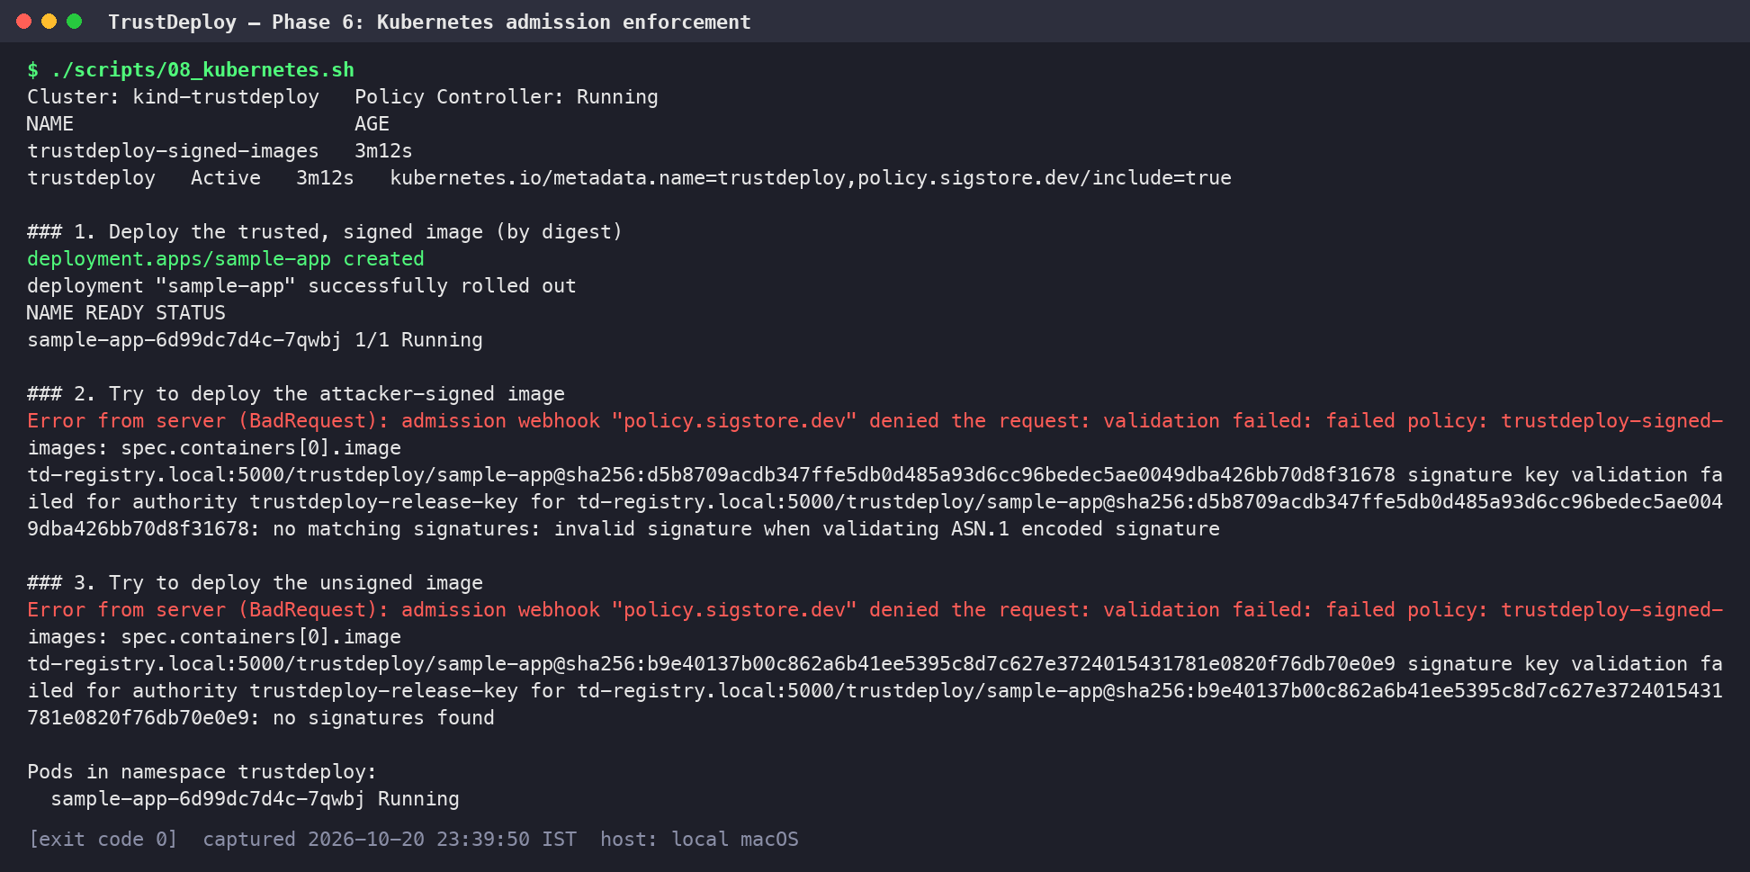
IMPLEMENTATION EVIDENCE
Enforced at deploy time: Docker and Kubernetes
Docker: attacker image blocked; verified digest deployed
Kubernetes: Policy Controller admission on kind
Docker gate: attacker-signed image blocked (exit code 2, 0 containers); approved image run as image@sha256 digest.
Admission: signed image admitted (pod Running); attacker-signed and unsigned images denied by the webhook.
TrustDeploy: Container Image Supply Chain Security | Integrity in the CIA triad
14
Notes:
Left: the deploy workflow. Deploying the attacker-signed image is rejected as UNTRUSTED_SIGNER, the script exits with code 2 and no container is running. Deploying the approved image is accepted, and Docker runs it by its verified digest, not the tag; the app answers status ok. Right: the same rule in Kubernetes. On a kind cluster with the Sigstore Policy Controller and a ClusterImagePolicy holding our public key, the signed image is admitted and its pod is Running, while the attacker-signed and unsigned images are denied by the admission webhook.

Slide 15
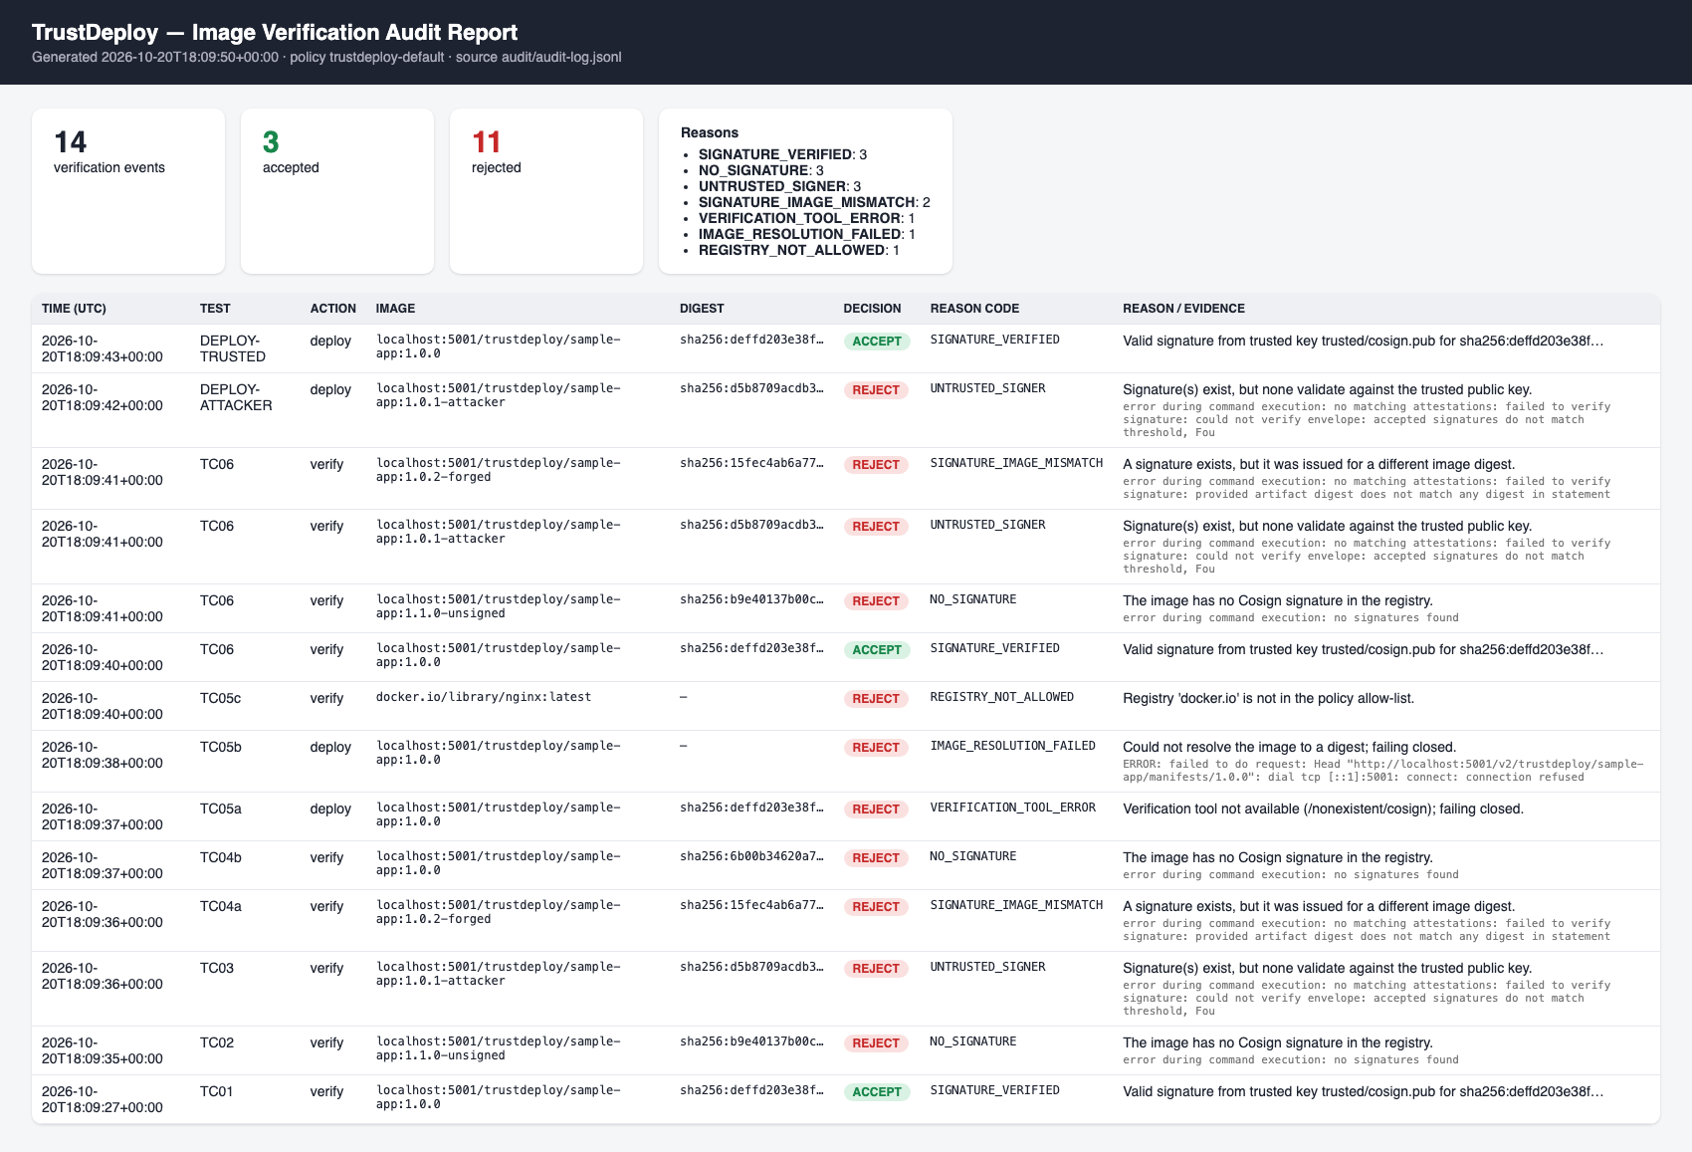
IMPLEMENTATION EVIDENCE
TC07: audit report and HTML dashboard
14 verification events
3 accepted
11 rejected
Exports: report.html, report.csv, report.json
Per record: digest, decision, reason code, key fingerprint, tool evidence
audit/report.html, generated from audit/audit-log.jsonl
TrustDeploy: Container Image Supply Chain Security | Integrity in the CIA triad
15
Notes:
TC07 exports the audit log. The report command writes report.html, report.csv and report.json. The HTML dashboard shows 14 verification events from this run, 3 accepted and 11 rejected, with the count for each reason code and one row per decision: time, test, image, digest, decision, reason code and the tool's evidence. Each audit record also stores the trusted key fingerprint, but never key material.

Slide 16
TESTING
Test results: every attack was rejected
ID
SCENARIO
EXPECTED
OBSERVED
TC01
Correctly signed image
Accepted
ACCEPT · SIGNATURE_VERIFIED
8/8
unit tests pass
TC02
Unsigned image
Rejected
REJECT · NO_SIGNATURE
TC03
Signed with the attacker’s key
Rejected
REJECT · UNTRUSTED_SIGNER
TC04a
Genuine signature copied onto another image
Rejected
REJECT · SIGNATURE_IMAGE_MISMATCH
TC04b
Trusted tag re-pointed to a tampered build
Rejected
REJECT · NO_SIGNATURE
TC05a
Verification tool (Cosign) missing
Deployment denied
REJECT · VERIFICATION_TOOL_ERROR
K8s
admission: signed admitted, attacker & unsigned denied
TC05b
Registry down during verification
Deployment denied
REJECT · IMAGE_RESOLUTION_FAILED
TC05c
Image from a registry outside the policy
Rejected
REJECT · REGISTRY_NOT_ALLOWED
TC06
Multiple images checked in one run
Each recorded separately
PASS · 4 separate audit entries
TC07
Audit report export
Report generated
PASS · HTML, CSV, JSON written
TrustDeploy: Container Image Supply Chain Security | Integrity in the CIA triad
16
Notes:
Summary of all test cases from the final run. The correctly signed image was accepted. The unsigned image, the attacker-signed image, the copied signature and the tampered build over the trusted tag were all rejected. With Cosign missing or the registry down, deployment was blocked, and an image from a registry outside the policy was rejected. Checking several images produced four separate audit entries, and the report was exported as HTML, CSV and JSON. All eight unit tests pass, and Kubernetes admission enforced the same rule.

Slide 17
LIMITATIONS
What a signature does not prove
!
Not a vulnerability scan
A signature proves origin and integrity under the policy, not that the image is free of vulnerabilities.
!
Depends on key security
If the private signing key is stolen, an attacker can produce signatures the gate will trust.
!
Transparency log disabled offline
The offline prototype skips the public Rekor log, so signing events are not publicly recorded.
!
No malware scanning
The contents of a correctly signed image are not inspected for malicious code.
Scope: TrustDeploy answers “is this the image we approved?” — not “is this image safe?”
TrustDeploy: Container Image Supply Chain Security | Integrity in the CIA triad
17
Notes:
A signature is strong evidence of origin and integrity under our policy, but it is not a security scan. A correctly signed image can still contain vulnerabilities or malware, because we do not inspect contents. The scheme is only as strong as the private key: if it is stolen, an attacker can create trusted signatures. And because the prototype is offline, upload to the public transparency log is disabled, so there is no public record of signing events.

Slide 18
FUTURE WORK
Hardening toward a production pipeline
CI/CD pipeline
Provenance
Keys and platform
1
GitHub Actions signing
4
SLSA provenance attestations
6
KMS-backed keys and rotation
2
Vulnerability scan (e.g. Trivy) before signing
5
Keyless signing with OIDC (Sigstore)
7
Amazon ECR / EKS deployment
3
SBOM generation
TARGET PIPELINE
Build
Scan
SBOM
Sign
Verify
Deploy digest
TrustDeploy: Container Image Supply Chain Security | Integrity in the CIA triad
18
Notes:
Next steps fall into three groups. In CI, signing moves into GitHub Actions, and images are scanned with Trivy and given an SBOM before they are signed. For provenance, SLSA attestations record how the image was built, and keyless signing with OIDC removes long-lived keys. On the platform side, keys move into a KMS with rotation, and the same gate runs against Amazon ECR and EKS.

Slide 19
CONCLUSION
Only proven images reach deployment
1
rule decides
ACCEPT only if verified is True; everything else is REJECT
What TrustDeploy delivers
Next steps
✓
Cosign signing with a dedicated ECDSA P-256 key
CI signing
GitHub Actions
✓
Tag resolved to digest before every check
Scan + SBOM
Trivy before signing
✓
Signature and signed-digest double-check
✓
Fail-closed gate with seven reason codes
Provenance
SLSA attestations
✓
JSONL audit with HTML, CSV and JSON reports
Keys
keyless OIDC or KMS with rotation
✓
Same rule enforced at Kubernetes admission
Sign
approved image, by digest
Verify
trusted key + digest check
Deploy
exact verified digest
TrustDeploy: Container Image Supply Chain Security | Integrity in the CIA triad
19
Notes:
To conclude: TrustDeploy turns image deployment from trusting a tag into verifying a signature on a digest. One rule decides everything: accept only if verified is true. The prototype signs with Cosign, resolves tags to digests, double-checks the signed digest, fails closed with seven reason codes, and audits every decision. Next we would move signing into CI, add scanning and SBOMs, and adopt keyless or KMS-backed keys. Thank you; we are happy to take questions.

