Slide 1


VIGNAN’S INSTITUTE OF MANAGEMENT AND TECHNOLOGY FOR WOMEN
Major Project Review On
ANDROID MALWARE DETECTION USING GENETIC ALGORITHM BASED OPTIMIZED FEATURE SELECTION
Batch -15
Department of Computer Science and Engineering
Under The Guidance of :
Ms. SAMREEN BEGUM
(Assistant Professor
Department of CSE)
Presented By:
G. Dishitha(20UP1A0570)
L. Akhila(20UP1A0579)
V. Amitha Reddy(20UP1A05A4)
N. Sandhya(20UP1A0591)

Slide 2
CONTENTS:
ABSTRACT
INTRODUCTION
EXISTING SYSTEM
DISADVANTAGES
PROPOSED SYSTEM
ADVANTAGES
SYSTEM REQUIREMENTS
ARCHITECTURE
MODULES
UML DIAGRAMS
OUTPUT
CONCLUSION
REFERENCES

Slide 3

ABSTRACT
Android platform due to open-source characteristic and Google backing has the largest global market share. Being the world's most popular operating system, it has drawn the attention of cyber criminals operating particularly through wide distribution of malicious applications. It is an effectual machine learning based approach for Android Malware Detection making use of evolutionary Genetic algorithm for discriminatory feature selection. Selected features from Genetic algorithm are used to train machine learning classifiers and their capability in identification of Malware before and after feature selection is compared. Genetic algorithm gives most optimized feature subset helping in reduction of feature dimension to less than half of the original feature-set. This approach offers a proactive and automated method for detecting and mitigating the risks associated with malware, helping to protect systems and networks from potential threats.

Slide 4
INTRODUCTION
Android Apps are freely available on Google Play store, the official Android app store as well as third-party app stores for users to download. Due to its open source nature malware writers are focusing on developing malicious applications.
They still find their way to mass market and cause harm to users by misusing personal information related to their phone book, mail accounts, GPS location information and others for misuse by third parties or else take control of the phones remotely.
Therefore, Android malware detection is crucial for safeguarding users from harmful software. It involves identifying, preventing, and mitigating malware threats on Android devices.

Slide 5
EXISTING SYSTEM
Malware analysis is performed to detect and analyse such threats.
Two types of analysis: Static Analysis and Dynamic Analysis. Static analysis examines code structure without executing it. Dynamic analysis examines runtime behaviour of Android apps.
Signature-Based Detection: Relies on a database of known malware signatures. Limited to known signatures, requires regular updates, and may miss new or zero-day threats.
Heuristic-Based Detection: Uses heuristics to identify suspicious behaviors. Prone to false positives and may not effectively handle complex behaviors exhibited by some malware.
Behavioral Analysis: Monitors runtime behavior. Resource-intensive and may not catch all malware variations.

Slide 6

DISADVANTAGES
Limited to Known Threats :Limited to known malware signatures, unable to detect new or zero-day threats.
False Positives: Heuristic approaches may flag harmless programs as malicious.
Scalability Issues: Difficulty handling the growing volume and diversity of malware.
May not cover all variations of malware behavior
Lack of accuracy in distinguishing between malicious and benign activities

Slide 7
PROPOSED SYSTEM
Two set of Android Apps or APKs: Malware/ Goodware are reverse engineered to extract features such as permissions and count of App Components such as Activity, Services, Content Providers, etc. These features are used as feature vector with class labels as Malware and Goodware represented by 0 and 1 respectively in CSV format.
To reduce dimensionality of feature-set, the CSV is fed to Genetic Algorithm to select the most optimized set of features. The optimized set of features obtained is used for training two machine learning classifiers: Support Vector Machine and Neural Network.

Slide 8

ADVANTAGES
Security
Efficient algorithm for feature selection to improve overall detection accuracy.
Machine-learning based approach in combination with static and dynamic analysis can be used to detect new variants of Android Malware posing zero-day threats

Slide 9
SYSTEM REQUIREMENTS
HARDWARE REQUIREMENTS:
Minimum of 4GB RAM
Quad-core processor
100GB of available storage
SOFTWARE REQUIREMENTS:
Operating System: Windows
Python
TensorFlow framework

Slide 10
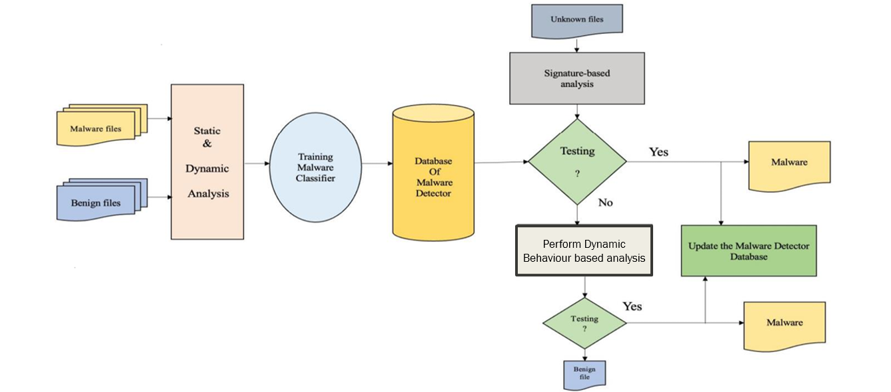
ARCHITECTURE

Slide 11
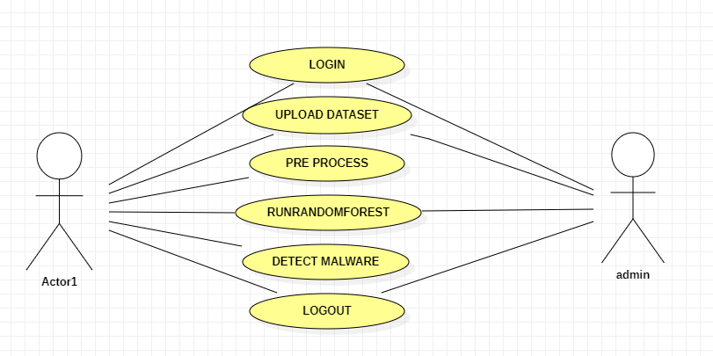
UML DIAGRAMS
USE CASE DIAGRAM:

Slide 12
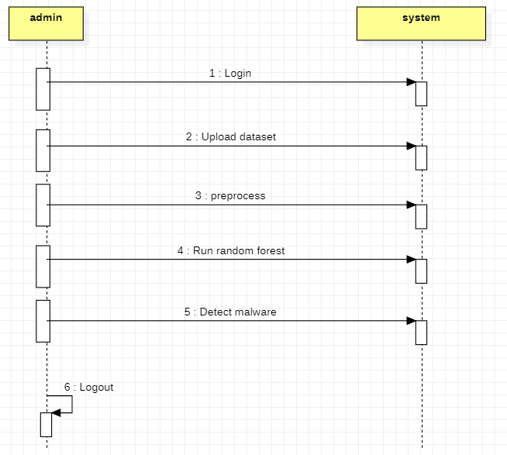
SEQUENCE DIAGRAM:

Slide 13
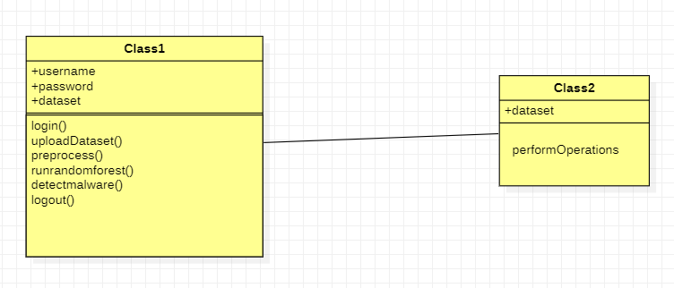
CLASS DIAGRAM

Slide 14

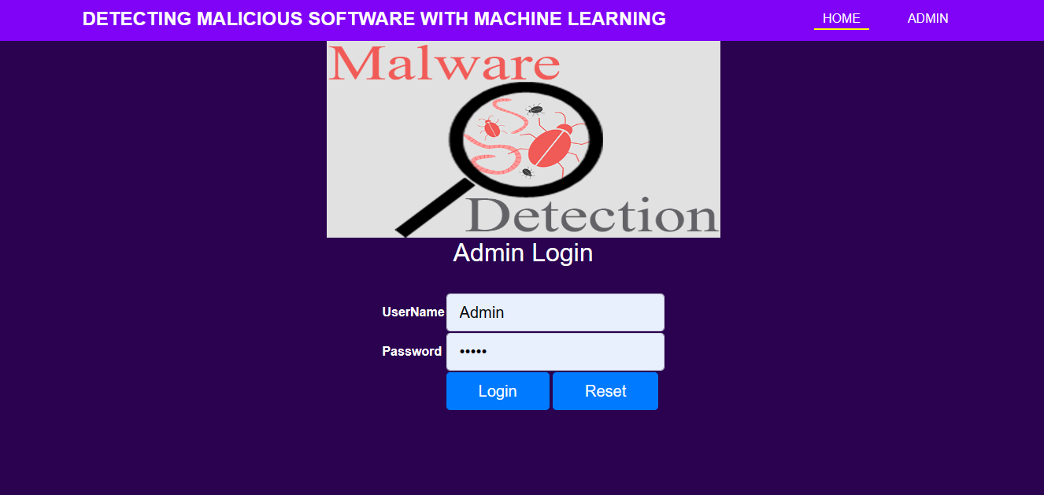
OUTPUT

Slide 15

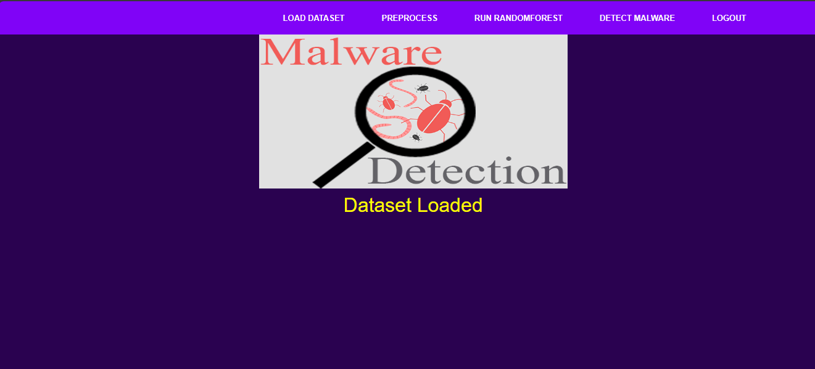

Slide 16
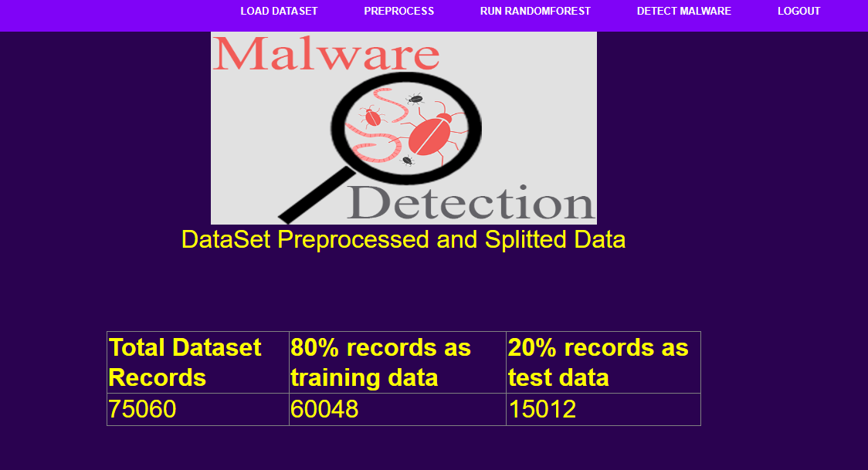
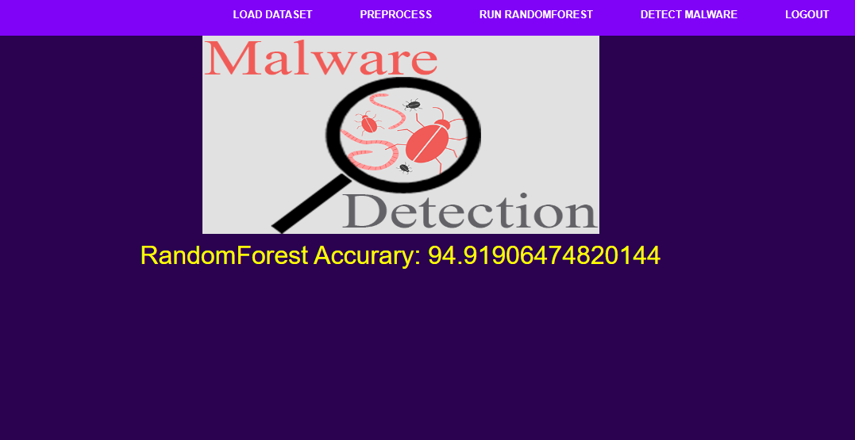

Slide 17
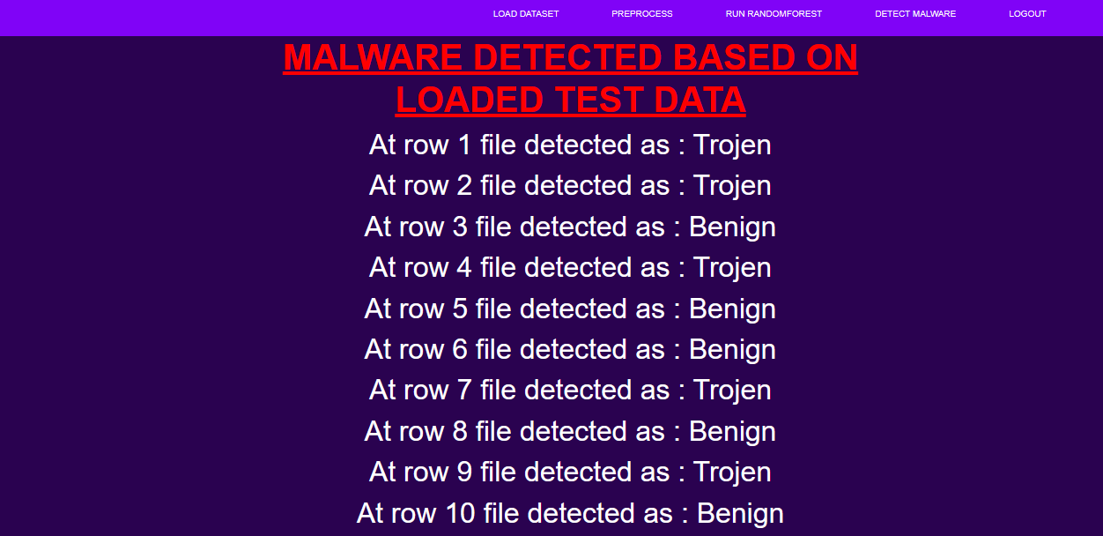

Slide 18
CONCLUSION
As the number of threats posed to Android platforms is increasing day to day, spreading mainly through malicious applications or malwares, therefore it is very important to design a framework which can detect such malwares with accurate results. Where signature-based approach fails to detect new variants of malware posing zero-day threats, machine learning based approaches are being used. The proposed methodology attempts to make use of evolutionary Genetic Algorithm to get most optimized feature subset which can be used to train machine learning algorithms in most efficient way.

Slide 19
REFERENCES
Anam Fatima, Ritesh Maurya, Malay Kishore Dutta, Radim Burget; Jan Masek
Android Malware Detection Using Genetic Algorithm based Optimized Feature Selection and Machine Learning | IEEE Conference Publication | IEEE Xplore

Slide 20


