Slide 1
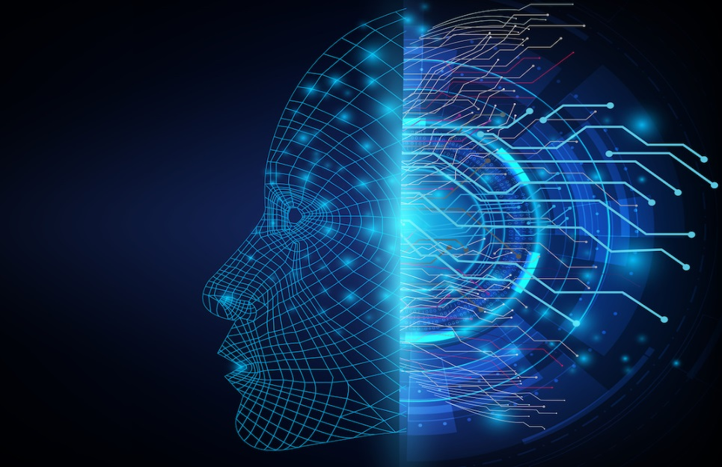
Predicting Diabetes using Machine Learning
By
Shashank Bayal

Slide 2

Introduction
B-tech Student at Indian Institute of Technology Ropar.
Cycling lover and enjoy playing Chess and Table Tennis
Interested in Artificial intelligence and Machine Learning
Hopes to focus more on data science and data engineering in future career

Slide 3
Objectives
Prediction of diabetes using different Machine learning Algorithms
Software Used
Anaconda Terminal Prompt
Jupyter Notebook
Google Collaboratory
Kaggle Dataset
Hardware Used
Intel i5 11th gen with 8Gb Ram on Windows 10 Operating System

Slide 4

What is Machine Learning ?
Machine learning is a branch of artificial intelligence (AI) and computer science which focuses on the use of data and algorithms to imitate the way that humans learn, gradually improving its accuracy
Predictive technology that see pattern in datasets.
Used in industry, medicinal fields, and primarily in research.

Slide 5
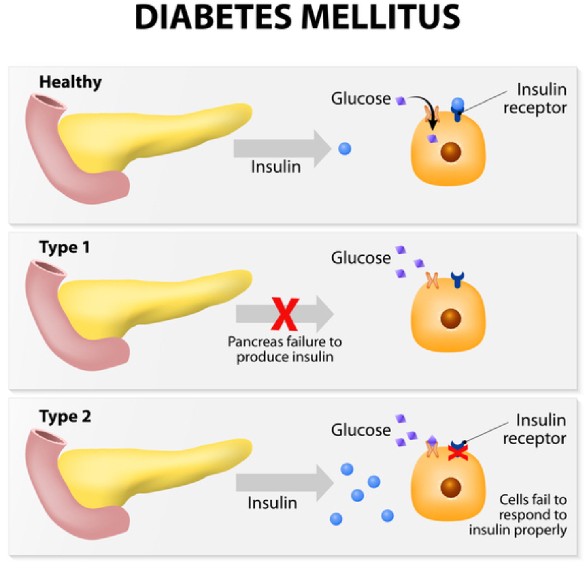
What is Diabetes ?
Diabetes is disease in which a person’s blood glucose level, or blood sugar level are too high.
It is caused mainly due to insufficient production of insulin, causing high blood glucose.
Symptoms may include frequent urination, excessive thirst or hunger, and weight changes.
Every year on 14th November Diabetes day is celebrated to spread awareness.
The theme for World Diabetes 2021-23 is “Access to Diabetes Care”

Slide 6
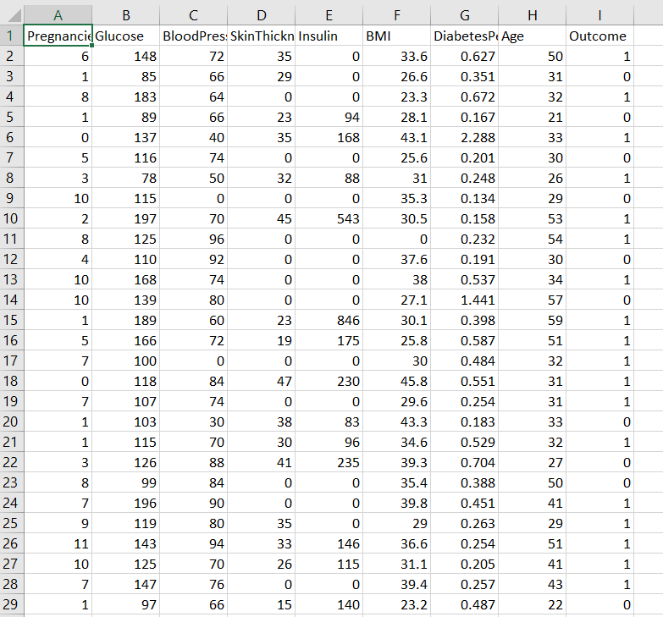
Diabetes dataset Used
Content:
Several constraints were placed on the selection of these instances from a larger database. In particular, all patients here are females at least 21 years old of Pima Indian heritage.
Pregnancies: Number of times pregnant
Glucose: Plasma glucose concentration a 2 hours in an oral glucose tolerance test
BloodPressure: Diastolic blood pressure (mm Hg)
SkinThickness: Triceps skin fold thickness (mm)
Insulin: 2-Hour serum insulin (mu U/ml)
BMI: Body mass index (weight in kg/(height in m)^2)
DiabetesPedigreeFunction: Diabetes pedigree function
Age: Age (years)
Outcome: Class variable (0 or 1)
If “1” the person is diabetic.
If “0” the person is non diabetic.
Link : https://www.kaggle.com/datasets/mathchi/diabetes-data-set

Slide 7
Libraries Used
Libraries Used
Pandas
Numpy
Sklearn
Seaborn
Streamlit
Future Use
For Diabetes Detection using Medical healthcare devices

Slide 9
Thank You

