Slide 1
CAP 5100 HCI Phase 1: Brainstorming & Affinity Diagrams
Submitted by:
Dishant Vyas, Nicholas Verdugo, Pratyush Shukla, Shlok Singh

Slide 2
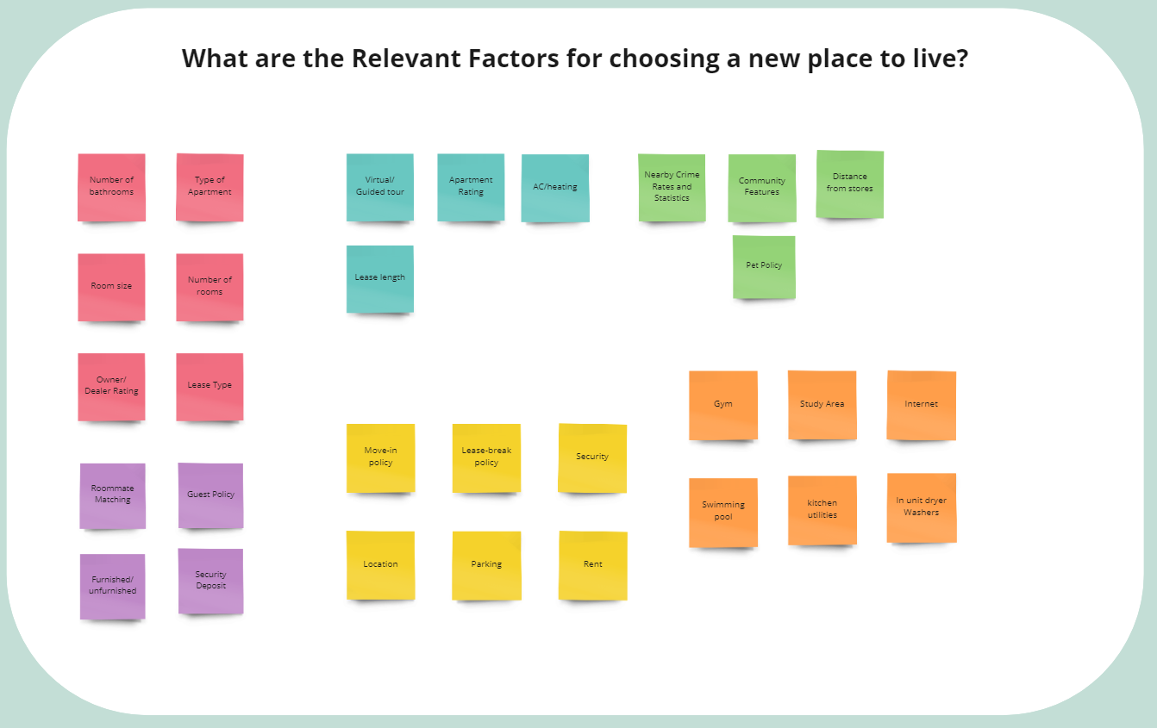
Photo of all Brainstormed Post-Its (unorganized)

Slide 3
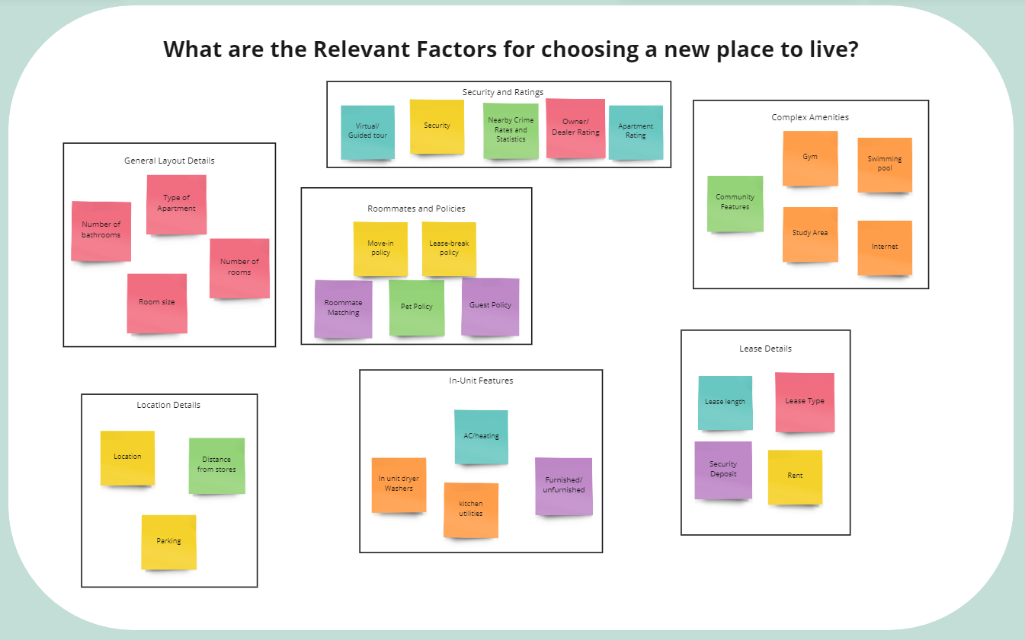
Photo of Complete Affinity Diagram (organized with themes annotated)

Slide 4
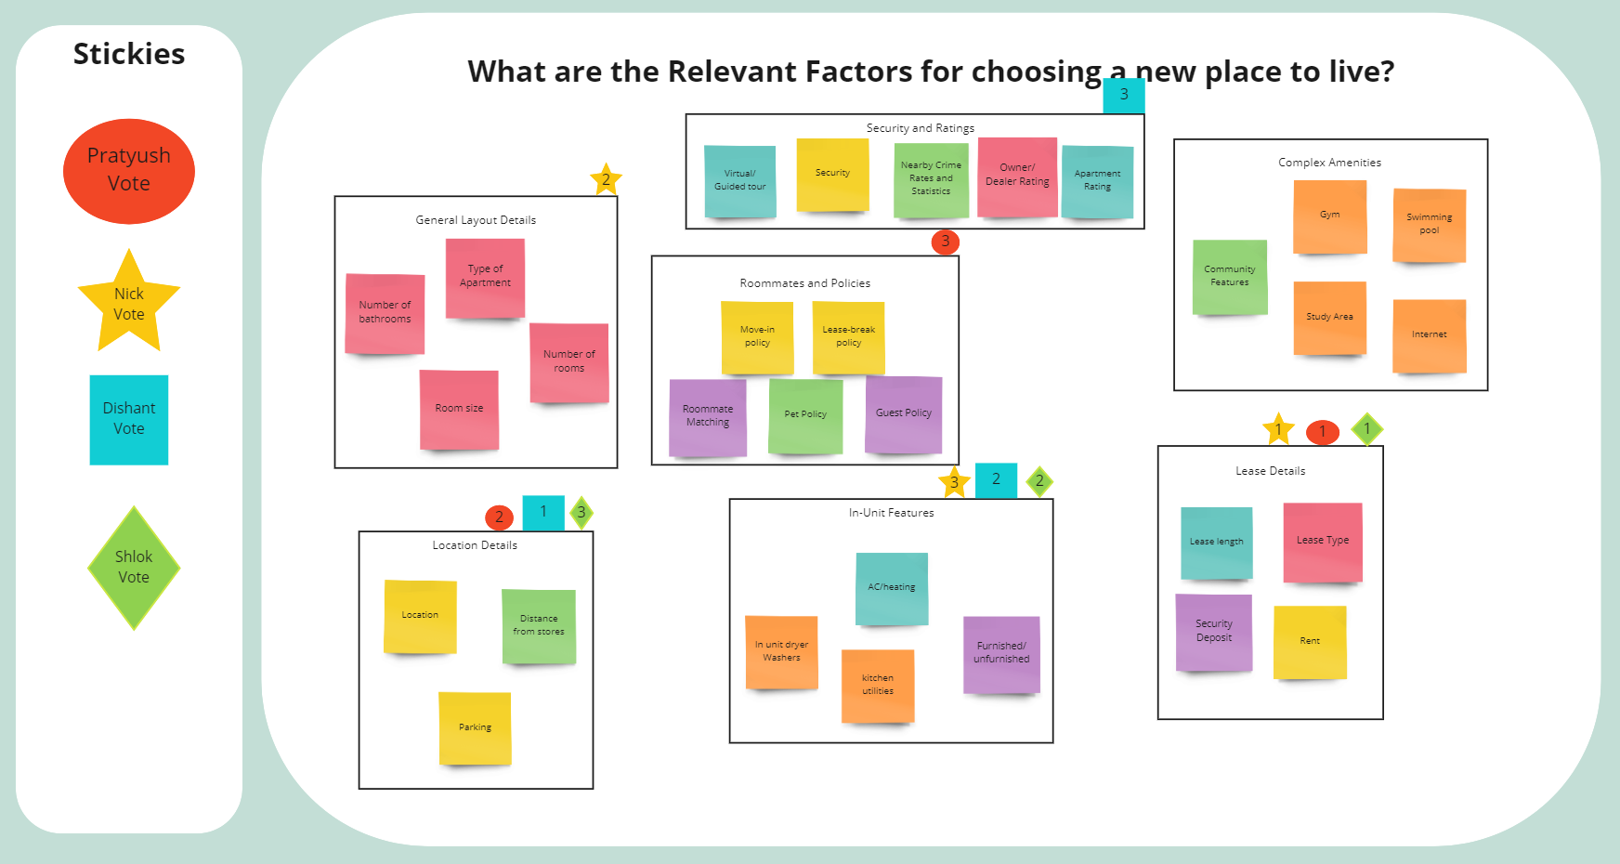
Photo of Final Organized Affinity Diagram (with votes on factors to focus on)

Slide 5
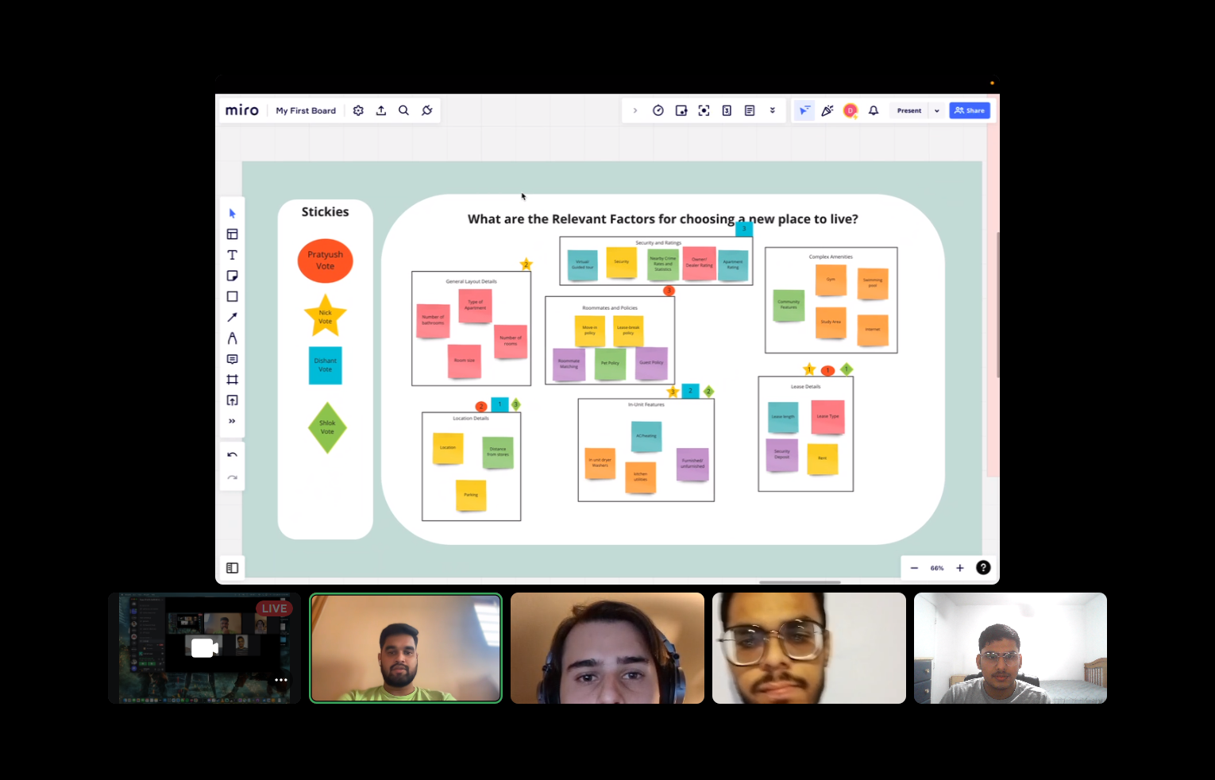
Done! (Group picture next to Affinity Diagram)

