Slide 1
CAP5100 HCI Phase-2: From Exploration to Generation
Submitted by:
Dishant Vyas, Nicholas Verdugo, Pratyush Shukla, Shlok Singh

Slide 2
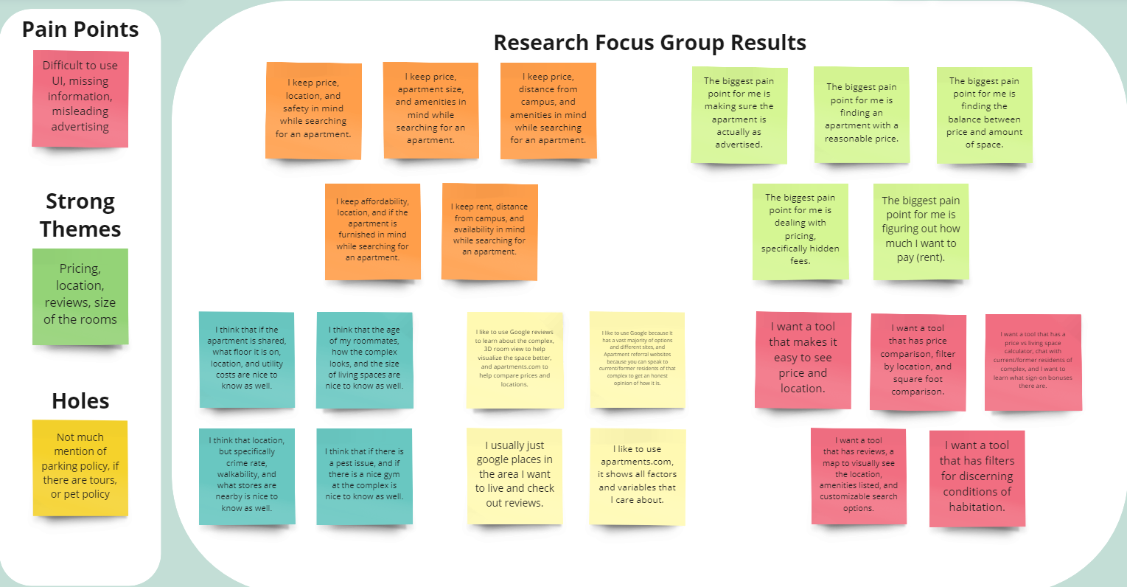
Picture of all User Research Post-Its (unorganized)

Slide 3
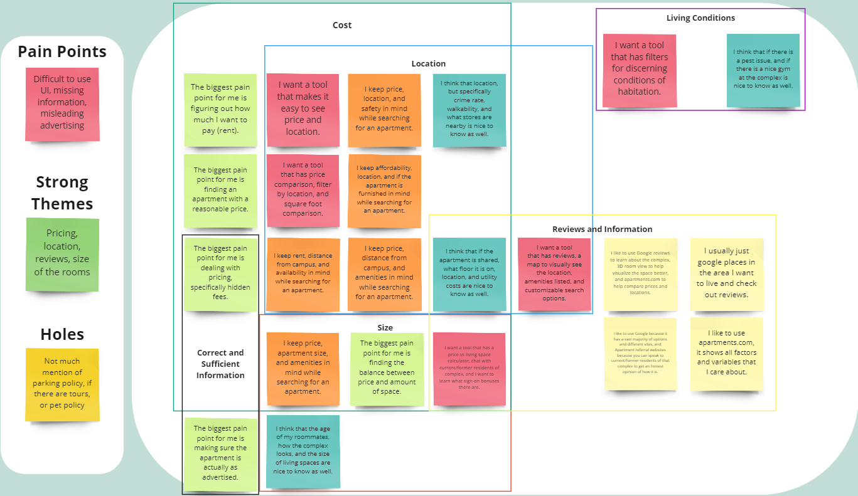
Picture of Complete User Research Affinity Diagram (organized with themes annotated)

Slide 4
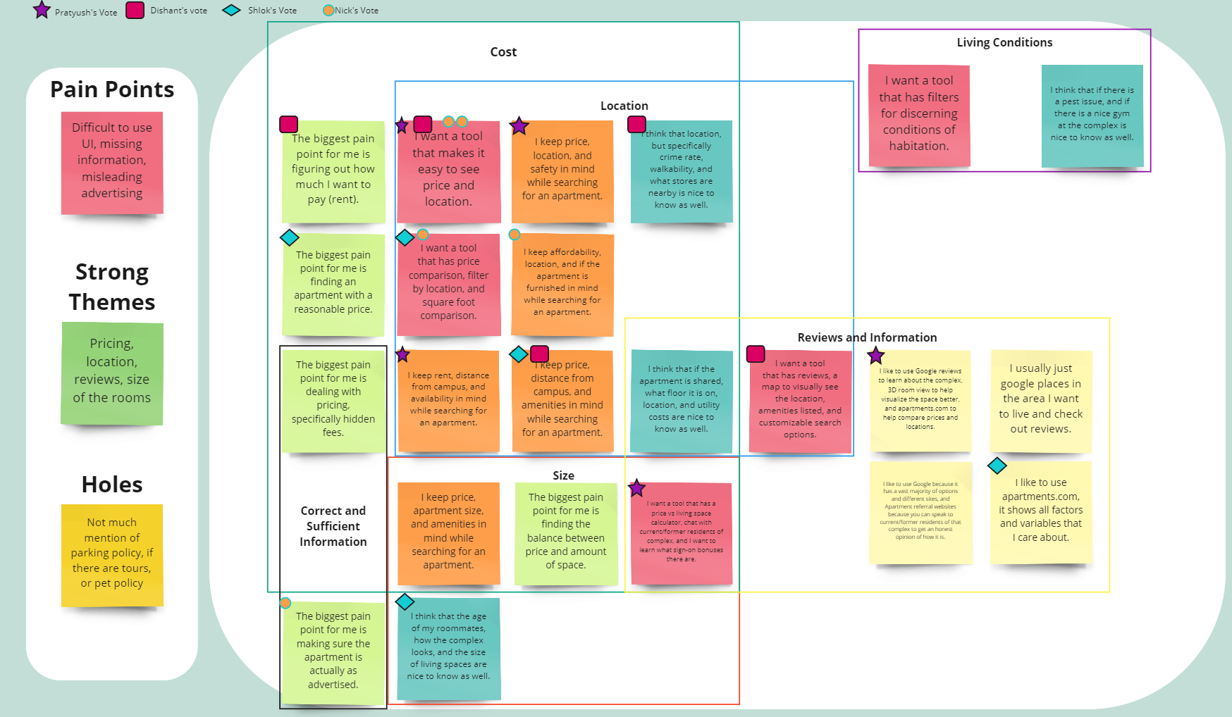
Picture of Final Organized Affinity Diagram (with votes on user needs to focus on)

Slide 5
List of User Needs and Rationale (can include text or pictures of original diagram/notes)
Price with Location map/feature: The most important concerns for anyone looking for apartment is the location, and it’s price as the foremost filter
Customizable search options: When you add more filters to the search, it helps the user narrow it further down without having to check properties individually in a preferred location and price range
Reviews and an easier way to communicate with current/former residents: Sometimes just a 5-star review with an amazing place isn’t convincing enough for a user to believe if the place is good enough for them
Potential sign-on bonuses for new renters: If an apartment has promotions and/or discounts over specific commodities, users would want to know when they are initially trying to narrow down some properties

Slide 6
Top 5 to 10 Design Features & Rationale
Price with Location map/feature: The most important concerns for anyone looking for apartment is the location, and it’s price as the foremost filter
Customizable search options: When you add more filters to the search, it helps the user narrow it further down without having to check properties individually in a preferred location and price range
Reviews and an easier way to communicate with current/former residents: Sometimes just a 5-star review with an amazing place isn’t convincing enough for a user to believe if the place is good enough for them
Potential sign-on bonuses for new renters: If an apartment has promotions and/or discounts over specific commodities, users would want to know when they are initially trying to narrow down some properties
Promotion, discounts and bonuses
It is always nice when an apartment offers more like utilities bill discount, moving in goodies or discounts in rent if booked before a specific date
Scenario 2
Locality Crime Rate and Safety
User prefer to live in communities that are safe
Scenario 1

Slide 7

Persona You Used for Scenario 1
Susan is a 2nd year PhD student at University of Florida pursuing Anthropology. She loves to read and spends most of her time at the campus in classes, lab or at the library. She is looking for a place near the UF campus for easy travel. Furthermore, she doesn’t care much about the amenities as she rarely spends time at her apartment except most sleep and occasionally preparing food. Her priority is easy transportation and less commute with the cheapest rent.

Slide 8
Scenario 1: Susan looking for a cheap apartment near the campus
The user is only looking for an apartment that is closest to her campus and has available public transportation to campus, which she can frequently and easily use
She doesn’t have a preference when it comes to number of roommates or what the apartments offer in terms of furniture
She is looking for an apartment that has rent in the range of 400-500$

Slide 9
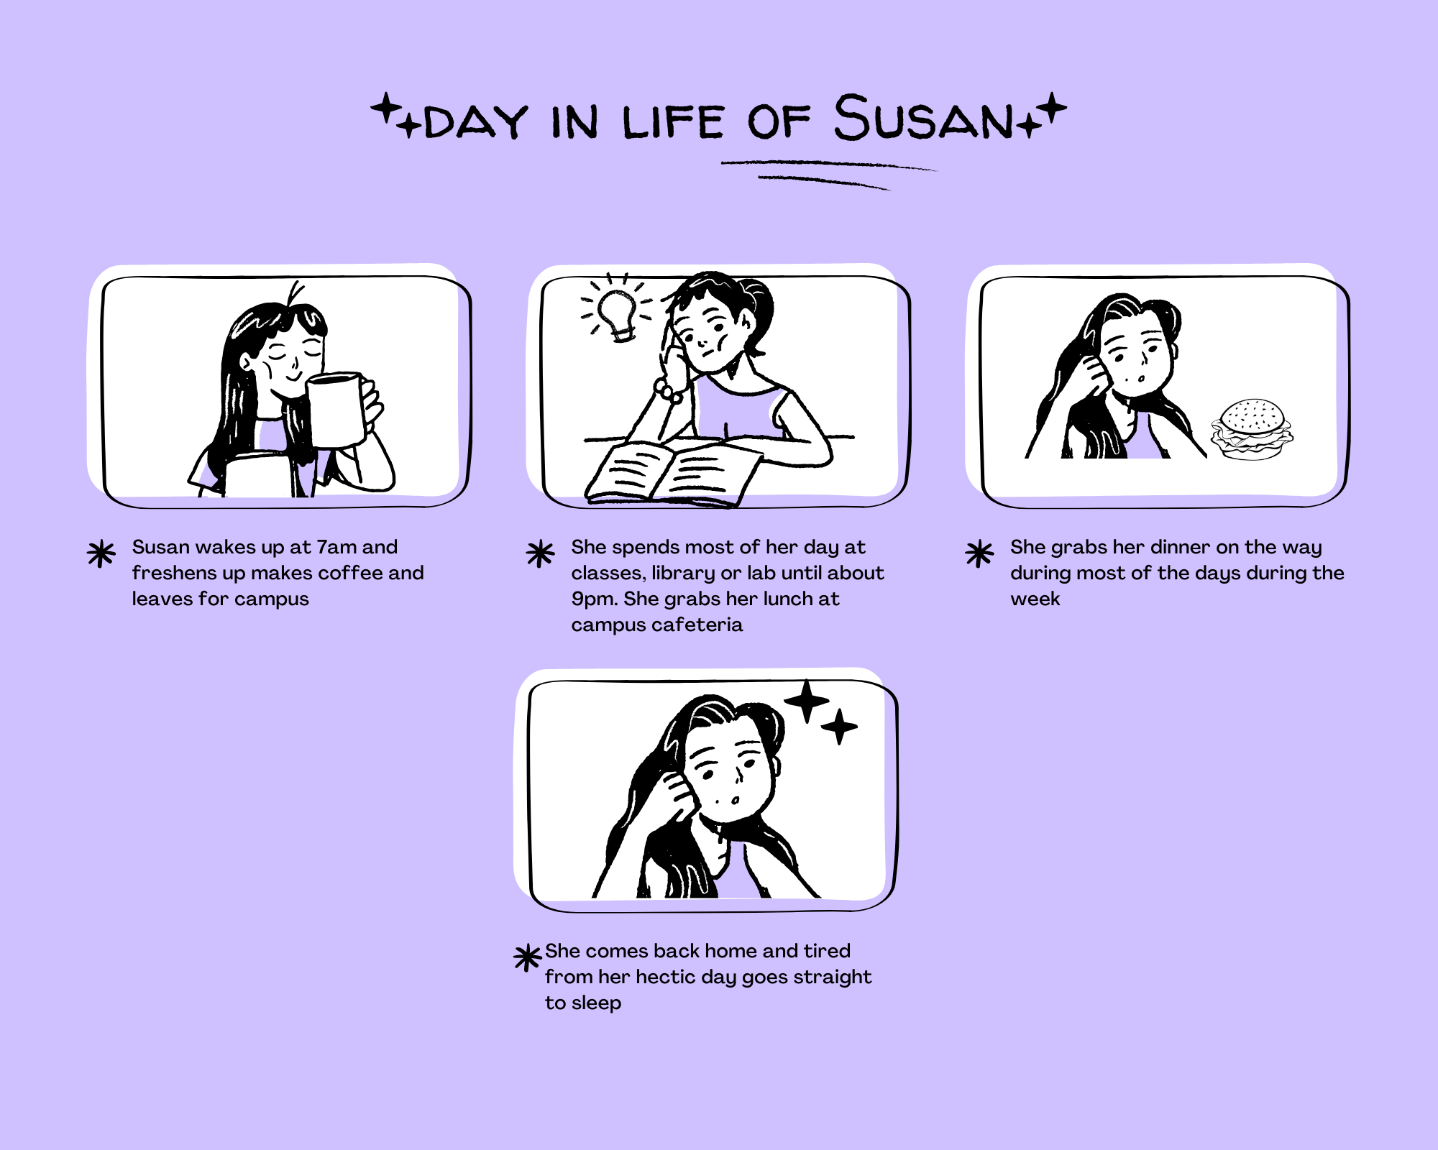
Storyboard 1

Slide 10

Persona You Used for Scenario 2
Evan is a 3rd year undergraduate student at University of Florida pursuing Business Administration. He loves to work play tennis and basketball and has often friends coming over for board games. He has specific amenities that he is looking for and doesn’t give priority to commute or distance to campus, as he has a car. Furthermore, he lives with 2 of his closest friends and hence lives in 3bhk, which was the preferred choice.

Slide 11
Scenario 2: Evan wants a 3bhk with tennis and basketball court
Evan is looking for a 3bhk apartment with very specific amenities which should be included. He also prefers apartments which have no specific guest policy as he has friends over frequently
He has a car and hence distance to campus or convenience stores is not a problem. Since, he has a car he requires an apartment that has parking for the residents included.
Evan has a dog that he likes to go on walks and hikes with and therefore prefers pet friendly apartments which are ideally closer to parks or hike trails.

Slide 12
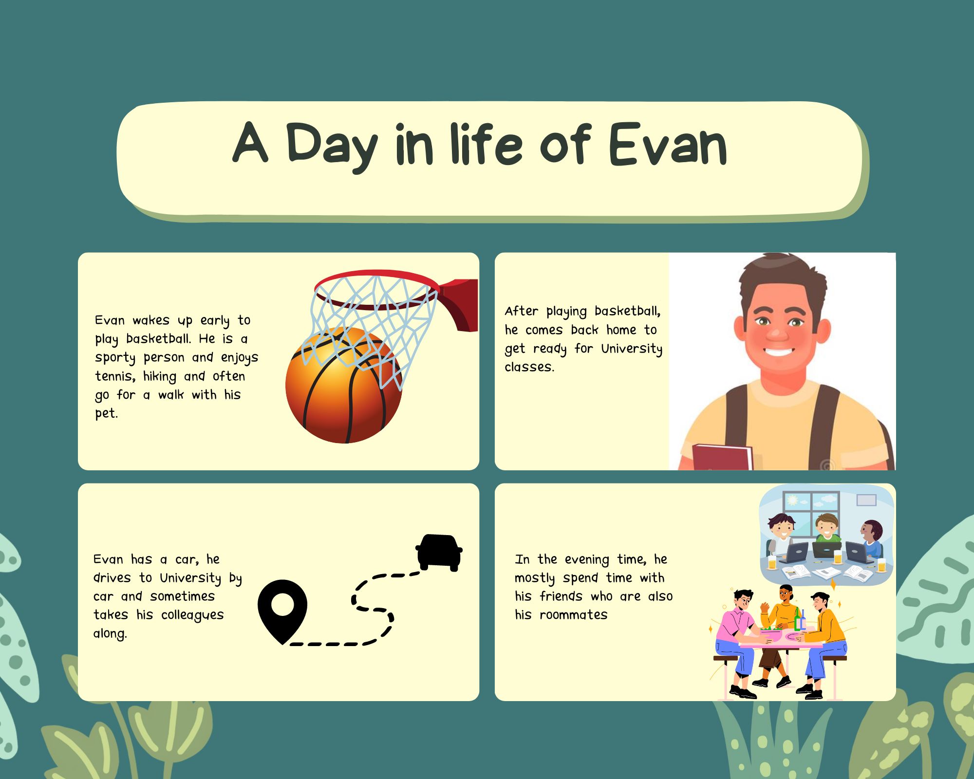
Storyboard 2

Slide 13
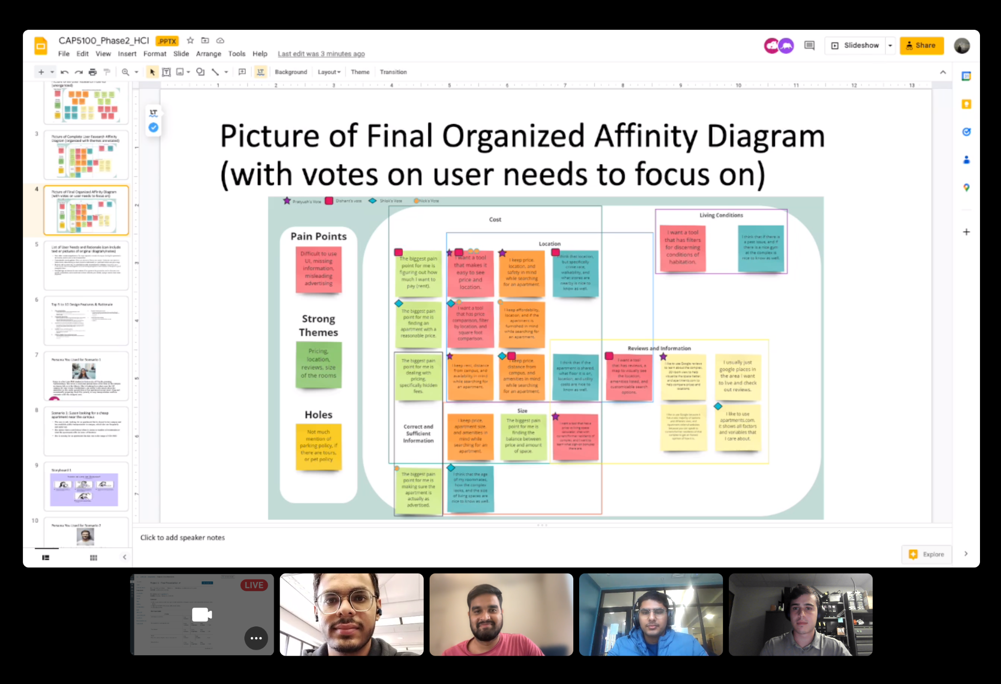
Done (Group picture!)

