Slide 1
Customer Retention Intelligence
74.6%
Business strategy, segmentation, churn scoring, and commercial recommendations drawn from the project notebooks and retained analysis outputs.
of revenue comes from the top 20% of customers, which makes retention precision more valuable than broad discounting.
3,917
$8.88M
customers profiled
known-customer revenue base
4
0.713
operational customer clusters
final churn ROC-AUC

Slide 2
Executive Summary
The analysis points to a concentrated customer base, fast early retention decay, and a need to prioritize high-value retention over broad win-back spending.
• Top-customer concentration is high: the top 20% of customers generate 74.64% of revenue, so account protection should be a board-level KPI.
• Revenue seasonality is visible, with a strong run-up from September to November; retention and upsell campaigns should be staged before the peak, not during it.
• The largest segment is Lost/Inactive, but the biggest value pool sits inside Champions and Loyal Base, so intervention budgets should skew toward preservation and expansion.
• Cohort retention drops sharply after the first purchase month, which means second-order activation and early repeat behavior are the highest-leverage lifecycle moments.
• The churn model is useful for prioritization rather than automation. It is good enough to rank outreach and save-costs, but still needs monitored business rules.
Source: eda.ipynb, rfm_analysis.ipynb, Segmentation.ipynb, churn_prediction.ipynb

Slide 3
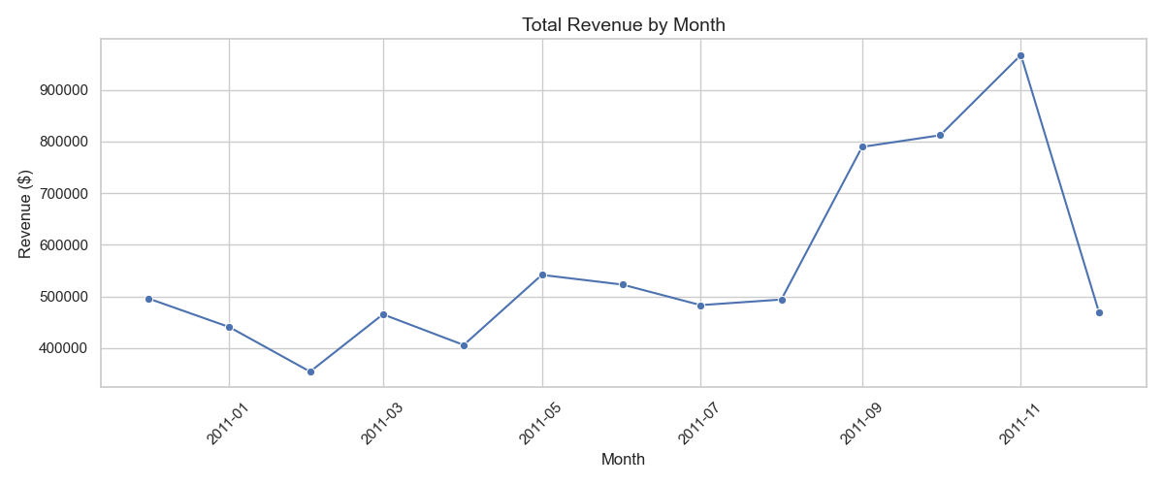
Commercial Footprint and Revenue Concentration
The customer base is geographically broad, but commercially concentrated. That combination favors targeted retention motions and strong key-account discipline.
$8.88M
known-customer revenue base
37
countries represented
90.08%
share of orders from the UK
74.64%
revenue contribution from the top 20% of customers
• The UK remains the operating core, which makes domestic lifecycle optimization the fastest path to measurable impact.
• International demand exists, but order density is low enough that the first commercial focus should stay on the domestic base.
• Top-customer dependency means a small amount of churn among major accounts can wipe out gains from broad acquisition activity.
Source: eda.ipynb, reports/figures/monthly_revenue_trend.png

Slide 4
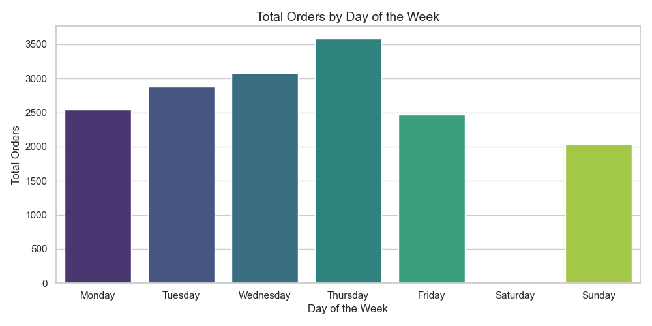
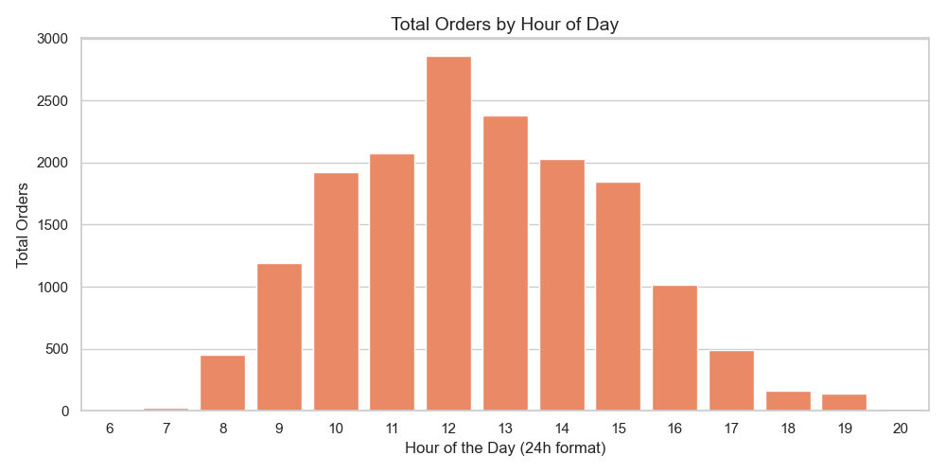
Demand Rhythm and Campaign Timing
Ordering behavior is not flat through the week or the day. The operation already has natural engagement windows that marketing and CRM should exploit.
• Thursday is the strongest ordering day, followed by Wednesday and Tuesday, so midweek outbound campaigns should receive priority inventory and creative attention.
• The order peak lands between 10:00 and 14:00, with 12:00 as the highest-volume hour. Time-sensitive nudges should align to that window.
• The seasonal peak begins building in September and crests in November. That argues for pre-peak reactivation, replenishment, and loyalty messaging in late summer.
• Because weekend demand is structurally weaker, discount-led weekend pushes should be used selectively and only when stock or campaign objectives justify them.
Source: eda.ipynb, reports/figures/day_of_week_trend.png, reports/figures/hour_of_day_trend.png

Slide 5
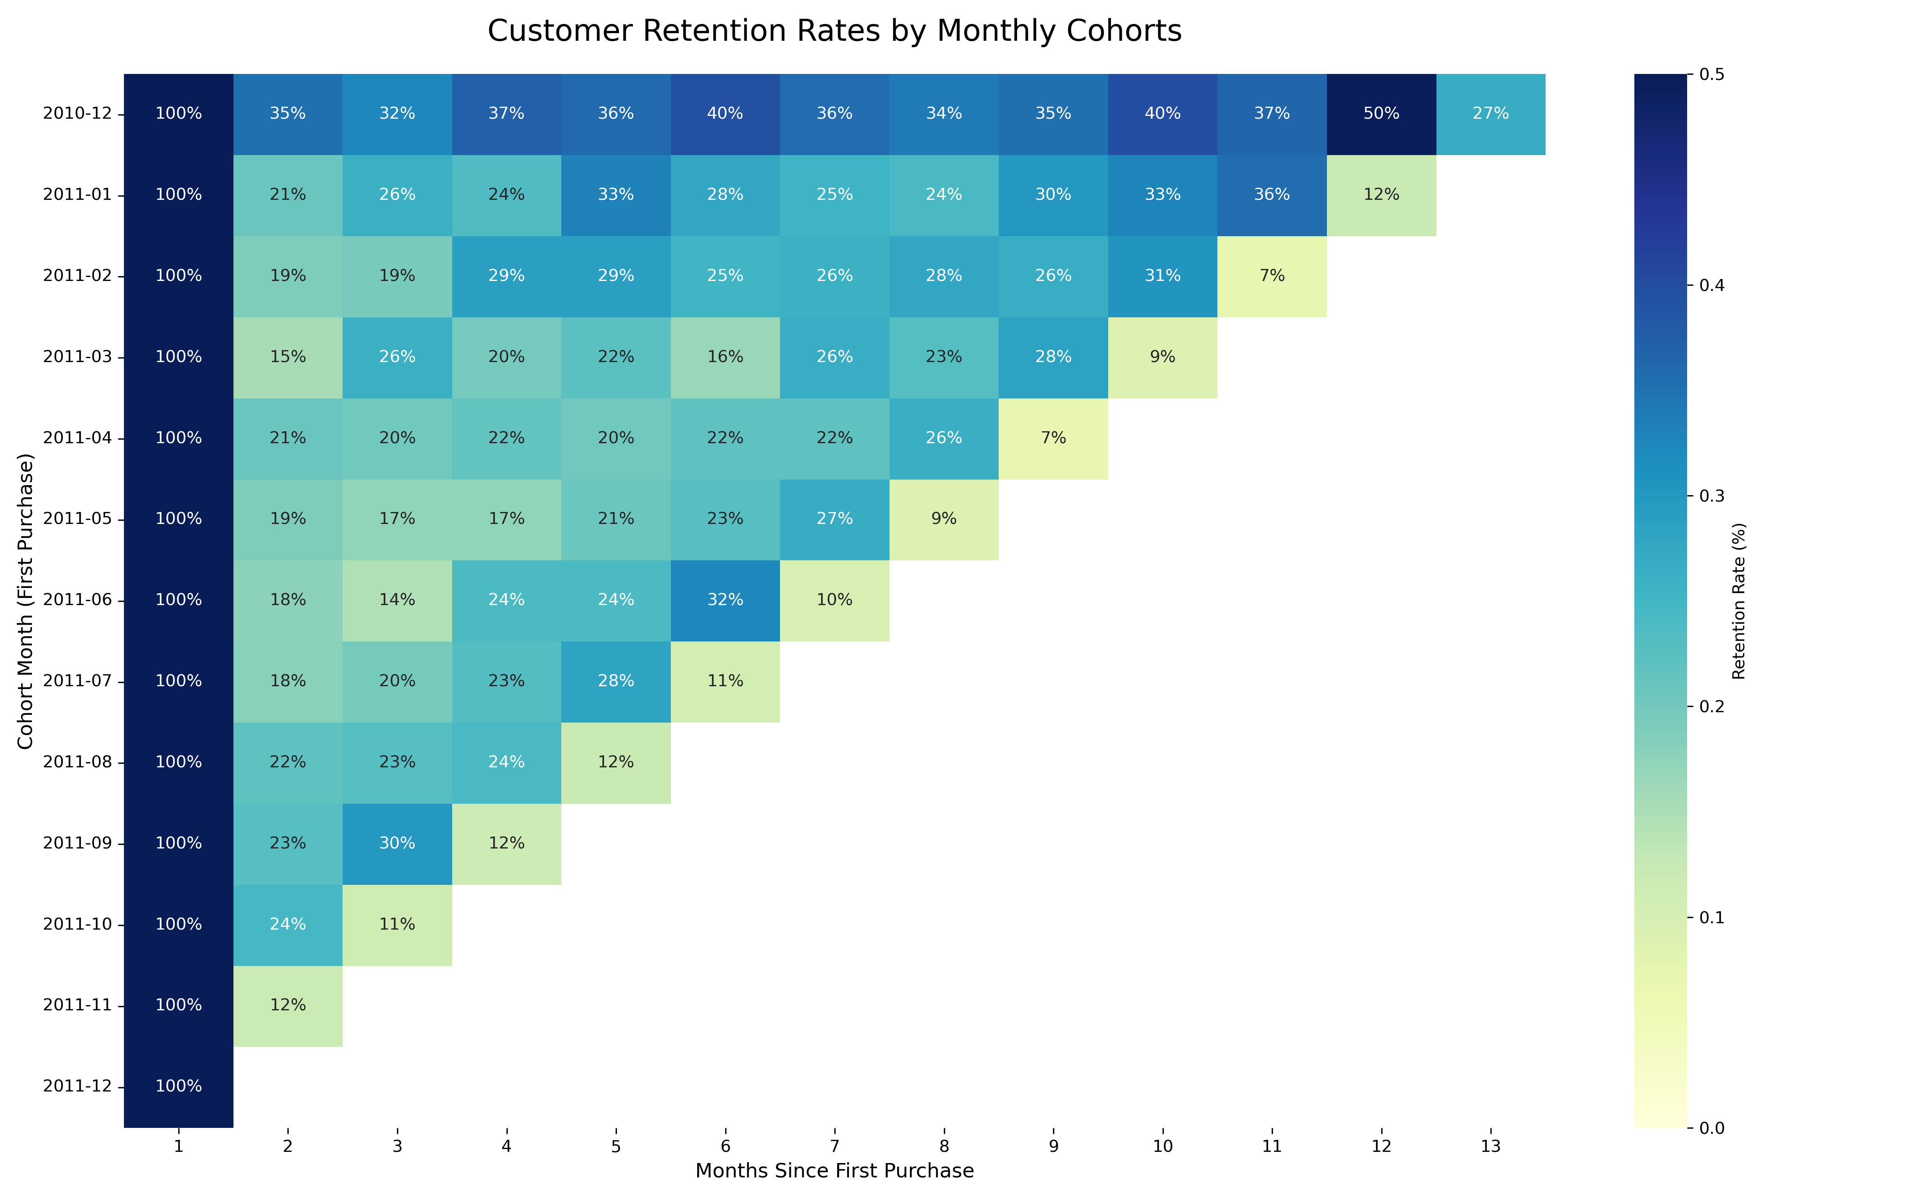
Retention Is Won in the First Few Months
The cohort heatmap shows sharp early drop-off and uneven long-run retention, which means first-to-second purchase conversion is the most important lifecycle moment to improve.
What the heatmap says
• Month-two retention commonly lands in the high teens to mid-thirties rather than staying near the acquisition baseline.
• Stronger early cohorts can still hold roughly 30% to 50% retention deeper into their lifecycle, proving that better outcomes are achievable.
• The commercial opportunity is not only to win back old customers, but to stop newer cohorts from cooling off so quickly after the first order.
Recommended focus
• second-purchase offers
• post-purchase replenishment journeys
• product-category based follow-ups within 30 to 60 days
Source: rfm_analysis.ipynb, reports/figures/cohort_retention_heatmap_optimized.png

Slide 6
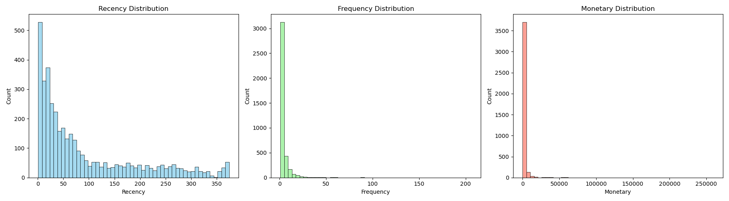
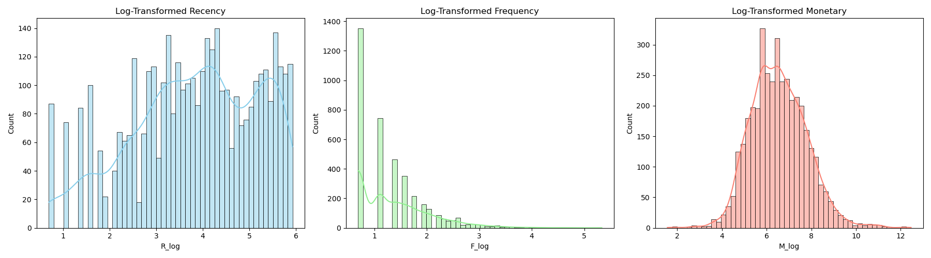
RFM Preparation Matters Because Customer Value Is Highly Skewed
The customer base is economically uneven. Without normalization, a small number of bulk buyers would dominate both segmentation and downstream model behavior.
3,917
customers in the RFM base
$17.28k
99th percentile monetary value
$259.66k
maximum single-customer monetary value
• Average monetary value is only $1,849, but the maximum customer value is more than fifteen times the 99th percentile.
• Median recency is 51 days and median frequency is 2 orders, which confirms that most customers are not habitually active.
• Log transforms are therefore not cosmetic; they are necessary to make clustering and scoring stable enough to support decisions.
Source: rfm_analysis.ipynb, reports/figures/rfm_raw_distributions.png, reports/figures/rfm_log_distributions.png

Slide 7
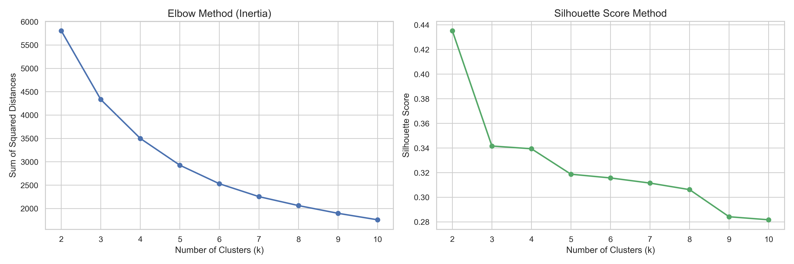
Segmentation Was Chosen for Business Use, Not Only Statistical Purity
The clustering exercise shows the best silhouette at k=2, but the project adopts four clusters because that gives the business more usable operational groups.
0.435
silhouette score at k=2
4
chosen operational clusters
• The steep inertia decline from k=2 to k=4 suggests meaningful additional structure before returns diminish.
• Moving from 2 to 4 clusters trades some statistical compactness for better commercial granularity.
• That is a reasonable decision because retention teams need more than a binary split; they need distinct plays for protection, growth, nurture, and low-cost win-back.
• The final segmentation assigns all 3,917 customers into four interpretable groups.
Source: Segmentation.ipynb, reports/figures/kmeans_optimal_k_evaluation.png

Slide 8
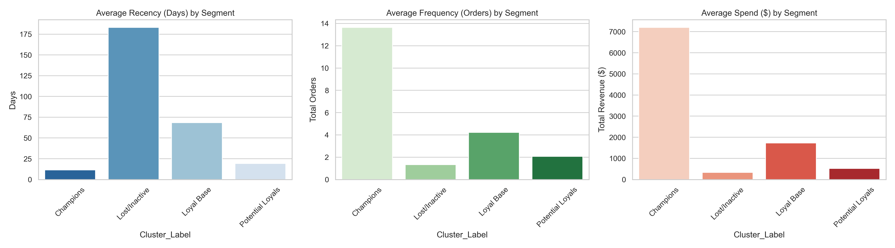
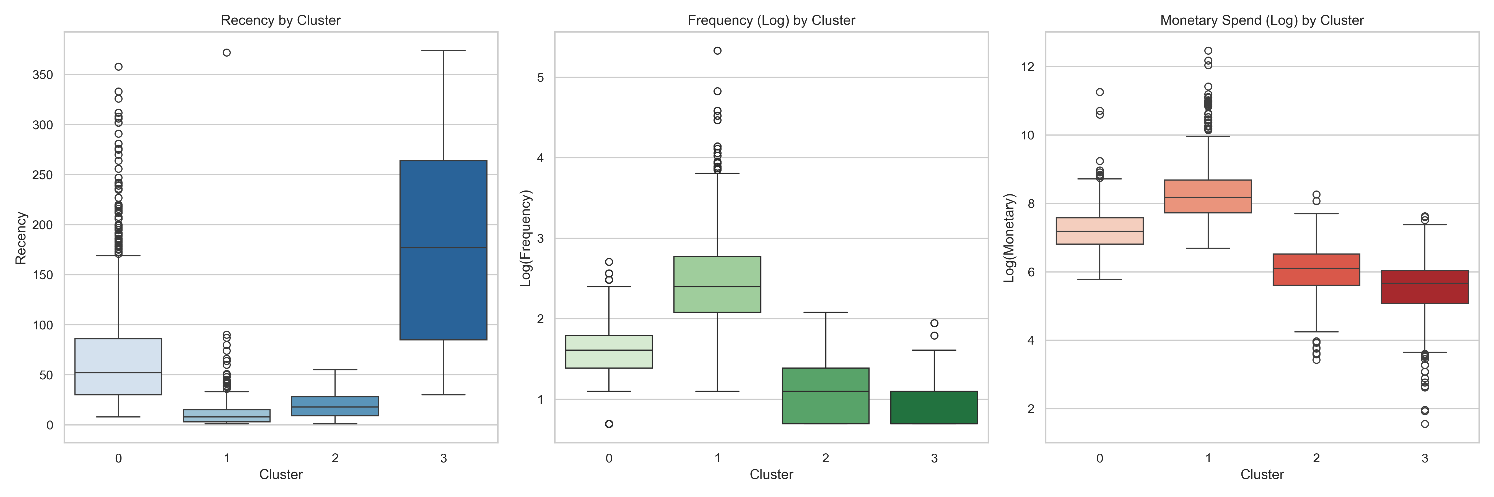
Segment Behavior Is Economically Distinct
The cluster profile work shows that the segments are not just mathematically separable; they represent genuinely different economic behaviors and lifecycle states.
Champions: 11.5-day recency, 13.7 orders, $7.2k average spend. These are the customers to protect aggressively.
Loyal Base: 68.3-day recency, 4.2 orders, $1.7k average spend. This is the upgrade pool with real expansion potential.
Potential Loyals: 19.2-day recency, 2.1 orders, $519 average spend. They are early-stage customers that need habit formation.
Lost/Inactive: 183.2-day recency, 1.3 orders, $331 average spend. They are numerous, but should be approached with cost discipline.
Source: Segmentation.ipynb, reports/figures/cluster_averages_barchart.png, reports/figures/kmeans_cluster_profiles.png

Slide 9
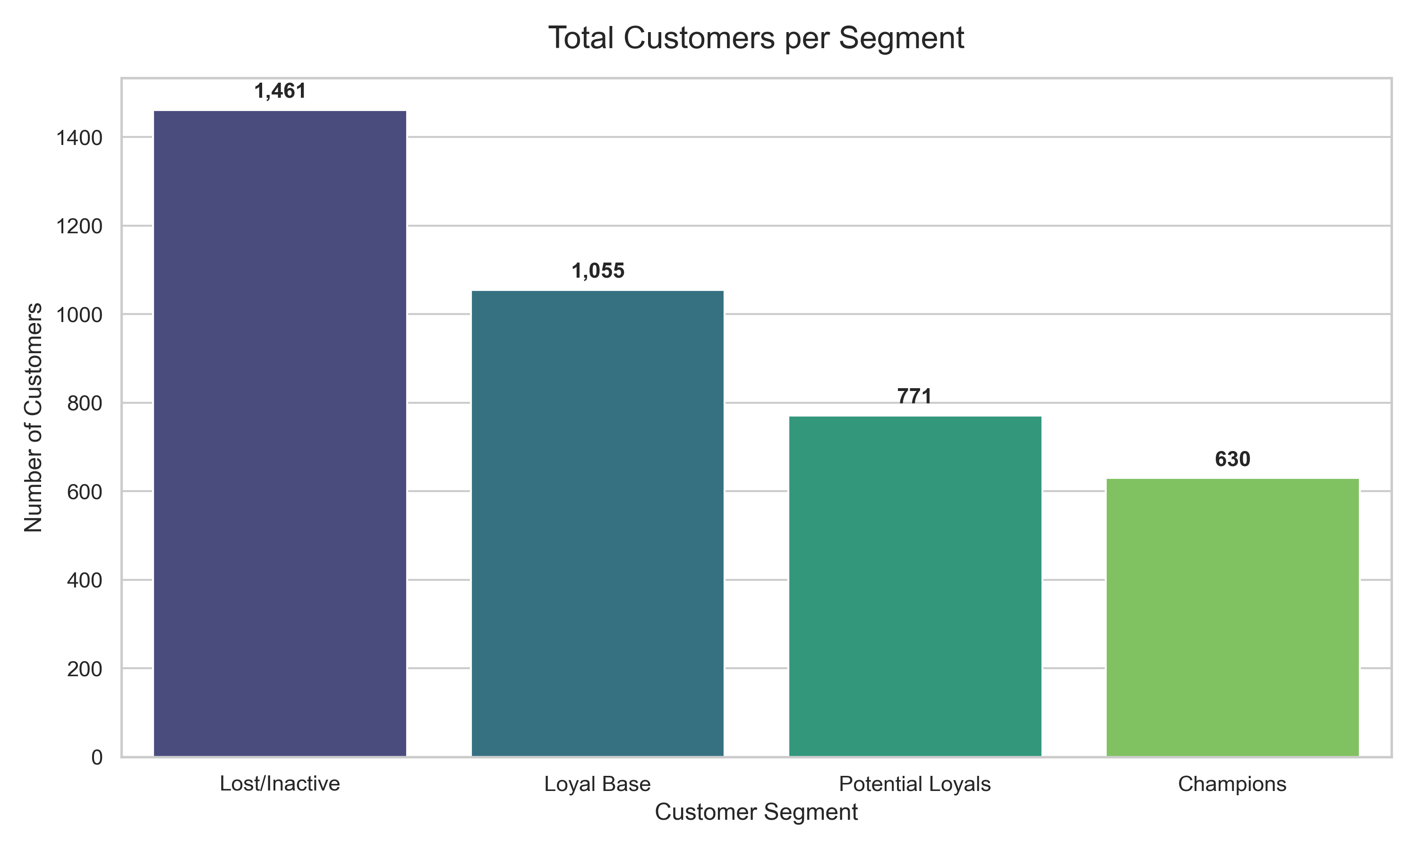
The Largest Segment Is Not the Most Valuable Segment
Lost/Inactive customers form the biggest headcount block, but Champions and Loyal Base contain the majority of economic value. Budgeting should follow value, not just volume.
Implication for spend allocation
• Lost/Inactive contains 1,461 customers, but their combined value pool is only about $0.48M using average spend x customer count.
• Champions are only 630 customers, yet they represent an estimated $4.54M pool, making them the most important retention asset.
• Loyal Base adds another ~$1.82M pool and is the best segment for upsell, loyalty migration, and frequency-building tactics.
• Potential Loyals are smaller economically today, but they are the cheapest segment to shape through onboarding and second-order nudges.
Recommended budget split
• Protect / expand Champions first
• Move Loyal Base toward Champion behavior second
• Nurture Potential Loyals through habit-building
• Keep Lost/Inactive win-back low-cost and tightly tested
Source: Segmentation.ipynb, reports/figures/cluster_size_distribution.png

Slide 10
The Churn Model Is Directionally Useful and Operationally Practical
The final churn model adds RFM score features to the log-transformed base and improves ranking quality enough to support prioritization workflows.
0.713
Business reading of model quality
• This is a prioritization model, not a fully automated decision engine. It is strong enough to rank customers for intervention and suppress low-value blanket outreach.
• Class-1 recall around 0.55 means the model will miss some true churners, so it should sit inside a rules-based workflow rather than replace human judgement outright.
• Because the application also uses monetary value to assign intervention classes, the model is most useful when paired with commercial value thresholds.
• The operational sweet spot is to use the churn score to decide who receives expensive save motions, who receives nurture messaging, and who receives low-cost treatment only.
final ROC-AUC
0.66
final accuracy
0.55
recall on churned customers
+0.005
ROC-AUC lift vs simpler feature set
Source: churn_prediction.ipynb

Slide 11
Recommended Segment Playbook
Retention strategy should be intentionally uneven. The right action depends on whether the segment carries near-term value, future potential, or low-return reactivation risk.
Segment
Commercial objective
Recommended action
Primary KPI
Champions
Protect revenue and defend relationship depth
VIP treatment, early-access launches, replenishment reminders, concierge support, and churn-score based save outreach only when risk rises materially
retention of top-value accounts, average order frequency
Loyal Base
Increase frequency and basket depth
Loyalty tiers, bundle offers, category cross-sell, and midweek re-engagement campaigns aligned to known order windows
orders per customer, average basket size
Potential Loyals
Convert into habitual repeat buyers
second-purchase incentives, onboarding journeys, timed reminders within 30 to 60 days, and low-friction product education
second-order conversion, 60-day repeat rate
Lost / Inactive
Recover selectively without over-spending
low-cost win-back tests, category-specific offers, suppression after non-response, and do-not-discount rules for chronically low-value profiles
reactivation rate, cost per reactivated customer
Source: eda.ipynb, rfm_analysis.ipynb, Segmentation.ipynb, churn_prediction.ipynb

Slide 12
90-Day Implementation Plan
The project is ready to move from analysis into an operating decision layer. The first quarter should focus on campaign integration, measurement discipline, and controlled rollout.
Days 1-30
Days 31-60
Days 61-90
• deploy the scoring app to Render or Railway
• finalize data refresh cadence for RFM inputs
• define business thresholds for Save, Protect, Maintain, and low-cost win-back
• launch dashboarding for churn score distribution, segment mix, and cohort retention
• run targeted campaigns for Champions, Loyal Base, and Potential Loyals
• test low-cost win-back treatments on Lost/Inactive cohorts
• compare midweek and midday send windows against current campaign baselines
• measure second-order conversion and early repeat lift
• review model lift by segment and customer value band
• tighten suppression rules for low-return reactivation attempts
• refresh the models if new performance data exposes drift
• turn the strongest interventions into standard CRM journeys before the next seasonal peak
Source: Project recommendation based on notebooks and deployed application behavior

