Slide 1
Predicting the Success of
Term Deposit
Marketing Activities
Offline Task for Data Scientists - Check24
Andrea Di Simone
University of Freiburg (DE)

Slide 2
Outline
Inspecting the inputs
  Campaign success
  Feature distributions
  Feature correlations
Fitting predictive models
  Data preparation
  Results
Dealing with “Duration”

Slide 3
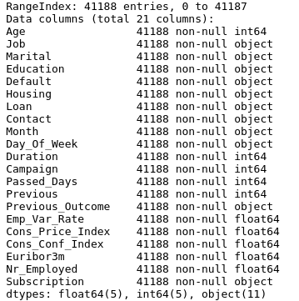
Feature inspection
The dataset appears to be extremely clean
  No NaN values
  Many categorical variables are represented by strings
    These are, however, all regularly formatted, so that no further pre-processing of the strings is needed
The fraction of success of the campaign is 4640/36548 = 12.7%

Slide 4
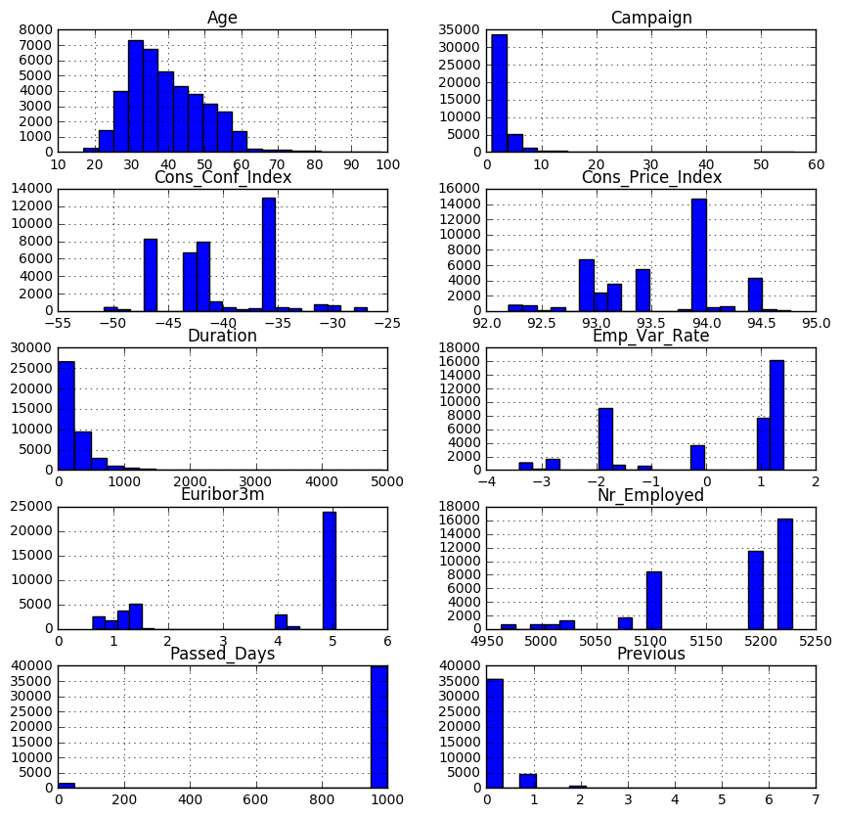
Numerical Features (1)

Slide 5
Numerical Features (2)

Slide 6
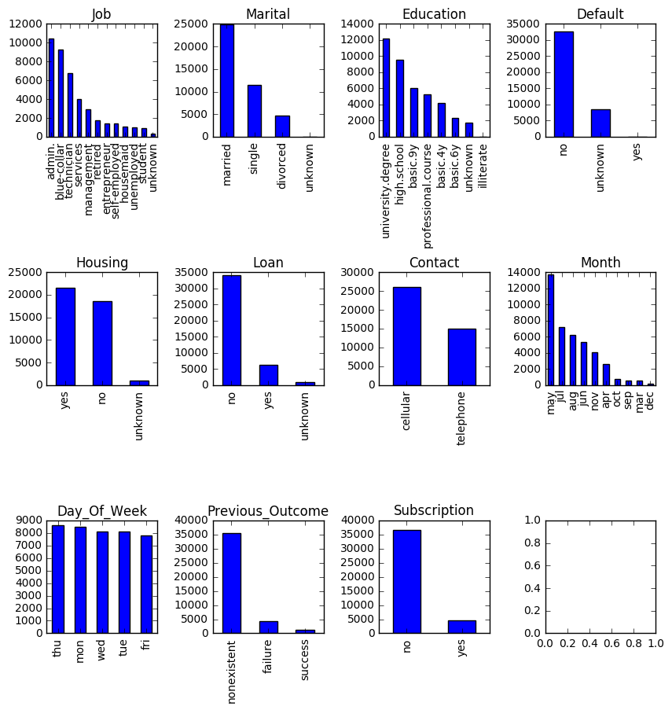
Categorical Features

Slide 7
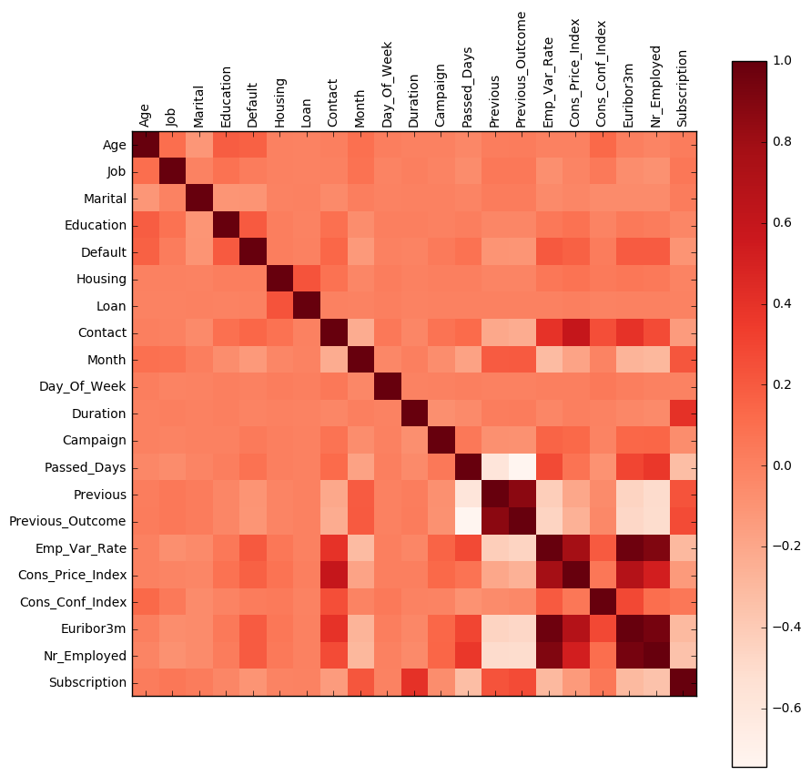
Feature Correlation (1)

Slide 8
Feature Correlation (2)
Subscription is moderately anti-correlated with Passed_Days.
  Even taking into account that Passed_Days has many "999" values, this seems to suggest that subscription is more likely after repeated contacts
Subscription is, on the other hand, positively correlated with Duration, which suggests a preference for longer calls.
Subscription is also positively correlated with Previous and Previous_Outcome (which are, on the other hand, strongly correlated with each other)
  This suggests that previous subscribers are more likely to subscribe again.
Subscription is anti-correlated with Cons_Price_Index and positively correlated with Cons_Conf_index which suggests more inclination towards subscription in relatively stable contexts, as far as consumers are concerned.
  The same argument holds for the anti-correlation with Emp_Var_Rate.
The anti-correlation of Subscription and Euribor3m probably indicates that consumers are more likely to subscribe to long-term investments plans when the yield of short-term deposits is low.
I am honestly not sure I understand the meaning and the values of Nr_Employed, and I would therefore refrain from commenting on its link to the subscription probability

Slide 9
Predictive models
The aim is to predict, given measurements for the features described in the previous slides, whether a phone call will result in a subscription or not
  Conceptually, this is a (binary) classification problem
Such models can be used to predict how likely a set of potential clients would subscribe the plan, and thus concentrate the campaign on those
Due do the time constraints of this test, only two models are trained, with arelatively simple pre-processing of the features
  All numerical features are scaled
  All categorical features are transformed in One-Hot variables
The models are fitted using cross validation, and the a minimal grid of possible values for hyper-parameters is tested
  The optimal parameters are those that yield the best score on the test data
  In this context, “score” is the accuracy of the model, i.e. the fraction of correct classifications

Slide 10
Models result
A simple LogisticRegression model yields a score of 90.9%
  Only the regularization parameter was optimized
Using a RandomForestClassifier, only a modest improvement is obtained, with a score of 91.3%
  Only the number of trees and the minimum number of entries required to split a leaf were optimized

Slide 11
Dealing with “Duration”
I chose to leave “Duration” as a feature during model fitting and evaluation
  Clearly this cannot be exploited on new calls, for which the duration is not known a priori
For new calls, a possible strategy could be to assign, randomly, an a-priori duration, based on the distribution observed in the past
  This works as long as Duration is not strongly correlated with any of the other features, which seems to be the case, based on the correlation plot shown in the previous slides
A somewhat more sophisticated approach could be to train a model to predict the duration
  This requires, however, better features (i.e. more discriminant as far as the duration is concerned), since the ones included in this dataset don’t appear to be particularly relevant
The only 100% correct approach is, of course, to leave out Duration from the model fitting
  This would result, however, in loss of predictive power, since Duration is correlated with the probability of subscription

Slide 12
Possible improvements
The time constraints imposed on this test don’t allow to perform a more detailed analysis
With more time, there are a few things that I would have tried
  Check correlations after fit: Simpler models (like LogisticRegression) allow easy inspection of the fitted parameters/coefficients. Due to the intermediate One-Hot encoding their interpretation is now non-trivial, but given more time it is always fruitful to check whether the fit discovered anything unexpected
  Feature engineering: it would be interesting to add some interaction terms between the categorical variables, i.e. building new features like Education*Marital. When done after the One-Hot encoding, this could help in exploiting some of the correlations between categories
  Better feature selection: Additional steps can be added to the fitting chain, in order to reduce the number of features being fitted. At the very least, I would have tried a model-based selection and principal-components-analysis

