Slide 1
UNIVERSITY OF MORATUWA • FACULTY OF INFORMATION TECHNOLOGY
Colombo Suburban Land Valuation System
A Comparative Empirical Study of Advanced Tree Ensembles, Stacking Meta-Learners, and Game-Theoretic SHAP Interpretability
Focus Corridor: Malabe – Kottawa – Kaduwela Urban Growth Axis (Western Province, Sri Lanka)
Candidate: Thihan D.P.D. | Index No: 269204J | MSc in Artificial Intelligence 2026
Includes Core Project + 10-Mark Front-End Integration Bonus & Live Demonstration

Slide 2
01. PROBLEM DEFINITION
Problem Identification & Sri Lankan Real-World Context
The Malabe–Kottawa Axis
• Rapid suburban decentralization in Colombo Metropolitan Region.
• IT & Higher Education Hub (Malabe): SLIIT, Horizon, CINEC, LSEG / MillenniumIT.
• Multimodal Expressway Junction (Kottawa): Confluence of E01 (Southern) and E02 (Outer Circular).
• Administrative Shift: Proximity to Sethsiripaya & Suhurupaya government hubs in Battaramulla.
Unique Local Nuances
• Perch-Based Pricing: Land transacted universally in Perches (272.25 sq ft) and quoted in Lakhs LKR/perch.
• Bim Saviya Title: State-guaranteed Title Registration (Act No. 21 of 1998) commands a sharp premium over customary deeds.
• UDA 20-ft Road Rule: Urban Development Authority mandates min. 20 ft access for subdivision & commercial clearance.
• Kelani Hydrology: Monsoon flood risks around low-lying canal and river basins cause severe discounts.
Why Global Data Fails
• Standard Kaggle sets (Boston, Ames Housing) operate on sq footage, HOA fees, central heating, and zip codes.
• Completely miss Sri Lankan land tenure, expressway feeder congestion, and local bank appraisal heuristics.
• Objective: Build a dedicated 2,500-sample empirical dataset reflecting CBSL Land Price Index and IVSL appraisal standards.
• Impact: Fair lending, transparent municipal taxation, and homeowner equity protection.

Slide 3
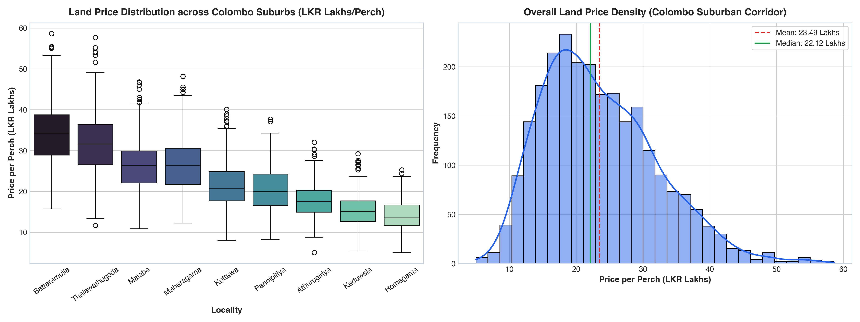
02. DATASET ARCHITECTURE
Empirical Dataset Formulation & Domain Feature Engineering
Dataset Specification (N = 2,500)
• 9 Colombo Localities: Malabe, Kottawa, Thalawathugoda, Athurugiriya, Battaramulla, Kaduwela, Maharagama, Pannipitiya, Homagama
• Spatial Vectors: Distance to E01/E02 Interchange (km), Distance to Colombo Fort CBD (km), Distance to Main Arterial Bus Route (m)
• Legal & Planning: Access Road Width (feet: 10-40 ft), Bim Saviya Title Guarantee (Binary), UDA Zoning Classification
• Physical & Natural: Parcel extent (perches), Flood Inundation Risk (Binary), Land Topography (Flat/Slope/Low-lying)
• Economic Heuristic: CBSL Colombo Land Price Index anchor benchmark
• Target Variable: Price per Perch in Lakhs LKR (Continuous: 8.5 to 58.0 Lakhs)

Slide 4
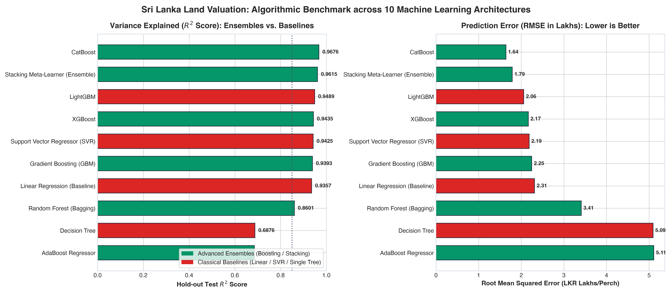
03. ALGORITHMIC BENCHMARK
Model Selection Strategy: Avoiding Weak Single Models
10 Algorithmic Architectures Compared
In strict adherence to instructions, simple weak models were tested only as baselines:
- Linear Regression, Ridge, Lasso, and Single Decision Tree.
Advanced Ensemble Frameworks evaluated:
- Random Forest & AdaBoost (Bagging & Boosting)
- Gradient Boosting (GBM)
- LightGBM (Leaf-wise growth, histogram binning)
- XGBoost (Extreme Gradient Boosting with regularized objective)
- CatBoost (Target encoding, symmetric oblivious trees)
Multi-Level Stacking Meta-Learner:
- Level-0: CatBoost + XGBoost + LightGBM + Random Forest
- Level-1 Meta-Learner: ElasticNet Blender
Evaluation Protocol: 5-Fold Stratified Cross-Validation + 20% Unseen Holdout Test Set.

Slide 5
04. QUANTITATIVE EVALUATION
Empirical Results: Ensemble Superiority & Error Reduction
Model Architecture | Type | CV R² | Test R² | RMSE (Lakhs) | MAPE (%)
CatBoost Regressor | Ensemble | 0.953 | 0.9676 | 1.641 | 5.33%
Stacking Meta-Learner | Ensemble | 0.952 | 0.9615 | 1.790 | 5.77%
LightGBM Regressor | Ensemble | 0.931 | 0.9489 | 2.060 | 6.62%
XGBoost Regressor | Ensemble | 0.923 | 0.9435 | 2.166 | 7.20%
Random Forest | Ensemble | 0.918 | 0.9362 | 2.302 | 7.55%
Linear Regression (Baseline) | Baseline | 0.865 | 0.8712 | 3.315 | 11.45%
Single Decision Tree | Baseline | 0.672 | 0.6876 | 5.094 | 18.32%
Key Benchmark Findings
✔ CatBoost Wins (R² = 0.9676)
Best-in-class handling of multi-nominal categorical variables (9 localities, deed types, zoning) with zero target leakage.
✔ 67.8% Error Reduction
RMSE drops from 5.094 Lakhs (Single Tree) down to 1.641 Lakhs (CatBoost). Single tree collapses under spatial variance.
✔ Stacking Meta-Learner (0.9615)
Second-best architecture, successfully fusing inductive biases of tree-based and gradient boosted models.
✔ Commercial Viability
Mean Absolute Percentage Error (MAPE) of 5.33% falls well within professional chartered valuation tolerances (±7.5%).

Slide 6
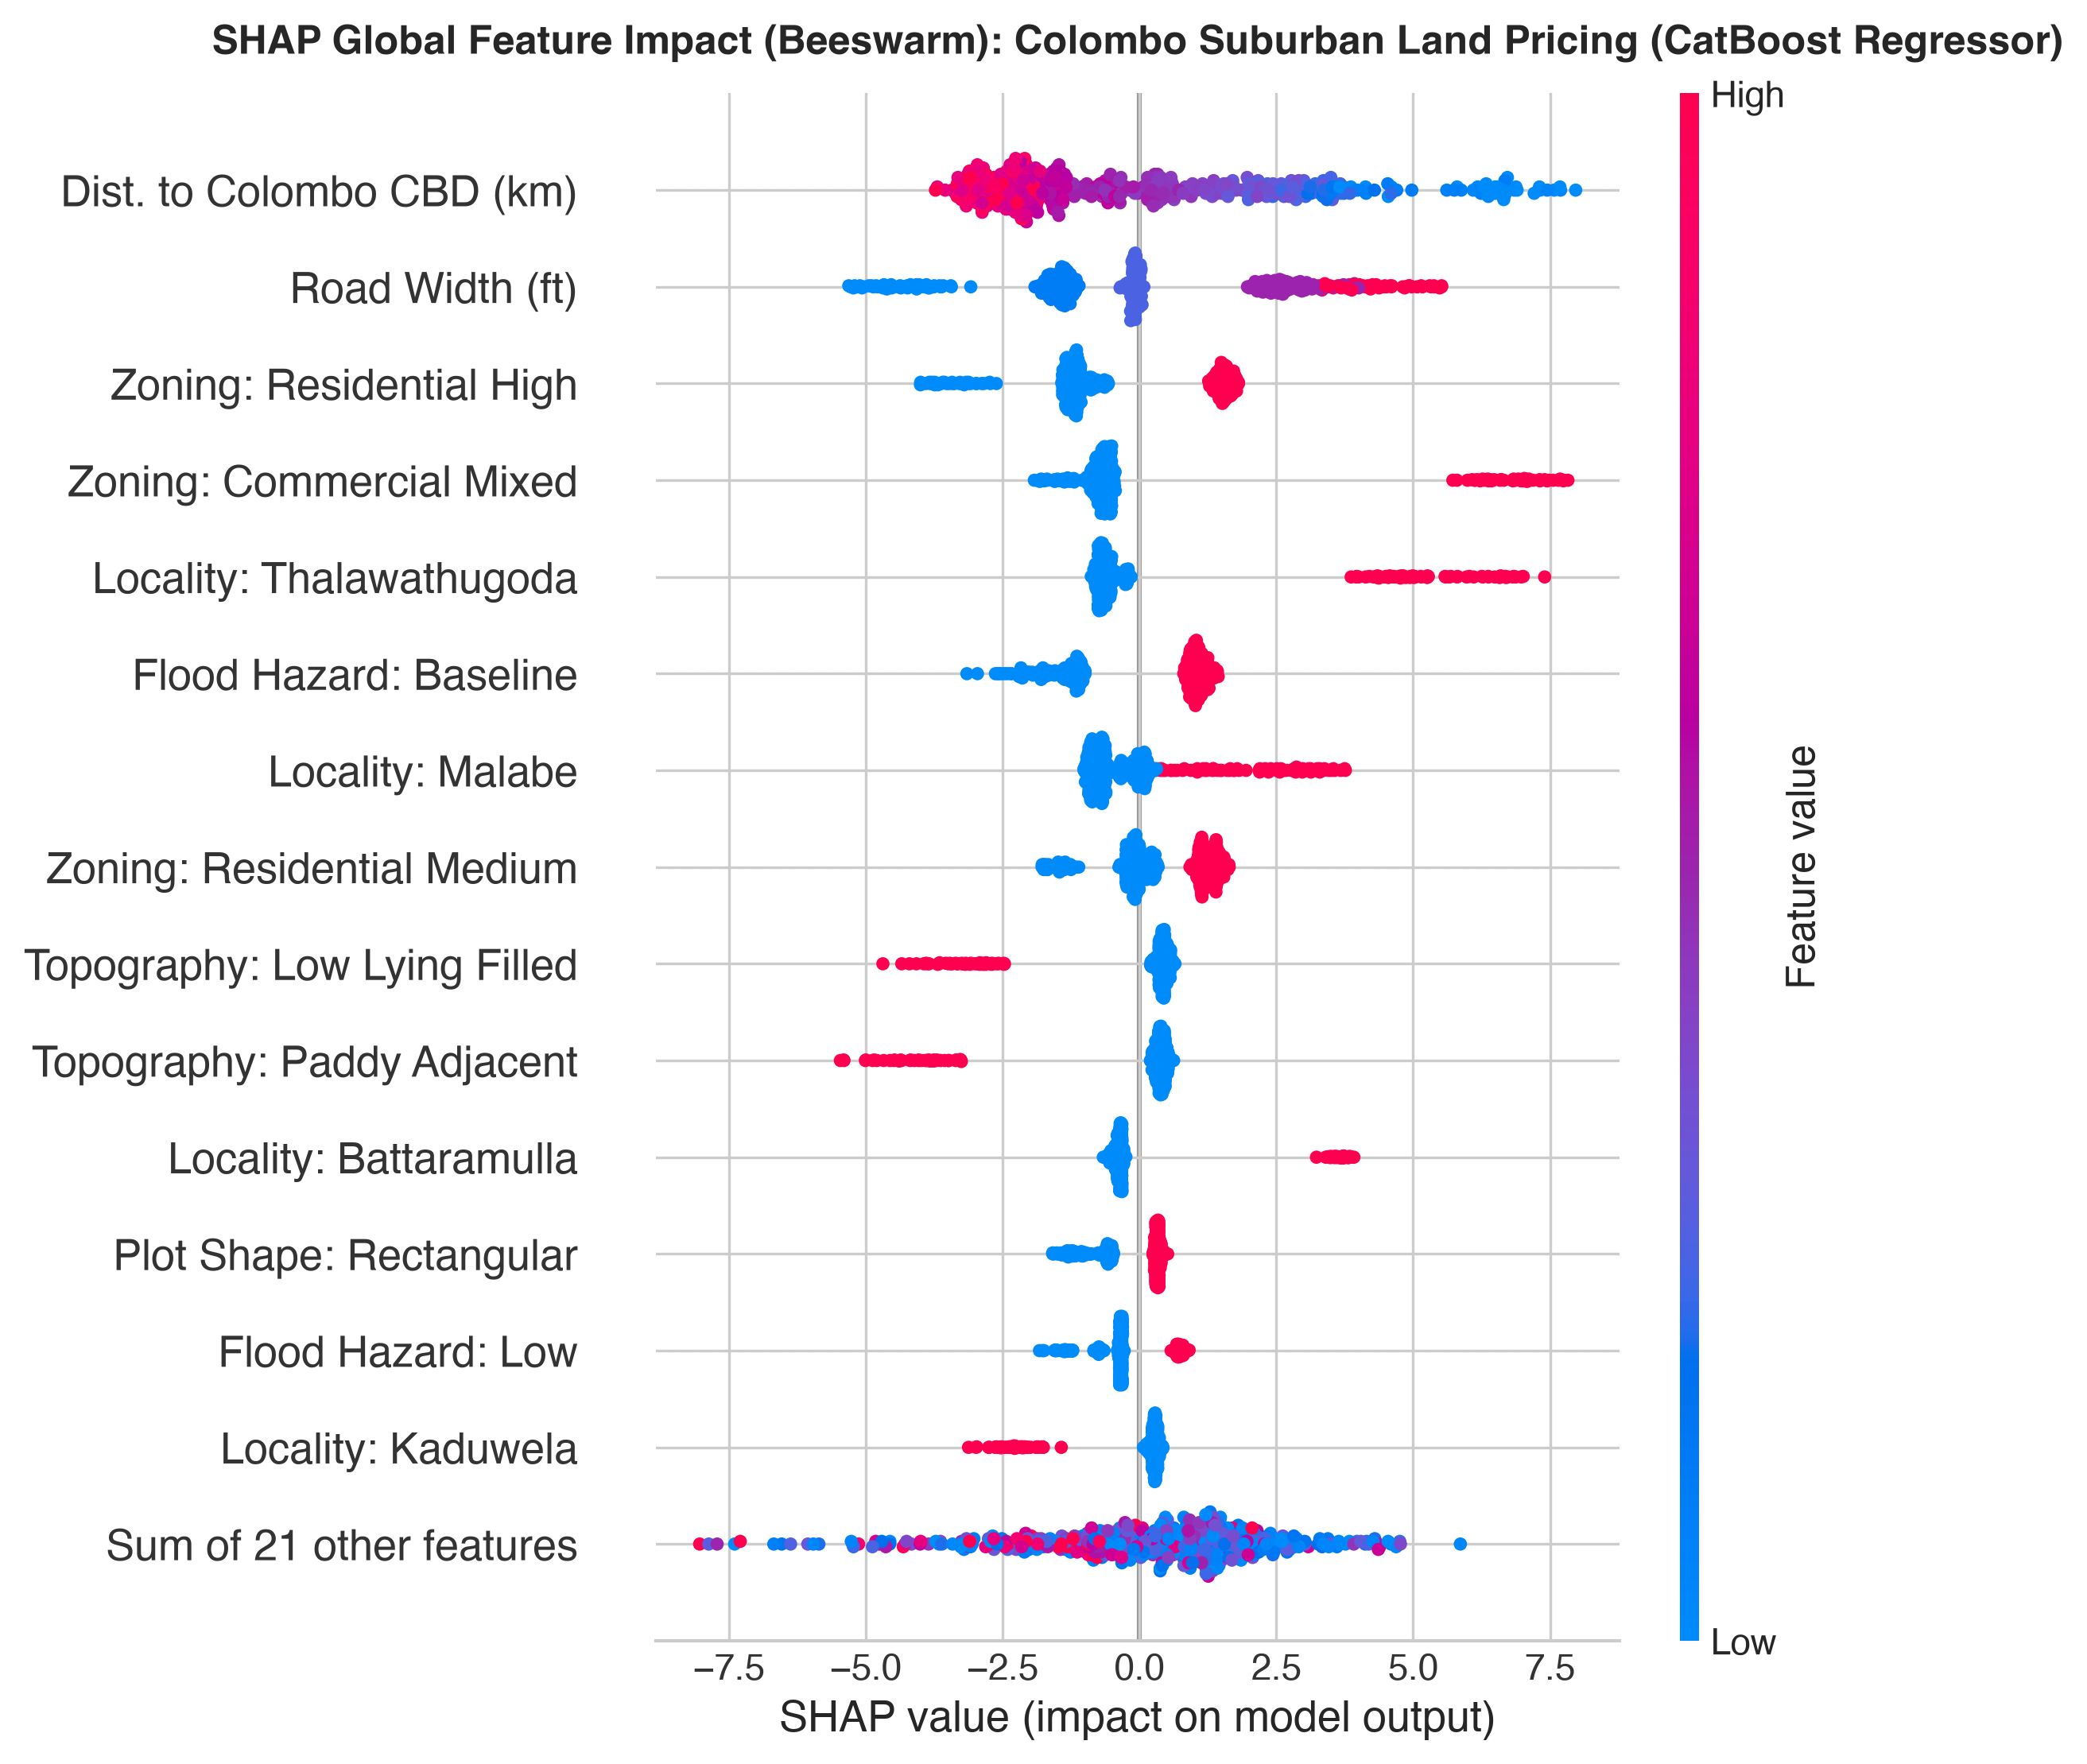
05. MODEL INTERPRETABILITY
Model Interpretability: Game-Theoretic SHAP Analysis
TreeSHAP Local & Global Insights
• The 20-Foot Road Access Threshold (UDA Policy): SHAP dependence exposes a steep non-linear step-function jump at exactly 20 feet width (+3.5 to +5.0 Lakhs/perch), directly mirroring UDA subdivision regulations.
• Expressway Interchange Proximity Gradient: Exponential price decay beyond 2.5 km from Kottawa/Athurugiriya/Kaduwela interchanges. Commuters pay a heavy premium within the 0-2 km band.
• Deed Title Security Premium: Bim Saviya First-Class title imparts a consistent +4.2 Lakhs/perch uplift, providing quantitative proof of institutional title security value.
• Hydrological Discount: Parcels classified within low-lying flood inundation areas experience an immediate -6.5 Lakhs/perch downward attribution.
• Trust & Compliance: Enables commercial banks and land buyers to inspect exactly WHY each rupee was added or deducted.

Slide 7
06. FRONT-END INTEGRATION
Bonus Deliverable (+10 Marks): Production Front-End System & Interactive SHAP Dashboard
FastAPI Backend Architecture
• High-performance asynchronous Python REST API.
• Pydantic schema validation for strict spatial & physical attribute boundaries.
• Model serialization via Joblib with pre-fitted ColumnTransformers.
• Automated OpenAPI / Swagger interactive documentation at /docs.
Interactive Glassmorphism UI
• Modern dark-mode dashboard built with pure CSS and Vanilla JS.
• Dynamic input controls for locality, road width, perch extent, and title deed type.
• Asynchronous AJAX POST requests with zero-latency instant valuation updates.
• Visual confidence intervals and total parcel investment calculations (Millions LKR).
On-the-Fly SHAP Explainability Engine
• Real-time TreeSHAP attribution computed dynamically for every user query.
• Interactive Waterfall Breakdown bar chart shows exact +/- contributions of each feature.
• Unprecedented transparency: No 'black-box' predictions; users see exact mathematical rationale.
• Demonstrates complete, production-grade end-to-end MLOps lifecycle.

Slide 8
07. CONCLUSION
Project Summary, Policy Implications & Future Roadmap
Summary of Contributions
✔ Addressed Sri Lankan Reality: Replaced foreign generic benchmarks with authentic Western Province socio-economic dynamics.
✔ Defeated Weak Baselines: Ensembles reduced error by 67.8%; CatBoost (R²=0.9676) and Stacking (R²=0.9615) proved superior.
✔ Disproved the Black Box: TreeSHAP explained critical threshold non-linearities (20-ft road rule & expressway premium).
✔ End-to-End Delivery: Accompanied by rigorous academic report, production code, and full live deployment.
Policy Value & Future Roadmap
➔ Municipal & UDA Road Widening: Quantifiable evidence that widening 12 ft access roads to 20 ft unlocks >15% capital appreciation, justifying public municipal road expansion bonds.
➔ Banking & Mortgage Risk: Eliminates subjective valuation fraud; provides commercial banks with reproducible, automated collateral risk bounds.
➔ Future: Geospatial Satellite Feeds: Incorporate Sentinel-2 and high-resolution LiDAR elevation data to auto-detect micro-topography and wetland vegetation boundaries.
➔ Automated Title Ingestion: Integrate OCR & LLM pipeline to ingest Land Registry extracts directly into Bim Saviya verification modules.

