Slide 1
Digital Portfolio
STUDENT NAME: K.ROSHINI
REGISTER NO AND NMID: 24132011802522083 ,
asanm20124132011802522083
DEPARTMENT: BSC. COMPUTER SCIENCE
COLLEGE: ARIGNAR ANNA GOVERNMENT ARTS COLLEGE
VILLUPURAM, ANNAMALAI UNIVERSITY

Slide 2
PROJECT TITLE
DIGITAL PORTFOLIO

Slide 3

AGENDA
Problem Statement
Project Overview
End Users
Tools and Technologies
Portfolio design and Layout
Features and Functionality
Results and Screenshots
Conclusion
Github Link
3/21/2024 Annual Review

Slide 4
PROBLEM STATEMENT
DESIGN AND DEVELOP A RESPONSIVE DIGITAL PORTFOLIO THAT IS EASY TO
UPDATE AND ACCESSIBLE ON ALL DEVICES

Slide 5
PROJECT OVERVIEW
The Digital Portfolio is a simple and responsive website to showcase personal details,
skills, projects and achievements. It is built using HTML and CSS for a clean design
and easy updates. This portfolio acts as an online resume and helps create a
strong professional identity.

Slide 6

WHO ARE THE END USERS?
RECRUITERS
EMPLOYERS
TEACHERS
CLIENTS
COLLABORATORS
THE PORTFOLIO OWNER

Slide 7
TOOLS AND TECHNIQUES
TOOLS: HTML, CSS, Javascript, code editors(vs code), hosting platforms
(GitHub pages, Netlify), graphic tools( Canva, Figma).
TECHNIQUES: Responsive web design, clean layout structure, content
organization, SEO basics, and regular updates.

Slide 8
POTFOLIO DESIGN AND LAYOUT
A clean, responsive layout with a sections for About,
Skills, Projects, Achievements and Contact using simple
colors and easy navigation
8

Slide 9
FEATURES AND FUNCTIONALITY
Showcase personal details, skills, projects, and achievements; offers responsive
design, easy navigation, contacts links and simple updates.

Slide 10
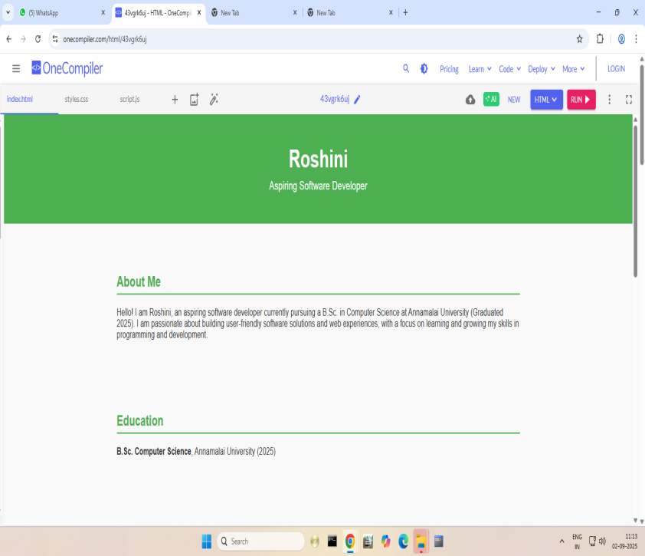
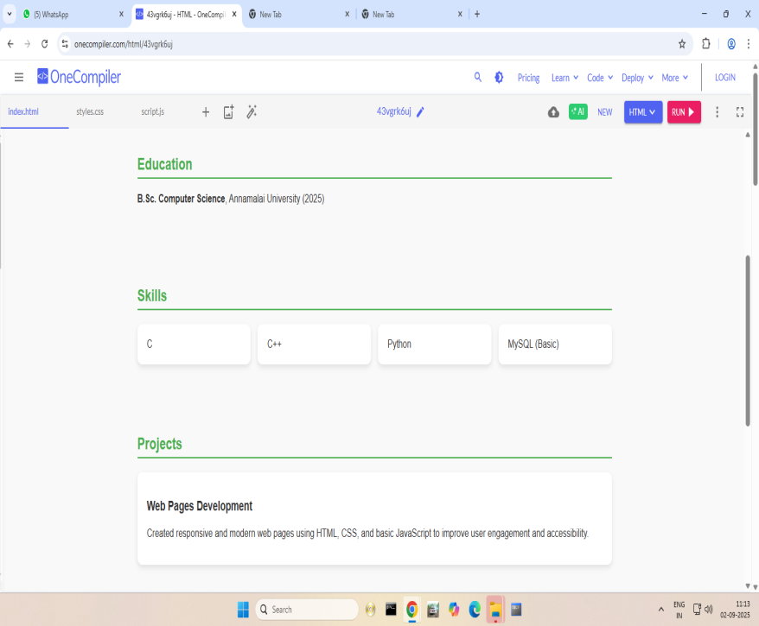
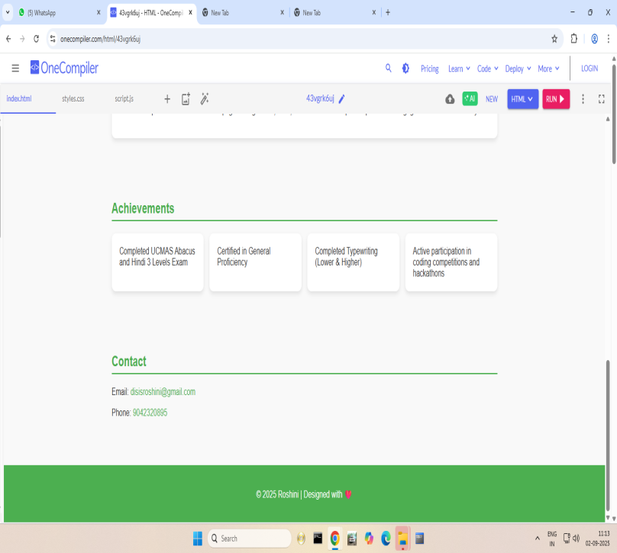
RESULTS AND SCREENSHOTS
The design is responsive, ensuring the resume displays properly on desktops,
Tablets and mobile device.
3/21/2024 Annual Review
10

Slide 11
CONCLUSION
A digital portfolio is an effective way to showcase skills, projects and achievements in a professional and accessible format. It enhances personal branding, is easy to update,
and helps create better academic and career opportunities.
11

