Slide 1
Sensors & embedded systems
COURSE 01 · INTRODUCTION
Sensing the physical world
Most electronic systems exist to capture information from the real world — a keystroke on a computer, a temperature or a position on a connected object — and react to it.
Overview and use cases

Slide 2
01
COMMON USE CASES
OVERVIEW
Sensors are everywhere around us
Temperature
Environment, devices, industrial processes
Humidity
Weather, agriculture, building comfort
Air quality
Pollution, CO₂ and particles, indoors and out
GPS
Locating and tracking an object
Accelerometer
Detecting movement and behaviours such as driving patterns
02

Slide 3
01
CHOOSING THE RIGHT SENSOR
OVERVIEW
Same family, very different sensors
The application decides which characteristics matter. Compare sensors on five criteria:
Precision
Operating range
Response time
How close a reading is to the true value
The span of values it can measure reliably
How quickly it reacts to a change
Acquisition frequency
Output format
How many readings it delivers per second
Analog voltage or digital bus such as I²C, SPI or UART
03

Slide 4
02
EXAMPLE: TEMPERATURE
EXAMPLES
The use case sets the precision
Processor monitoring
Weather monitoring
± a few °C
± 0.1 °C
Goal: detect overheating
Goal: record small, real variations
An error of a few degrees is acceptable
Readings must stay consistent across many sensors
Indicative orders of magnitude; meteorological stations typically target about 0.1 °C.
04

Slide 5
02
EXAMPLE: ACCELEROMETERS
EXAMPLES
Speed requirements vary by orders of magnitude
Orientation detection
Drone flight control
6 states
10 Hz → 1 kHz
Up, down, left, right, front, back
Measures the full acceleration vector accurately
A low acquisition rate is enough
Reacts fast enough to compensate for gravity, wind and movement
05

Slide 6
03
INSIDE A SENSOR
ARCHITECTURE
Sensors now process data before reporting it
Physical quantities are analog at the source: pressure, temperature, force, acceleration
IIS3DWB10IS
one package
Simple sensors expose them as a change in resistance, current or voltage, read by the processor
Sensing element
MEMS · 3 axes
ADC
analog → digital
Integrating the ADC inside the sensor reduces noise and the transformations applied to the signal
Digital processing
filtering · FIFO buffer
ISPU
C code · neural networks
A small dedicated block drives this conversion — a tiny processor, not user-programmable
SPI / I3C · interrupt on event
New sensors embed real processing, even neural networks, so the host can sleep until an event matters
Host processor
sleeps until woken
Simplified view. ISPU: intelligent sensor processing unit. Source: STMicroelectronics, IIS3DWB10IS product page.
06

Slide 7
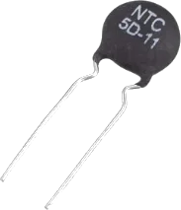
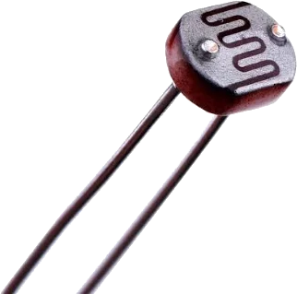

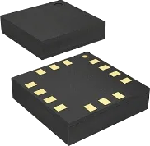
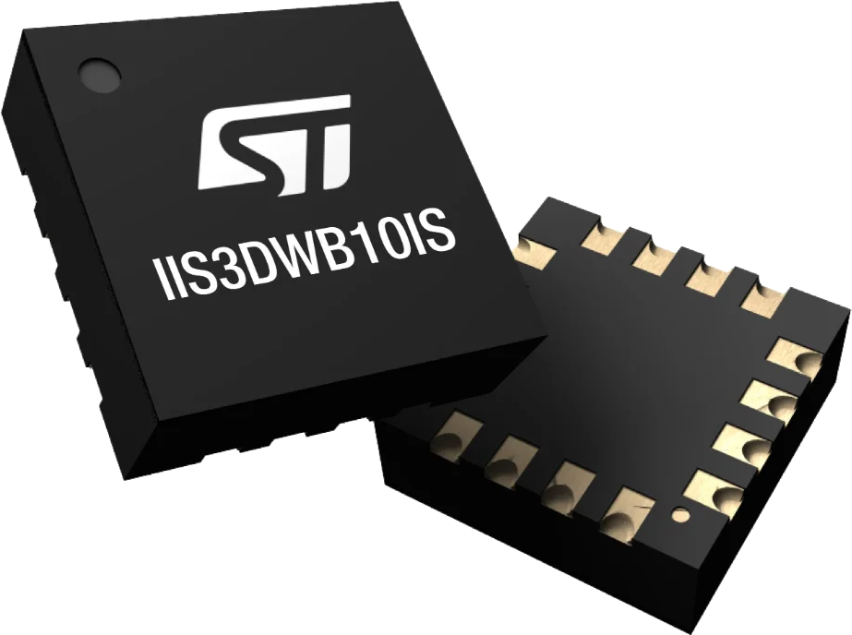
03
SENSOR TYPES
ARCHITECTURE
From raw signal to on-chip decision
Temperature
Light
Temperature
Accelerometer
ST IIS3DWB10IS, with ISPU
ANALOG
DISCRETE DIGITAL
SMART SENSOR
The processor measures the signal
The sensor sends a value
The sensor makes a decision
Output is a resistance or voltage; the MCU must convert it
Small PCB modules with built-in ADC; readings arrive over I²C or SPI
Runs filtering and neural networks inside; wakes the host only on events
07

Slide 8
The RP2040
The microcontroller, its interfaces, and the setup we use in practical sessions.

Slide 9
04
OUR MICROCONTROLLER
RP2040
The RP2040 runs every practical session
A low-cost microcontroller designed by Raspberry Pi, best known from the Raspberry Pi Pico board.
2
133
264
30
Arm Cortex-M0+ cores
MHz maximum clock speed
KB of on-chip SRAM; program stored in external flash
GPIO pins, 4 of them usable as analog inputs
Source: Raspberry Pi, RP2040 datasheet.
09

Slide 10
04
ARCHITECTURE
RP2040
Two cores and flexible peripherals
Core 0
Core 1
DMA
Cortex-M0+ · 133 MHz
Cortex-M0+ · 133 MHz
moves data without the CPU
Bus fabric
connects cores, memory and peripherals
SRAM
Flash interface
USB 1.1
PIO
264 KB · 6 banks
QSPI · external
device or host
8 state machines
Peripherals
ADC · 4 inputs
I²C ×2
SPI ×2
UART ×2
PWM · 16 channels
Timers
Temperature sensor
30 GPIO pins
each pin selects which peripheral drives it
Simplified view. Highlighted: the interfaces we use in the practical sessions. Source: RP2040 datasheet.
10

Slide 11
04
INTERFACES
RP2040
Four ways to talk to a sensor
A quick map for now — each interface gets its own session later.
ADC
I²C
SPI
Serial
4 inputs · 12-bit
2 wires · SDA, SCL
4 wires · SCK, MOSI, MISO, CS
UART · TX, RX
Reads a voltage directly from an analog sensor
Shared bus: many sensors, each with its own address
Point-to-point stream between two devices
Fast link, one chip-select line per device
11

Slide 12
04
PRACTICAL SESSIONS
RP2040
One setup for every project
The topology stays the same; only the sensor interface changes.
MICROCONTROLLER
PC
HARDWARE
ADC
RP2040
Sensor
I²C
Application
Reads the sensor, processes the data, streams the result
USB
Measures a physical quantity
SPI
Reads the serial stream and plots the data
Serial
serial
changes
Partially vibe-coded
Vibe-coded
12

Slide 13
Analog-to-digital conversion
How a continuous voltage becomes a number a microcontroller can process.

Slide 14
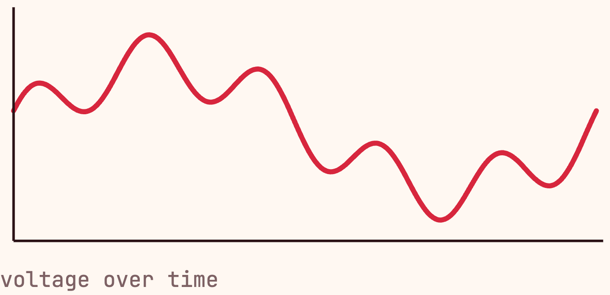
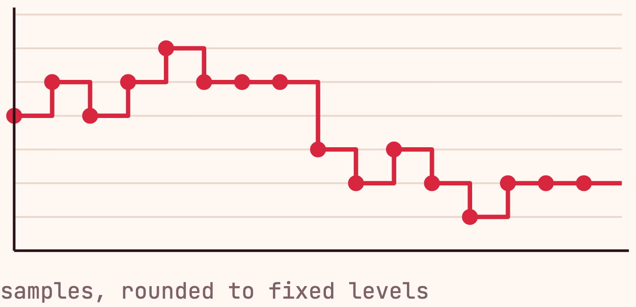
05
ANALOG VS DIGITAL
ADC
An ADC turns a continuous voltage into numbers
Analog: continuous
Digital: discrete
Changes smoothly and can take any value in a range
Only a finite set of values
The ADC samples the voltage and approximates each sample by a number
Example: a sensor voltage varying between 0 V and a maximum
14

Slide 15
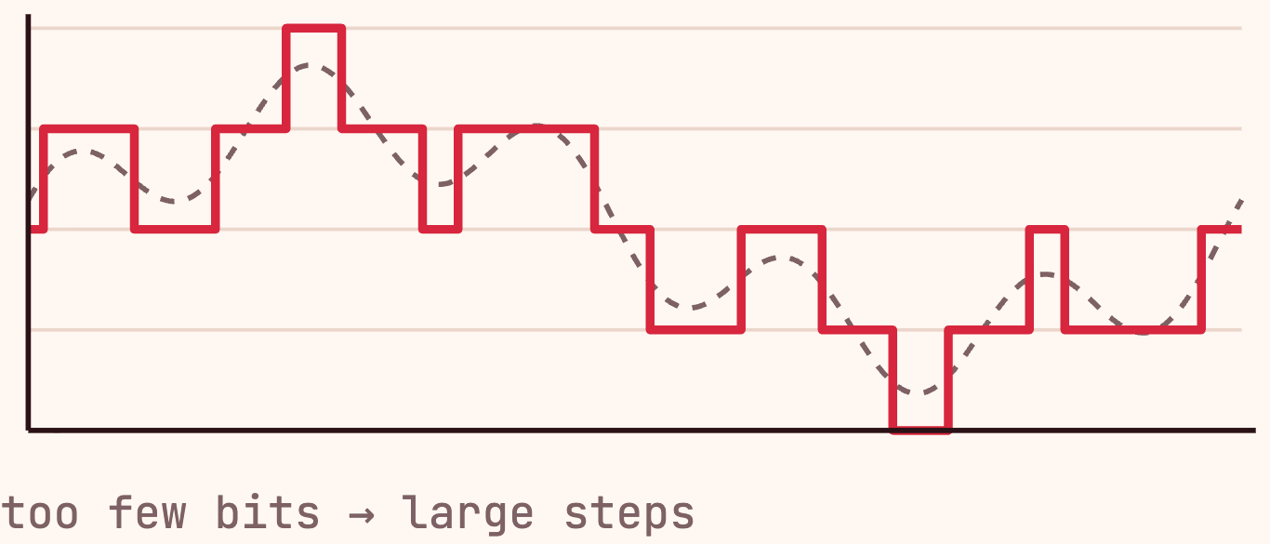
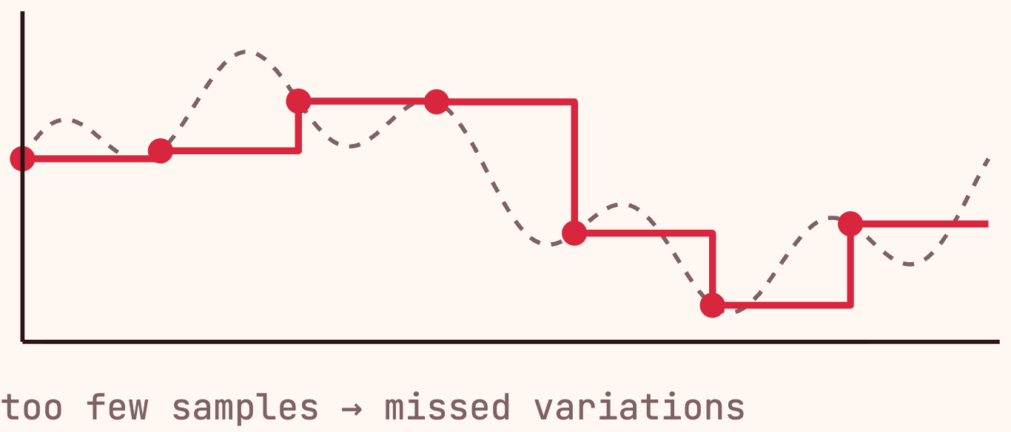
05
CONVERSION QUALITY
ADC
Two parameters set conversion quality
Resolution
vertical precision
Sampling rate
horizontal precision
8-bit
10-bit
Samples/s
256 values · 0–255
1024 values · 0–1023
how often the voltage is measured
More bits → smaller steps, less quantization error
Faster sampling → fast variations are captured
15

Slide 16
05
REFERENCE VOLTAGE
ADC
The reference voltage sets the scale
code = V_{in} / V_{ref} × 255
8-bit code
0
128
255
input voltage
0 V
V_{ref} / 2
V_{ref}
Why not simply VCC?
What it means for the sensor
VCC varies with battery level and supply conditions
Its output must stay between 0 V and V_{ref}
Outside this range, the signal must be adapted first
If V_{ref} moves, the same input gives a different code
Use a fixed reference, below the minimum expected VCC
16

Slide 17
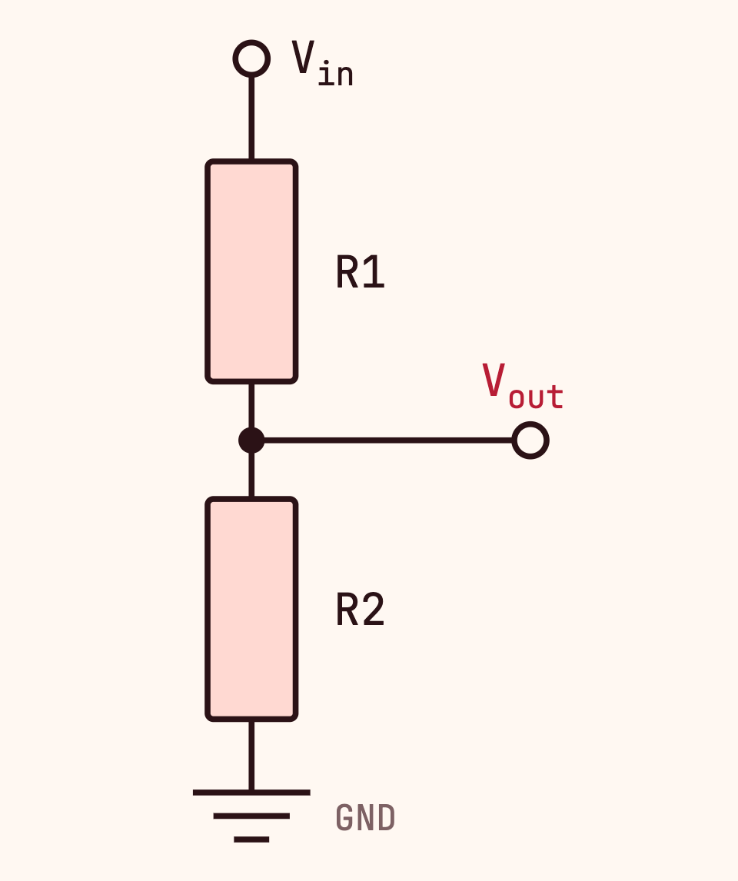
05
ADAPTING THE SIGNAL
ADC
A voltage divider scales a voltage down
V_{out} = V_{in} × R2 / (R1 + R2)
V_{in}
Input voltage to scale
R1
Resistor connected to V_{in}
R2
Resistor connected to ground
V_{out}
Voltage between R1 and R2, sent to the ADC
EXAMPLE
5 V signal into a 3.3 V ADC: R1 = 22 kΩ, R2 = 33 kΩ → V_{out} = 3.0 V
17

Slide 18
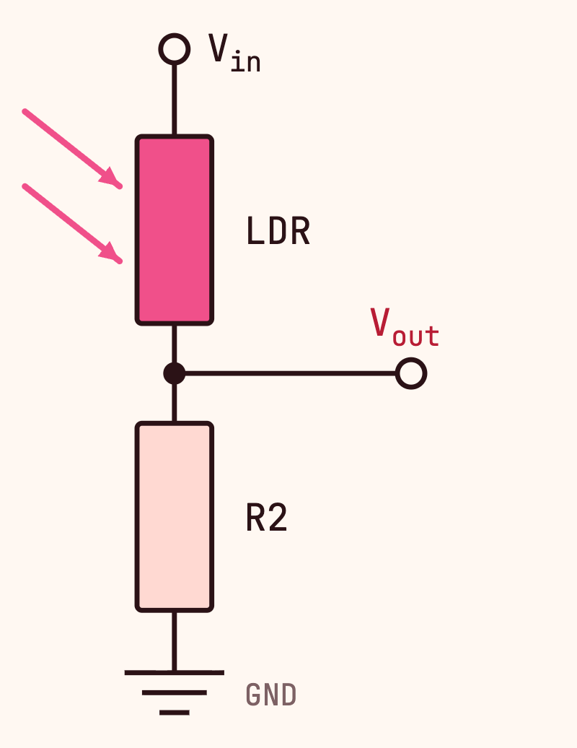
05
RESISTIVE SENSORS
ADC
A divider turns resistance into voltage
Many sensors change resistance, not voltage: a photoresistor (LDR) reacts to light
Use the sensor as one of the two divider resistors
Its resistance variation becomes a voltage variation the ADC can read
photoresistor
More light
→
Lower R_{LDR}
→
Higher V_{out}
light level
resistance
ADC reading
18

Slide 19
05
RP2040 ADC
ADC
One converter, five inputs
AIN0
GPIO26
RESULT register
AIN1
GPIO27
Multiplexer
SAR ADC
latest value
AIN2
GPIO28
→
AINSEL picks one input
→
12-bit · 48 MHz clock
→
AIN3
GPIO29
FIFO · 4 entries
→ IRQ or DMA
AIN4
Temp. sensor
Successive approximation: the input is compared bit by bit, from MSB to LSB
One conversion takes 96 clock cycles: 2 µs
Only one input is converted at a time
Source: RP2040 datasheet, section 4.9.
19

Slide 20
05
RESOLUTION
ADC
Natively 12 bits, effectively about 8.7
8-bit
12-bit
16-bit
10-bit
0–255
0–4095
0–65535
—
Optional: FIFO SHIFT keeps the 8 most significant bits. Saves memory with DMA.
The real hardware resolution. RESULT always holds 12 bits.
Not a hardware mode. MicroPython read_u16() rescales the 12-bit value.
No 10-bit mode on the RP2040.
8.7
ENOB: the resolution of an ideal ADC with the same noise and distortion. Here, 12 bits on paper behave like 8.7 in practice
ENOB, measured
Effective Number Of Bits
Known DNL errors around codes 512, 1536, 2560 and 3584
Source: RP2040 datasheet, section 4.9.3.
20

Slide 21
05
SAMPLING AND CONFIGURATION
ADC
Up to 500 kS/s, shared across inputs
500 kS/s
4 + 1
÷ N
Maximum rate: 48 MHz ÷ 96 cycles
External inputs plus the internal temperature sensor
With N inputs in round-robin, each gets 500 ÷ N kS/s
Single conversion
Free-running
Start once, read RESULT when ready
Continuous conversions; a clock divider sets the rate
Round-robin
FIFO + DMA
Cycles automatically through the selected inputs
Streams samples to memory without the CPU
Source: RP2040 datasheet, section 4.9.2.
21

Slide 22
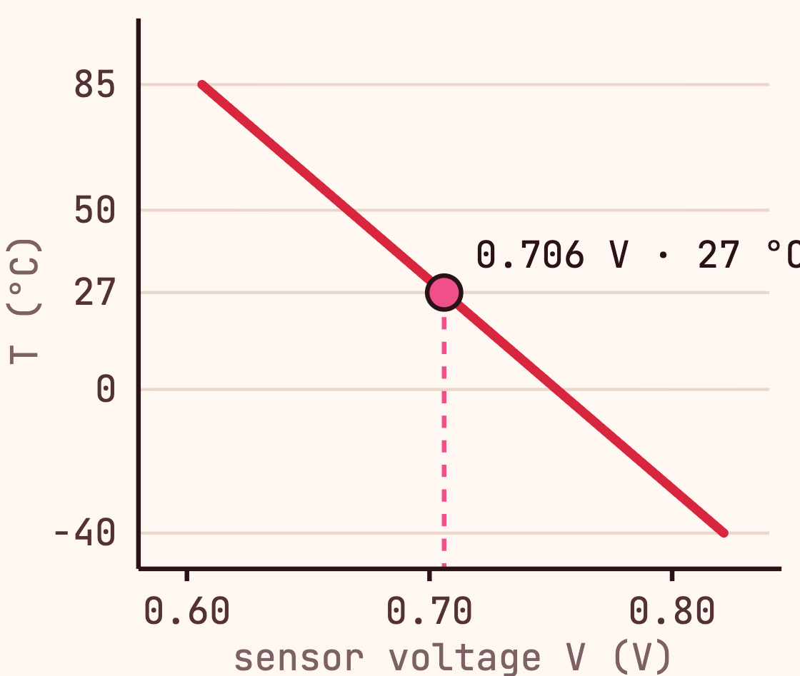
05
INTERNAL TEMPERATURE SENSOR
ADC
The chip can measure its own temperature
How it works
T = 27 − (V − 0.706) / 0.001721
Accuracy
Measures V_{be} , the voltage of a biased bipolar diode, on input AIN4
No guaranteed accuracy: V_{be} and its slope vary from chip to chip
Typically 0.706 V at 27 °C
User calibration is needed for accurate readings
Falls by 1.721 mV per °C
Very sensitive to the reference voltage, which the RP2040 does not provide internally
Must be enabled first (TS_EN bit)
1 LSB ≈ 0.8 mV ≈ 0.5 °C at 3.3 V: a coarse sensor
Linear: −1.721 mV per °C, from −40 to 85 °C
Sources: RP2040 datasheet, section 4.9.4; Raspberry Pi documentation.
22

Slide 23
I²C communication
Many sensors on two wires: addressing, reading, configuring, and how fast it can go.

Slide 24
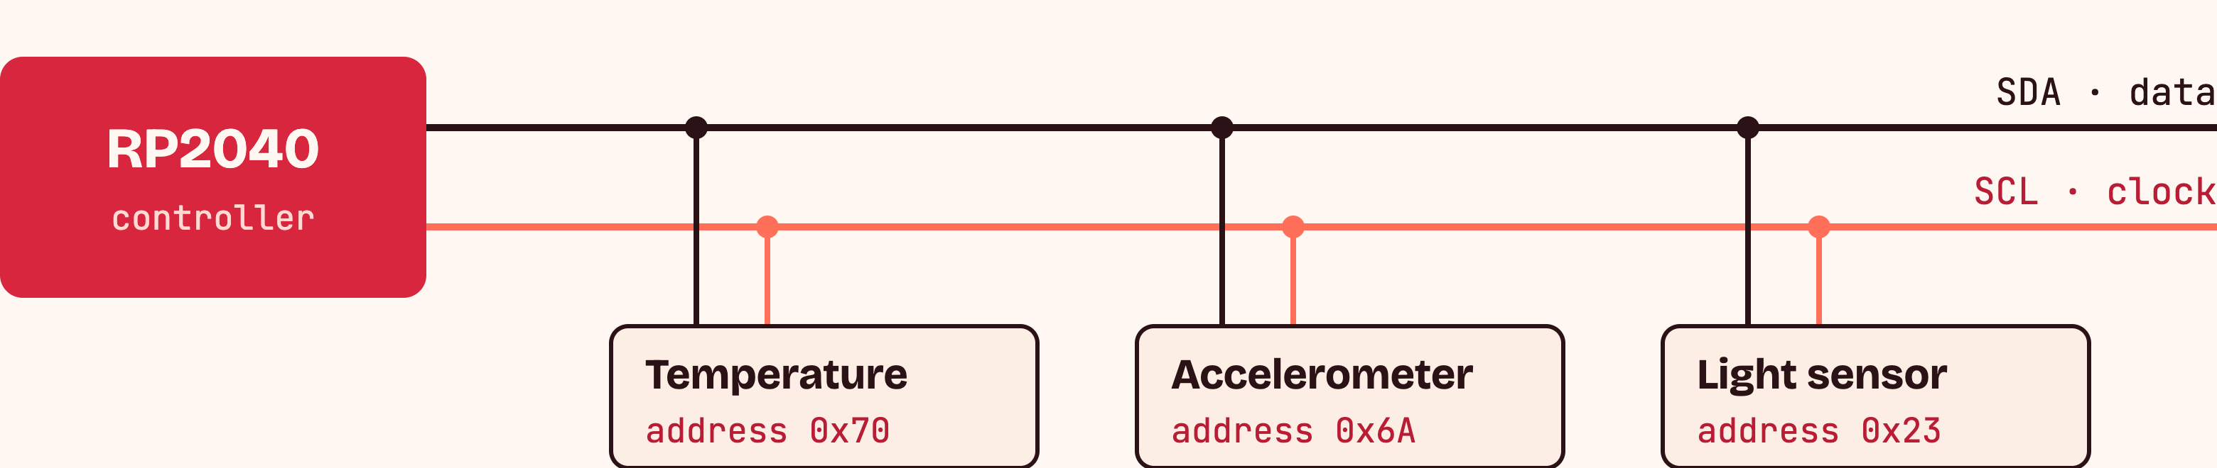
06
WHY I²C
I²C
Several sensors share the same two wires
One bus, many devices: no dedicated lines per sensor
SDA carries the data, in both directions
SCL carries the clock that synchronizes the exchange
Example addresses shown for illustration; each device has its own address on the bus.
24

Slide 25
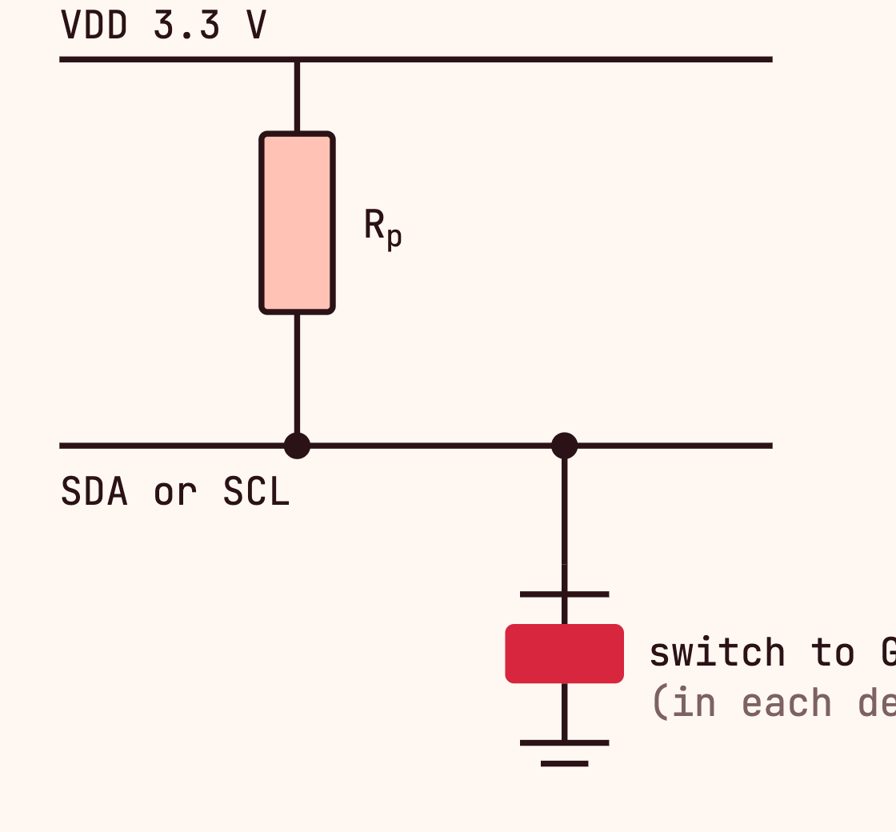
06
SDA, SCL AND PULL-UPS
I²C
Pull-ups give the bus a defined high level
Devices never drive the line high: they can only pull it low
When no one pulls, the resistor brings the line back to a known high level
Without pull-up, an idle line floats : neither high nor low, so readings become random
Both SDA and SCL need one, typically a few kΩ (10 kΩ in the SHTC3 example)
Idle → line high
Talking → pulled low when needed
Pull-ups may also be built into a microcontroller or a sensor breakout board. Source: SHTC3 datasheet, section 4.
25

Slide 26
06
PROTOCOL
I²C
Every exchange starts with an address
start
7-bit address · 0x70
R/W
data byte(s)
stop
Write
S
1
1
1
0
0
0
0
0
ACK
command or register → sensor
ACK
P
Read
S
1
1
1
0
0
0
0
1
ACK
measurement bytes ← sensor
ACK
P
sent by the RP2040
sent by the sensor
START: the controller takes the bus
Address + R/W bit: only the matching device answers; 0 = write, 1 = read
ACK: the receiver confirms each byte by pulling SDA low
Example: SHTC3, fixed address 0x70. Source: SHTC3 datasheet, section 5.1.
26

Slide 27
06
TWO-WAY COMMUNICATION
I²C
An I²C sensor can be read and configured
Analog sensor
I²C sensor
One direction only: the sensor outputs a voltage
Read: the sensor sends digital bytes, not a voltage
The microcontroller measures it with its ADC
Write: the controller sends commands or register values
No way to change how the sensor works
Configure operating mode, resolution or sampling behavior
Bytes must be decoded using the sensor datasheet
SHTC3 EXAMPLE
Writing a command selects normal or low-power mode, sleep or wake-up
Source: SHTC3 datasheet, sections 5.2 and 5.3.
27

Slide 28
06
READING THE SHTC3
I²C
One measurement takes four I²C exchanges
1
Wake up
2
Measure
3
Read
4
Sleep
0x70 W
0x35
0x17
0x70 W
0x7C
0xA2
0x70 R
T MSB
T LSB
0x70 W
0xB0
0x98
wait ≤ 240 µs
wait ≤ 12.1 ms
CRC
RH MSB
RH LSB
saves power
CRC
6 bytes received
T = −45 + 175 · S_{T} / 2¹⁶
Example: 0x64, 0x8B → S_{T} = 25 739 → 23.7 °C
S_{T}: raw 16-bit value = (MSB × 256) + LSB
CRC byte lets us detect transmission errors
Command 0x7CA2: normal mode, temperature first, clock stretching. Source: SHTC3 datasheet, sections 5.3–5.11.
28

Slide 29
06
ARDUINO EXAMPLE
I²C
Reading the SHTC3 with Arduino
Wire is the Arduino I²C library: it drives the bus as controller
#include <Wire.h>
const uint8_t ADDR = 0x70; // SHTC3 address
SDA and SCL on the Pico: GP4 and GP5 by default (Arduino-Pico core)
void cmd(uint16_t c) { // 16-bit command
Wire.beginTransmission(ADDR);
Wire.write(c >> 8); Wire.write(c & 0xFF);
0x70 selects the SHTC3 on the bus
Wire.endTransmission();
}
The SHTC3 has no temperature register: a write command starts the measurement, then we read 2 bytes
void setup() { Serial.begin(115200); Wire.begin(); }
void loop() {
cmd(0x3517); delay(1); // wake up
cmd(0x7866); delay(13); // measure, T first
Wire.requestFrom(ADDR, 2); // read T MSB, LSB
uint16_t raw = Wire.read() << 8 | Wire.read();
cmd(0xB098); // sleep
SERIAL MONITOR
Serial.println(-45 + 175.0 * raw / 65536);
23.71 23.74 23.70
delay(1000);
}
Command 0x7866: normal mode, temperature first, no clock stretching. CRC not checked here. Source: SHTC3 datasheet, sections 5.3–5.11.
29

Slide 30
06
BUS SPEED
I²C
Bus speed sets a theoretical ceiling
Standard mode
Fast mode
Fast mode plus
100 kHz
400 kHz
1 MHz
≈ 1.5 ms on the bus
≈ 0.39 ms on the bus
≈ 0.15 ms on the bus
~650
~2 600
~6 500
measurements / s, bus limit
measurements / s, bus limit
measurements / s, bus limit
One SHTC3 measurement ≈ 154 clock cycles: 4 exchanges, address, commands, 6 data bytes, ACK bits
Max rate ≈ SCL frequency ÷ bits exchanged per measurement
Bit count from SHTC3 datasheet Figure 7; speeds from Table 6. Bus time only: waiting for the sensor is not included.
30

Slide 31
06
IN PRACTICE
I²C
The sensor, not the bus, sets the pace
At 400 kHz, the bus alone would allow ~2 600 measurements/s. But each measurement also waits for the sensor.
wake 0.24
bus 0.39
measure 12.1 ms
~80 /s
Normal mode
12.7 ms each
wake 0.24
bus 0.39
measure 0.8 ms
~700 /s
Low-power mode
1.4 ms each
I²C transfer
sensor busy measuring
Several sensors share the bus: the transfer time is split between them
While one sensor measures, the bus is free to talk to the others
Maximum times from SHTC3 datasheet, Table 5. Bar lengths not to scale for low-power mode.
31

