Slide 1
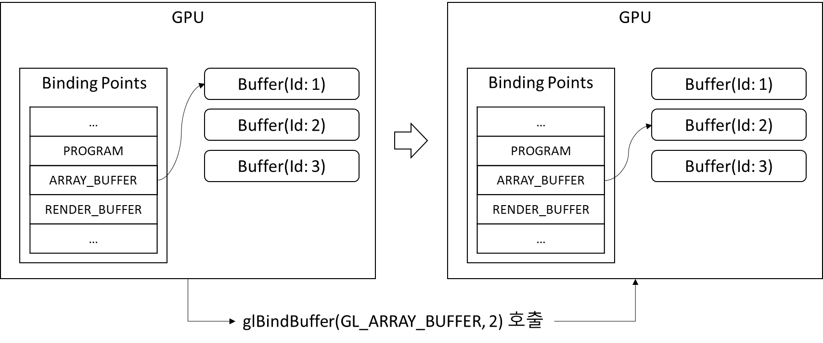
GPU
GPU
Binding Points
Buffer(Id: 1)
Binding Points
Buffer(Id: 1)
…
PROGRAM
ARRAY_BUFFER
RENDER_BUFFER
…
Buffer(Id: 2)
…
PROGRAM
ARRAY_BUFFER
RENDER_BUFFER
…
Buffer(Id: 2)
Buffer(Id: 3)
Buffer(Id: 3)
glBindBuffer(GL_ARRAY_BUFFER, 2) 호출

Slide 2
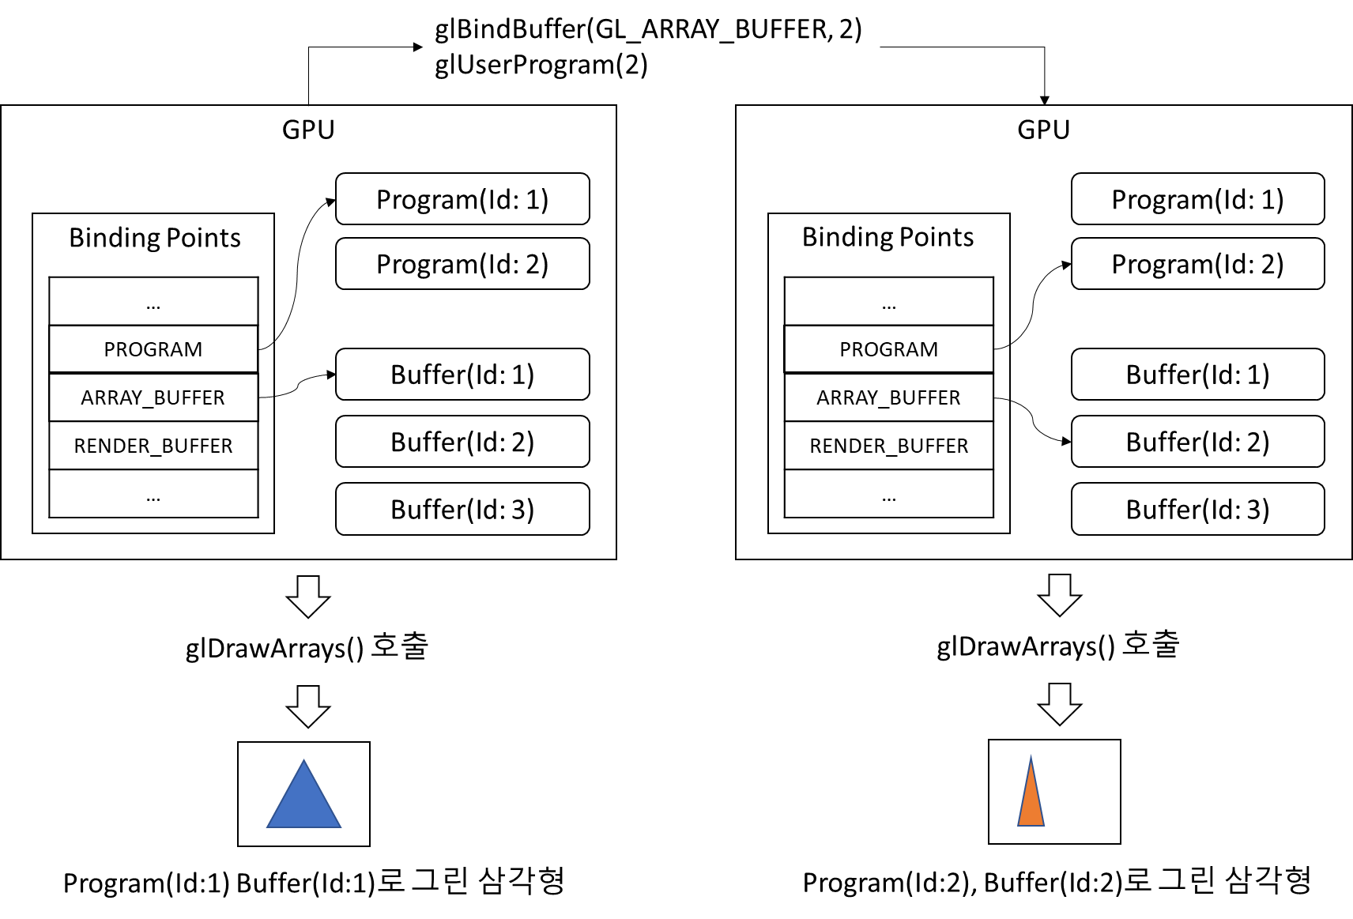
glBindBuffer(GL_ARRAY_BUFFER, 2)
glUserProgram(2)
GPU
GPU
Program(Id: 1)
Program(Id: 1)
Binding Points
Binding Points
Program(Id: 2)
Program(Id: 2)
…
PROGRAM
ARRAY_BUFFER
RENDER_BUFFER
…
…
PROGRAM
ARRAY_BUFFER
RENDER_BUFFER
…
Buffer(Id: 1)
Buffer(Id: 1)
Buffer(Id: 2)
Buffer(Id: 2)
Buffer(Id: 3)
Buffer(Id: 3)
glDrawArrays() 호출
glDrawArrays() 호출
Program(Id:1) Buffer(Id:1)로 그린 삼각형
Program(Id:2), Buffer(Id:2)로 그린 삼각형

Slide 3
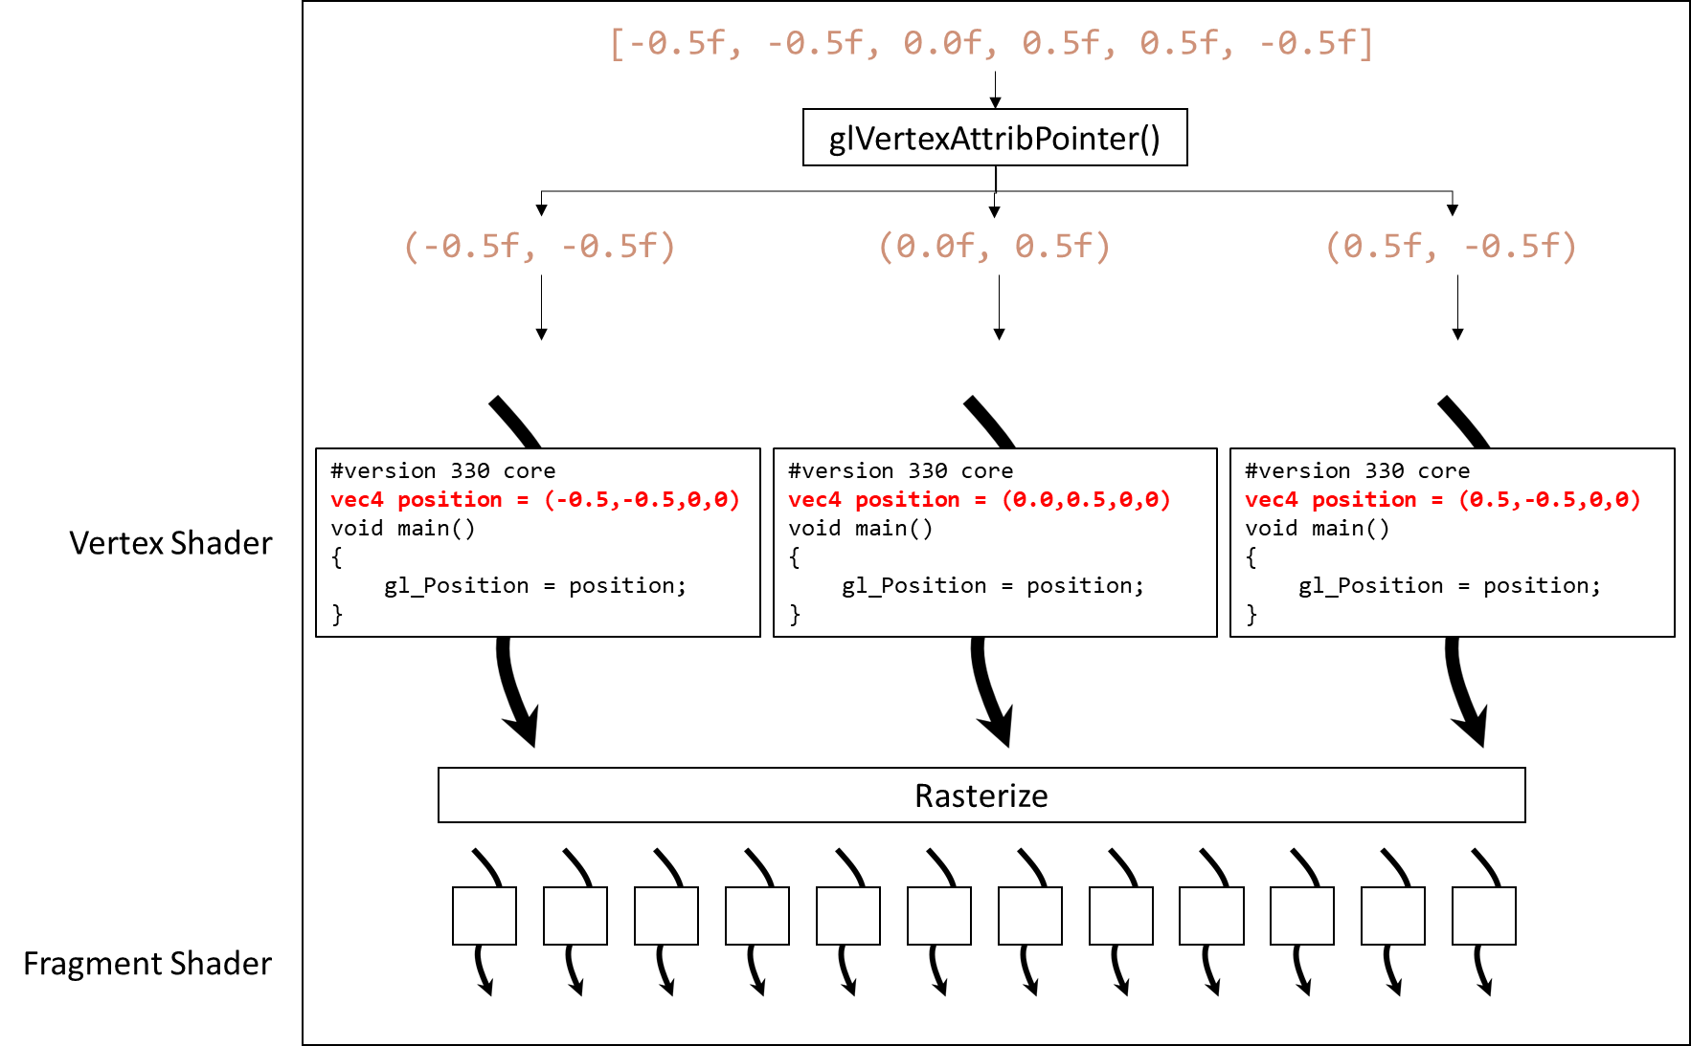
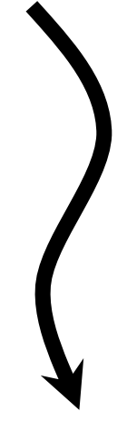
#version 330 core
layout(location = 0) in vec4 position;
void main()
{
gl_Position = position;
}
[-0.5f, -0.5f, 0.0f, 0.5f, 0.5f, -0.5f]
glVertexAttribPointer()
(-0.5f, -0.5f)
(0.0f, 0.5f)
(0.5f, -0.5f)
GPU
#version 330 core
vec4 position = (-0.5,-0.5,0,0)
void main()
{
gl_Position = position;
}
#version 330 core
vec4 position = (0.0,0.5,0,0)
void main()
{
gl_Position = position;
}
#version 330 core
vec4 position = (0.5,-0.5,0,0)
void main()
{
gl_Position = position;
}
Vertex Shader
Rasterize
Fragment Shader

Slide 4
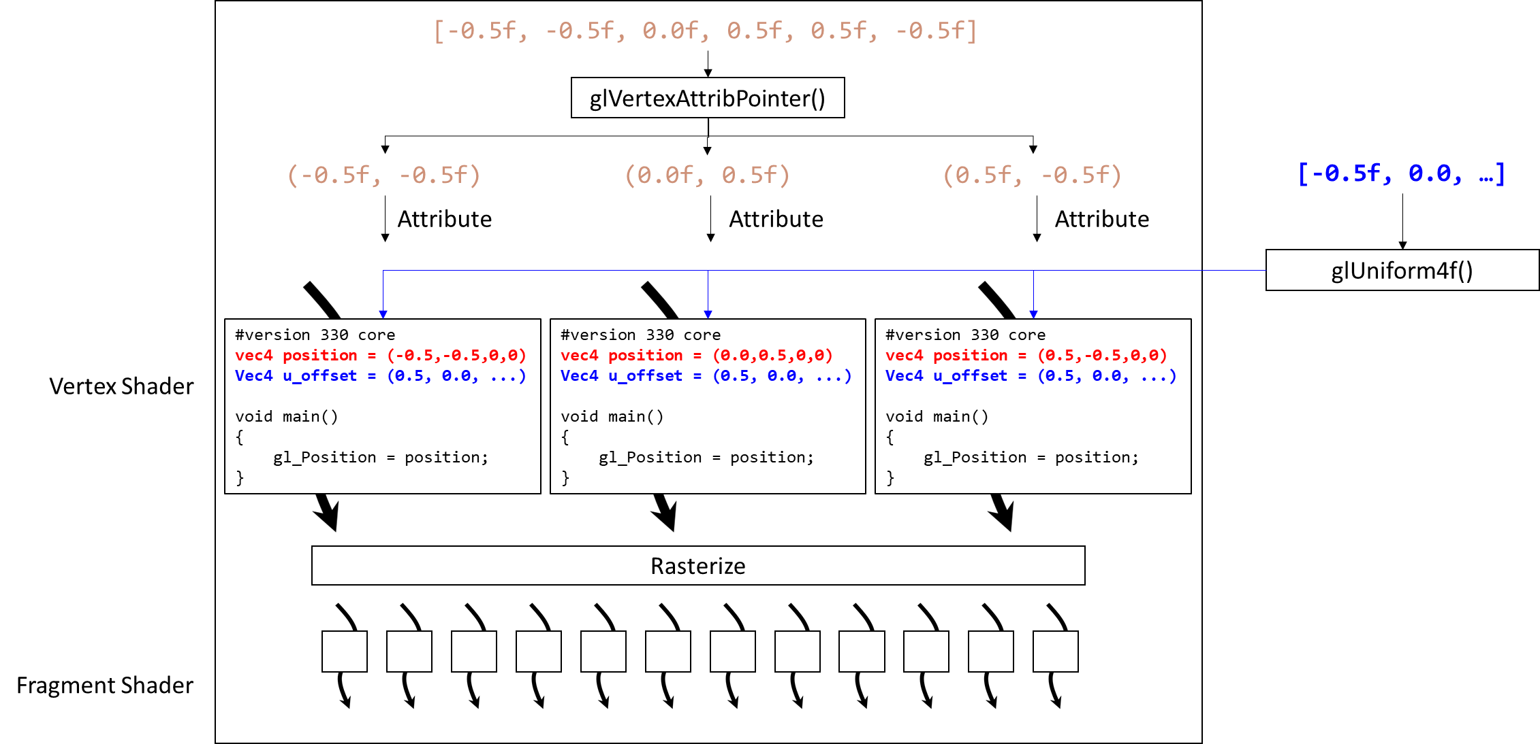
[-0.5f, -0.5f, 0.0f, 0.5f, 0.5f, -0.5f]
glVertexAttribPointer()
(-0.5f, -0.5f)
(0.0f, 0.5f)
(0.5f, -0.5f)
[-0.5f, 0.0, …]
Attribute
Attribute
Attribute
glUniform4f()
#version 330 core
vec4 position = (-0.5,-0.5,0,0)
Vec4 u_offset = (0.5, 0.0, ...)
void main()
{
gl_Position = position;
}
#version 330 core
vec4 position = (0.0,0.5,0,0)
Vec4 u_offset = (0.5, 0.0, ...)
void main()
{
gl_Position = position;
}
#version 330 core
vec4 position = (0.5,-0.5,0,0)
Vec4 u_offset = (0.5, 0.0, ...)
void main()
{
gl_Position = position;
}
Vertex Shader
Rasterize
Fragment Shader

