Slide 1
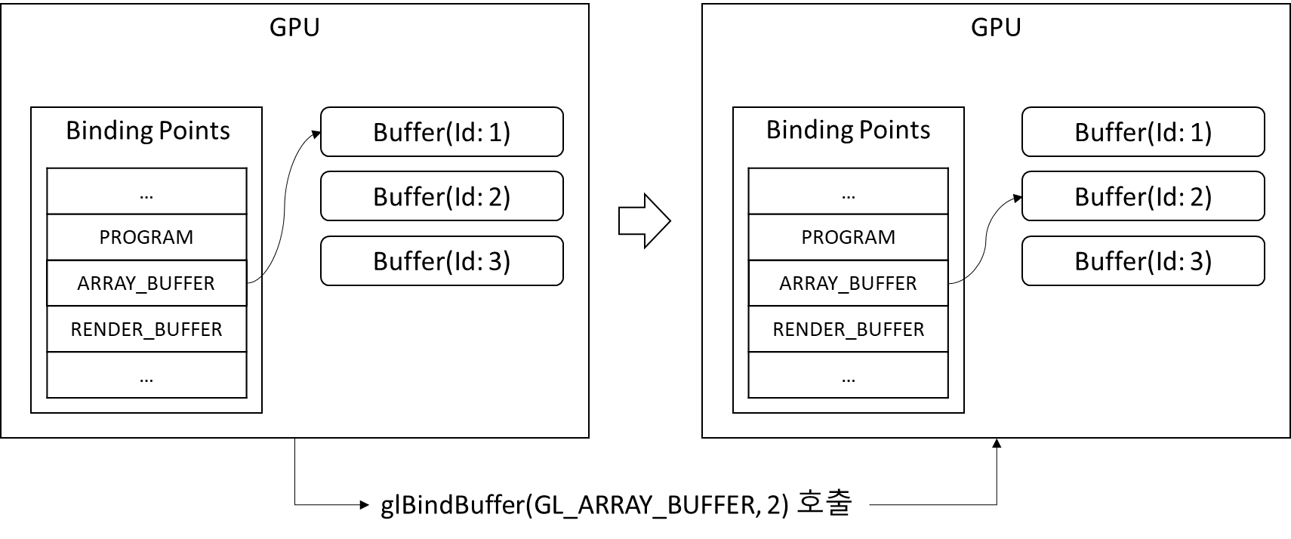
GPU
GPU
Binding Points
Buffer(Id: 1)
Binding Points
Buffer(Id: 1)
…
PROGRAM
ARRAY_BUFFER
RENDER_BUFFER
…
Buffer(Id: 2)
…
PROGRAM
ARRAY_BUFFER
RENDER_BUFFER
…
Buffer(Id: 2)
Buffer(Id: 3)
Buffer(Id: 3)
glBindBuffer(GL_ARRAY_BUFFER, 2) 호출

Slide 2
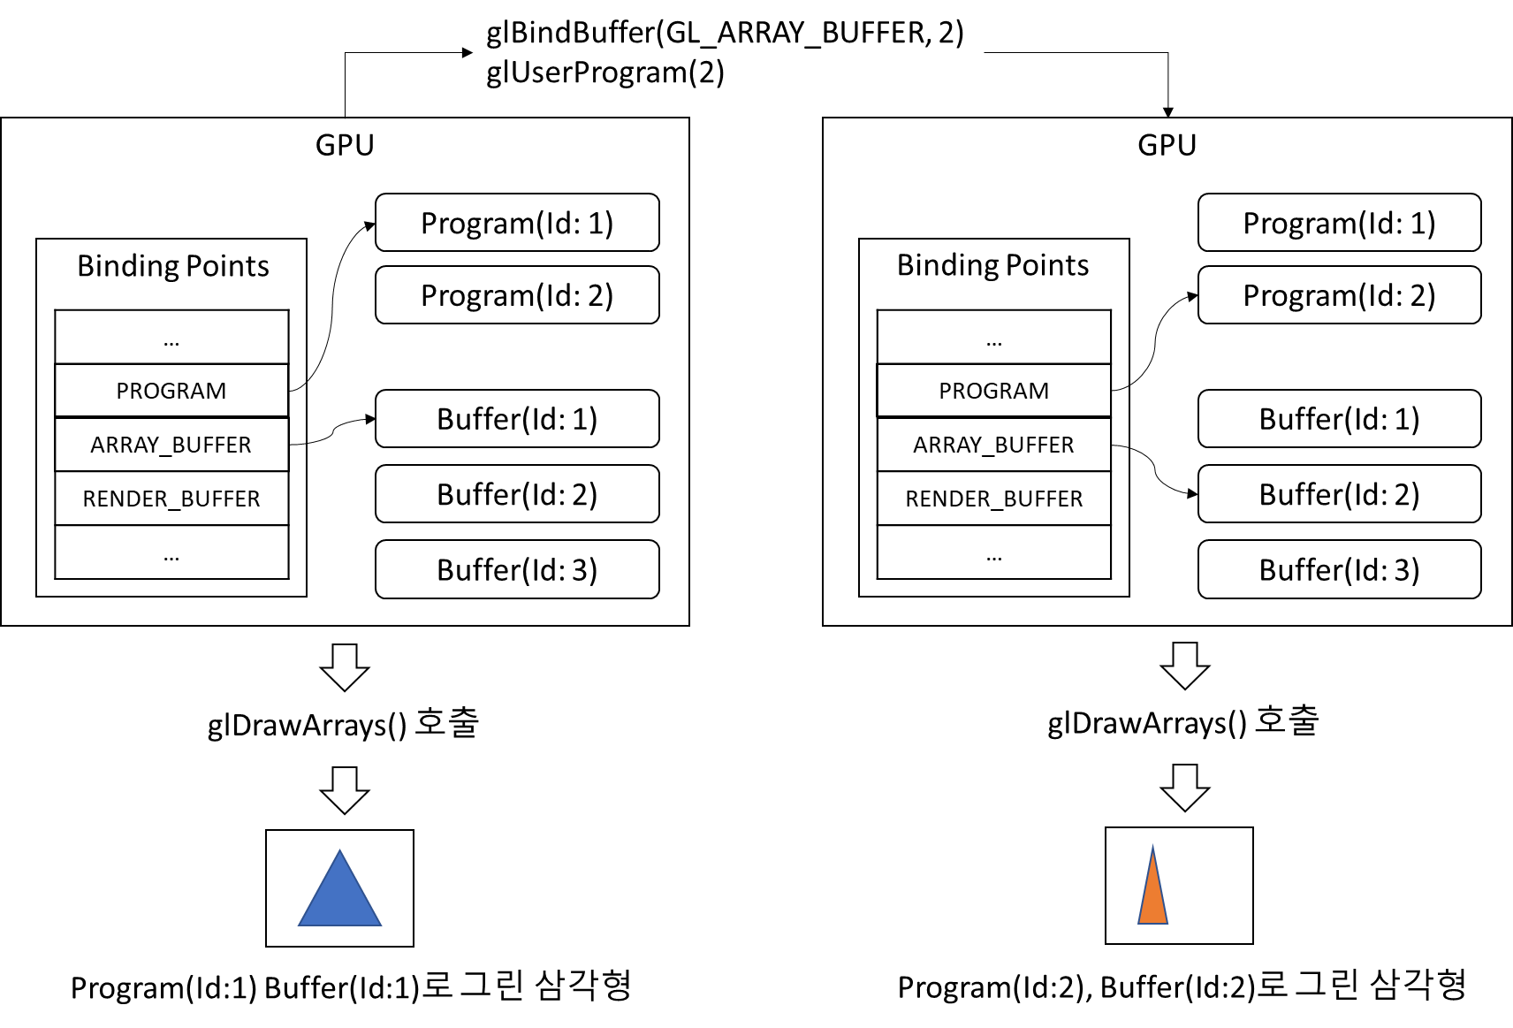
glBindBuffer(GL_ARRAY_BUFFER, 2)
glUserProgram(2)
GPU
GPU
Program(Id: 1)
Program(Id: 1)
Binding Points
Binding Points
Program(Id: 2)
Program(Id: 2)
…
PROGRAM
ARRAY_BUFFER
RENDER_BUFFER
…
…
PROGRAM
ARRAY_BUFFER
RENDER_BUFFER
…
Buffer(Id: 1)
Buffer(Id: 1)
Buffer(Id: 2)
Buffer(Id: 2)
Buffer(Id: 3)
Buffer(Id: 3)
glDrawArrays() 호출
glDrawArrays() 호출
Program(Id:1) Buffer(Id:1)로 그린 삼각형
Program(Id:2), Buffer(Id:2)로 그린 삼각형

Slide 3
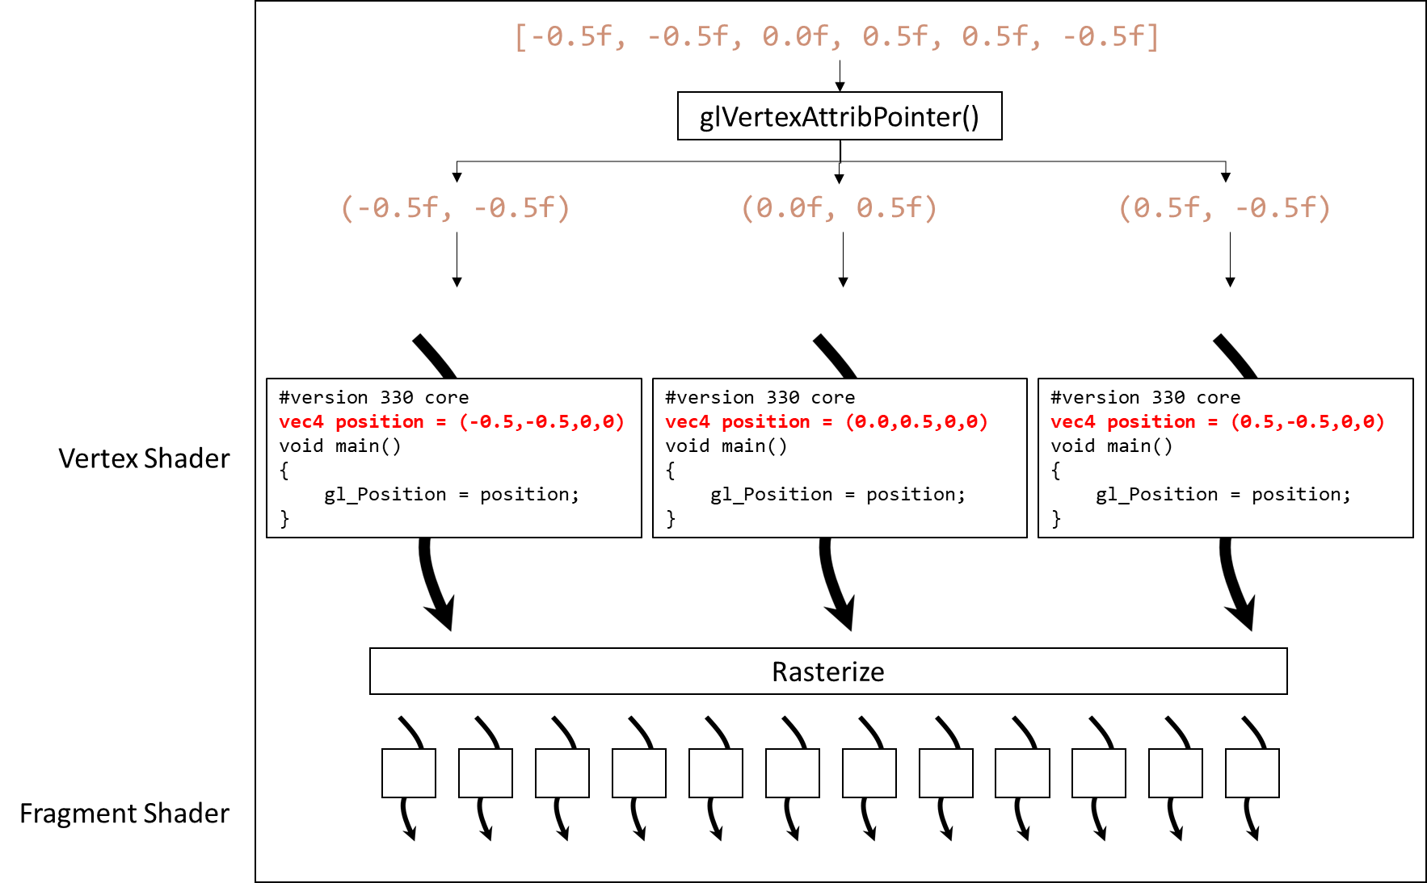
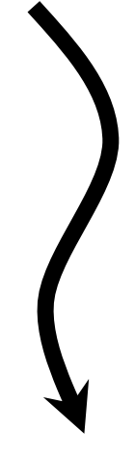
#version 330 core
layout(location = 0) in vec4 position;
void main()
{
gl_Position = position;
}
[-0.5f, -0.5f, 0.0f, 0.5f, 0.5f, -0.5f]
glVertexAttribPointer()
(-0.5f, -0.5f)
(0.0f, 0.5f)
(0.5f, -0.5f)
GPU
#version 330 core
vec4 position = (-0.5,-0.5,0,0)
void main()
{
gl_Position = position;
}
#version 330 core
vec4 position = (0.0,0.5,0,0)
void main()
{
gl_Position = position;
}
#version 330 core
vec4 position = (0.5,-0.5,0,0)
void main()
{
gl_Position = position;
}
Vertex Shader
Rasterize
Fragment Shader

Slide 4
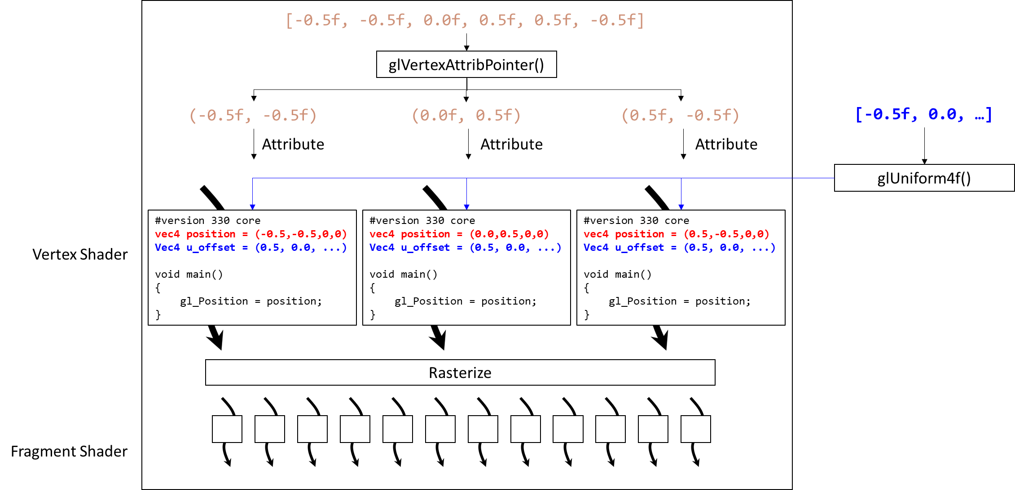
[-0.5f, -0.5f, 0.0f, 0.5f, 0.5f, -0.5f]
glVertexAttribPointer()
(-0.5f, -0.5f)
(0.0f, 0.5f)
(0.5f, -0.5f)
[-0.5f, 0.0, …]
Attribute
Attribute
Attribute
glUniform4f()
#version 330 core
vec4 position = (-0.5,-0.5,0,0)
Vec4 u_offset = (0.5, 0.0, ...)
void main()
{
gl_Position = position;
}
#version 330 core
vec4 position = (0.0,0.5,0,0)
Vec4 u_offset = (0.5, 0.0, ...)
void main()
{
gl_Position = position;
}
#version 330 core
vec4 position = (0.5,-0.5,0,0)
Vec4 u_offset = (0.5, 0.0, ...)
void main()
{
gl_Position = position;
}
Vertex Shader
Rasterize
Fragment Shader

Slide 5
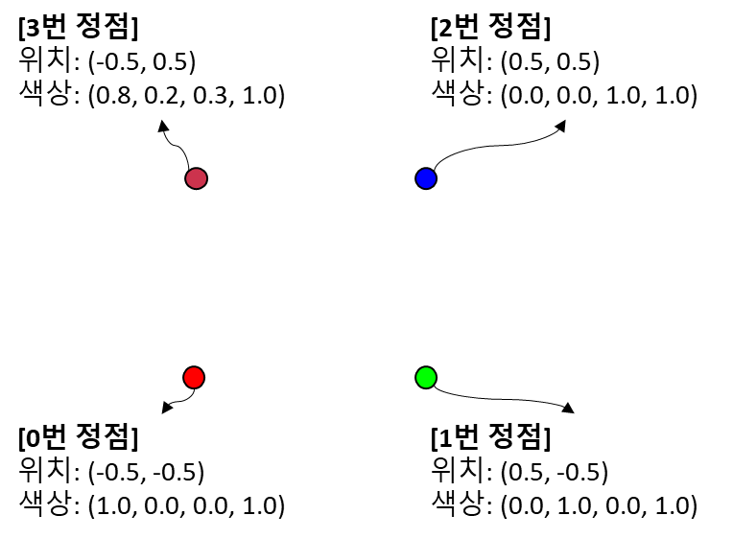
[3번 정점]
위치: (-0.5, 0.5)
색상: (0.8, 0.2, 0.3, 1.0)
[2번 정점]
위치: (0.5, 0.5)
색상: (0.0, 0.0, 1.0, 1.0)
[0번 정점]
위치: (-0.5, -0.5)
색상: (1.0, 0.0, 0.0, 1.0)
[1번 정점]
위치: (0.5, -0.5)
색상: (0.0, 1.0, 0.0, 1.0)

Slide 6
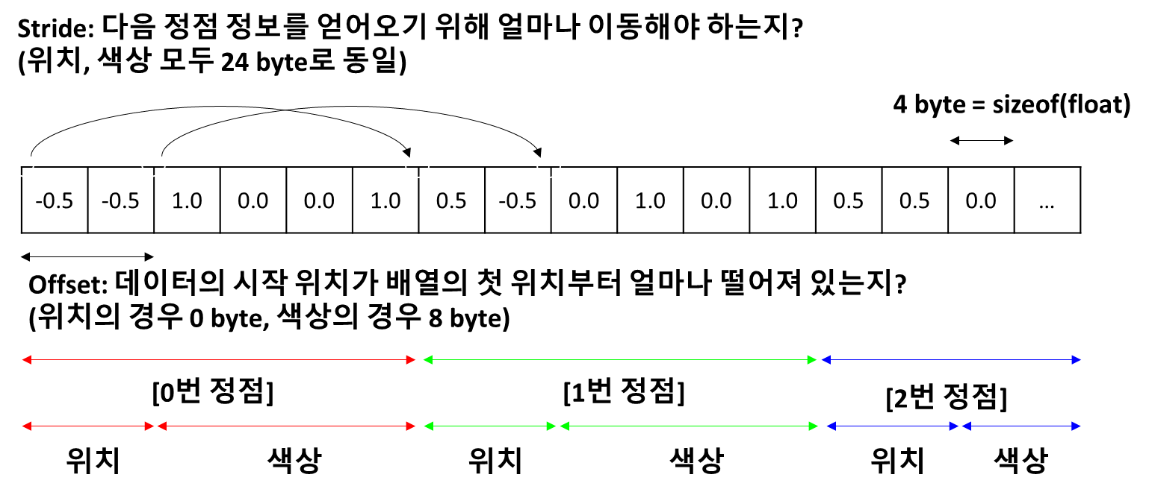
Stride: 다음 정점 정보를 얻어오기 위해 얼마나 이동해야 하는지?
(위치, 색상 모두 24 byte로 동일)
4 byte = sizeof(float)
-0.5 | -0.5 | 1.0 | 0.0 | 0.0 | 1.0 | 0.5 | -0.5 | 0.0 | 1.0 | 0.0 | 1.0 | 0.5 | 0.5 | 0.0 | …
Offset: 데이터의 시작 위치가 배열의 첫 위치부터 얼마나 떨어져 있는지?
(위치의 경우 0 byte, 색상의 경우 8 byte)
[0번 정점]
[1번 정점]
[2번 정점]
위치
색상
위치
색상
위치
색상

Slide 7
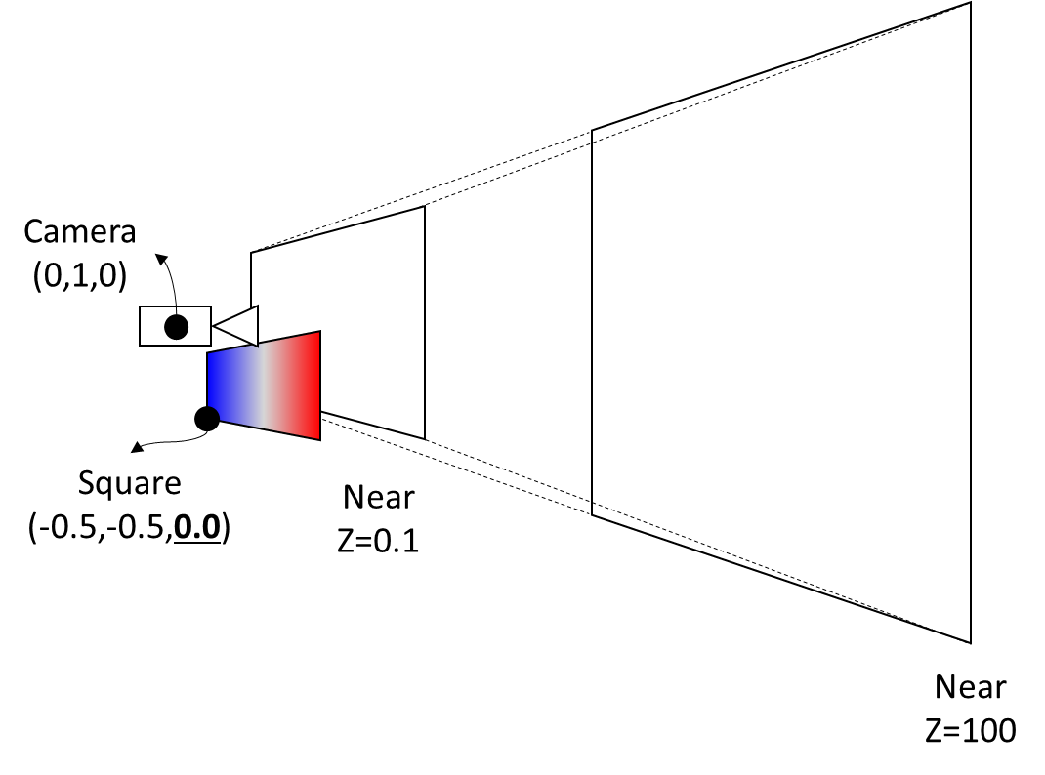
Camera
(0,1,0)
Square
(-0.5,-0.5,0.0)
Near
Z=0.1
Near
Z=100

Slide 8
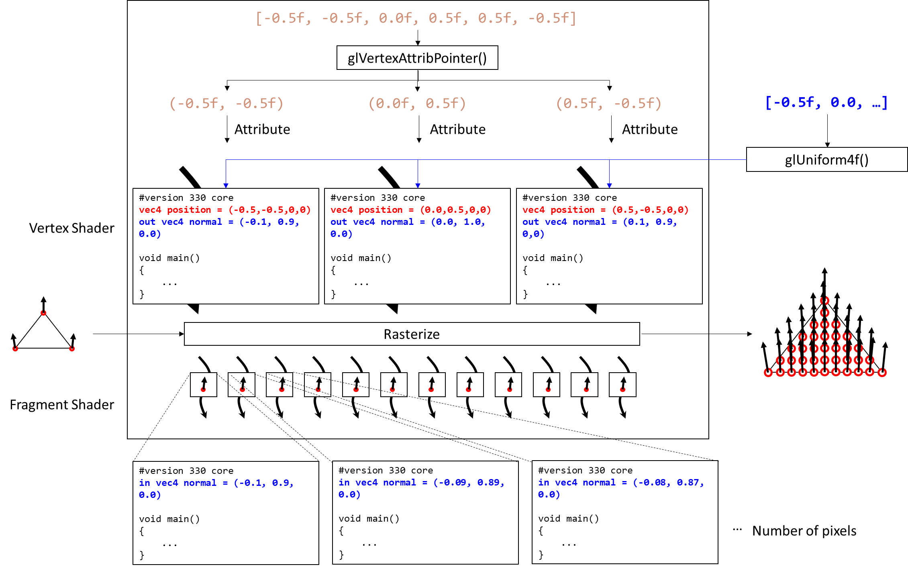
[-0.5f, -0.5f, 0.0f, 0.5f, 0.5f, -0.5f]
glVertexAttribPointer()
(-0.5f, -0.5f)
(0.0f, 0.5f)
(0.5f, -0.5f)
[-0.5f, 0.0, …]
Attribute
Attribute
Attribute
glUniform4f()
#version 330 core
vec4 position = (-0.5,-0.5,0,0)
out vec4 normal = (-0.1, 0.9, 0.0)
void main()
{
...
}
#version 330 core
vec4 position = (0.0,0.5,0,0)
out vec4 normal = (0.0, 1.0, 0.0)
void main()
{
...
}
#version 330 core
vec4 position = (0.5,-0.5,0,0)
out vec4 normal = (0.1, 0.9, 0,0)
void main()
{
...
}
Vertex Shader
Rasterize
Fragment Shader
#version 330 core
in vec4 normal = (-0.1, 0.9, 0.0)
void main()
{
...
}
#version 330 core
in vec4 normal = (-0.09, 0.89, 0.0)
void main()
{
...
}
#version 330 core
in vec4 normal = (-0.08, 0.87, 0.0)
void main()
{
...
}
…
Number of pixels

Slide 9
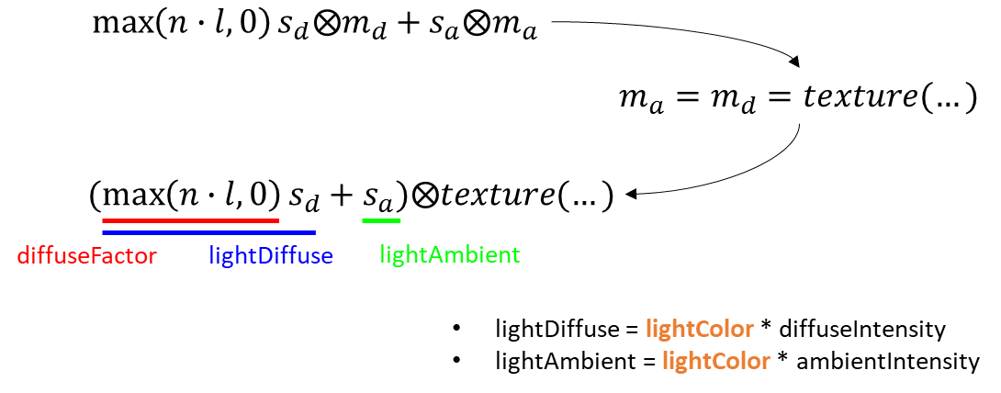



$$\max\left(n∙l,0\right)s_{d}⨂m_{d}+s_{a}⨂m_{a}$$
$$m_{a}=m_{d}=texture(…)$$
$$(\max\left(n∙l,0\right)s_{d}+s_{a})⨂texture(…)$$
diffuseFactor
lightDiffuse
lightAmbient
lightDiffuse = lightColor * diffuseIntensity
lightAmbient = lightColor * ambientIntensity

Slide 10
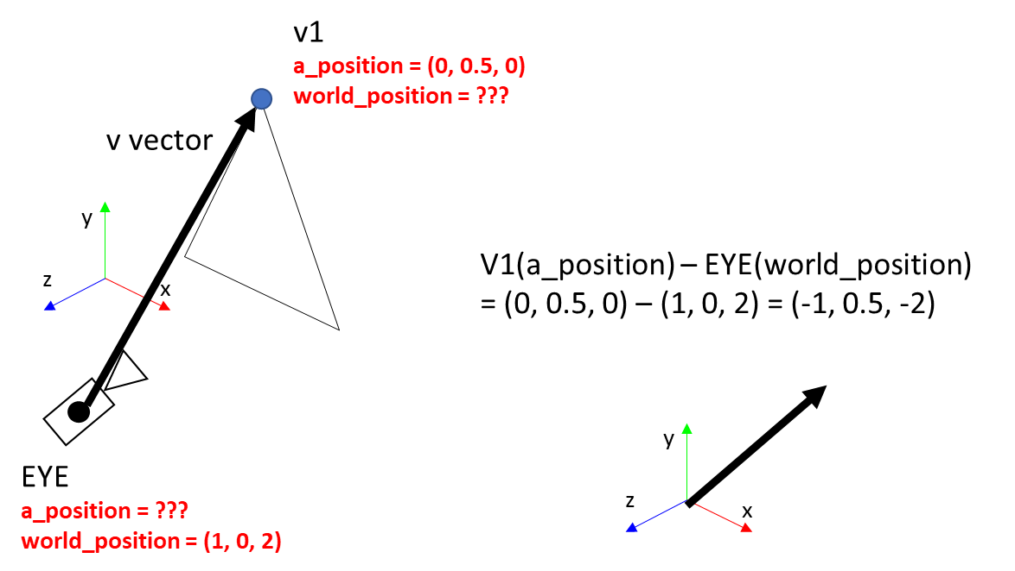
v1
a_position = (0, 0.5, 0)
world_position = ???
v vector
y
z
V1(a_position) – EYE(world_position)
= (0, 0.5, 0) – (1, 0, 2) = (-1, 0.5, -2)
x
y
EYE
a_position = ???
world_position = (1, 0, 2)
z
x

