Slide 1
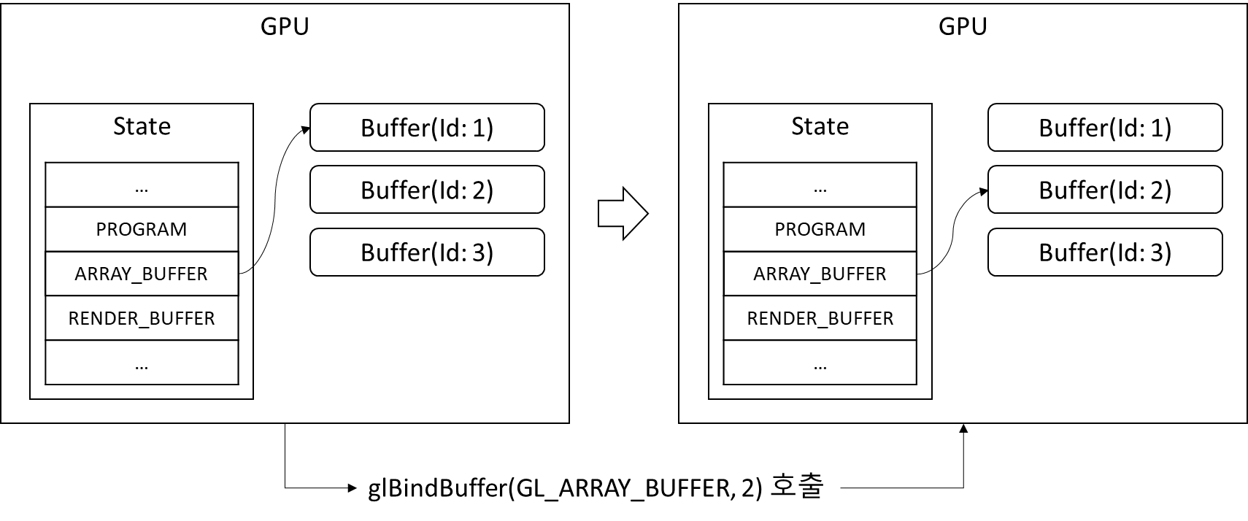
GPU
GPU
State
Buffer(Id: 1)
State
Buffer(Id: 1)
…
PROGRAM
ARRAY_BUFFER
RENDER_BUFFER
…
Buffer(Id: 2)
…
PROGRAM
ARRAY_BUFFER
RENDER_BUFFER
…
Buffer(Id: 2)
Buffer(Id: 3)
Buffer(Id: 3)
glBindBuffer(GL_ARRAY_BUFFER, 2) 호출

