Slide 1
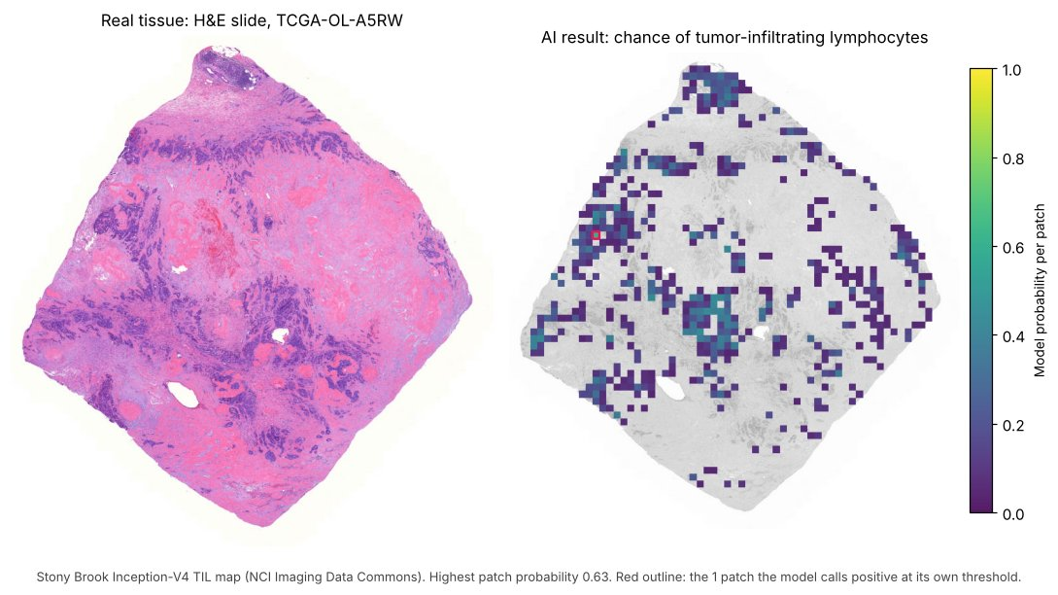
HEALTHCARE AI HACKATHON · KICKOFF
OncoSys Cancer AI Lab
Build AI tools that help cancer researchers trust their data and decide what to do with it.
Wednesday, November 11 · 7:00 PM ET
The Open Accelerator · Red Hat · Northeastern University · OncoSys AI
Notes:
Welcome everyone. Thank you for joining, and thank you to Red Hat and The Open Accelerator, Northeastern and our judges and mentors. Tonight is about 40 minutes: why this matters, what you’ll build, how judging works, and a live run of the starter. Questions at the end, and anytime in Discord.

Slide 2
TONIGHT
40 minutes, then your questions
Time (ET) | What
7:00 | Welcome and why connecting cancer evidence is hard
7:10 | The challenge: tracks, six featured products, the data
7:20 | How judging works, what to submit, the rules
7:27 | Live: run the starter in Colab
7:32 | The week ahead, teams and links
7:40 | Questions
Notes:
Keep it tight: 40 minutes of content, then open Q&A. Mentors and organizers can answer questions in Discord while we talk.

Slide 3
WHY THIS MATTERS
Real cancer evidence doesn’t always line up
535
11%
1,978
of 1,101 breast tumors in TCGA have every data layer. Each join changes who is in the study.
of tumors get a different molecular subtype depending on which call you use.
of 3,111 tissue slides are frozen sections, not diagnostic slides.
Source: TCGA-BRCA via UCSC Xena and NCI Imaging Data Commons; counted for this event, November 2026.
Notes:
These are real numbers from the data you’ll use. Half the tumors drop out when you require every data layer. One in nine tumors changes subtype depending on which call you trust. Most slides are frozen sections, which look different from diagnostic slides. None of this is a mistake in the data; it’s what real research data looks like. The tools you build this week are about catching this and helping people decide what to do.

Slide 4
Is this AI result right, and how would anyone check?
Left: a real tumor slide from TCGA.
Right: a published model’s estimate of where immune cells are.
Its highest patch score is 0.63, and at its own threshold it calls one patch positive.
Notes:
This is a real result from a published model, the Stony Brook TIL map, on a real slide. It looks impressive, but what does it actually tell a researcher? The highest probability is 0.63, and only one patch passes the model’s own threshold. Should you trust it? Which patches should a person look at? That’s the kind of question your tools will answer this week.

Slide 5
THE CHALLENGE
Pick a user.
Build one workflow they can finish.
Give a judge one result they can verify and one limitation they can inspect.
Notes:
This is the whole challenge in one line. Not a slide deck, not a notebook of plots: a working tool for a real user. Web app, AI agent, visual workflow, or a plug-in to a notebook, your choice. And the bar is simple: a judge can use it without you narrating, and it shows one result they can check and one limitation they can see.

Slide 6
TWO TRACKS
Catch the problem, then help someone decide
Cohort Firewall
Evidence Navigator
Catches what could make a result unreliable.
Helps someone investigate a result and decide what to do.
Must prove: which samples can answer the question, and how a change in the data affects the result.
Must prove: a reviewer can trace a claim to the data, reproduce it, and see where it stops being supported.
Notes:
The two tracks are two halves of one research workflow. Firewall tools catch what could go wrong. Navigator tools help a person investigate and make a call. Each track has its own seven-criterion rubric, same as announced.

Slide 7
SIX FEATURED PRODUCTS
Pick one, combine two, or pitch your own
Cohort Control Tower
Cohort Studio
Multimodal Case Room
Compare two data releases; rerun only what changed.
Build a cohort from plain English; catch joins that double-count.
One case: slides, record and molecular data, sources linked.
Evidence Copilot
Research Claim Auditor
Repair Review Desk
Answers questions by running real analyses, with sources.
Checks each claim in a report against the data.
Reviews proposed data fixes; approve, reject or ask for more.
Teal: Cohort Firewall · Pink: Evidence Navigator · Briefs, practice inputs and ideas: products/ in the repo
Notes:
Each product has a page in the repo with its user, the workflow, practice inputs and a demo idea. These six have full starter support. You can combine two, for example a Control Tower plus a Repair Review Desk, or pitch your own using any data pack. If you pitch your own, tell us in Discord which product and pack you’re using.

Slide 8
THE DATA
Start small; go bigger only if you need to
Pack | One record is… | Laptop start
TCGA breast cancer (core) | A tumor sample: clinical, survival, DNA, RNA, protein, slide links | ~70 MB
PathMNIST | A labelled colorectal tissue patch | Smallest version
CPTAC | A lung, colon or kidney case, with protein data and slides | Under 1 MB
LIDC-IDRI | A chest CT with radiologists’ nodule marks | 34–230 MB
DepMap | A lab-grown cancer cell line | ~100 kB
Trial records | A trial’s eligibility rules, with fictional cases | Small
CAMELYON17 | A lymph-node slide from one of 5 hospitals | Labels only
Only join records with a documented match. Tissue patches, cell lines, tumors and CT scans describe different things.
Notes:
The core pack is TCGA breast cancer: it powers all six featured products. The other packs are for pitch-your-own ideas. Every pack has a small download that runs on a laptop; larger datasets and models are optional. One rule matters most: only join records where there’s a documented match. A PathMNIST patch and a TCGA tumor are not the same patient, ever.

Slide 9
THE FINALE
Two teams’ tools, working as one
TEAM A · FIREWALL
TEAM B · NAVIGATOR
Cohort Control Tower
Repair Review Desk
findings.json
Catches a silent change in a new data release
shared format
Sees which results moved and records a decision
Live, on data neither team has seen. We’ll pair Control Tower and Repair Review Desk teams tonight.
Notes:
The finale is where this stops being twenty separate demos. A Control Tower team gets a new data release on stage, catches what changed, and writes its findings in the shared format. A different team’s Repair Review Desk imports that file and makes the review call. If you’re building either of these, talk to us after this session and we’ll pair you up. The format is in format/ in the repo, with a validator.

Slide 10
HOW JUDGING WORKS
Judges use your tool on something you haven’t seen
1
2
3
4
3-minute demo
A hidden test
A quick check
7-criterion rubric
Your user, your workflow, one result and one limitation.
In the 2 minutes of questions, you get a new input and run your tool on it live.
For four products, a script compares your output file with the answer, and judges see a short summary.
Each track has its own 100-point rubric, scored by five judges.
A working core beats an ambitious half-build. And “this data can’t answer the question, and here’s why” can win.
Notes:
Here’s exactly what happens on Saturday. You demo for three minutes. Then, at the start of your two minutes of questions, we hand you an input you haven’t seen, a new data release, a new report or a new case, and you run your tool on it. For four products, a small script compares your output file with the answer, so judges get a fair, consistent check. Judges score the rest from what they see. Two things to remember: finish the core workflow before adding features, and an honest “the data can’t answer this” is a strong result.

Slide 11
CODE FREEZE · SATURDAY 2:15 PM ET
What to submit
Everyone
Output files the checker reads
A repo judges can open, with a README: product, user, workflow, setup steps
Runs from a fresh clone (ask a teammate to try it)
Uses the frozen TCGA release; extra data listed
A short demo video link
No API keys or secrets in the repo
Product | File
Cohort Control Tower | findings.json
Repair Review Desk | decisions added
Research Claim Auditor | audit.json
Cohort Studio | cohort_samples.csv
Check JSON files with format/validate.py.
Notes:
The full list is SUBMISSION_CHECKLIST.md in the repo. The most common failure at hackathons is a repo that doesn’t run on someone else’s machine, so have a teammate clone it fresh and follow your README before the freeze. If you’re building one of these four products, your tool must write the file shown on the right, because that’s what the checker reads during your questions. The validator in format/ tells you in a second whether your file is well formed.

Slide 12
THE RULES
Real patient data, research use only
No clinical claims
No re-identification
No diagnosis, treatment advice or risk scores. A tissue label on an image is a research output.
The data is de-identified but came from real people. Don’t link it to outside records about individuals.
AI that shows its work
Models are welcome
Run real queries, cite sources, say when the data can’t answer. Use a local model or the user’s own key.
Test on held-out patients, slides or cell lines, and add a short model card: data, split, where it fails.
Notes:
Four rules cover almost everything; the full text is RULES.md in the repo. This is real, de-identified patient data, so research use only: no diagnosis, no treatment advice, no attempts to identify anyone. AI is very welcome, but it has to show its work and run without your API key in the repo. If you train a model, test it on data it hasn’t seen and tell us where it fails.

Slide 13
LIVE NOW
Run the starter in 15 minutes
Open the repo and click Run the starter (Colab)
It downloads the TCGA data and checks every file
See what one row means
Watch the cohort shrink as you add data layers
Open a real tissue slide in your browser
REPO
github.com/disleveK/
oncosys-hackathon-challenge
No GitHub account needed to open it. To run it in Colab, sign in to Google.
No Google account? Clone it, pip install -r requirements.txt, and open starter/tcga_starter.ipynb in Jupyter.
Notes:
Say this first: you don’t need a GitHub account to open the starter, but you’ll need to sign in to Google to run it in Colab. If you don’t have or don’t want a Google account, clone the repo and run the same notebook in Jupyter on your laptop. Then share your screen and run it live, signed in to Google: open the repo, click Run the starter, choose Runtime, Run all, and walk through each step. The fetch takes a few seconds. Point out the chart where the cohort drops from 1,101 to 535 tumors, and open one slide in the viewer. Encourage every team to run this tonight or tomorrow morning; it’s the fastest way to find setup problems before Saturday.

Slide 14
THE WEEK AHEAD
Four days, two checkpoints, one finale
Wed · tonight
Thu · build
Fri · build
Sat · finals
Kickoff. Form your team, pick a product, run the starter.
Checkpoint 1: post one working result in Discord.
Checkpoint 2: swap repos with your paired team; each reruns the other from the README.
In person at the Cabral Center, Northeastern. Every team member attends.
Saturday (ET) | What happens
9:30 AM | Doors open, breakfast
10:00 AM – 2:15 PM | Overview, then build time with lunch; code freeze at 2:15 PM
2:30 – 4:00 PM | Demos: 3 minutes plus 2 minutes of questions
4:30 – 5:00 PM | Finale and awards
Notes:
Thursday and Friday are build days on your own. The two checkpoints are lightweight: on Thursday, post one working result in Discord; on Friday, swap repos with the team you’re paired with, and each team clones the other’s repo fresh and follows the README alone. We’ll post the pairs in Discord after registration closes Thursday at 1:30. That second one catches most Saturday surprises. Saturday is in person at the Cabral Center, and every team member needs to be there.

Slide 15
TEAMS AND HELP
Register your team, then find us in Discord
Register your team
Get help
Who’s helping
Captains only: red.ht/toa-oncosys-team-matching
Discord: red.ht/oncosys-discord
10 · 4
Teams of 3–5. Register by Thursday, 1:30 PM ET with your team name, members and track.
Find teammates, ask mentors, share checkpoints. Email: hackathon@the-open-accelerator.com
10 industry judges and 4 mentors from Red Hat on Saturday.
Notes:
Team registration is through the form at red.ht/toa-oncosys-team-matching, captains only. Say this clearly, because the earlier announcement said 4–5 people and a Wednesday deadline: teams are 3–5 people, and registration closes Thursday at 1:30 PM ET. If you don’t have a team yet, post in Discord and we’ll match you. Mentors from Red Hat will be in Discord this week and in the room on Saturday.

Slide 16
Questions?
1 · Explore the data
2 · Pick a mission
3 · Run the starter
All three start at github.com/disleveK/oncosys-hackathon-challenge
Help: red.ht/oncosys-discord · See you Saturday at the Cabral Center.
Notes:
Open the floor for questions. Leave this slide up so people can copy the links. If questions run long, move them to Discord and remind everyone: register your team, pick a product, and run the starter tonight.

